Slide 1

Experiences with UK-SA Research Collaborations
Prof S Moyo (DVC Research, Innovation & Internationalisation
Presented at Equitable Partnership Conference 2026 organized by the British Academy
3-5 February 2026
Photo by Stefan Els

Slide 2
What do we mean by equitable partnerships?
Equitable partnerships address historical, structural and inequalities amongst partners while sustaining excellence.
Equitable partnerships also play a Transformative and Collaborative role in higher education to significantly enhance educational frameworks.
They leverage collective strengths of institutions for mutual benefit.

Slide 3
Summary
Equitable partnerships in higher education are collaborative relationships between institutions and stakeholders that are deliberately designed to address structural power asymmetries, ensure mutual benefit, and enable shared ownership of agendas, resources, knowledge, and outcomes across the full partnership lifecycle.
They go beyond formal equality (treating partners the same) to equity, which recognises differences in historical context, resources, epistemic authority, and institutional capacity—particularly in Global South–Global North and inter-regional collaborations.

Slide 4

Why does Equity matter – Alignment and Re-Alignment?
Jonathan Trevor in his book, Re-Align, refers to “Path-Dependency” - Persistence of established norms even when they are no longer applicable
Demographic dividend & youth employment pressures
Alignment through STISA-2034
Universities as engines of development

Slide 5
Why Equity?
Equity is now an expectation, not an aspiration
Linked to research quality, legitimacy and impact
Foresight through the British Academy, The Guild of European Research Intensive Universities (The Guild), The Africa Research University Alliance (ARUA) etc
Articulation through Key Documents (examples given here)
Source: British Academy. (2025). Analysis of guidance documents on equitable international research partnerships. London: British Academy.
https://www.thebritishacademy.ac.uk/documents/5818/BA_SS_report_-_ES3_-_Guidance_document_analysis_v2.pdf

Slide 6
Examples of Guiding Documents
The review synthesised recommendations from 4 equitable partnerships guidance documents:
1. Africa Charter for Transformative Research Collaborations
“The Africa Charter is an Africa-centred framework for advancing a transformative mode of research collaborations that will serve to advance and uphold the continent’s place in the global production of scientific knowledge.
It was co-created by Africa’s major higher education constituencies, including the Association of African Universities (AAU), African Research Universities Alliance (ARUA), African Academy of Sciences (AAS), CODESRIA and International Network for Higher Education in Africa (INHEA) among others. It has been endorsed by more than 100 signatories”
Source: https://bpb-eu-w2.wpmucdn.com/blogs.bristol.ac.uk/dist/1/627/files/2024/05/Africa-Charter-web-new-cover-52e5a047925be9dc.pdf

Slide 7
2. Cape Town Statement on Fostering Research Integrity through Fairness and Equity
“The Cape Town Statement on Fostering Research Integrity through Fairness and Equity advocates for fair practice from conception to implementation of research and provides 20 recommendations aimed at all involved stakeholders.”
Source: https://www.wcrif.org/guidance/cape-town-statement

Slide 8
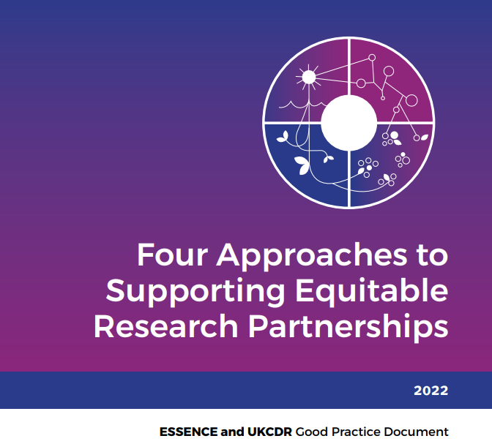
3. Four Approaches to Supporting Equitable
Partnership:
Source: :https://www.ukcdr.org.uk/wp-content/uploads/2022/09/UKCDR_ESSENCE_Equitable_Research_Partnerships.pdf
/
4.Envisioning an Equitable Future for Research across the North-South Divide
Source: https://www.ids.ac.uk/publications/envisioning-an-equitable-future-for-research-across-the-north-south-divide

Slide 9
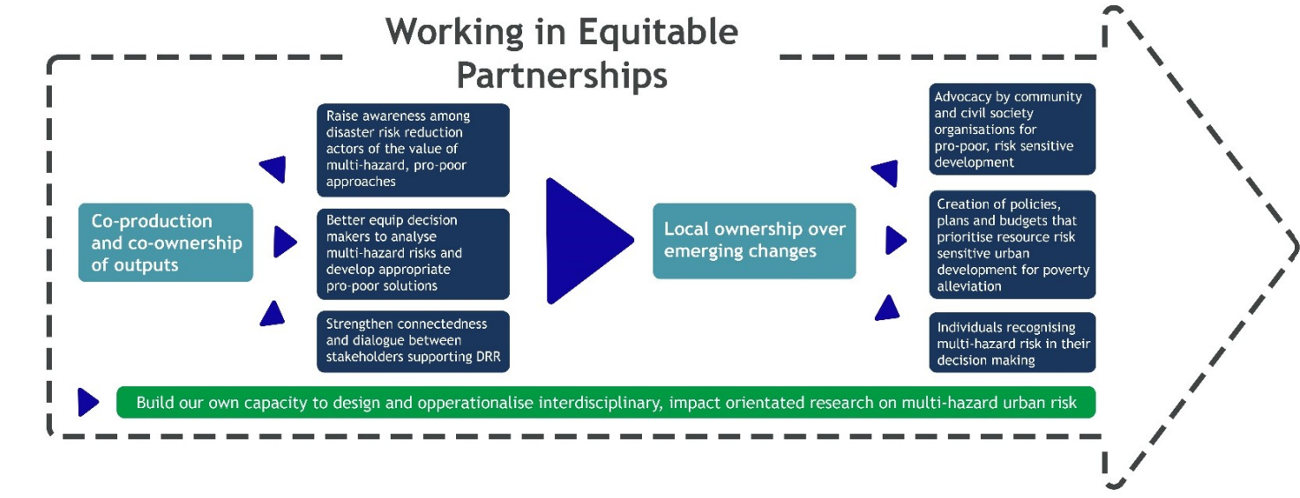
Source: British Academy. (2025). Analysis of guidance documents on equitable international research partnerships. London: British Academy. https://www.thebritishacademy.ac.uk/documents/5818/BA_SS_report_-_ES3_-_Guidance_document_analysis_v2.pdf

Slide 10
(6 thematic areas which emerge and include):
  LMIC leadership and ownership - Funding LMIC researchers directly; Engaging with Southern-led agendas for research priority setting; Addressing power imbalances in research planning
  Research capacity strengthening Assess capacity of partners and develop measures to address and monitor; Support for research management capacity within project funding; Support individual, institutional and ecosystem levels of capacity
  Research budgets, contracts and due diligence Fair indirect cost calculations; Use standards to streamline contracting processes [Researcher feedback on this is still that institutional processes are convulated- a wish for efficiency postaward]
  Research dissemination and impact Ensure appropriate benefit sharing through Fair authorship and data sharing policies and practices; Budget for research dissemination and impact work including covering open-access fees and journal subscriptions
  Building and maintaining partnerships Two-stage funding calls
  Attitudes towards other cultures, peoples and contexts No common recommendations in this thematic area

Slide 11
Why UK-South Africa
Three contextual realities:
Deep historical ties
– Long-standing academic and disciplinary relationships
Persistent asymmetries
– Funding control, grant leadership, publishing power
Exceptional potential
– South Africa as a research-intensive, continental anchor
– UK as a global convenor and funder
Source:
https://ukcdr.org.uk/wp-content/uploads/2023/08/UKCDR-UK-research-funding-report-South-Africa-Jan-2020.pdf

Slide 12
Strategic Positioning and Selected Examples (SA-UK)

Slide 13
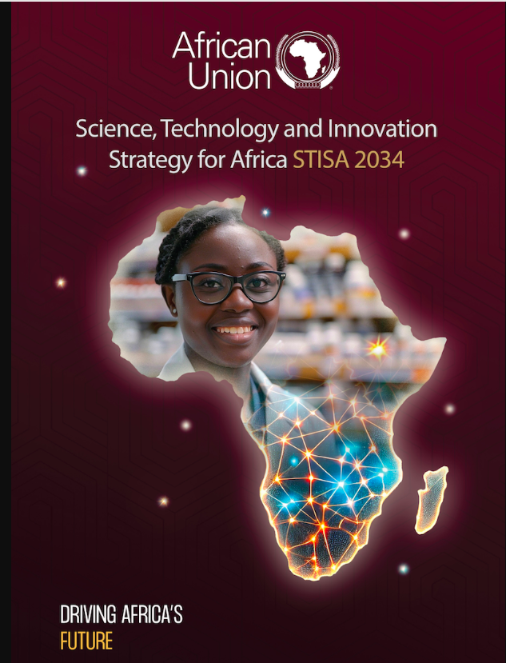
Developments in Africa’s STI landscape
Africa’s STI ecosystem is growing in scale and sophistication. The African Union’s continental strategy has moved from STISA-2024 to a new STISA-2034 roadmap that explicitly frames STI as a driver of inclusive development and digital transformation. This continental policy architecture provides a foundation for harmonised investment and shared infrastructural planning. (African Union)
STISA-2034
• Centres of Excellence & Africa CDC networks
• Growing innovation ecosystems
Source: https://au.int/sites/default/files/documents/45087-doc-AU_STISA_2025-2034_Strategy_ENGLISH.png

Slide 14

Selected Case Studies
Bilateral Research Centers and Africa Europe Clusters of Research Excellence
Bilateral research centres linking African universities with Global North partners can deepen collaboration when governance structures are genuinely shared.
“The African Research Universities Alliance (ARUA) and UK Research and Innovation (UKRI) partnership programme was delivered as part of the Global Challenges Research Fund (GCRF). ARUA is an alliance of research-intensive universities across Africa, bringing together 16 leading universities to form 13 Centres of Excellence (CoEs) in nine African countries. The partnership programme provided a unique opportunity for UKRI to directly fund Africa-led research. The programme provided £14 million funding over three years (2019-2022) to ARUA’s CoEs and funded two types of awards: Capacity Building and Research Excellence, across 17 projects. The programme took a ‘hub and spoke’ approach, whereby a ‘centre hub’ worked together with ‘spoke’ universities. Capacity Building (CB) grants aimed to invest in and build capacity at ARUA’s 13 CoEs through supporting researchers, workshops, networking, researcher exchange and interactions with research projects. “
Source: https://www.ukri.org/wp-content/uploads/2025/06/UKRI-120625-ARUAUKRIPartnershipProgrammeImpactEvaluationFinalReportMay2025.pdf

Slide 15
UK SA Partnership Programmes Impact Report – Take Aways to Scale other Programmes
Partnerships deliver capacity and pipelines
(training, facilities, co-supervision). UKRI’s evaluation of ARUA–UKRI emphasizes sustainable capability,
not just outputs.)
Designed basic-science programmes matter for maths
(data, modelling, algorithms, HPC). STFC/ISPF initiatives provide shared infrastructure
that mathematics feeds and benefits from.
https://www.ukri.org/news/stfc-announces-funding-for-two-flagship-african-partnerships/
Targeted bilateral funding is growing, esp. in health (modelling, biostats, AI-in-medicine):
leverage the 2024 UK–SA NCD call to embed mathematical sciences. (Up to R1 Billion for UK-SA partnerships Announced in 2024).
https://www.gov.uk/government/news/up-to-r1-billion-available-for-uk-sa-research-partnerships?
ARUA CoEs provide the continental mesh to embed UK partners with African leadership—
energy, health, food security, etc.—and are designed for equitable collaboration.

Slide 16
Emerging Good Practices (UK-SA)
Long-term institutional partnerships
Explicit equity criteria in programme design
Doctoral pipelines and early-career researcher support
Joint reflection and learning mechanisms
Evidence: British Academy – Equitable Partnerships in International Collaboration (EqPIC) Call to Action:
https://www.thebritishacademy.ac.uk/international/equitable-partnership-in-international-collaboration/equitable-partnership-in-international-collaboration-eqpic-a-call-to-action/?
Conference on Equitable Partnerships (NRF–Royal Society–British Academy)

Slide 17
Selected Research Platforms for Possible Collaborations
(Stellenbosch University & Partners)

Slide 18

ENVIRONMENTAL
FUTURES
SCHOOL FOR CLIMATE STUDIES
A Transdisciplinary Hub for Climate Solutions – approaching climate challenges holistically
The School for Climate Studies is the first of its kind in South Africa—an academic platform integrating climate science, policy, technology, and development to address climate change across disciplines.
  Works across all 10 faculties of Stellenbosch University
  Engages with government, industry, and civil society
https://climate.sun.ac.za
Notes:
The School for Climate Studies is the first of its kind in South Africa.
It addresses climate change by integrating science, policy, technology, and development across all 10 SU faculties.
The School operates as a transdisciplinary hub, partnering with government, civil society, and industry to co-create solutions.
Our goal is not only to understand climate change but to act decisively through research-led impact.

Slide 19
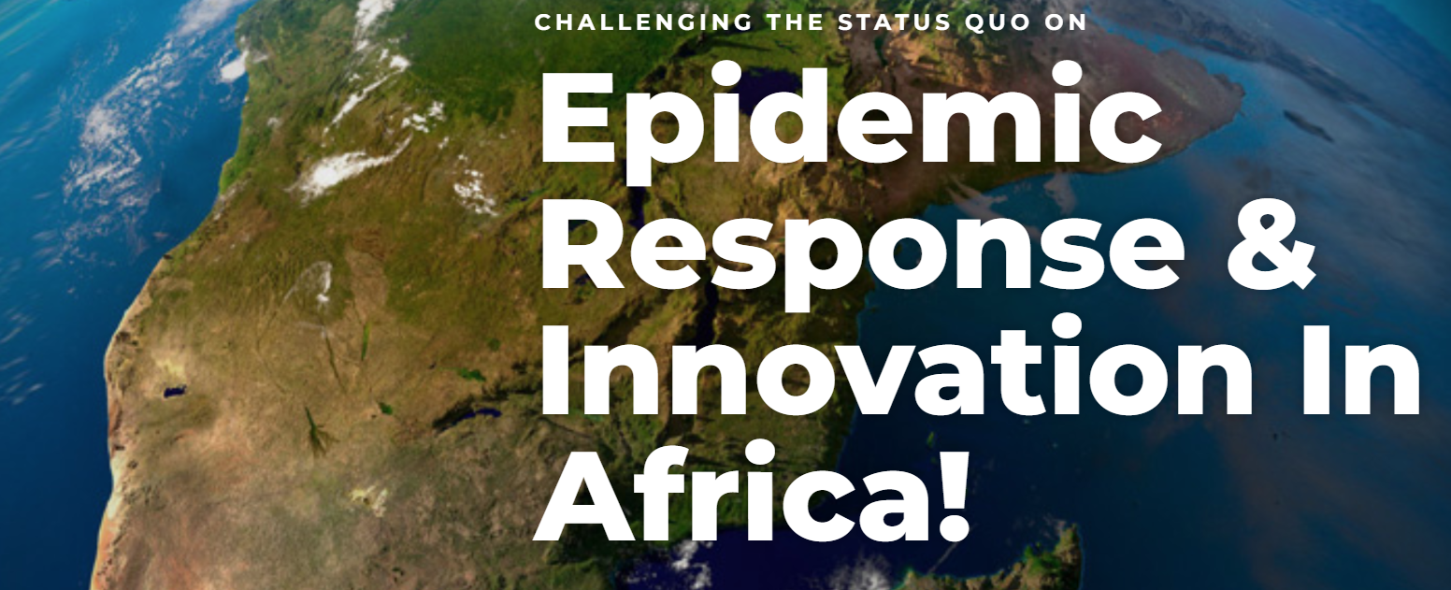
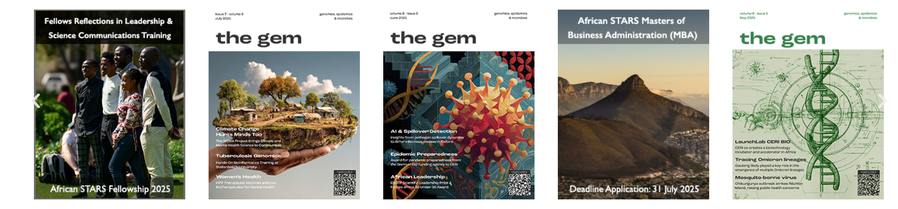
Centre for Epidemic Response and Innovation (CERI)
HEALTH
RESILIENCE
The Centre for Epidemic Response and Innovation (CERI) at Stellenbosch University www.ceri.org.za
Notes:
Headed by world-renowned bioinformatician Prof Tulio de Oliveira, CERI has been at the forefront of pathogen genomics surveillance to enhance biomedical discovery and to respond effectively to epidemics. The surveillance done at CERI helped South African scientists to quickly spot and warn the rest of world about the Beta and Omicron variants of COVID-19.
Envisioned to be the largest genomics facility in Africa, CERI also provides capacity building to other African countries as part of its support programme to the Africa Centres for Disease Control and Prevention (Africa CDC) and the World Health Organisation (WHO). CERI trains fellows from across Africa in genomics, bioinformatics, big data and artificial intelligence analysis. The African STARS programme – funded by the Mastercard Foundation – further expanded CERI’s African footprint.

Slide 20

SOCIAL JUSTICE &
DEVELOPMENT
CENTRE FOR THE STUDY OF THE AFTERLIFE OF VIOLENCE AND THE REPARATIVE QUEST (AVREQ)
Exploring Legacies of Violence, Envisioning Repair – led by Templeton Prize winner, Prof Pumla Gobodo-Madikizela
AVReQ is a research centre dedicated to understanding how individuals and communities live with the long-term impacts of violence, including colonialism, apartheid, dispossession, and structural injustice—and how reparative futures might be imagined and pursued.
  Works across humanities, law, political science, theology, and arts
  Engages with survivors, scholars, artists, and policy-makers
  Builds South–South and African continental dialogues on justice and repair
https://avreq.sun.ac.za
Notes:
The AVReQ Centre explores the legacies of violence—colonialism, apartheid, and systemic injustice—and how societies can move toward reparation and healing.
It’s interdisciplinary, involving scholars from humanities, theology, law, and the arts.
AVReQ works with survivors and community voices to foster global South-South dialogues on justice, healing, and repair.
This is research that doesn’t shy away from painful histories—it uses them to envision better futures.

Slide 21

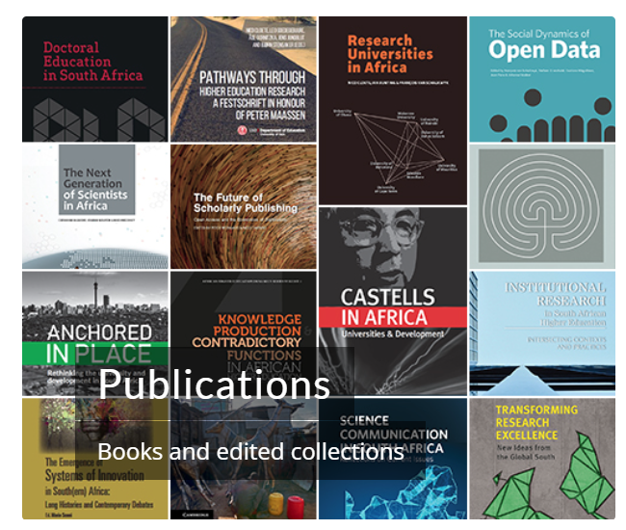
INNOVATION &
SOCIETY
SciSTIP is the DSI-NRF Centre of Excellence in Scientometrics and Science, Technology and Innovation Policy.
SciSTIP has two “mandates” which are reflected in its name: the first is to monitor and measure the (performance of the) South African STI system (scientometrics), and the second is to conduct research and analysis that contributes to national policy debates on STI (STI policy).
Research activities include:
- Science, technology and innovation policy;
- Human resources for science and innovation;
- Science and innovation for inclusive development;
- Scholarly publishing and social studies of science; and
- Research evaluation and the social impact of research.
https://www0.sun.ac.za/scistip

Slide 22


SMART SYSTEMS
& DIGITAL FUTURES
SCHOOL FOR DATA SCIENCE & COMPUTATIONAL THINKING
Enabling Interdisciplinary, Data-Driven Discovery and Impact
  Established in 2019 as a university-wide initiative.
  Facilitates interdisciplinary collaboration, research, and training in data science and computational thinking.
https://www.su.ac.za/en/faculties/data-science
Notes:
The School for Data Science and Computational Thinking was launched in 2019 as a cross-campus initiative. The school celebrated its 5-year anniversary in 2024.
It enables data-driven discovery by facilitating interdisciplinary research and training.
It supports everything from basic science to applied solutions in business, health, and policy.
This school exemplifies how we prepare our students and researchers for the digital future.

Slide 23

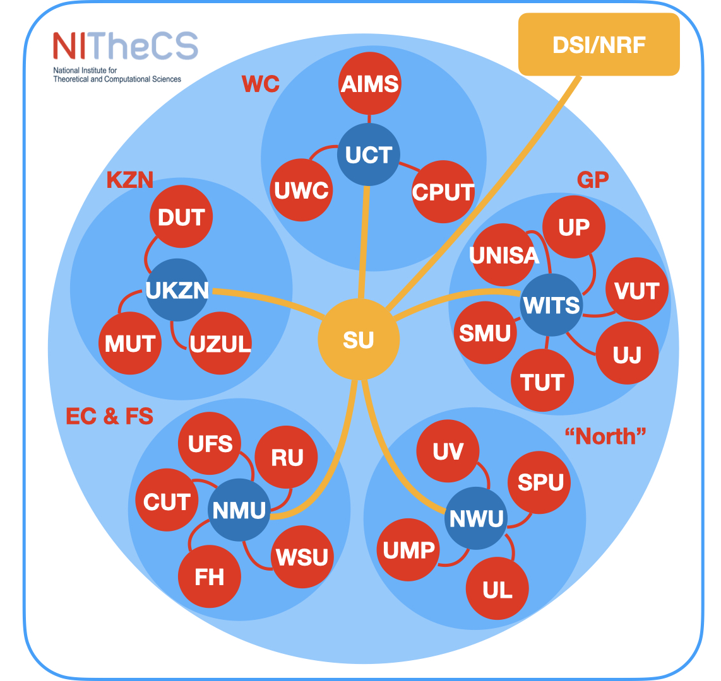
SMART SYSTEMS
& DIGITAL FUTURES
13 November 2024
Consortium Agreement signed
2025 in Numbers
Strong Partners: ICTP & CoRE-AI
26 Universities & AIMS
1 Hub at SU
5 Nodes
26 Branches
340 Associates
60 Associates at SU
8 Disciplines
10 Research Programmes
4 Coordinators at SU
193 Publications
https://nithecs.ac.za/research

Slide 24


ENABLING RESEARCH TRANSLATION
INNOVUS
STRENGTHENING THE RESEARCH ECOSYSYTEM
Stellenbosch University’s Innovation and Commercialisation Division
  Mandate: Drive the commercialisation of SU’s research outputs and intellectual property (IP)
  Impact: Over 30 SU spinout companies formed; numerous licenses generating societal and economic value
  Encourage creativity and entrepreneurial behaviour.
  Promote interaction with industry.
  Research, consultation and the establishment of new businesses.
  Expand initiatives which focus on knowledge exchange,
  Encourage research translation as part of research agenda.
LAUNCHLAB
Startup Incubator and Accelerator
  Mandate: Bridge research and entrepreneurship by supporting early-stage startups
  Collaborative Ecosystem: Connects researchers, students, and industry to co-create solutions
https://innovus.co.za
Notes:
SU’s Innovation and Commercialisation Division (Innovus) turns research into real-world solutions—generating value through spinouts and licensing.
LaunchLab serves as our startup incubator and accelerator, helping early-stage innovations thrive.
These entities form an ecosystem where entrepreneurship meets academia.
We promote creativity, industry collaboration, and the commercialisation of intellectual property, ensuring our research reaches the people who need it most.

Slide 25

AFRICA-EUROPE CLUSTERS OF RESEARCH EXCELLENCE (CORE)
Tackling Global & African Challenges – four CORE hosted by SU
https://arua.org/africa-europe-core
Addressing Global and African Challenges through Methods from Artificial Intelligence, Data Science and Theoretical and Computational Thinking
Nature-Based Solutions for Climate Adaptation & Mitigation
Priority: Green Transition
  Advance transdisciplinary approaches
  Address climate change and biodiversity loss as interconnected global issues
Priority: Innovation & Technology
  Apply AI, data science, and theoretical/computational methods
  Solve critical challenges in healthcare, education, agriculture, energy, infrastructure
Renewable Energy
Genomics for Health in Africa
Priority: Sustainable Transition
  Develop renewable energy technologies
  Promote an equitable energy transition
  Strengthen education and training
Priority: Public Health
  Focus on rare diseases, rare cancers, infectious diseases, and pandemic preparedness
Notes:
Stellenbosch University (SU) has secured four Africa-Europe Clusters of Research Excellence (CoRE), established by the African Research Universities Alliance (ARUA) and The Guild of European Research-Intensive Universities.
Launched in 2023, Africa-Europe CoRE unites top researchers from both continents to foster equitable, high-impact collaboration on societal challenges. Each cluster involves at least three African and two European universities, ensuring long-term, multilateral research excellence and advancing the next generation of scientists.

Slide 26

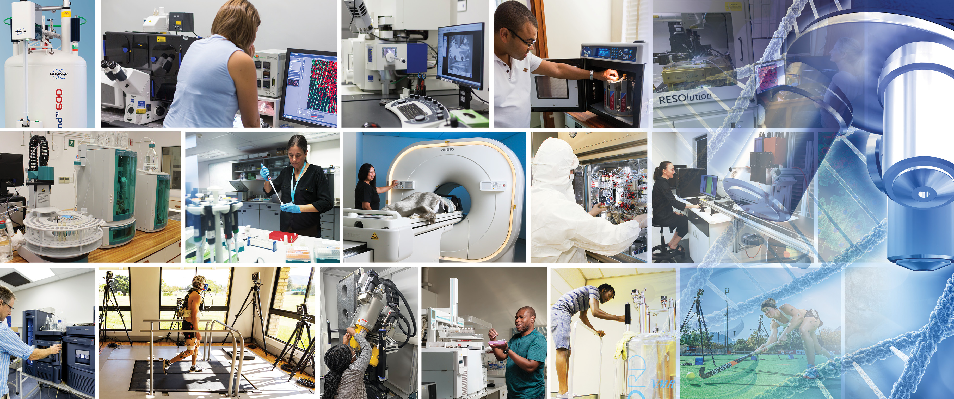
Central Analytical Facilities
supporting research at SU.
https://www.sun.ac.za/english/research-innovation/caf

Slide 27
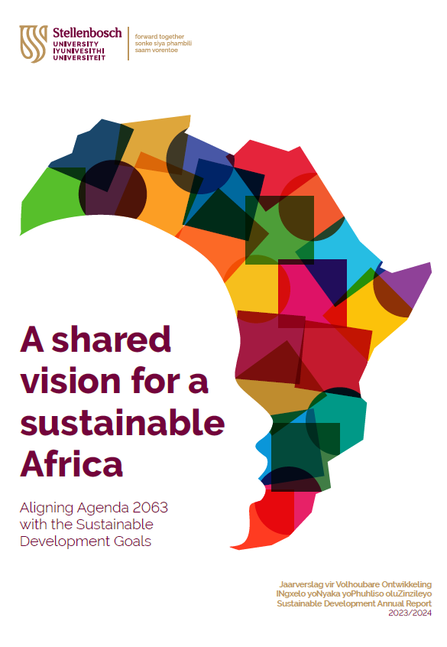
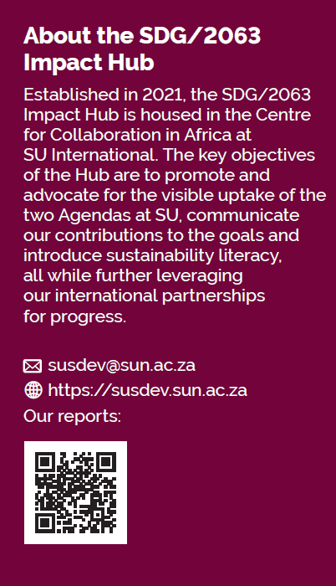
In Africa, With Africa, For Africa
Notes:
Many people are familiar with the SDGs, but as African Institutions it is also important for us to consider the AU Agenda 2063 goals. These two groups of goals largely overlap. To highlight our commitment to both sets of goals, we map our research to SDGs and AU Agenda 2063 goals. The SDG/2063 Impact Hub, situated in the SU International, further highlights and expands on research promoting the SDGs and AU Agenda 2063 goals.

Slide 28





Visit ‘Research for Impact’, SU`s digital research magazine and platform:
https://www0.sun.ac.za/researchforimpact
researchforimpactatsu
MatiesResearch
research-at-stellenbosch-university
SCAN FOR ACCESS TO OUR PLATFORM
Visibility

