Slide 1
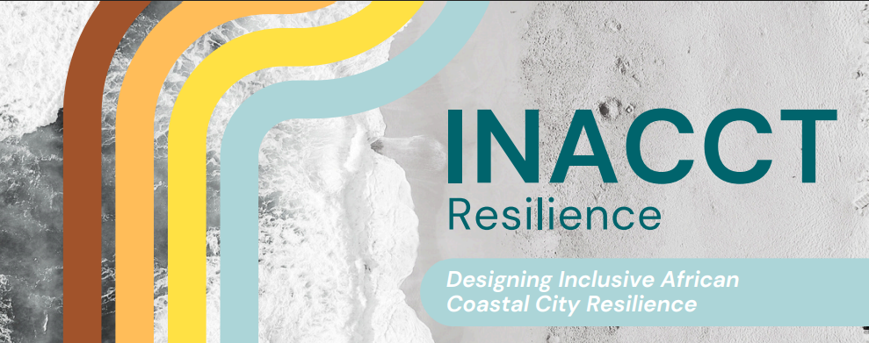



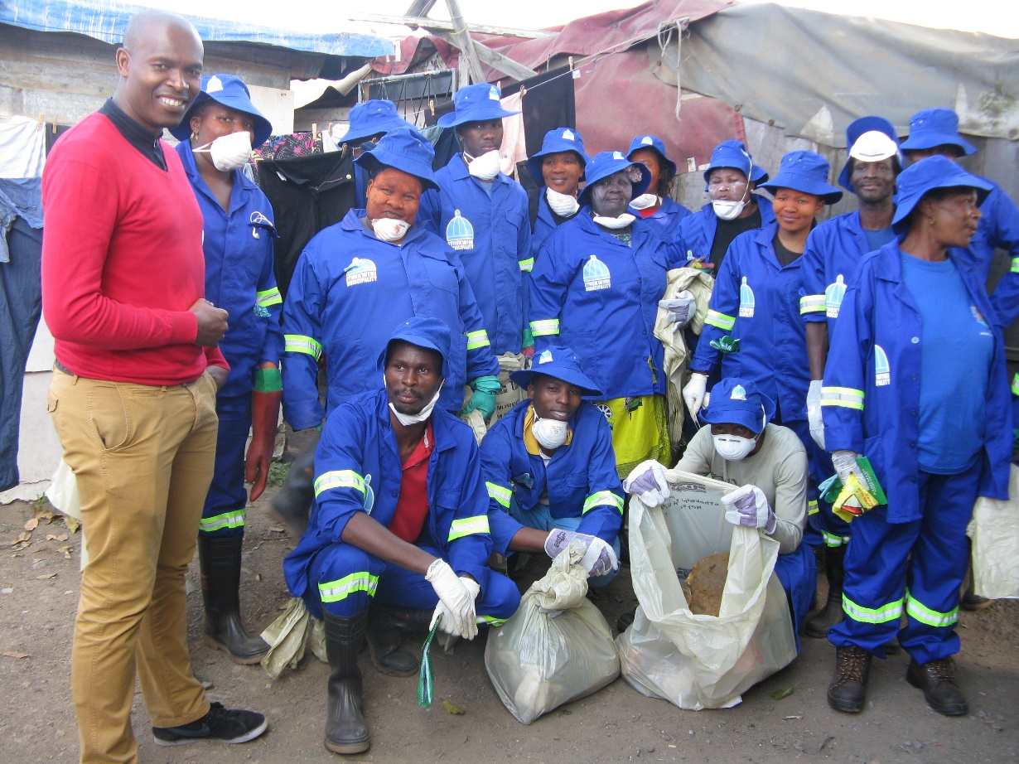


Building equitable research partnerships across different scales of transdisciplinary research: SHEFS-SA, LfD, INACCT
Catherine Sutherland, Sibongile Buthelezi, Nkosinathi Mncwabe, Zandile Ntuli, Luyanda Xolo
University of KwaZulu-Natal, Quarry Road West Community Research, eThekwini Municipality
SHEFS-SA (Wellcome Trust); Learning from Durban (British Academy); INACCT (CLARE)
2nd Equitable Partnerships Conference
British Academy, Royal Society, National Research Foundation
3-5 February, 2026

Slide 2
Equitable Partnerships in Research
The lens …
Where do we need to focus our attention?
SHEFS-SA Sustainable Healthy Environment and Food Systems in Southern Africa (Wellcome Trust, 2024-2029)
Learning from Durban: Resilience, climate action and reconfigured infrastructure in changing social and environmental conditions (British Academy, 2024-2026)
Climate Adaptation and Resilience Programme (CLARE) INACCT: Designing inclusive African city coastal resilience (FCDO and IDRC, 2024-2026)
Across scales
Across histories and geographies
Across sites (who is the researcher and who is being researched? Positivism, post-positivism, social constructivism; critical theory)
Across practices and methods
Across knowledges
Across ownership
Across outcomes

Slide 3
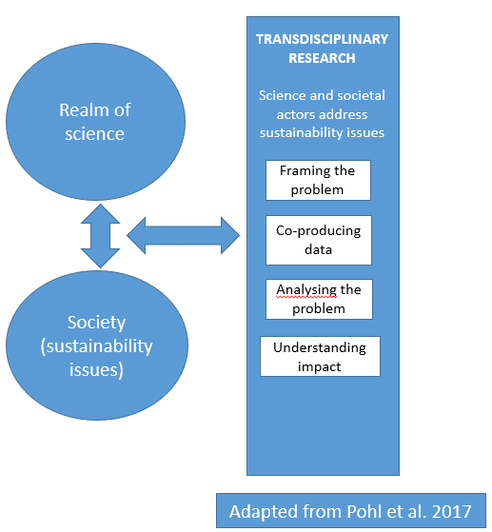
Transdisciplinary Research Equitable Partnerships
British Academy (EqPIC, 12/02/2025)
Equitable Partnerships are based on mutual respect, trust, and shared benefits
Principles include
  co-creation of research from design to output
  equitable resource distribution
  transparency in budgeting and data ownership
  recognition of diverse knowledge systems to ensure local relevance.

Slide 4
Equitable Research Partnerships
African Charter is an Africa-centred framework for advancing a transformative mode of research collaborations that will serve to advance and uphold the continent’s place in the global production of scientific knowledge
  North-South
  Global-Local
  South-South
  Scientific-Practitioner
  Scientific-Practitioner-Community
  Support Africa – Global North Research Relationships
  Support plurality of knowledges
Supports Open Science
Equity in Research Partnerships (how we recognise and address inequality)
Equitable Research Partnerships or transformed research relations

Slide 5
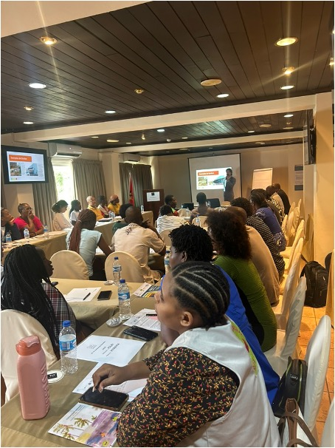
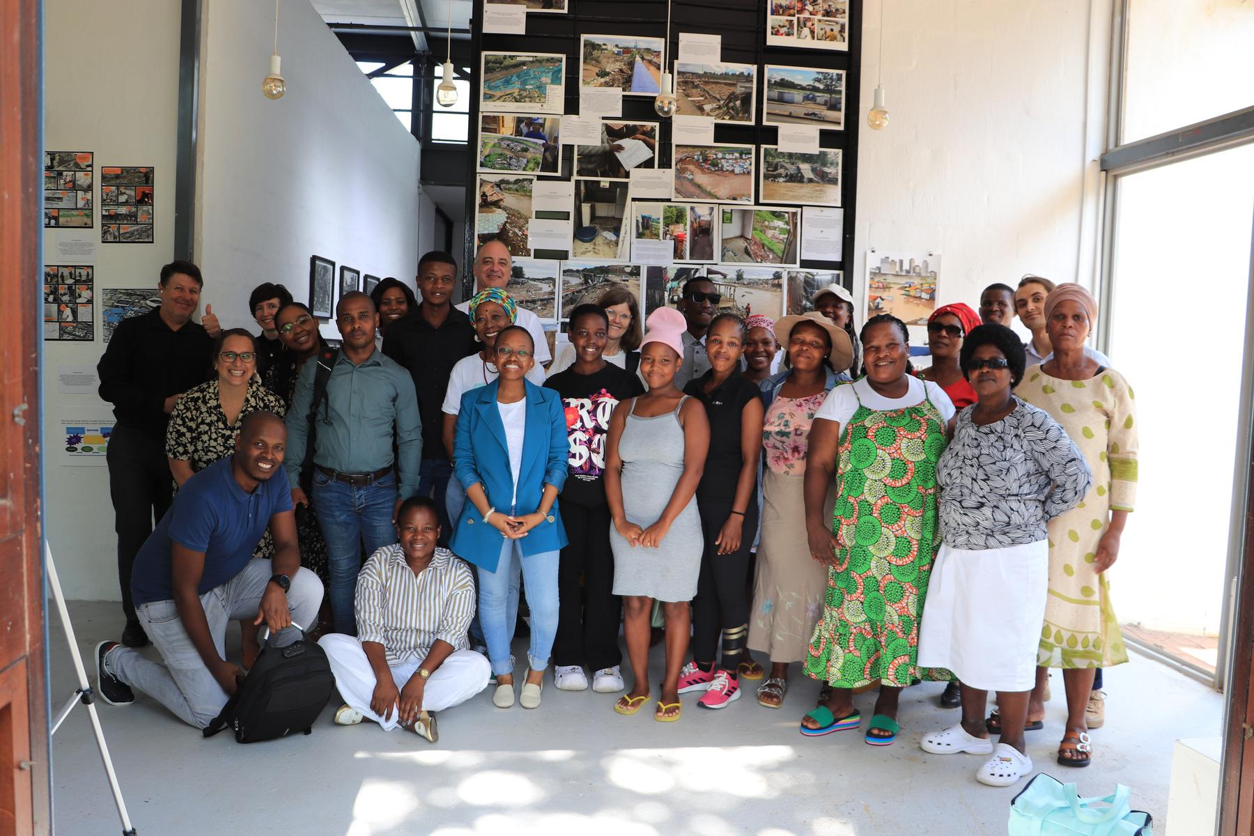
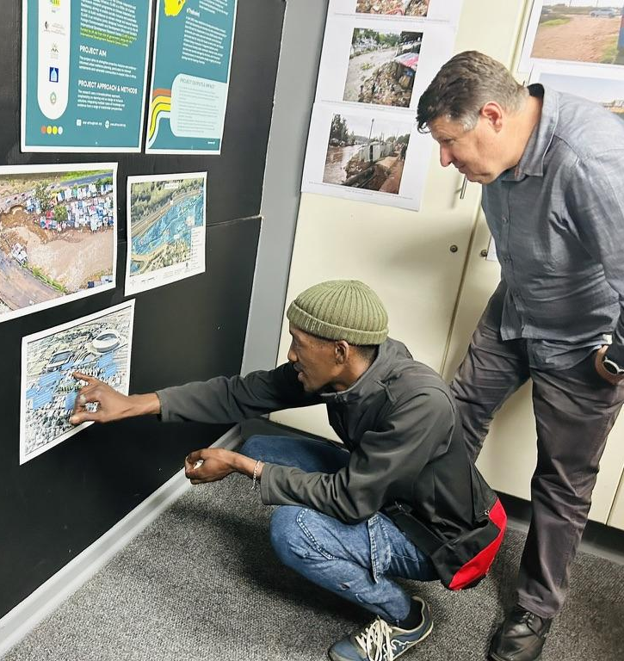
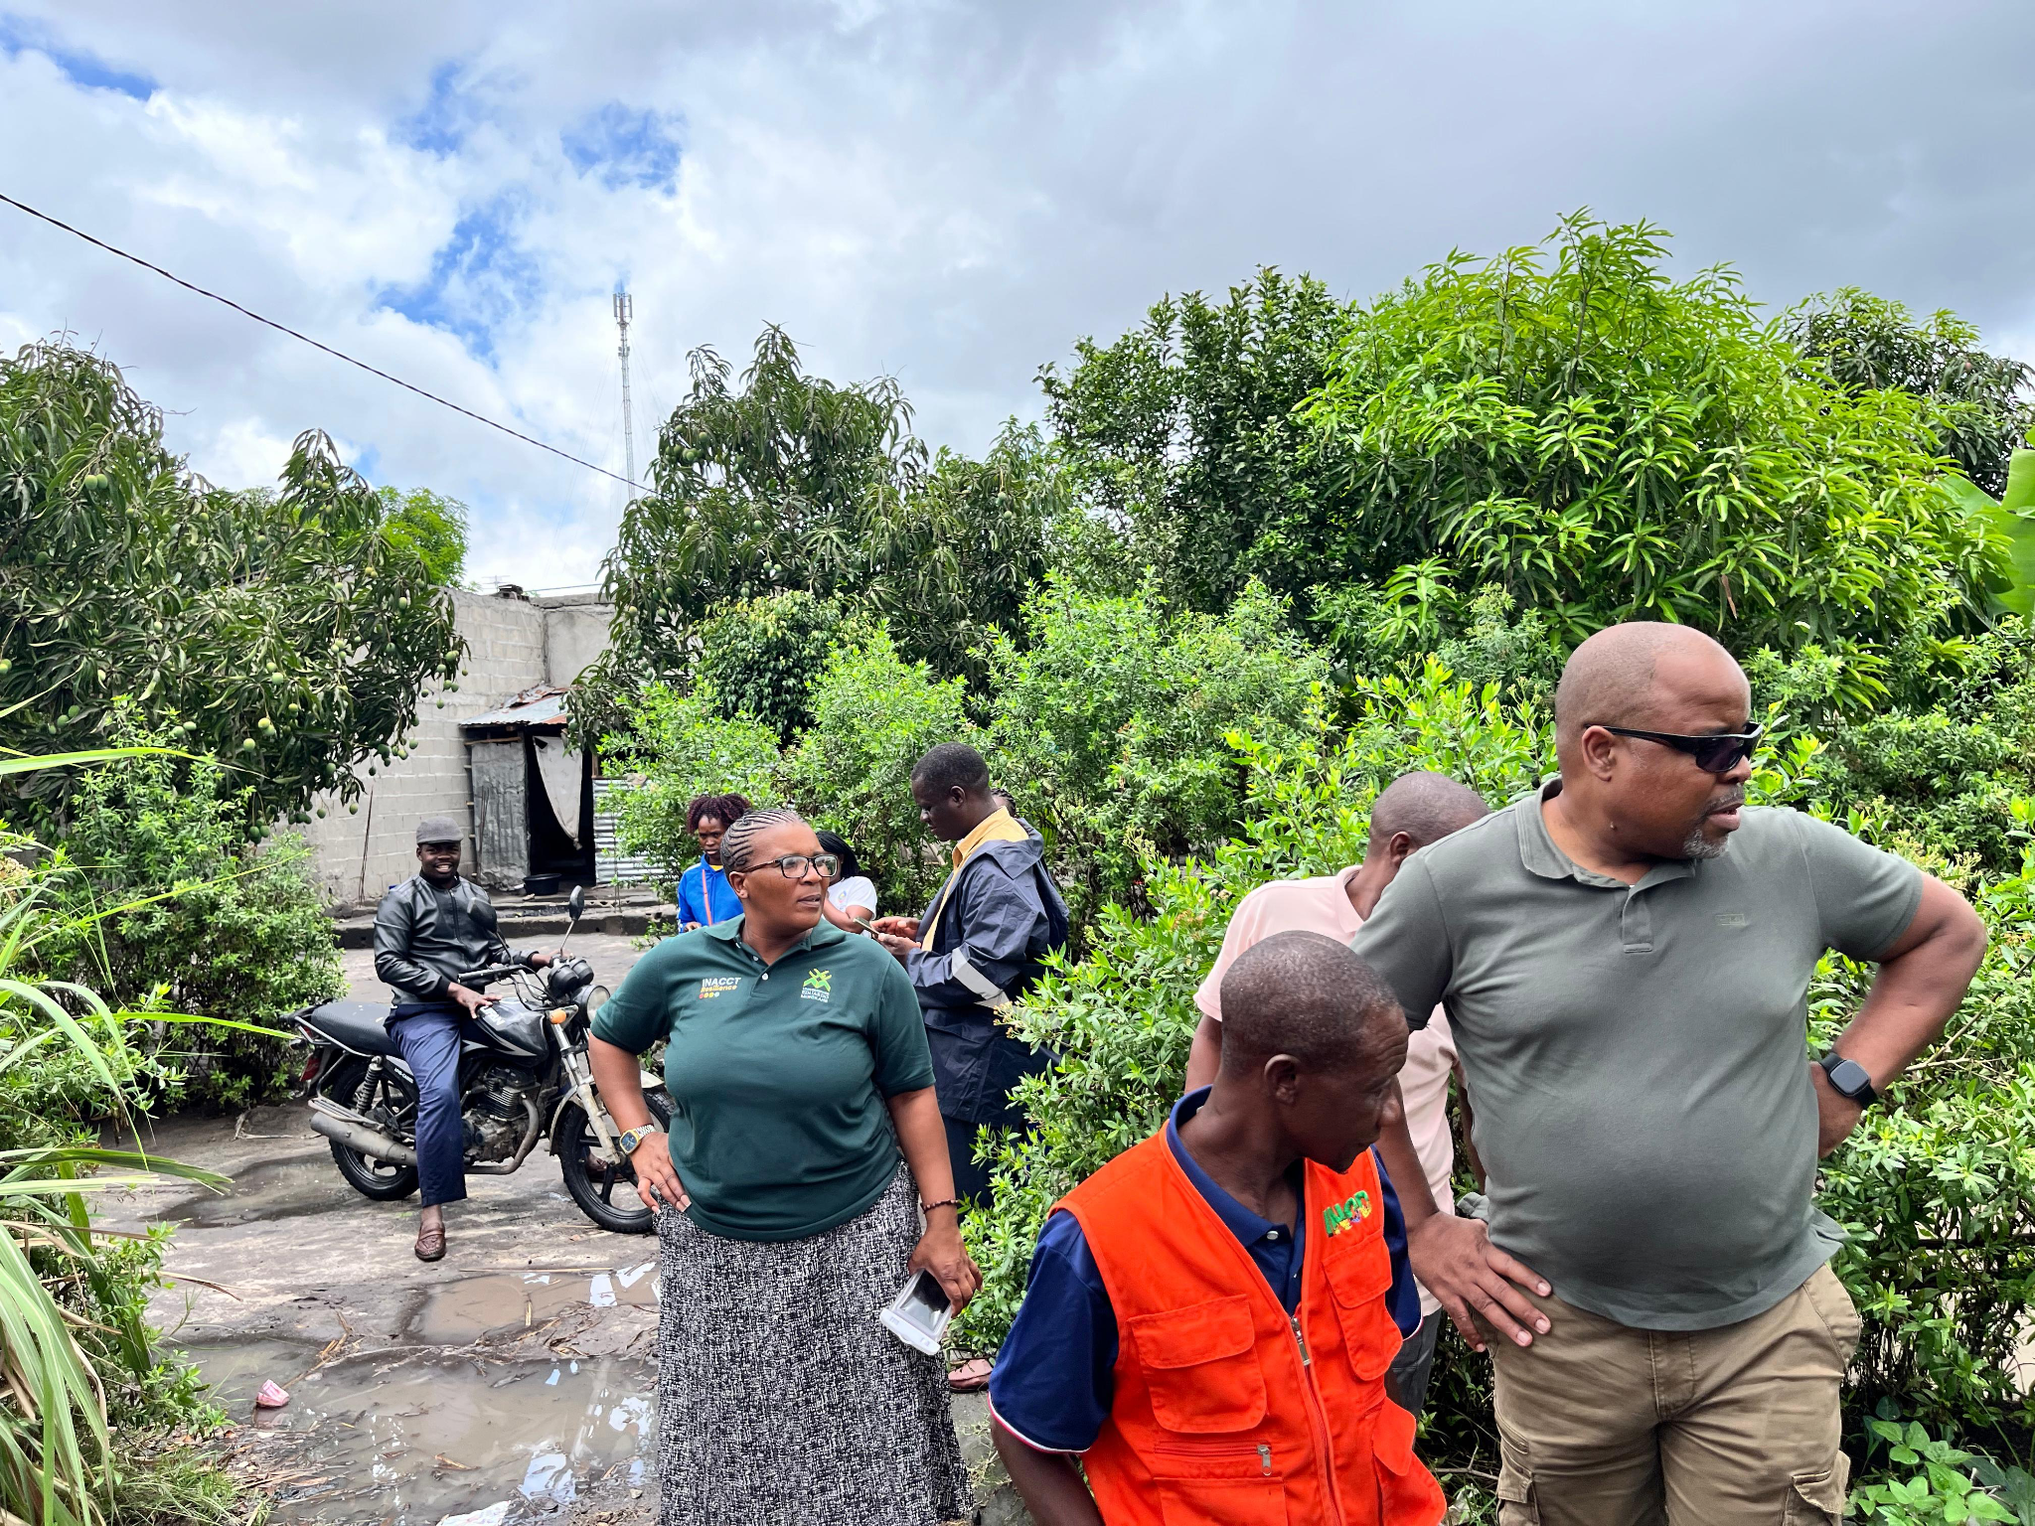
Enabling mobility of stakeholders and investment in partnership development is crucial and requires funding, based on recognition that greater awareness of each partner’s environment and objectives is conducive to more effective and impactful research

Slide 6
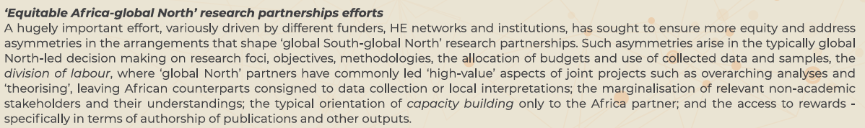



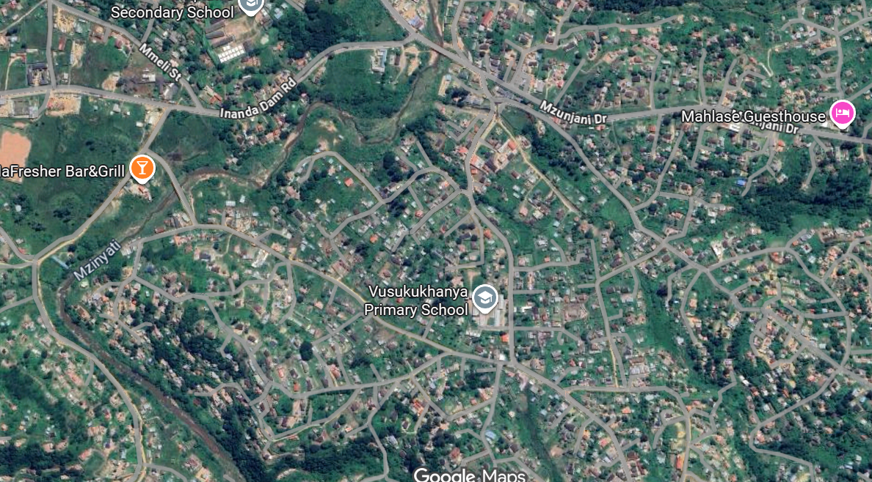

The division of labour
Who theorises and analyses, who writes ….?
Who collects data, ensures analysis within context and supports local interpretation ?
Who are marginalized as non-academic actors: municipal practitioners, communities, intermediaries …. ?
Who ‘invisibly’ manages the context and the risk of northern academics in southern contexts? Or southern academics in real world contexts?
The division of recognition
Papers and social impacts (NRF)
And WHY ?

Slide 7
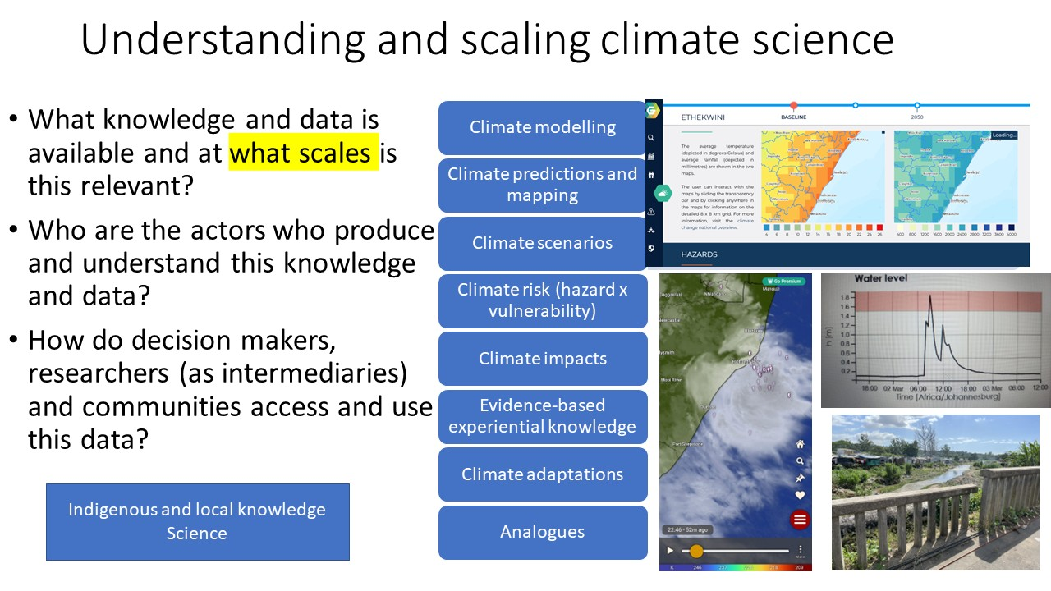
Plurality of knowledges

Slide 8

Sustainable & Healthy Food Systems in Southern Africa (SHEFS-SA)
The challenge
The approach
The vision
Highly climate-exposed communities facing severe health & environmental challenges
Policy and implementation disconnected from everyday lived worlds
Linear thinking may lead to maladaptation & worsening CC impacts.
Catalyse transformation towards healthy & resilient food systems and communities
Transdisciplinary research and co-creation with stakeholders
Localised solutions inform national and regional response strategies
Southern African food systems and communities
that are healthy and resilient to climate risks

Slide 9
SHEFS-SA: A CoP for EqPIC
Equity should feature at all stages of the research and innovation lifecycle across the knowledge and evidence ecosystem. This requires co-creation from agenda setting, partnership development, project design, budgeting and financial management and awareness of potential incompatibility of policy and governance frameworks to jointly owning and agreeing on use of any research data and knowledge, publications and other outputs
A COP is a network of stakeholders, that come together across different scales and times
  multi-scalar and time sensitive, to enhance political and knowledge based opportunities of bringing about change in a system that stakeholders are concerned about and share common goals and interests in
  COP is a learning-based organisation
  Bridges or intermediaries are critical to the cohesion, sustainability, outputs and impacts of a COP
    build relationships between different stakeholders, across multiple scales, who do not usually engage with each other due to politics and unequal power relations, different ways of framing problems, different mandates and goals, conflicts or having not ever been in the same space as each other, to build much needed knowledge sharing and relationships.
  relationship building and knowledge co-production and sharing
  how to build a collaborative environment, ensure inclusion and diversity, determine membership characteristics and the identification of invisible stakeholders (Scott and Oelofse, 2005) at different scales, develop principles, process and structure, address resources and ways of interacting, engaging and sharing knowledge, and use innovative qualitative methodologies for knowledge co-production
Vertical power relations
CoP
Horizontal power relations

Slide 10

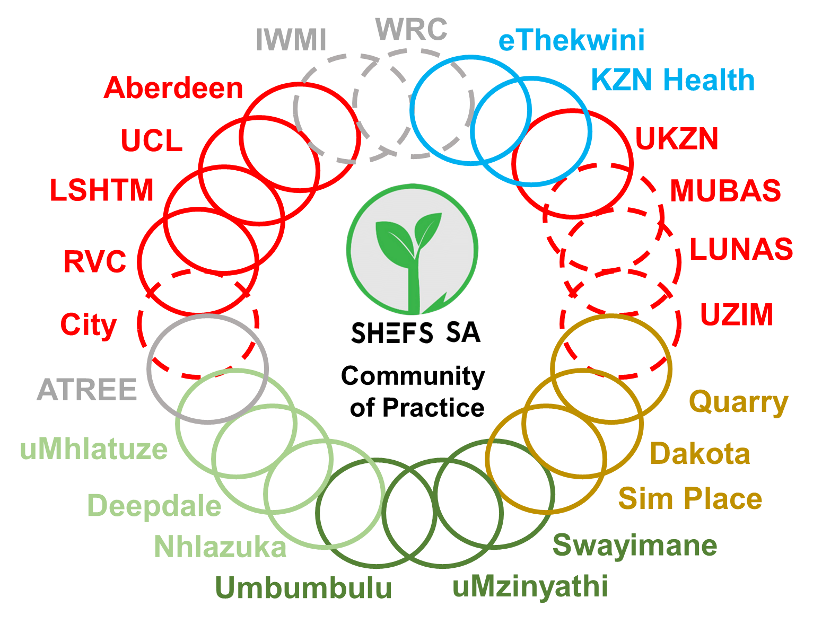





Universities
INR
Research
Institutes
Local/regional
government
Peri-urban
settlements
Rural
settlements
Informal
settlements
SHEFS
partner
New SHEFS-SA
partner

Slide 11
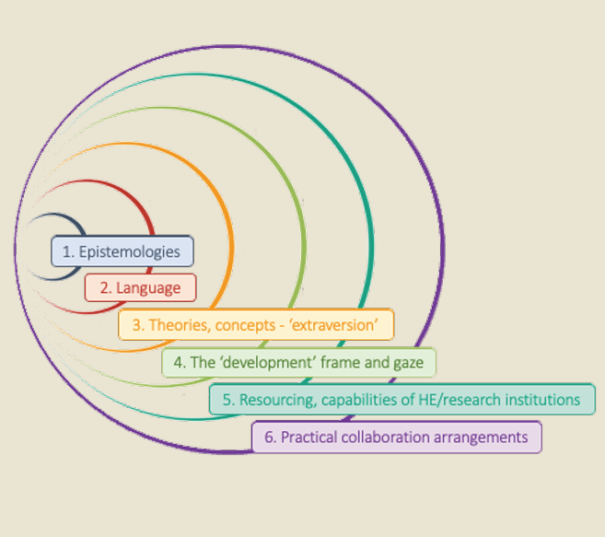
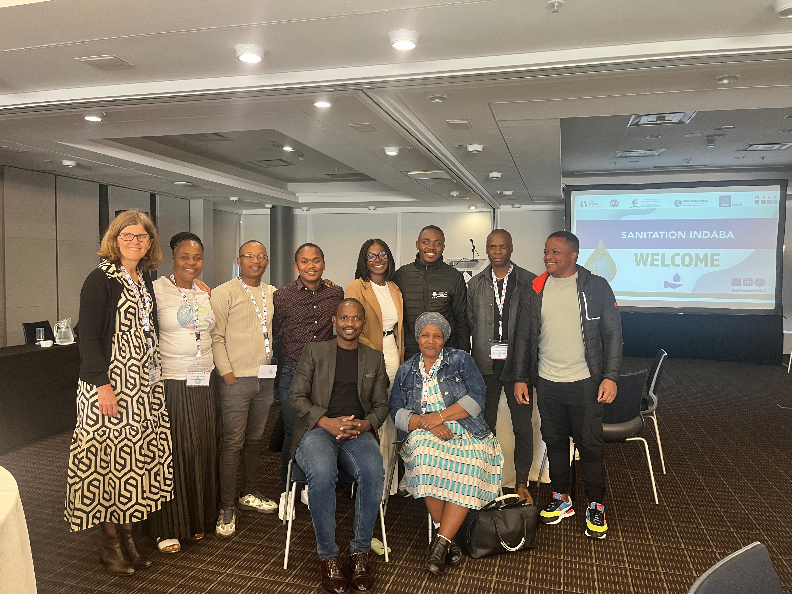
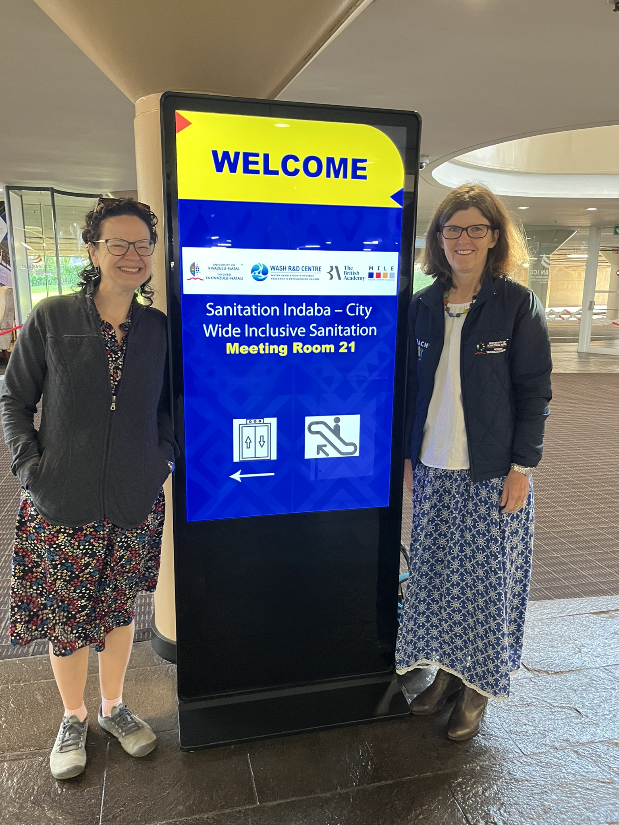
British Academy: Learning from Durban (LfD)
WASH R&D Centre Cathy Sutherland and University of Edinburgh Mary Lawhon
Building equitable research partnerships through negotiation, engagement, co-learning and supporting each other’s capabilities and exploring these together

Slide 12
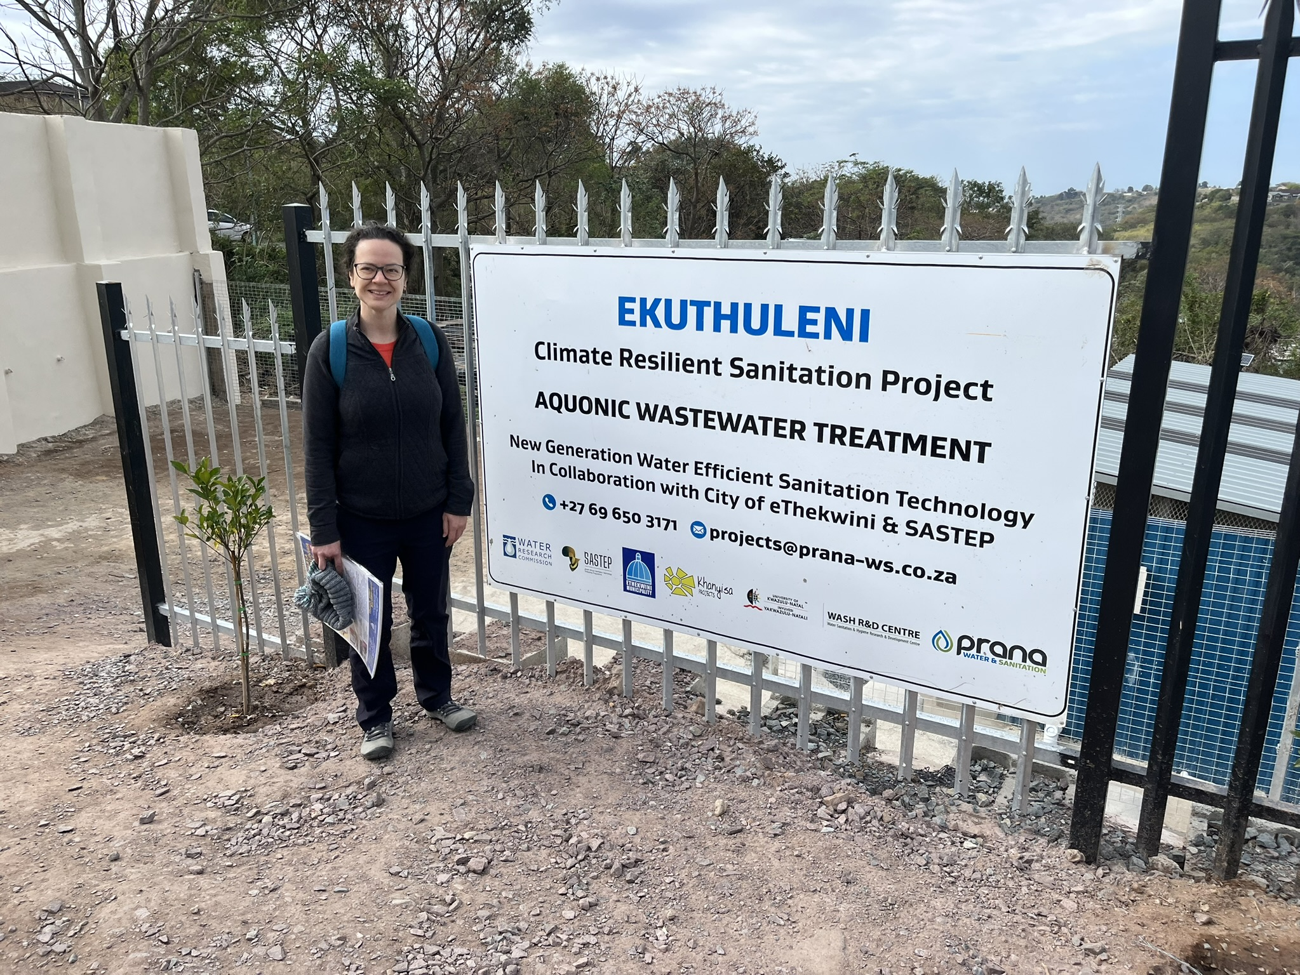
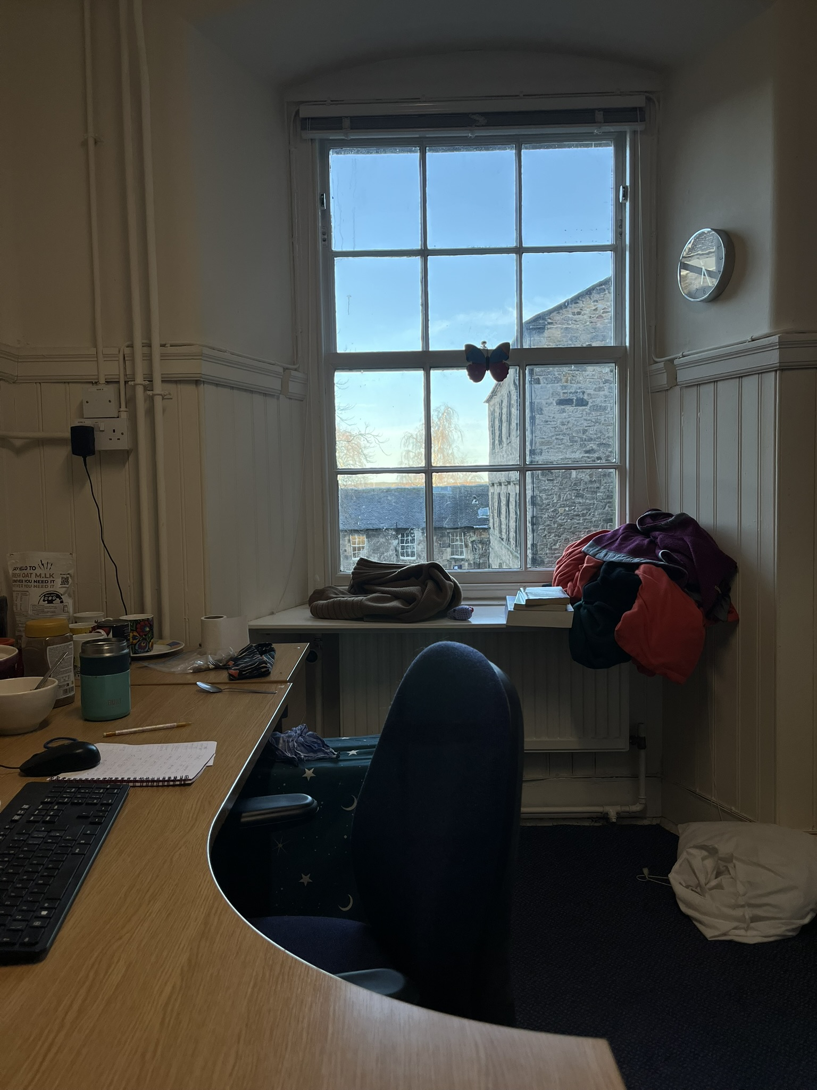
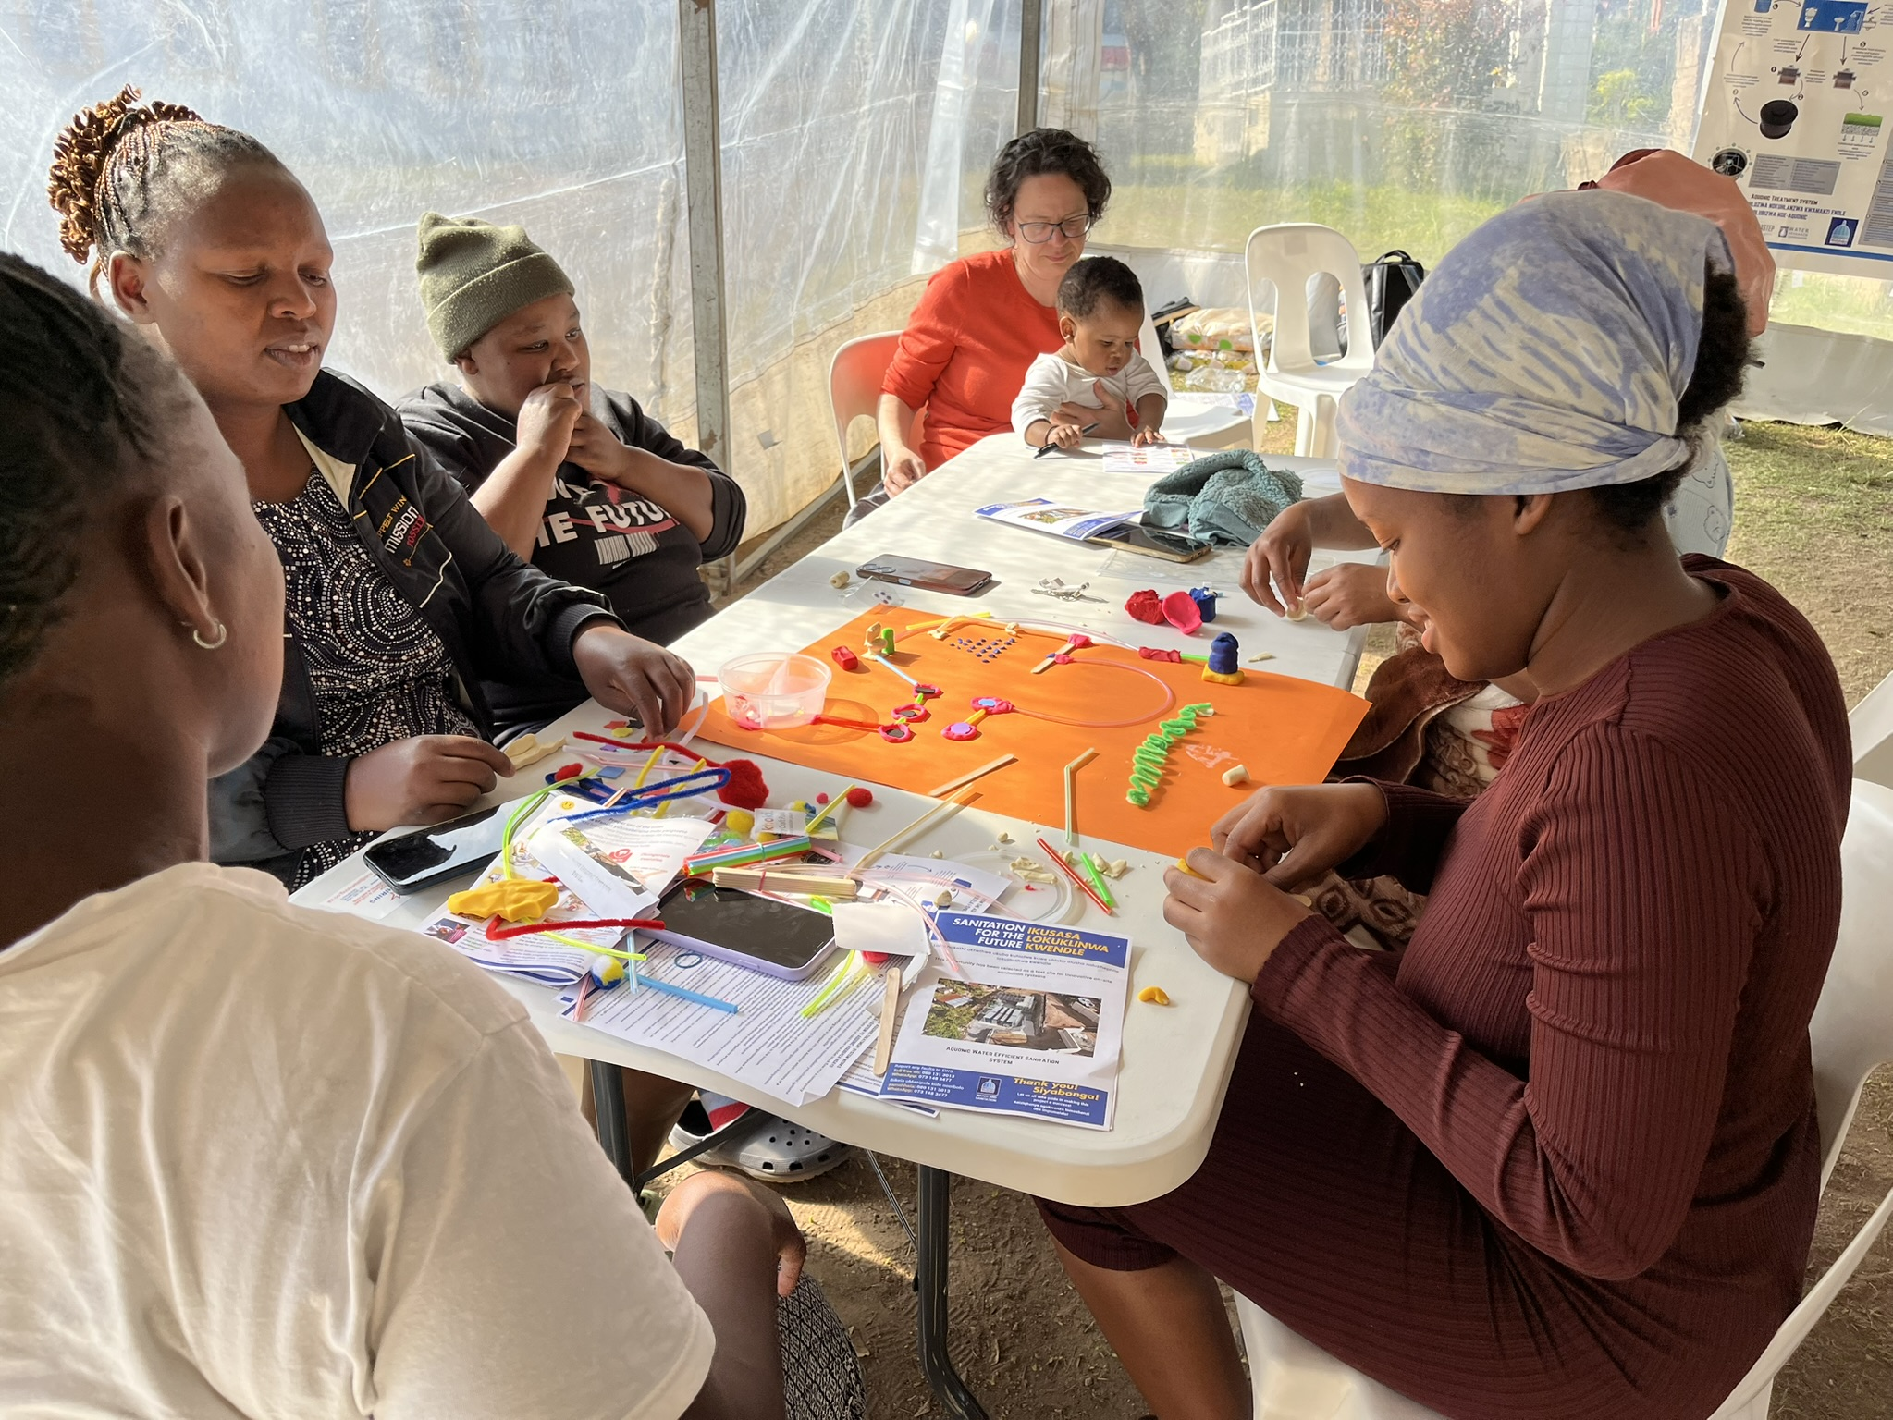
LfD: Building new and transformed research relationships
Respect, trust and open communication must be fundamental principles of any collaboration, taking into consideration the diversity of languages
Collaborative research should be driven by reciprocity, by seeking mutual benefits for all stakeholders and by recognising the expertise and value of the wide range of stakeholders contributing to research
Two sites of learning

Slide 13
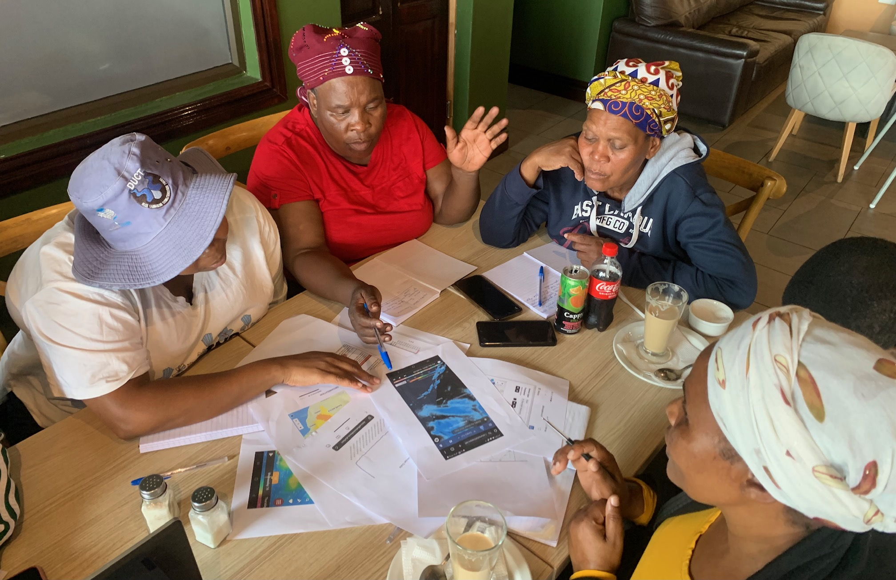
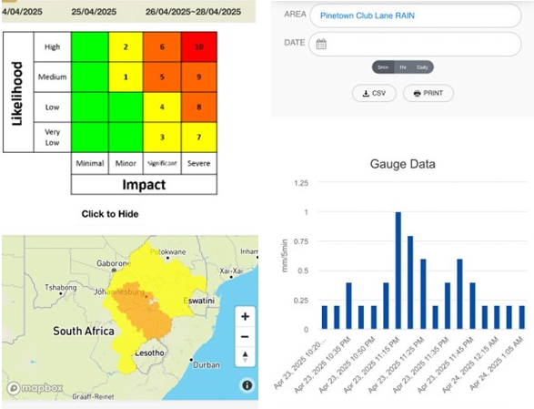
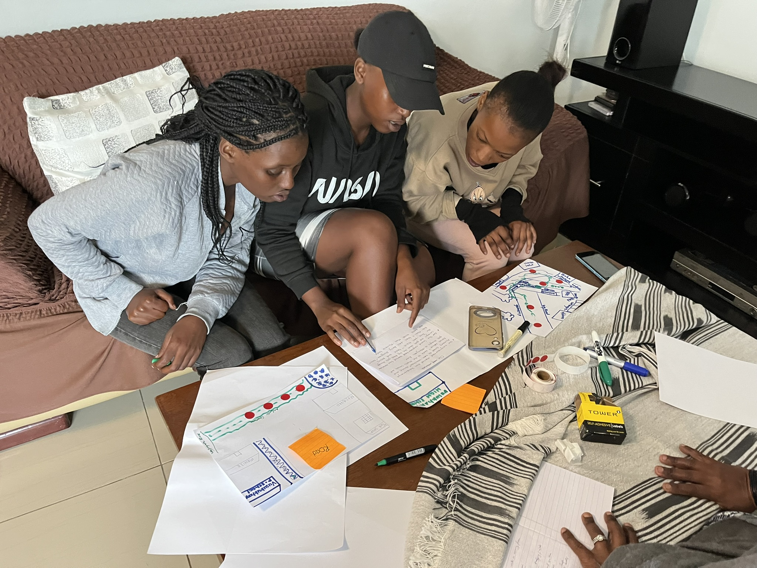
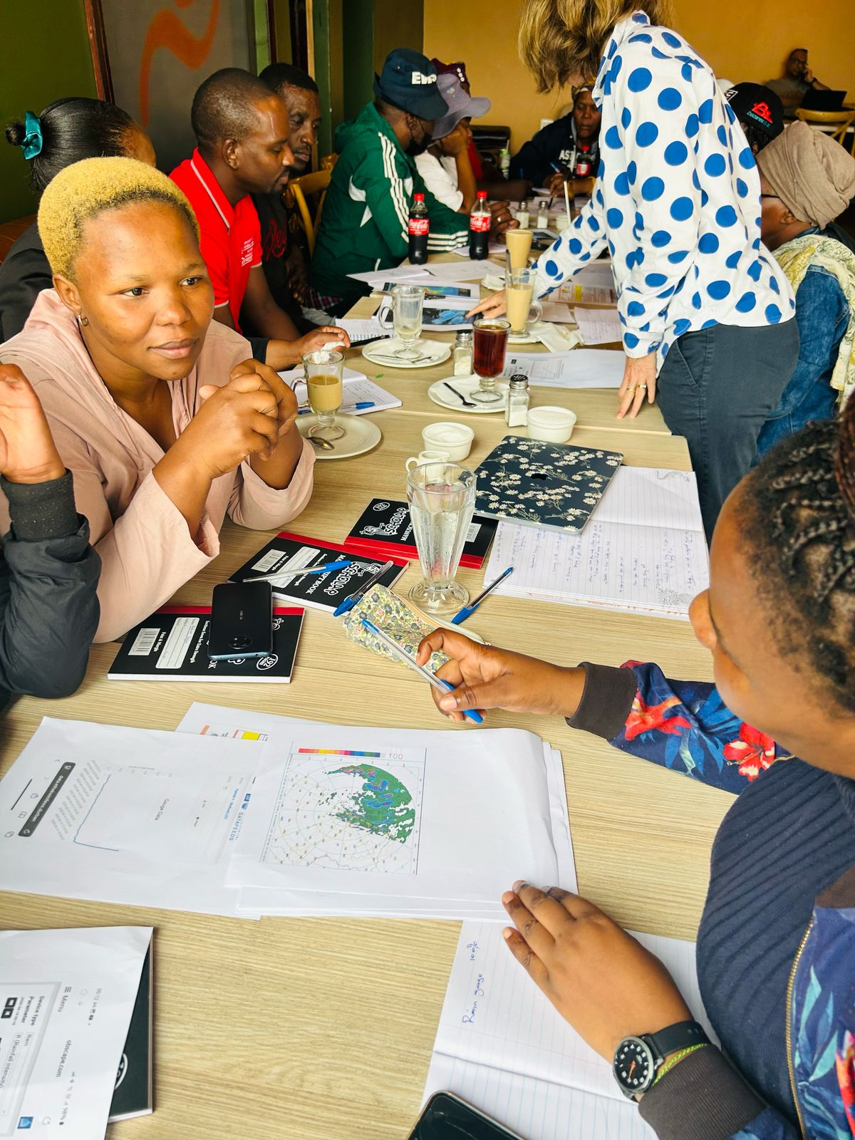
INACCT: A plurality of knowledges for CBFEWS
Diversity fosters innovation, and so cultural differences should be recognised as an enabler rather than seen as an obstacle

Slide 14
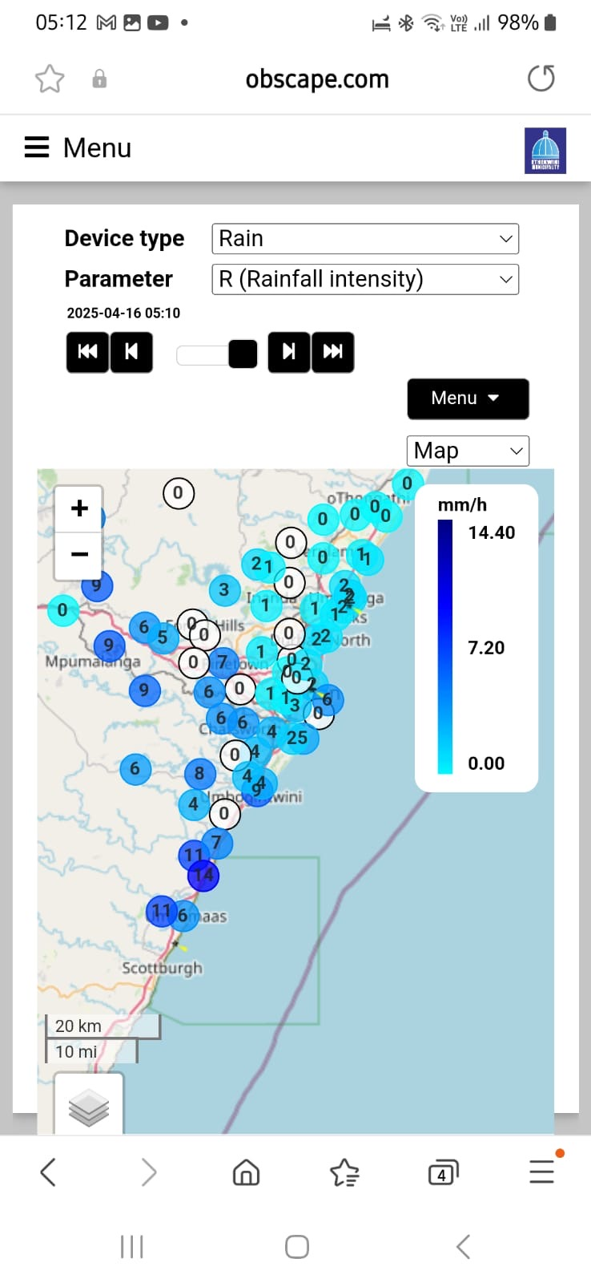
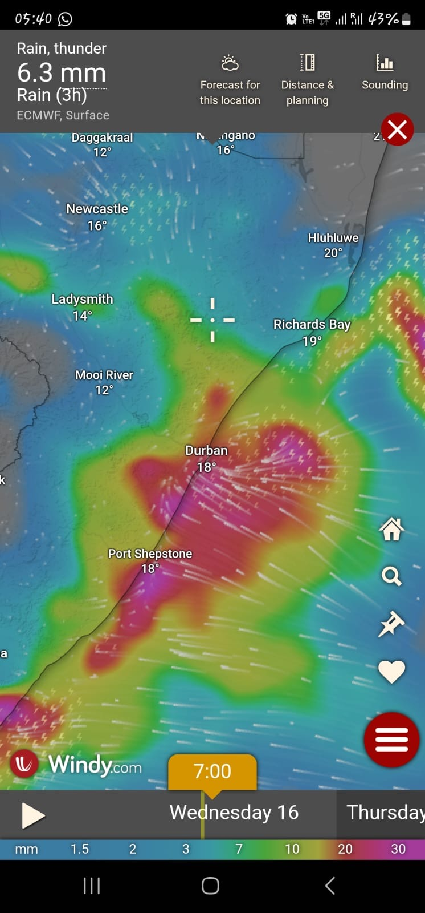
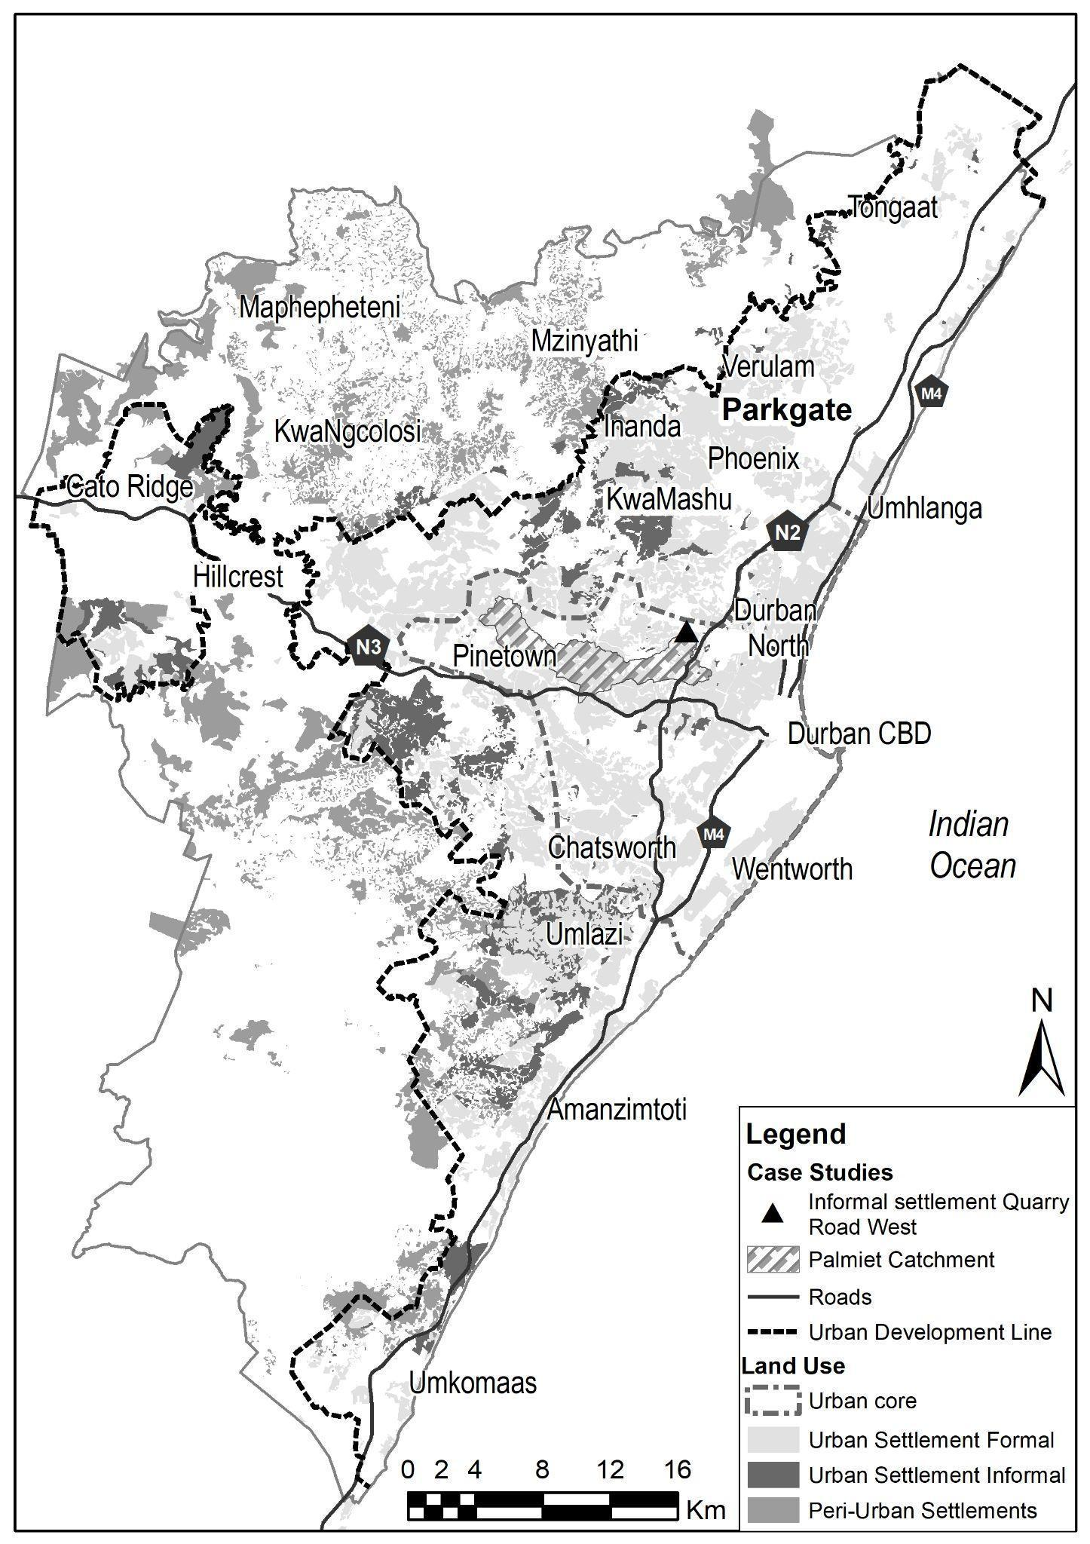
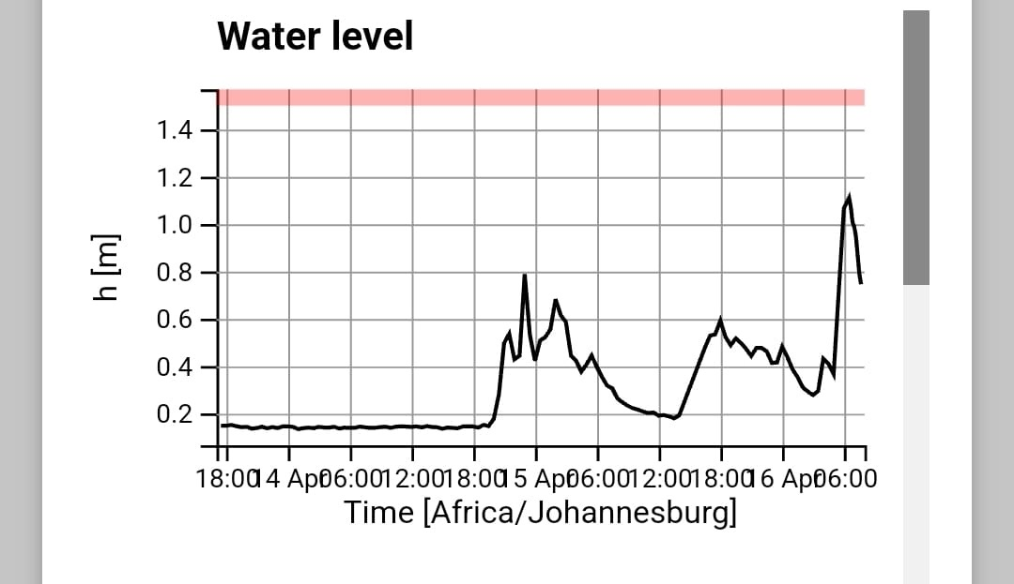
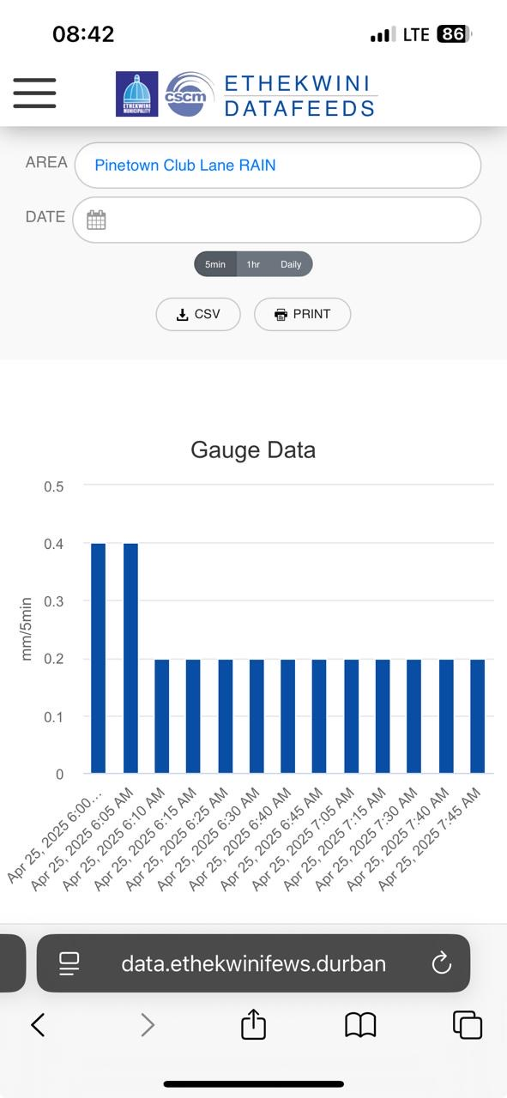
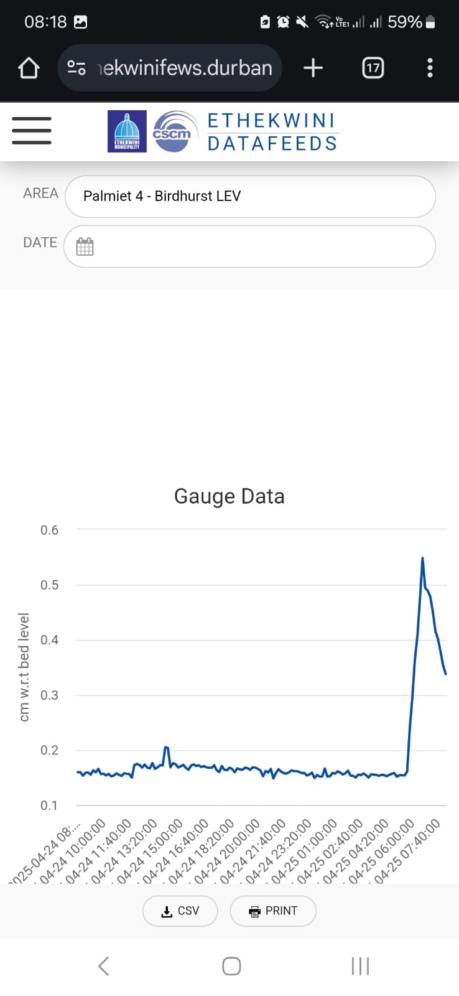
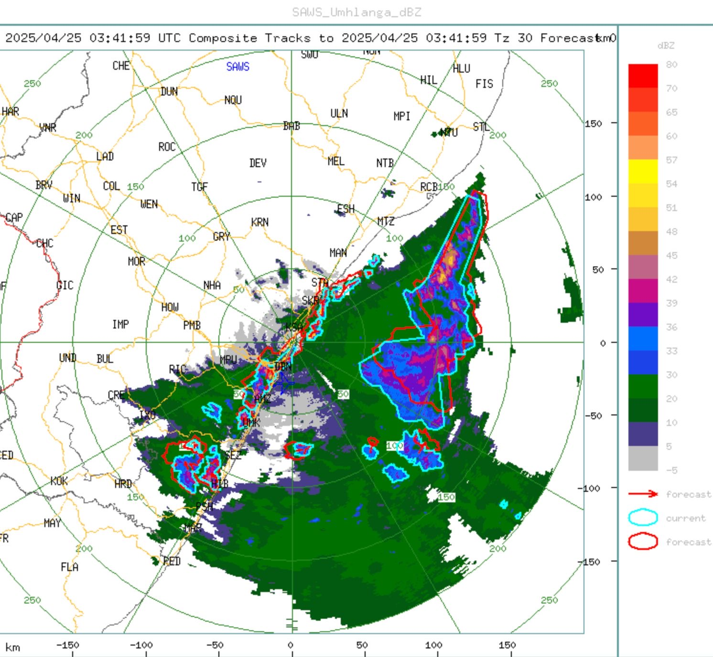
Climate risk
Collaborative Action
At what scale?
Forms of governance

Slide 15
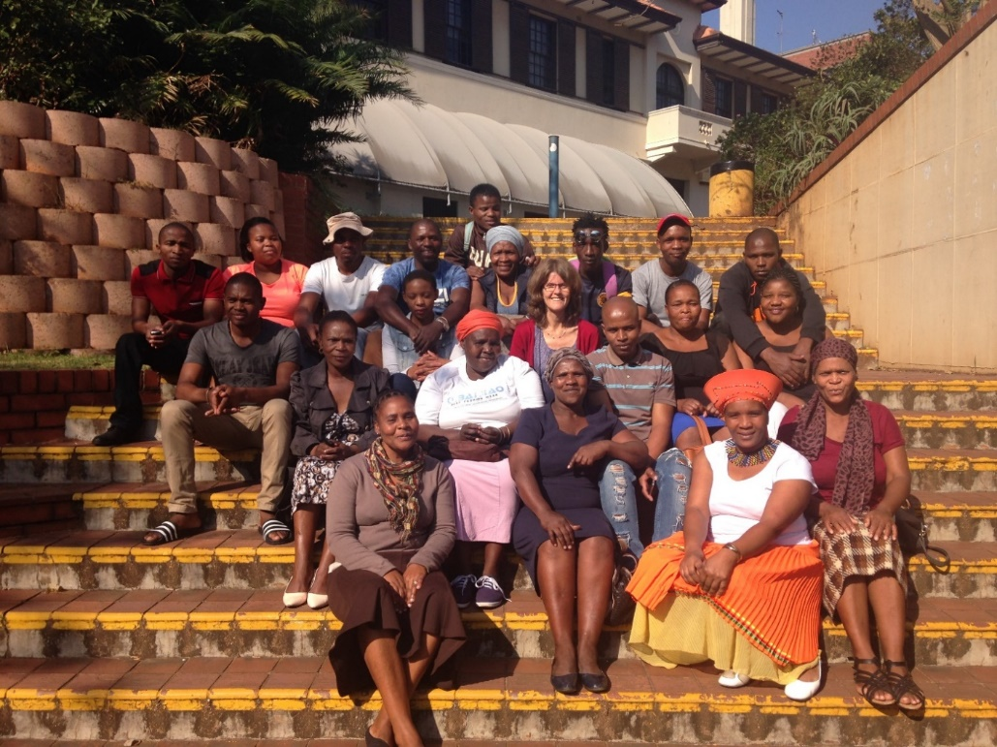
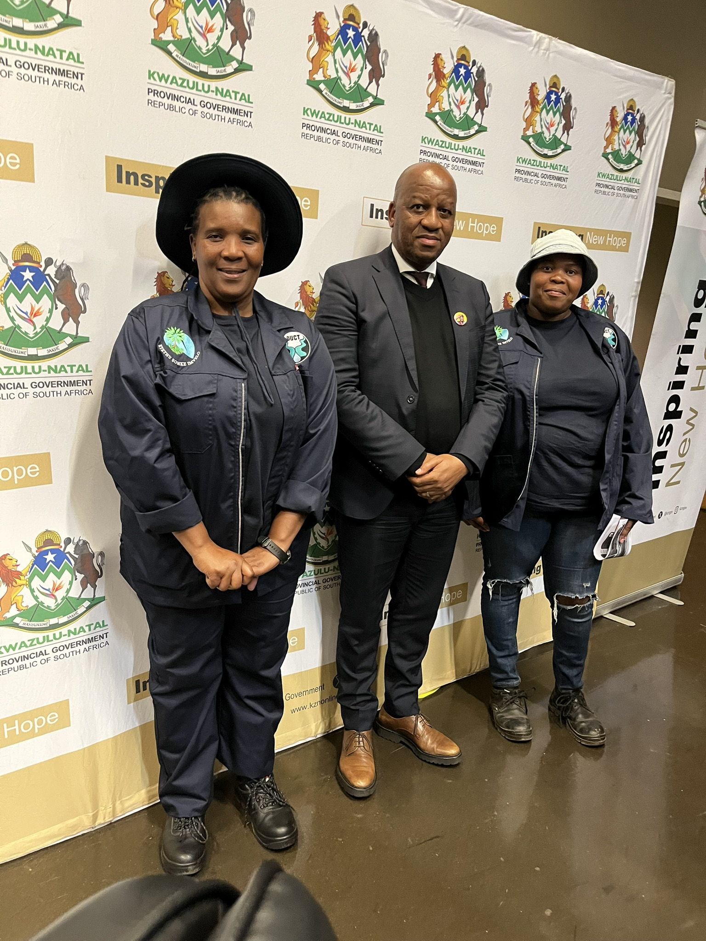
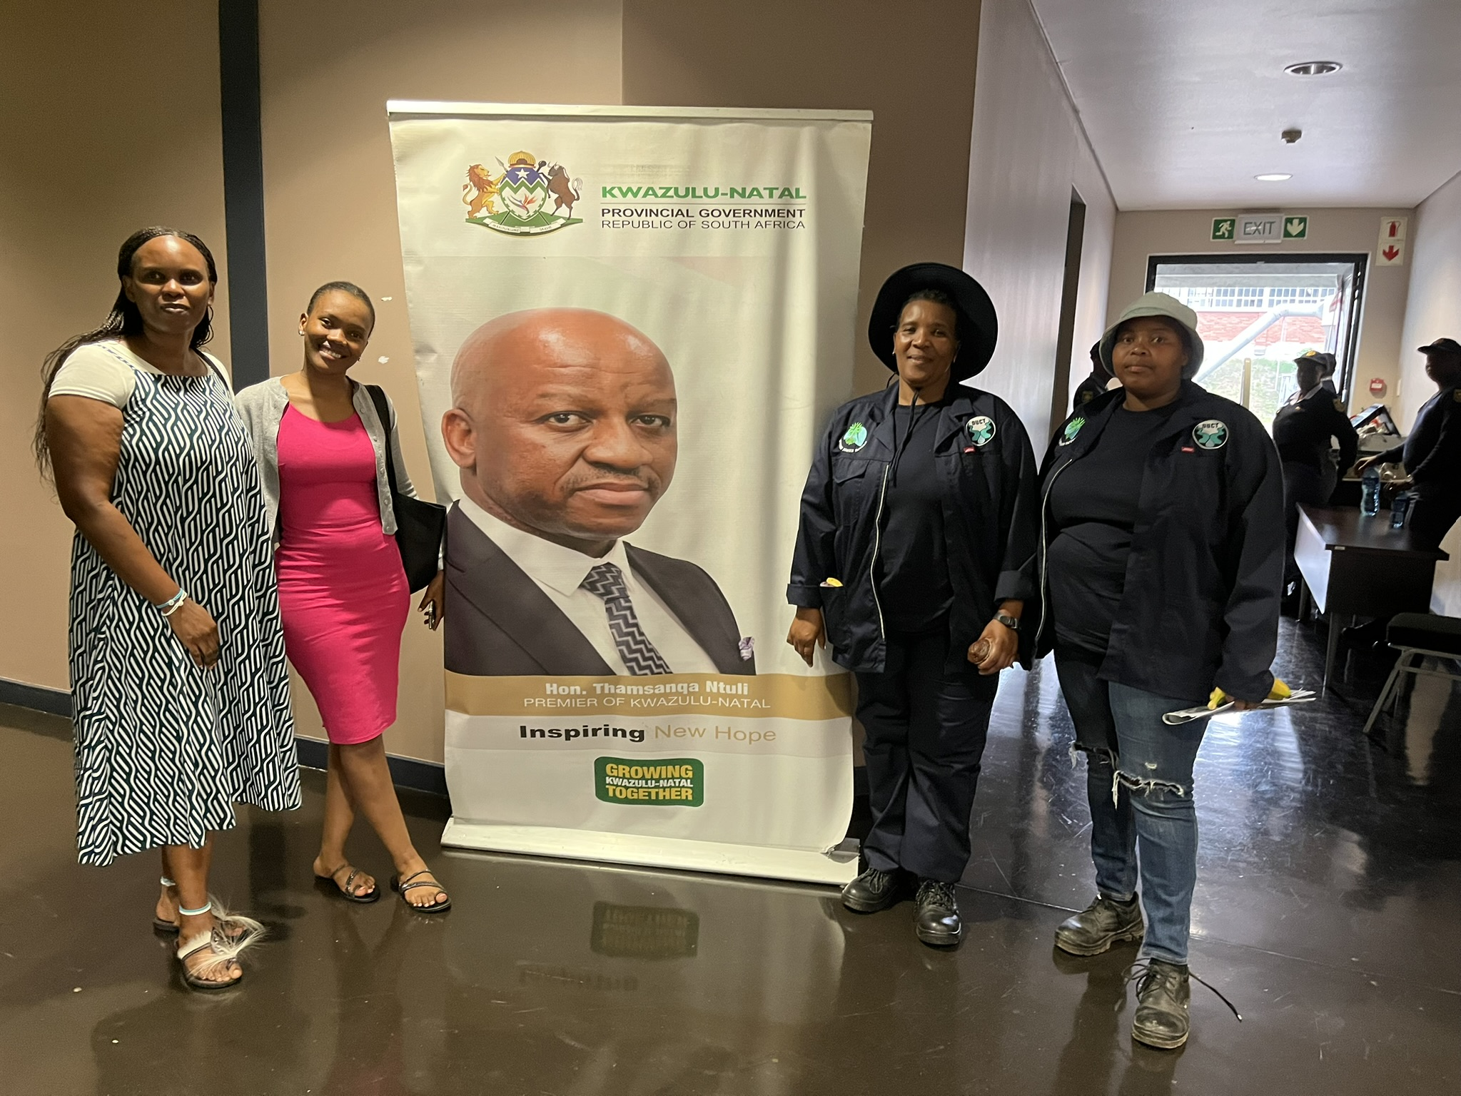
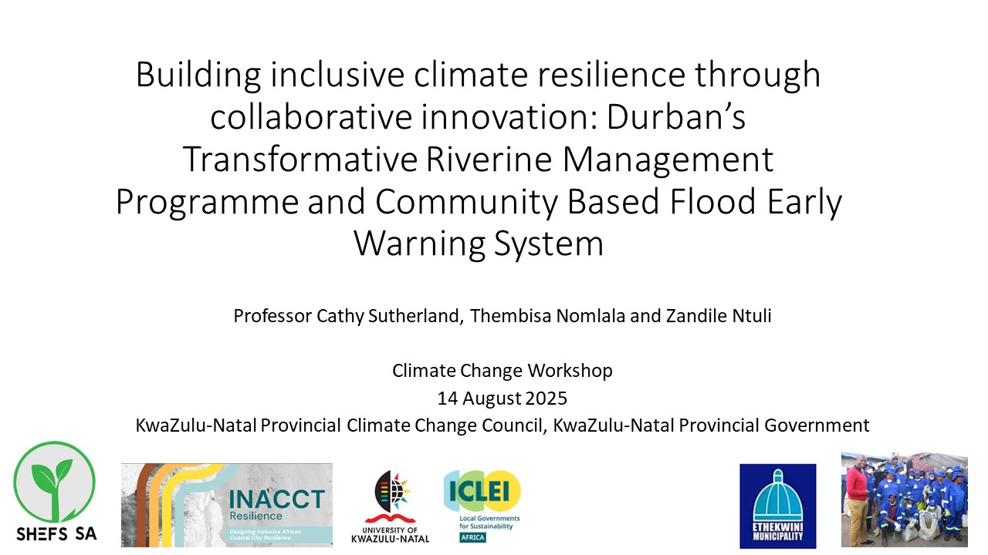
Speaking knowledge to power

Slide 16
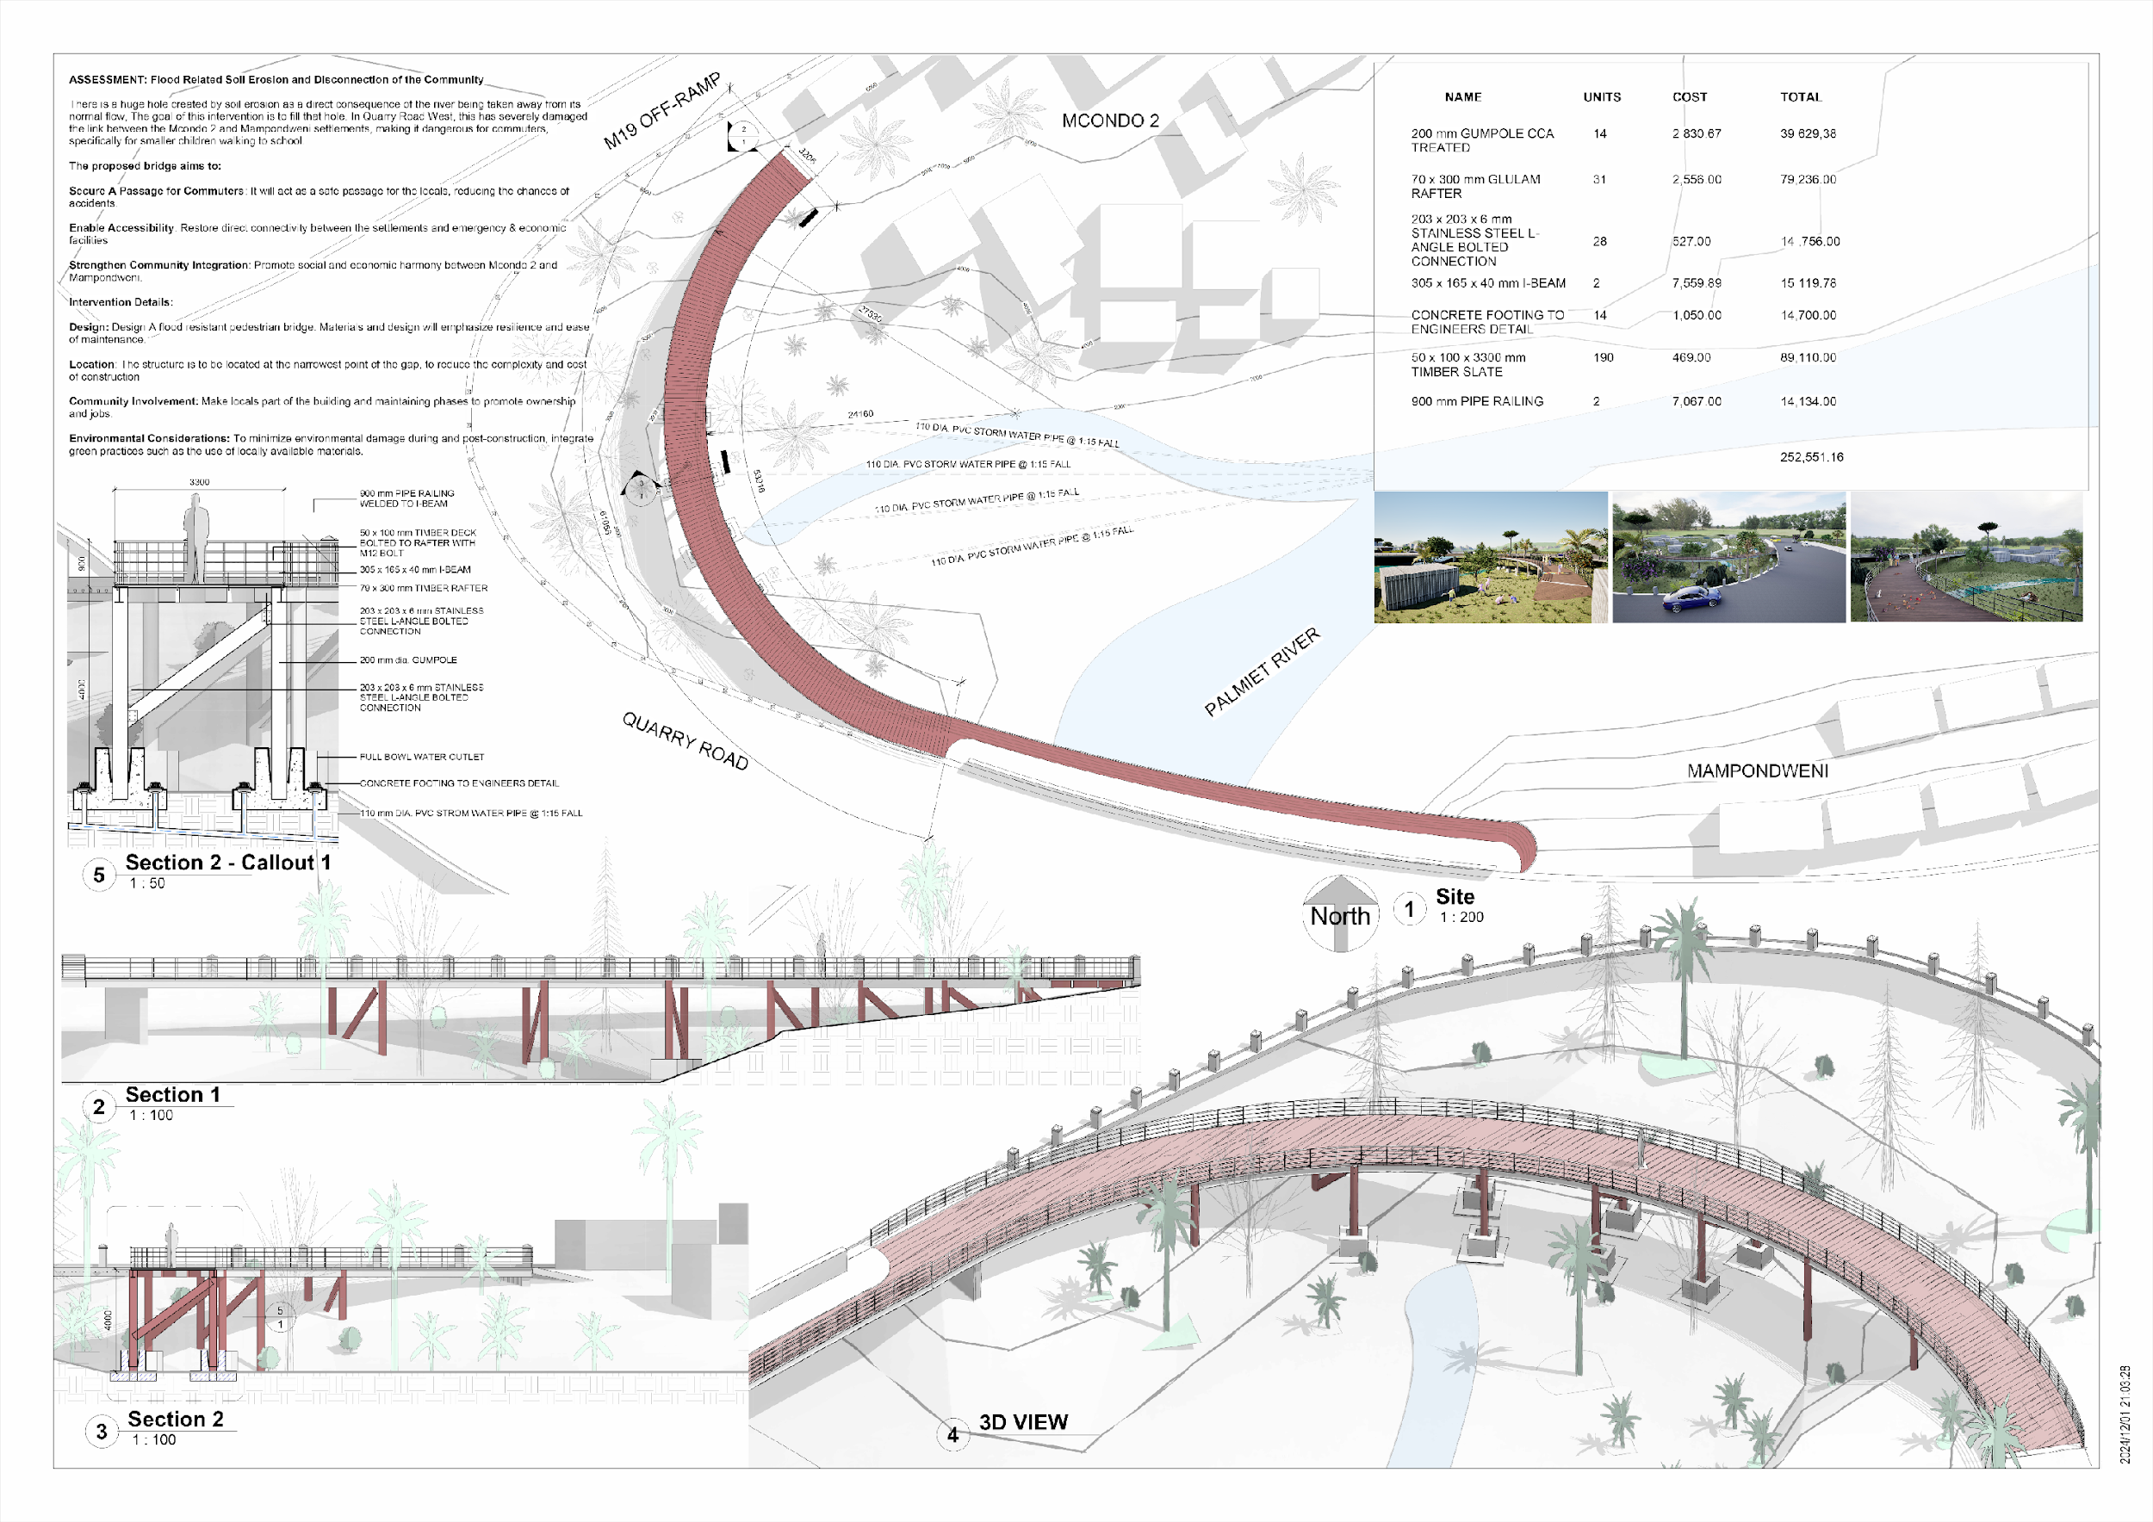
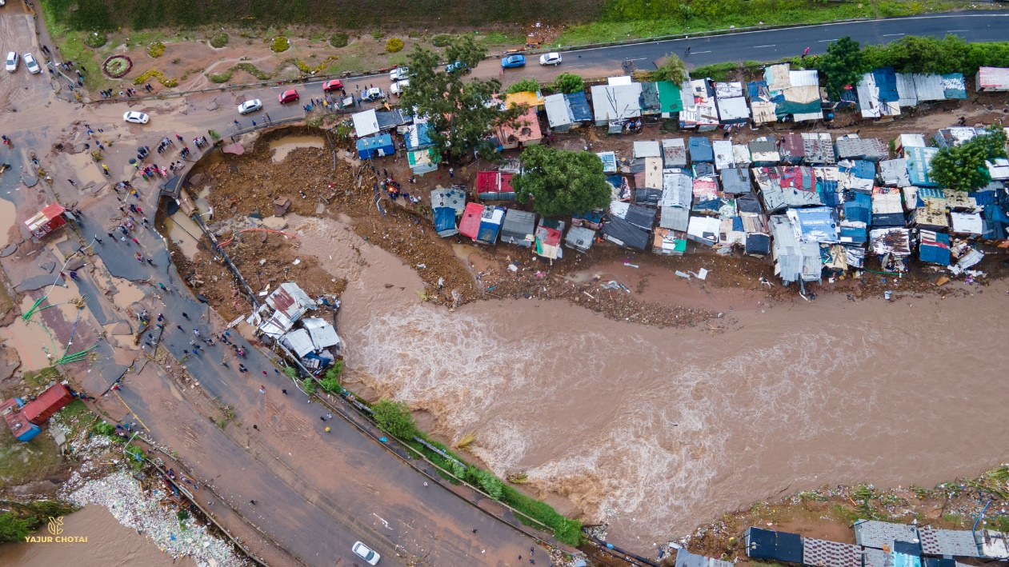
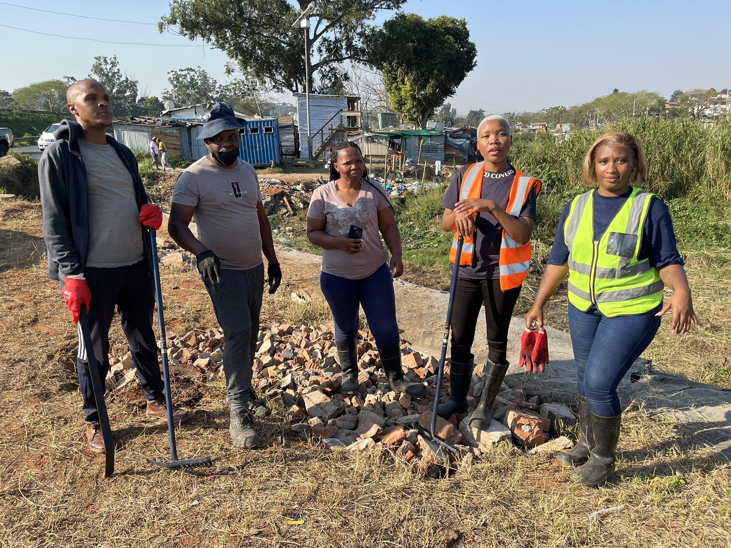
EPIC A and EPIC Durban
Municipal/
University Partnership
Students undertake research with communities to address municipal challenges

Slide 17
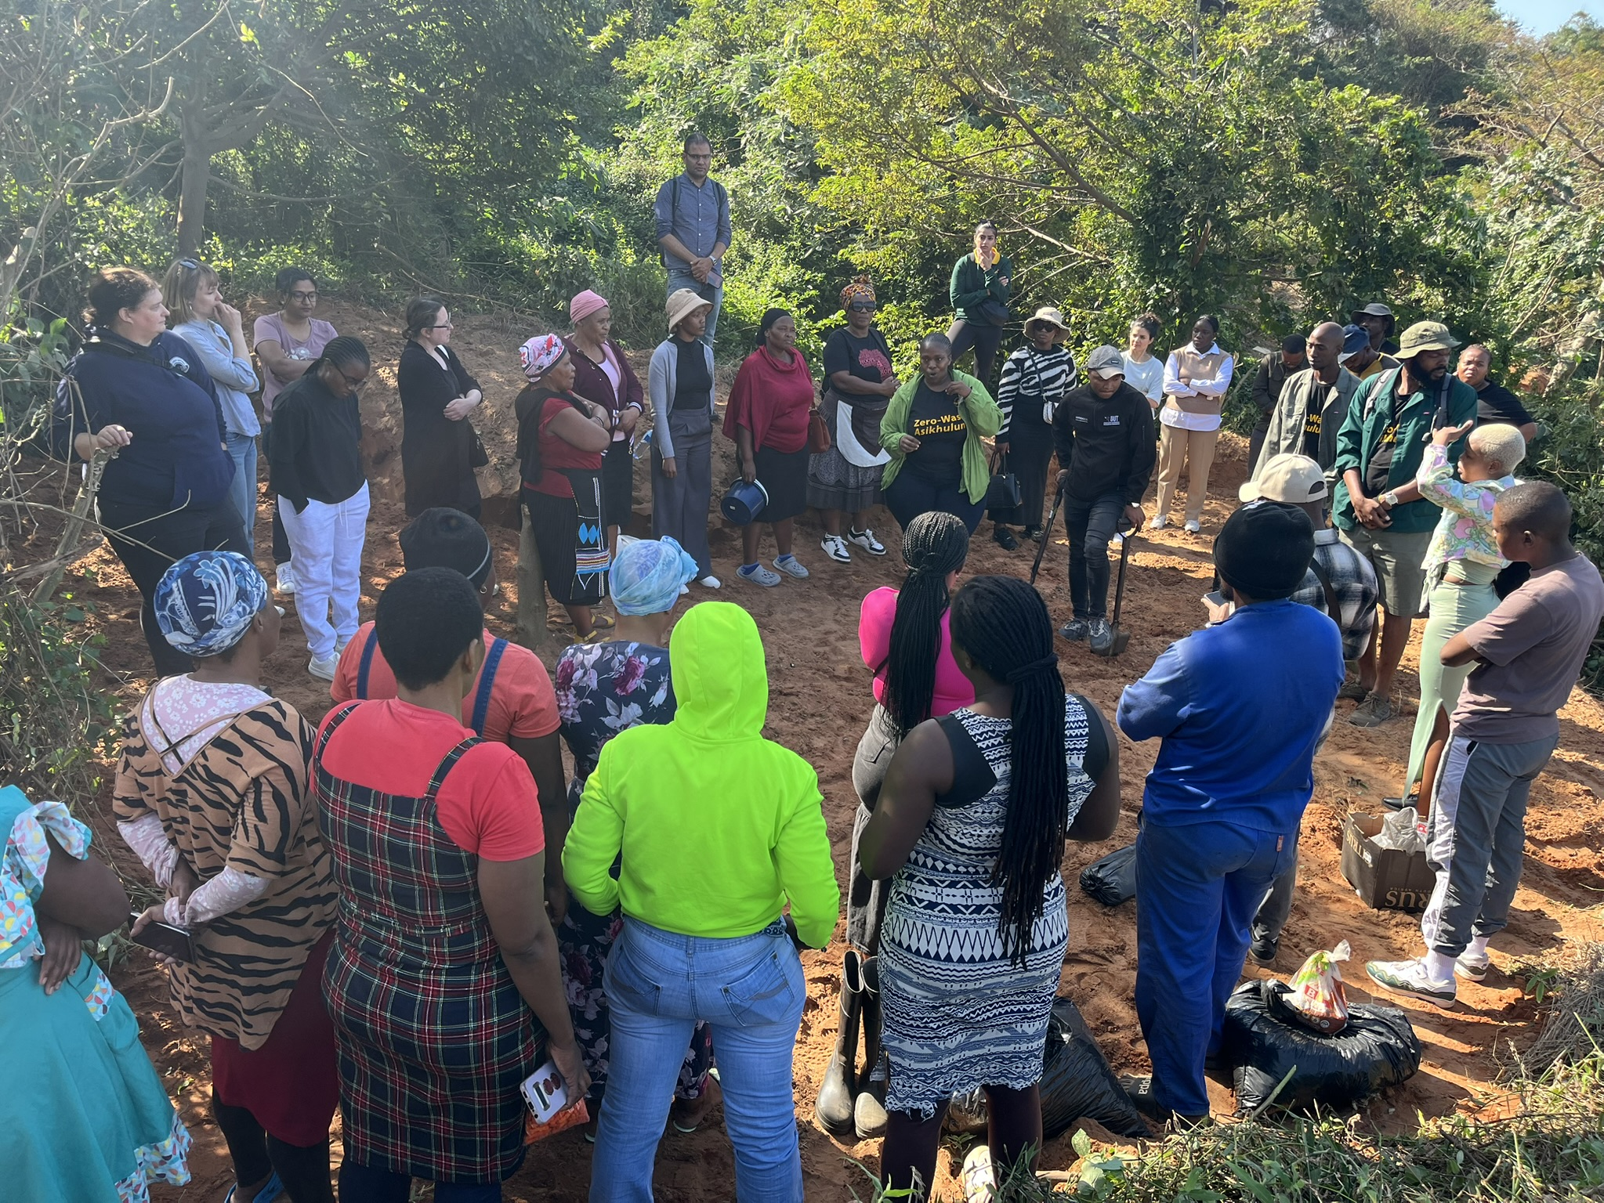
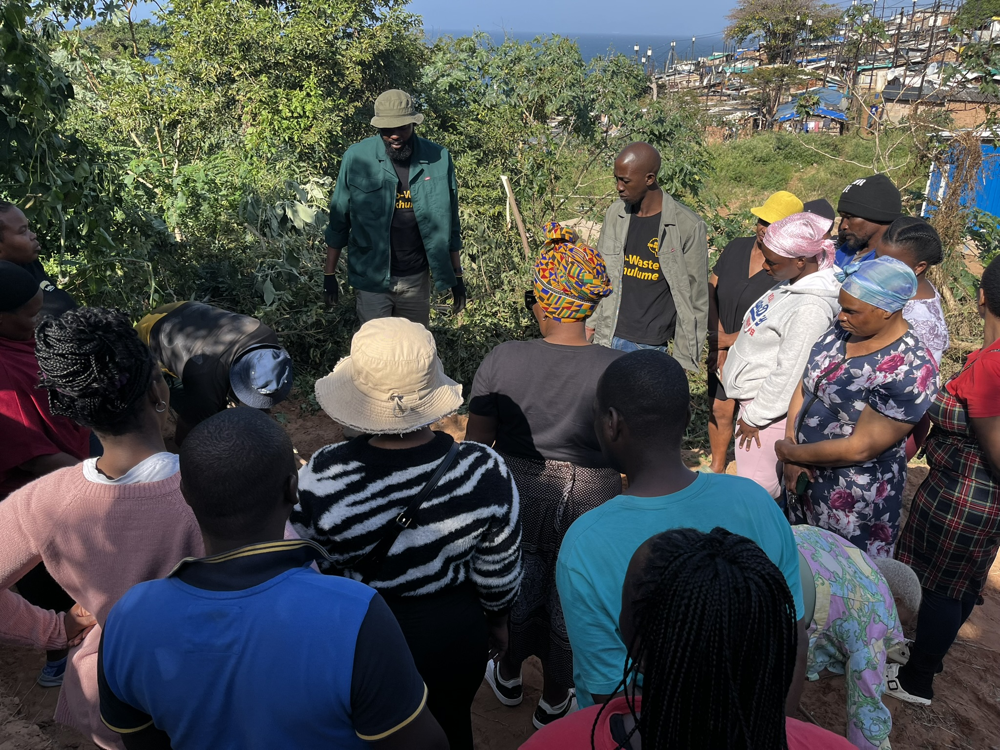
Shared learning across all spaces

Slide 18
In all projects …
Equitable partnerships should be underpinned by forms of funding that enable institutions to become more resilient, supporting researchers and research managers in research collaborations that lead to the strengthening and flourishing of their respective research and innovation environments.
Stakeholders (funders, researchers, research managers, institutions etc) should ensure that equitable partnership principles are demonstrably embedded throughout the research lifecycle, in evidenced ways that support accountability and mutual learning
Joint research endeavours should serve all stakeholders’ needs, while recognising that their objectives might be different
Recognise the continuous evolution of concepts and practices of research excellence, to embrace scientific rigor and validity, and societal relevance, purpose, value and application

Slide 19
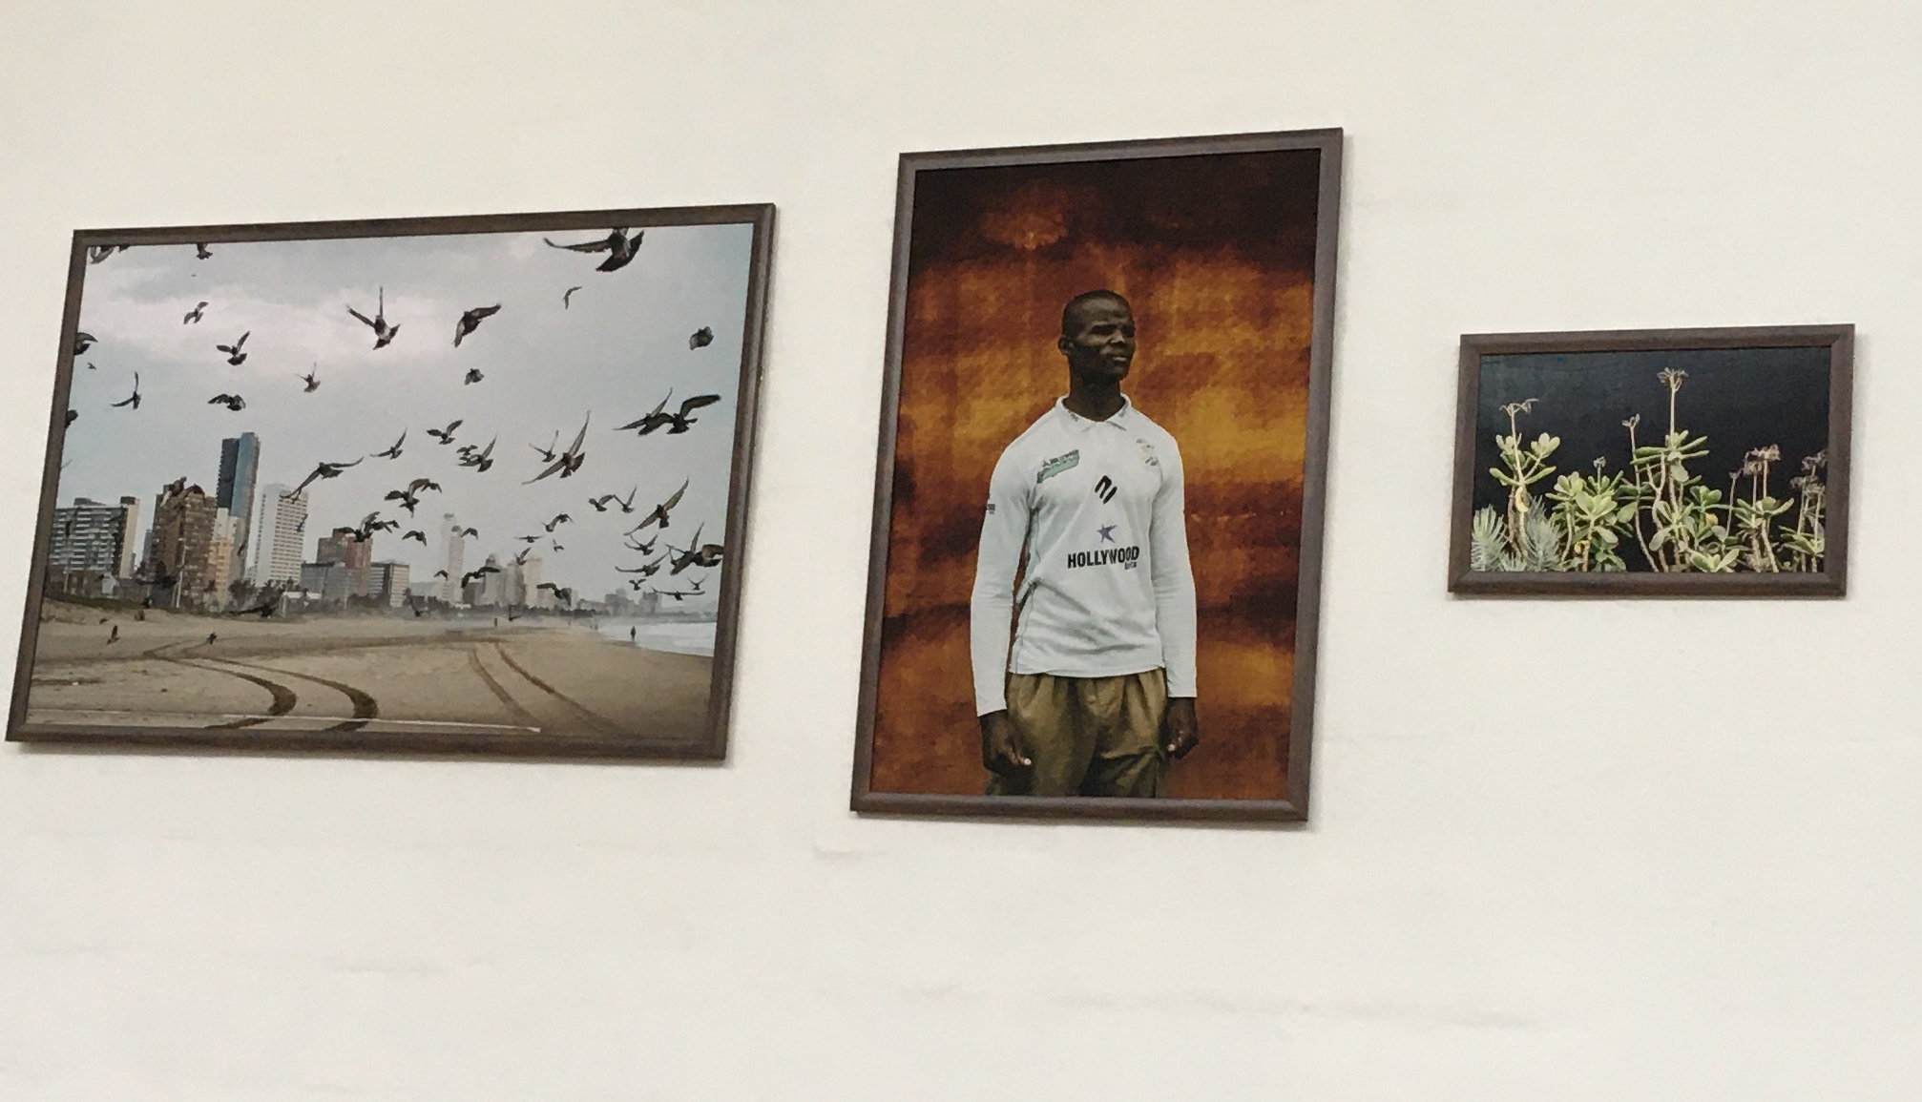
THANK YOU

