Slide 1
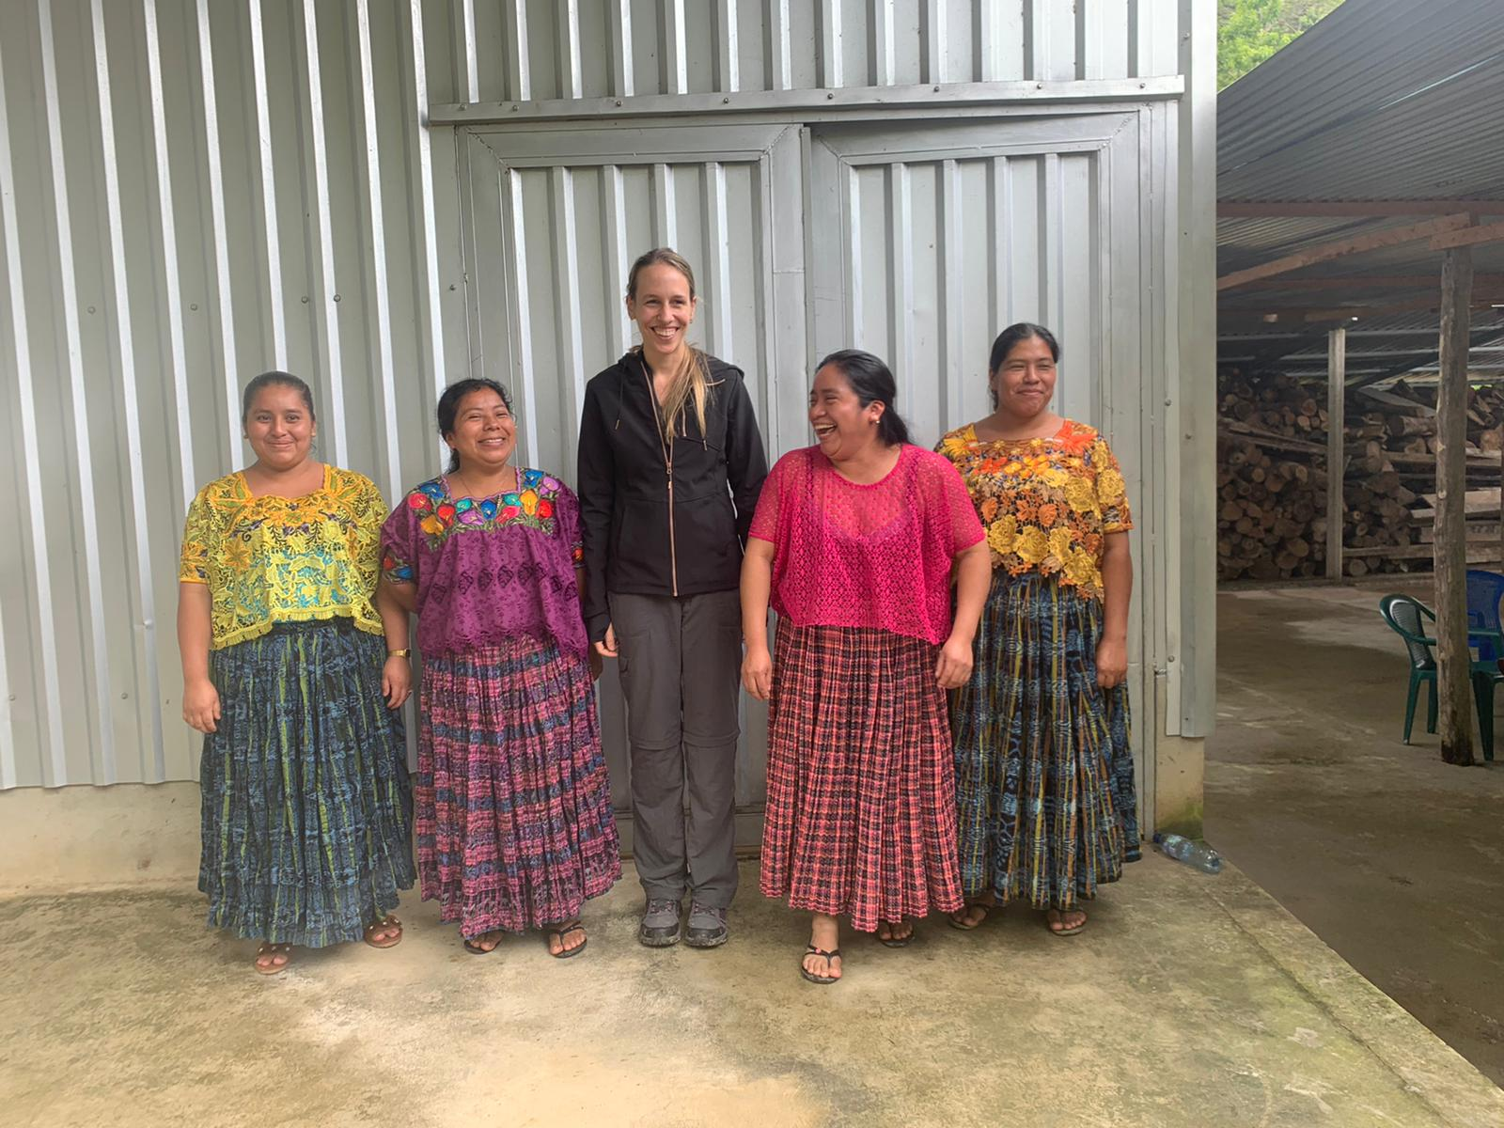
Indigenous-Led Co-Creation: Reimagining Equitable Partnerships in Global Research
Dr Pamela Giselle Katic
Natural Resources Institute, University of Greenwich, UK

Slide 2
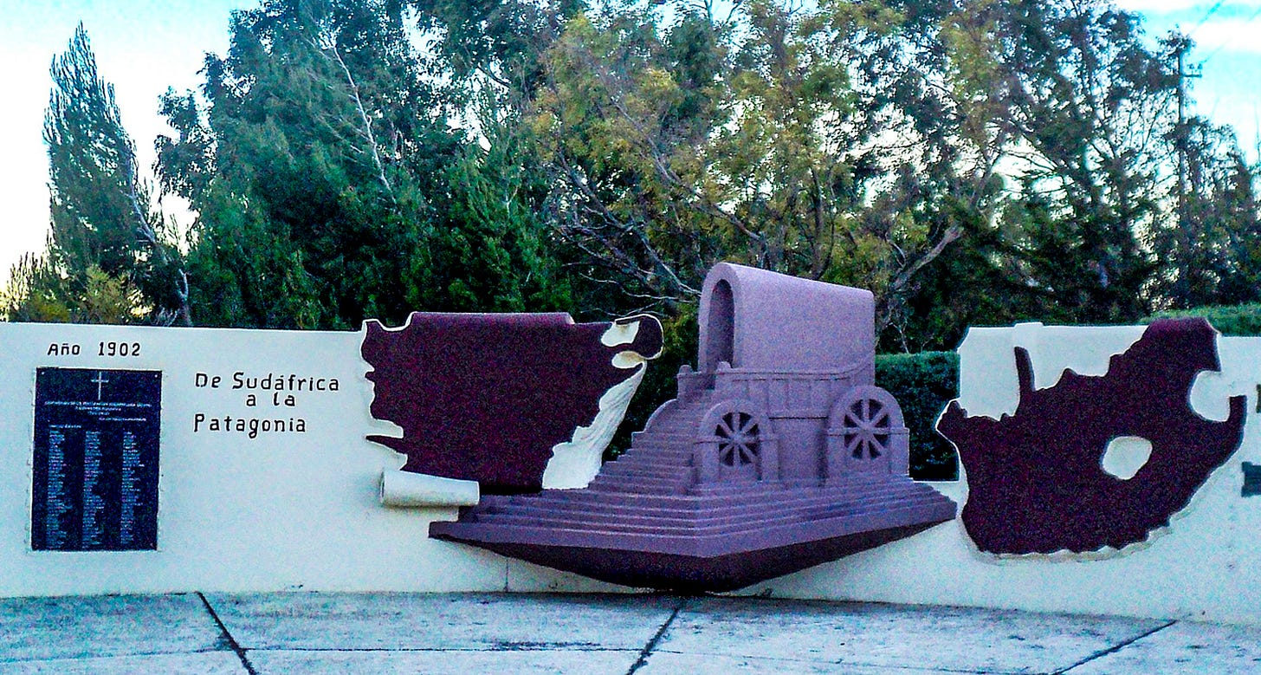
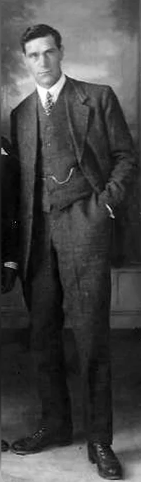
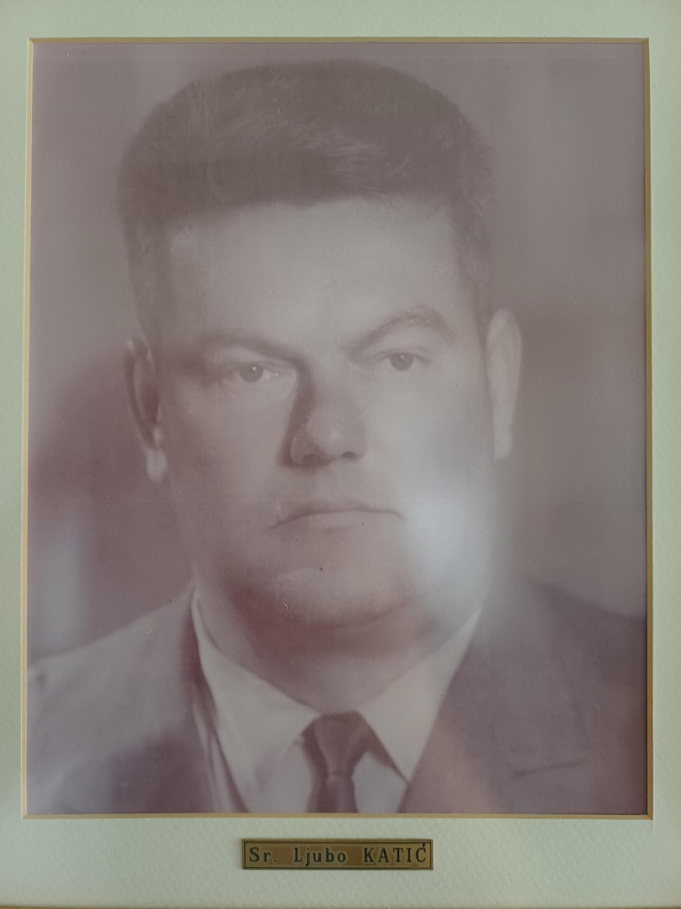
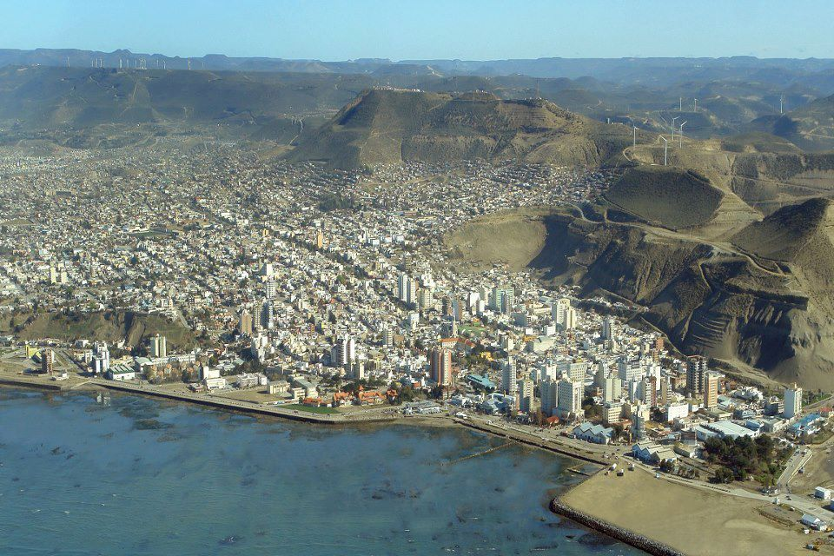
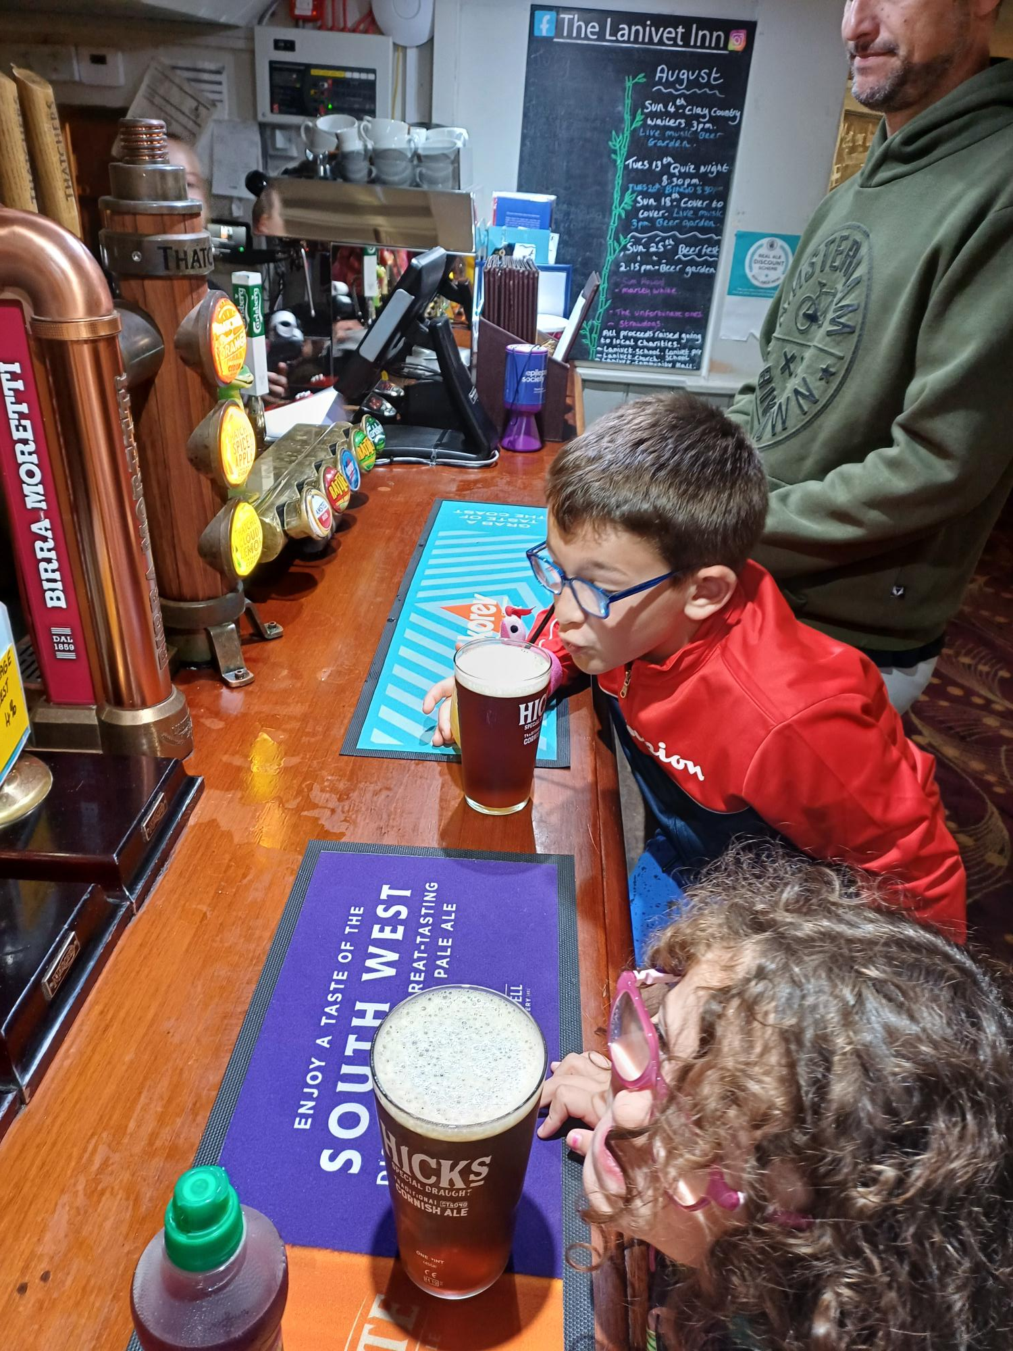
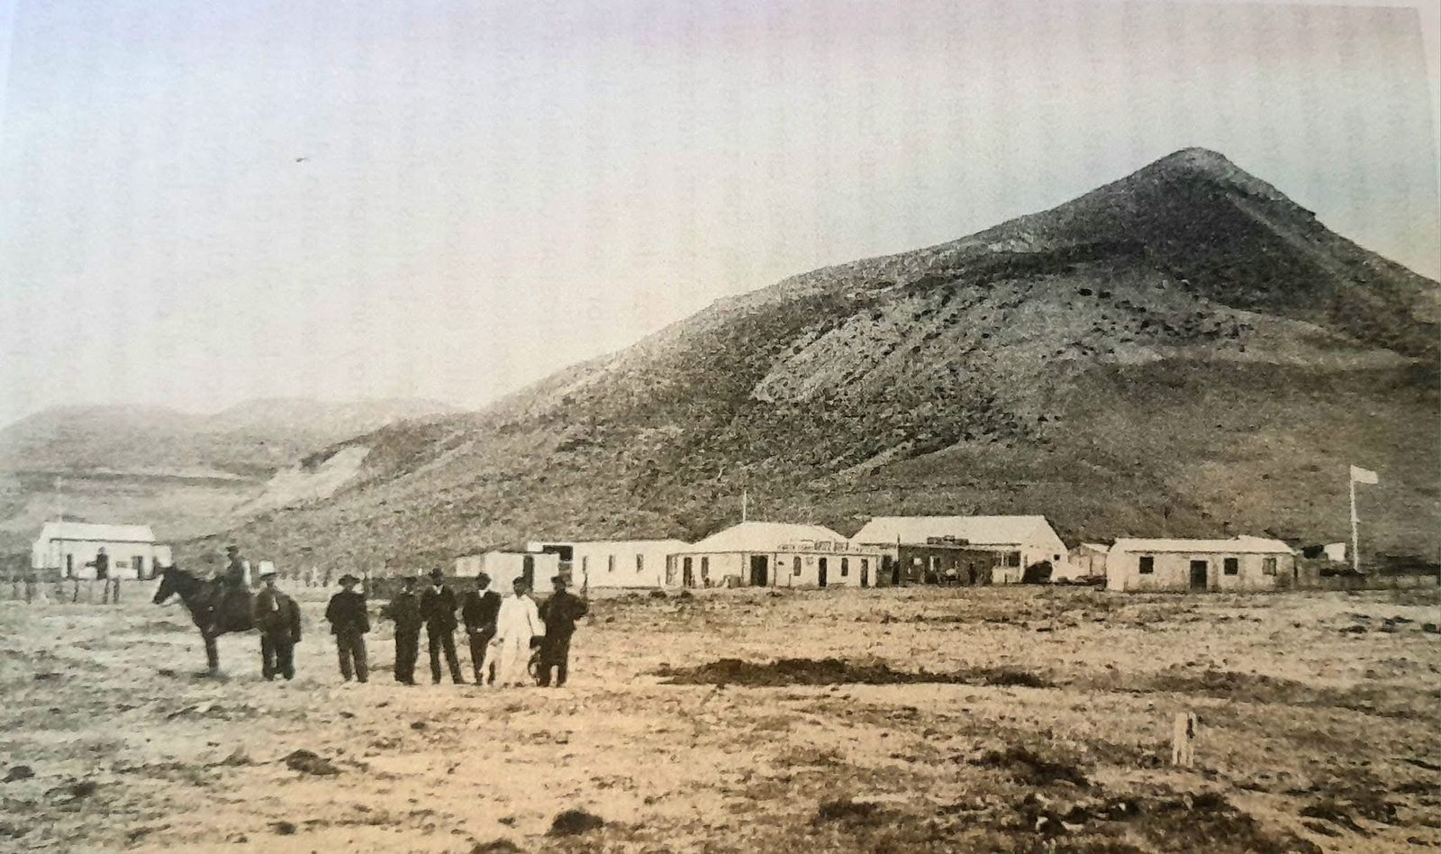
Who am I?
Patagonia Argentina

Slide 3

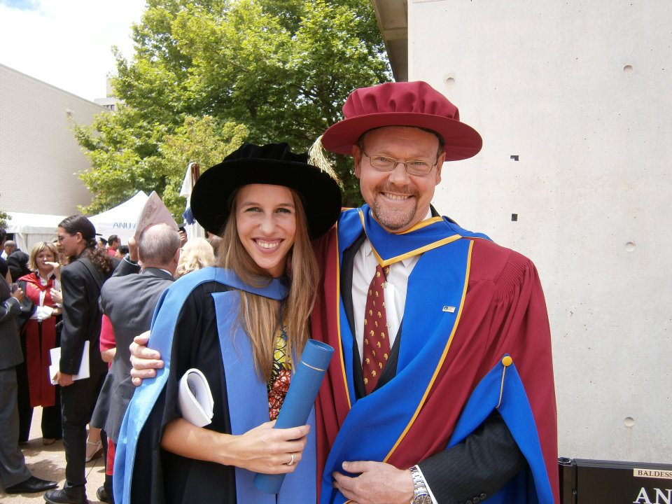
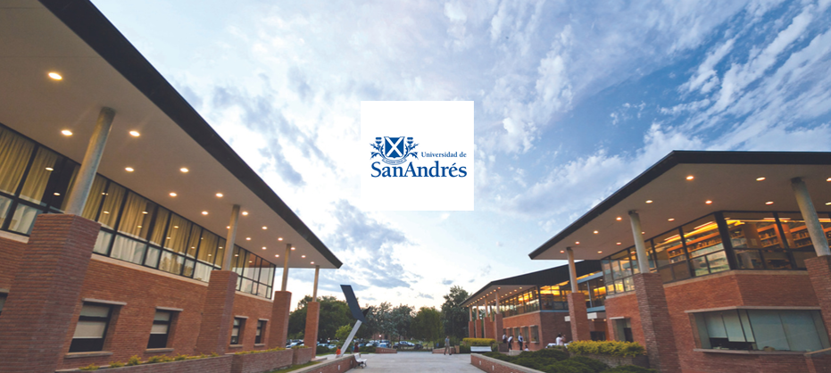
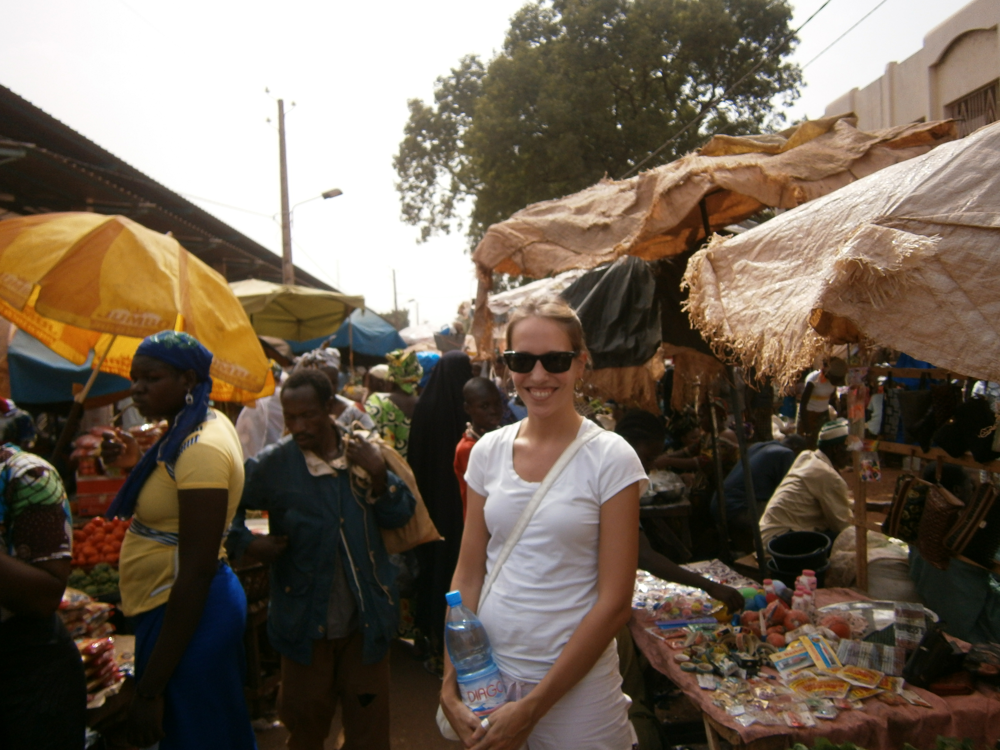
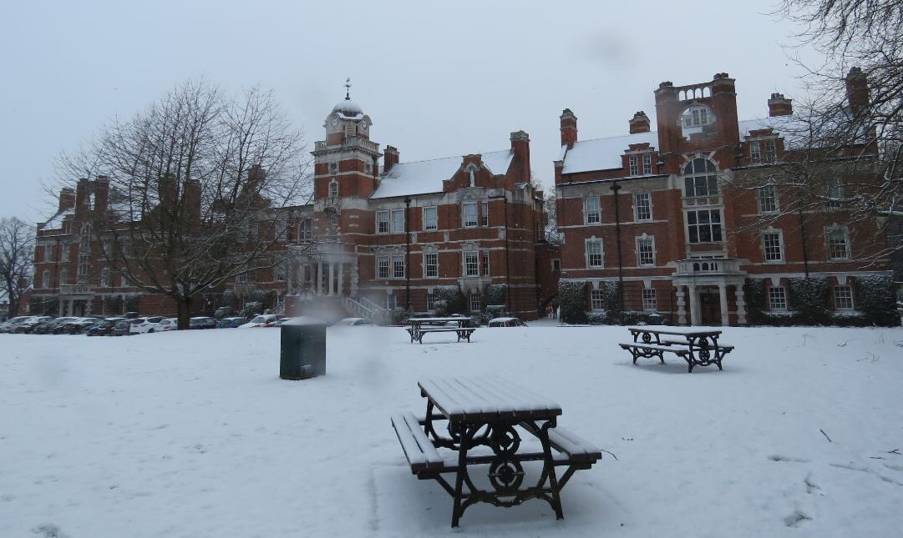


Who am I?

Slide 4

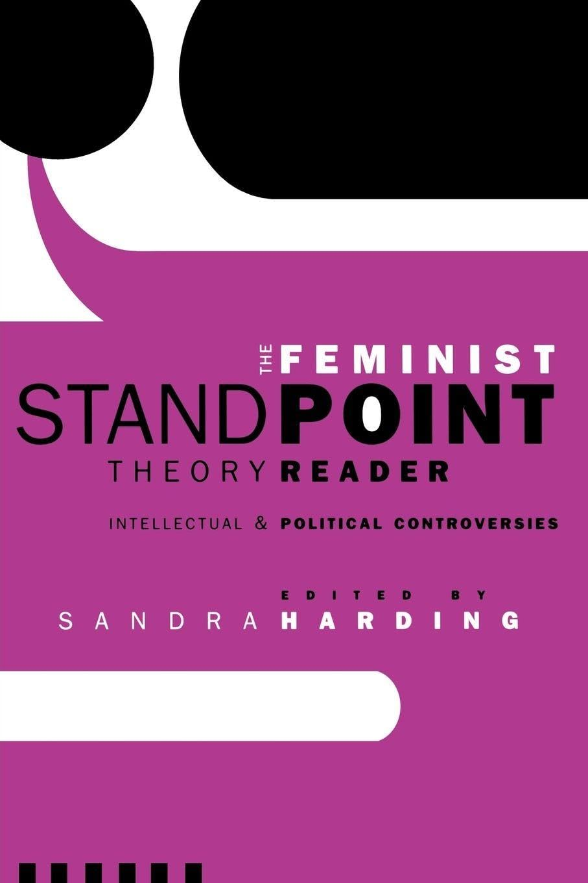
Why is this important?

Slide 5
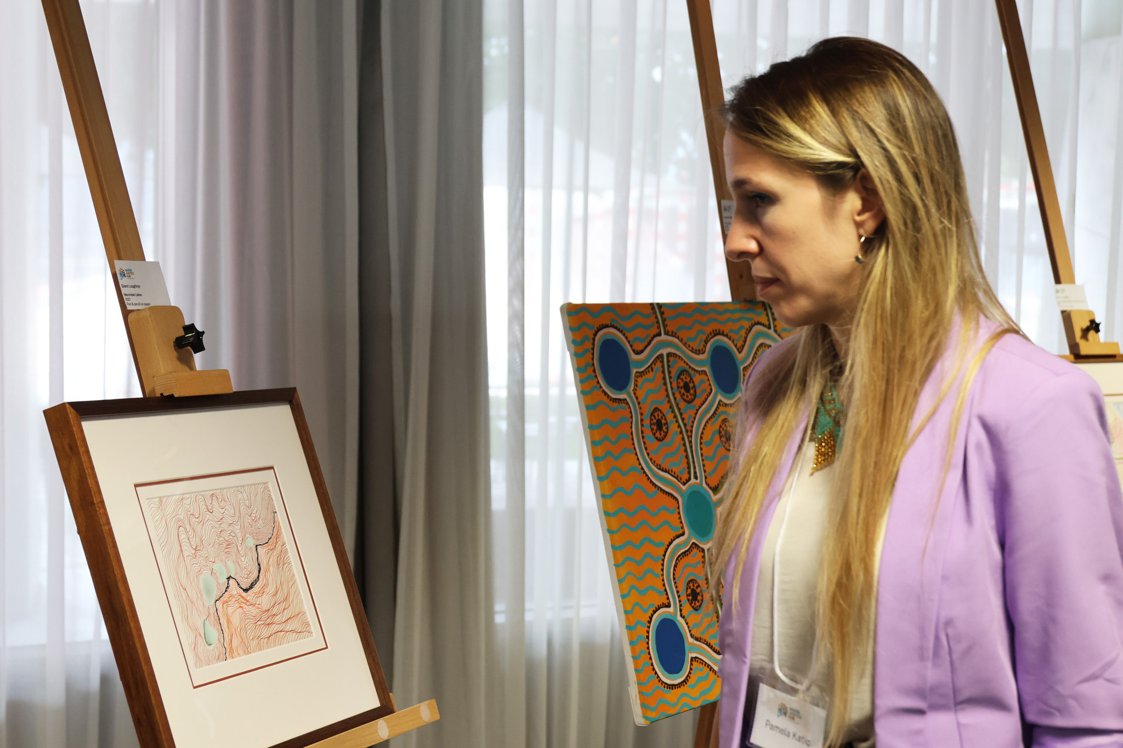
What do I do?
I lead by empowering NETWORKS in very exciting research projects and platforms!
-> In relation to biocultural conservation, water justice, food systems, climate change adaptation, …
-> in partnership with Indigenous and non-Indigenous communities and organisations, civil society organisations and Universities all over the world.
I teach and I learn in and outside the classroom.
I reflect, I change, and I grow in the process.

Slide 6
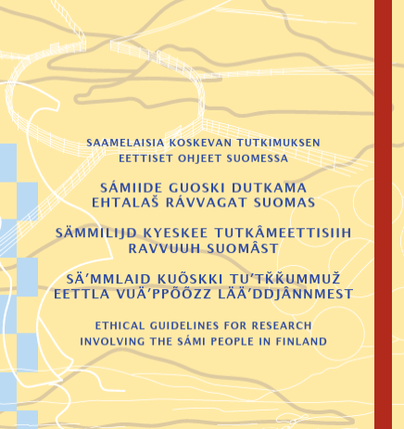
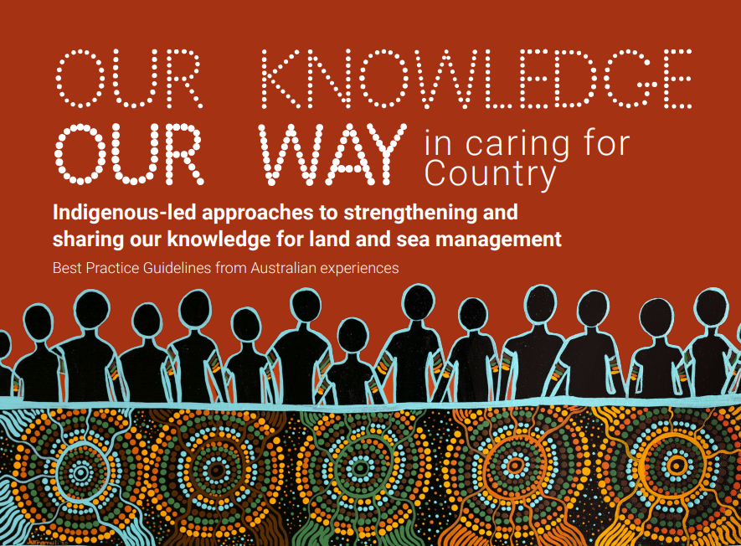
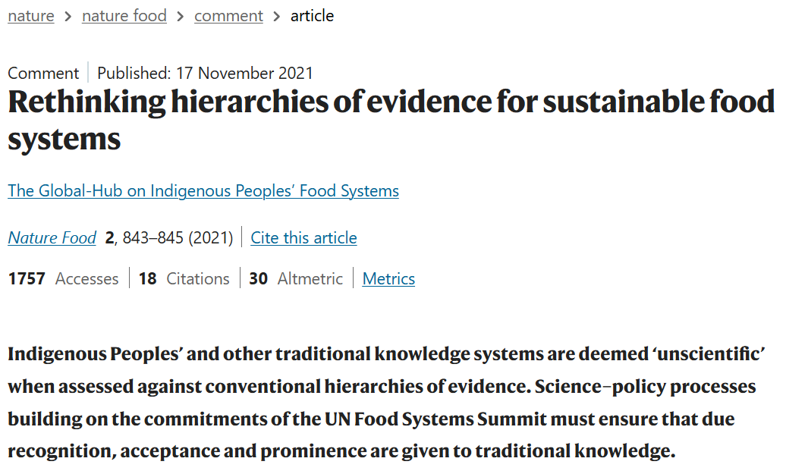
How do I do it?
I take “bad” advice as inspiration!
I advocate for paradigm and practice shifts.
I cede power and space, foregrounding respect and self-determination in research.
I mobilise knowledge and creativity.

Slide 7
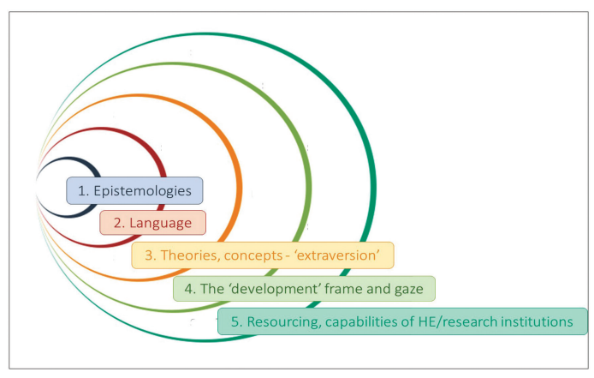
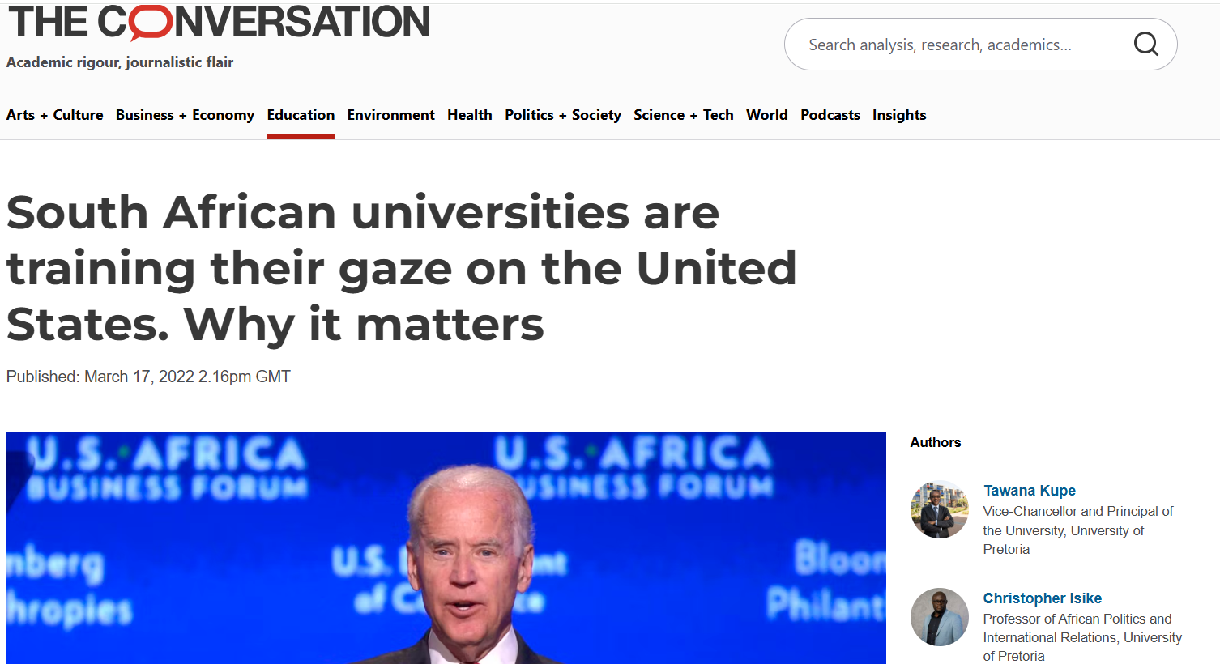
How do I understand equity in international research partnerships?
A more fundamental rebalancing is needed.
Present positionings are neither accidental nor benign. Rather than be taken as face value, our role is to problematise them.
Layers of power imbalances in global North - Africa scientific knowledge production
(Source: Aboderin, I., Fuh, D., Balcha Gebremariam, E., & Segalo, P. (2023). Beyond ‘equitable partnerships’: the imperative of transformative research collaborations with Africa. Global Social Challenges Journal, 2(2), 212-228.)

Slide 8
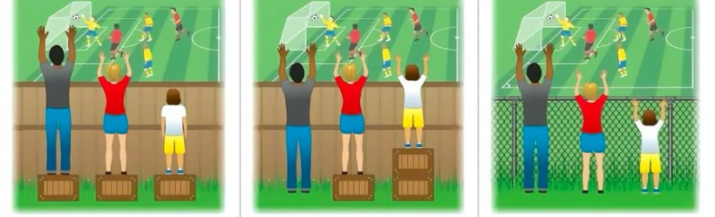
From equity to justice in international research partnerships?
Equality means everyone gets the same resources, but not everyone starts in the same place.
Equity means giving people what they need to reach an equal outcome. It’s about recognising that some people need more support to reach fairness.
Justice goes a step further: it’s about addressing the root causes of inequality and creating systemic change so that everyone can thrive.

Slide 9
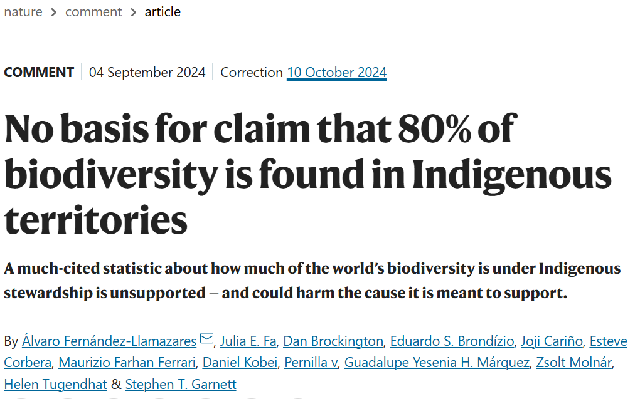
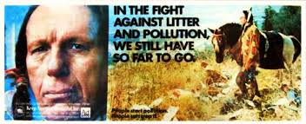
What does equitable partnerships look like in research with and by Indigenous Peoples?
Starting point: reject the concept of the “imagined Indian”, confront mischaracterisation and misrepresentation.

Slide 10
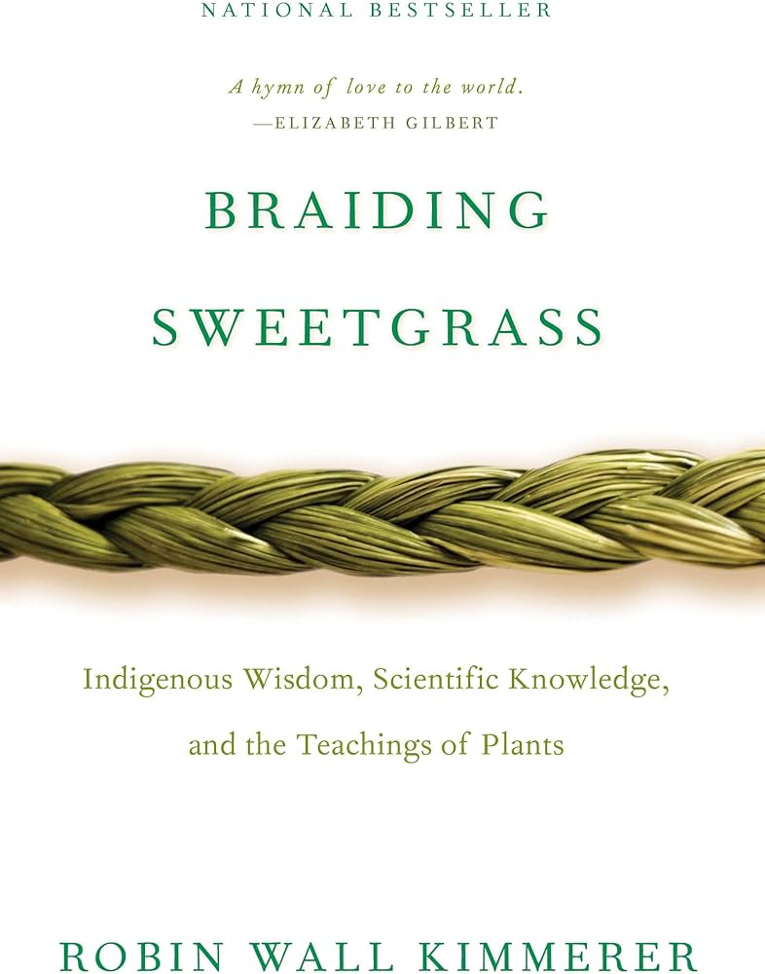
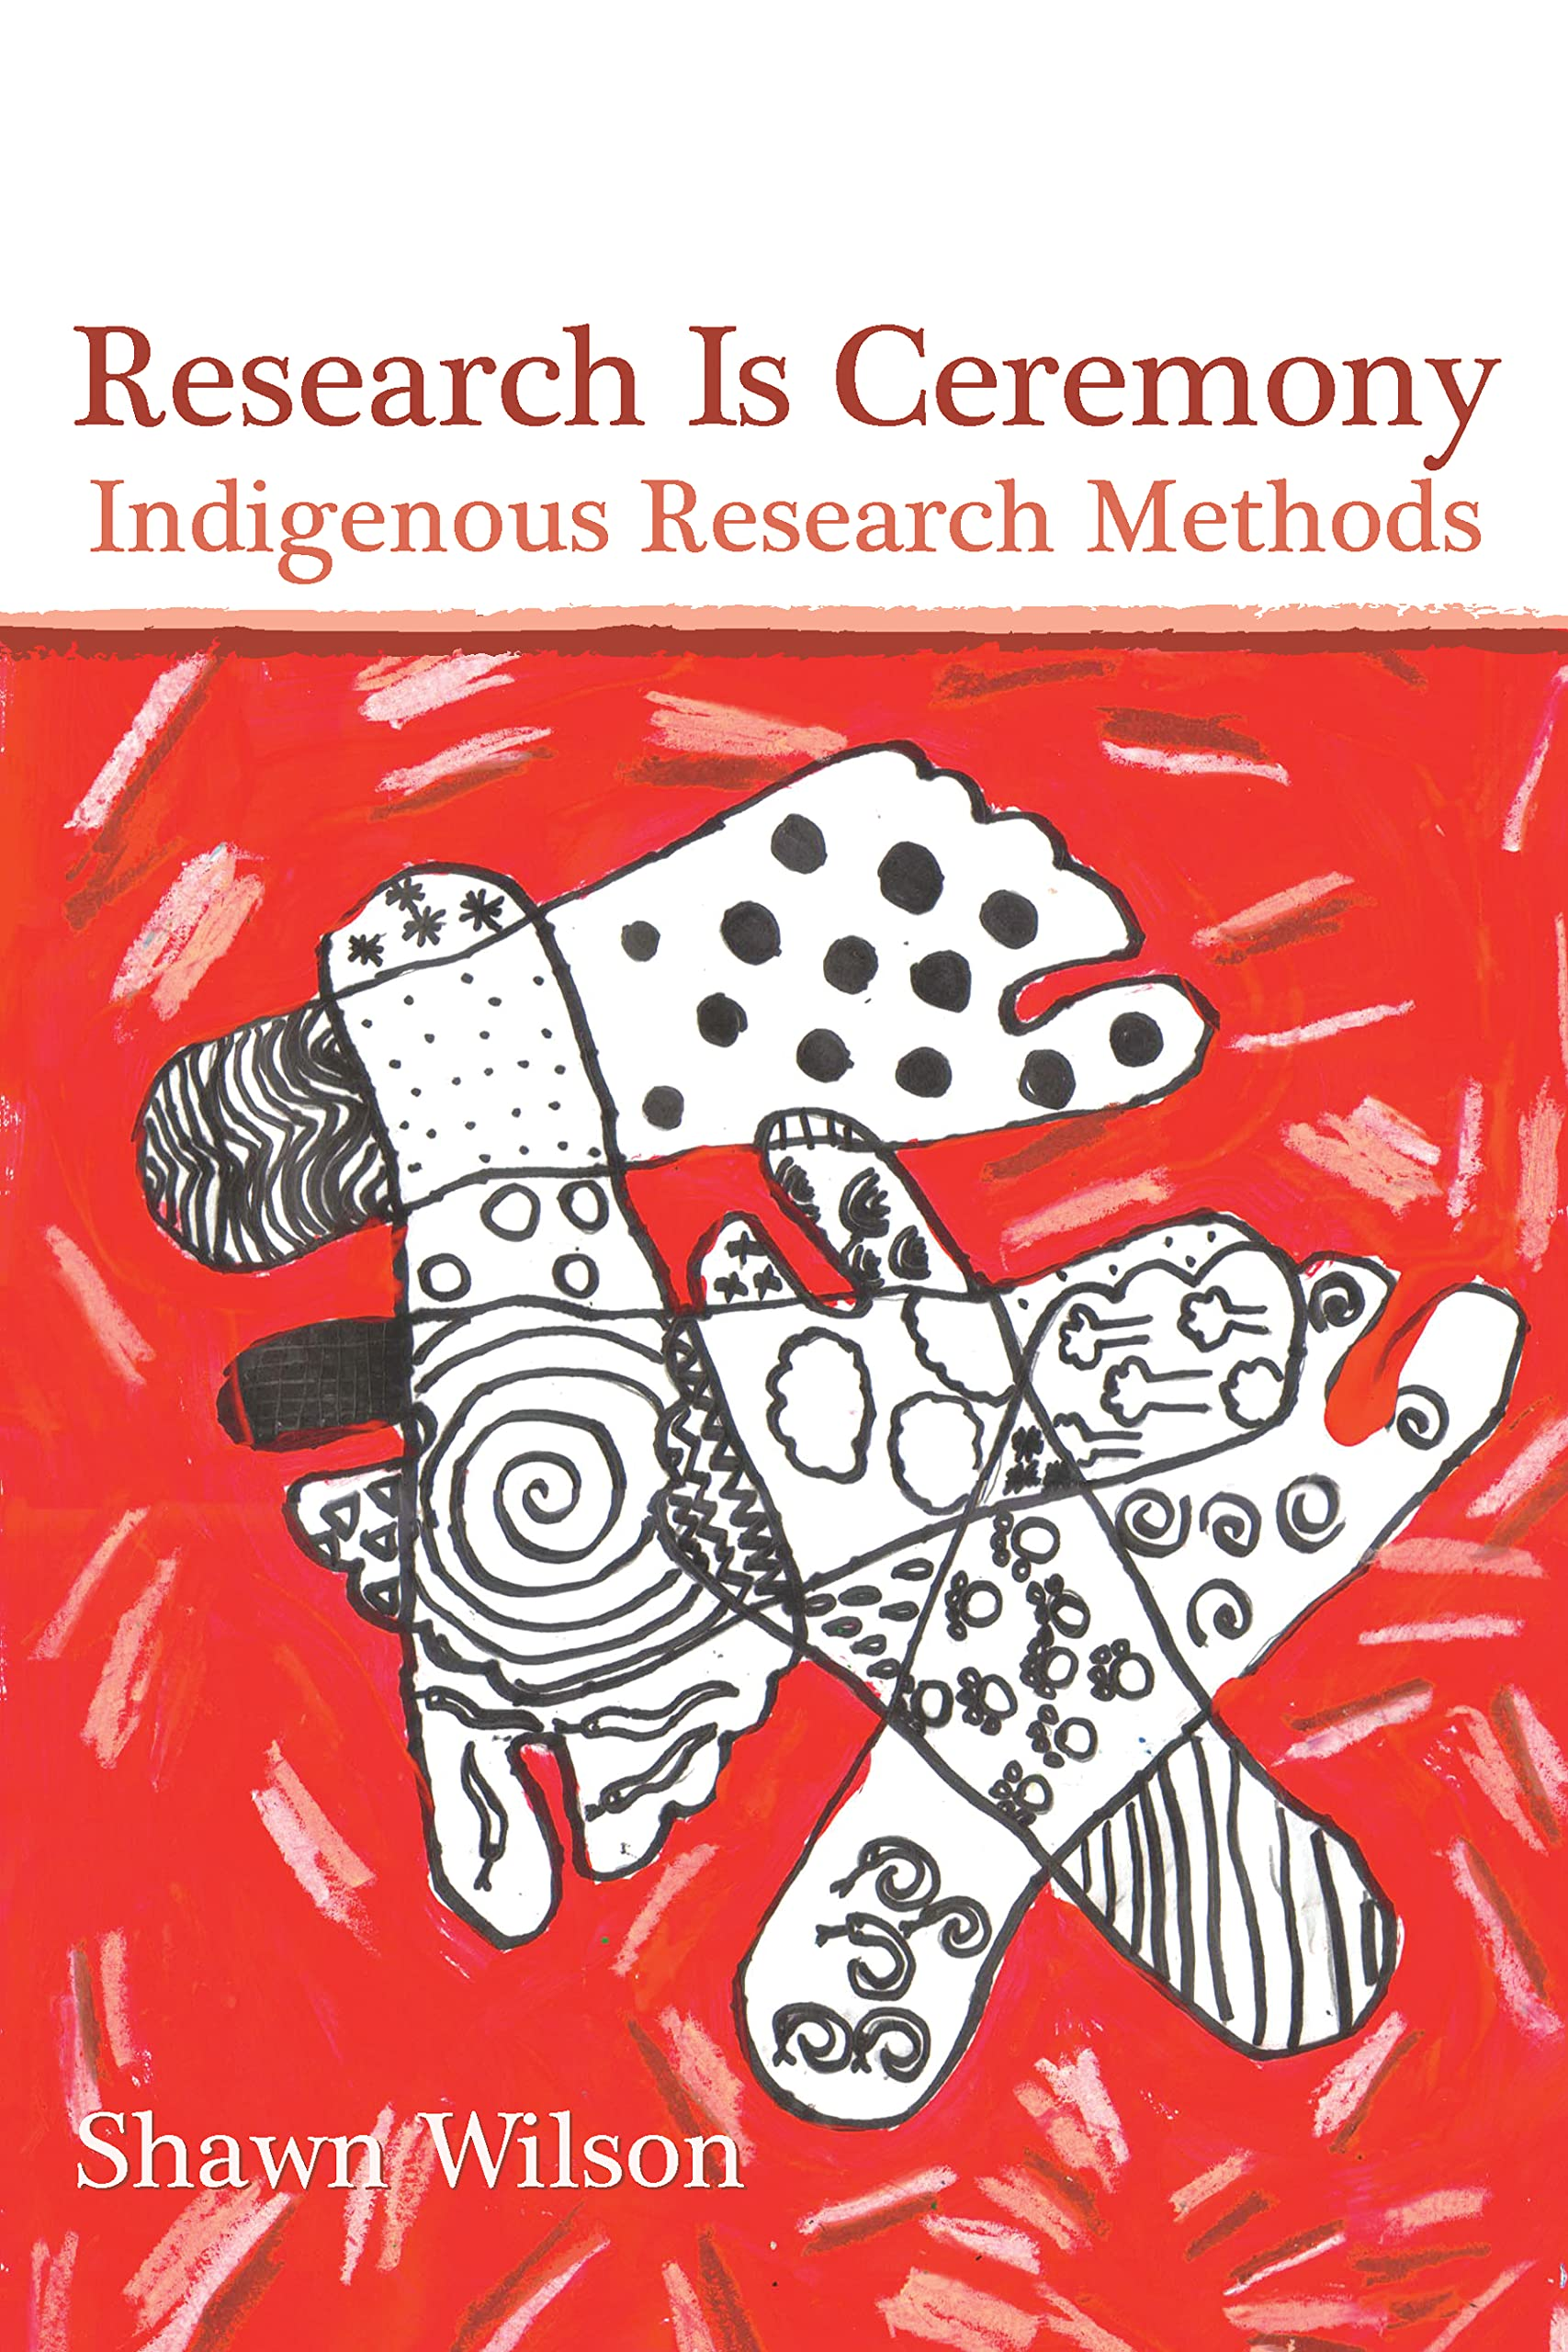
What does equitable partnerships look like in research with and by Indigenous Peoples?
Celebrate plural worldviews
“Relationships don't just shape Indigenous reality, they are our reality.”
“Only when we can hear the languages of other beings will we be capable of understanding the generosity of the earth and learn to give our own gifts in return.”

Slide 11
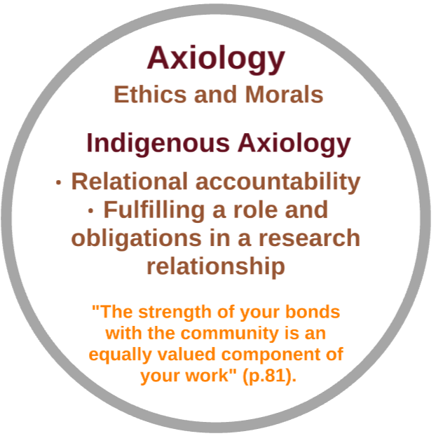
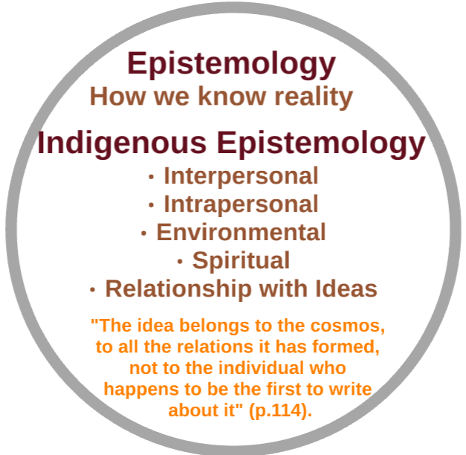
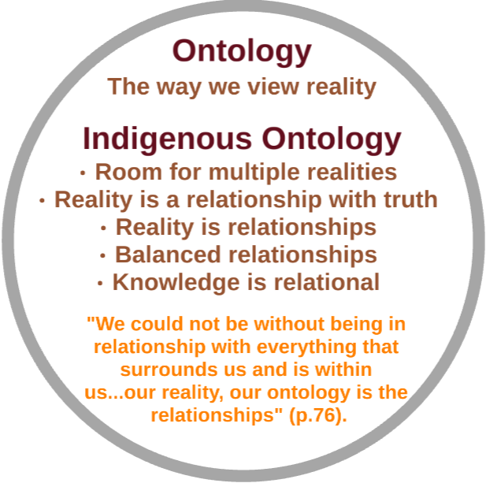
What does equitable partnerships look like in research with and by Indigenous Peoples?

Slide 12
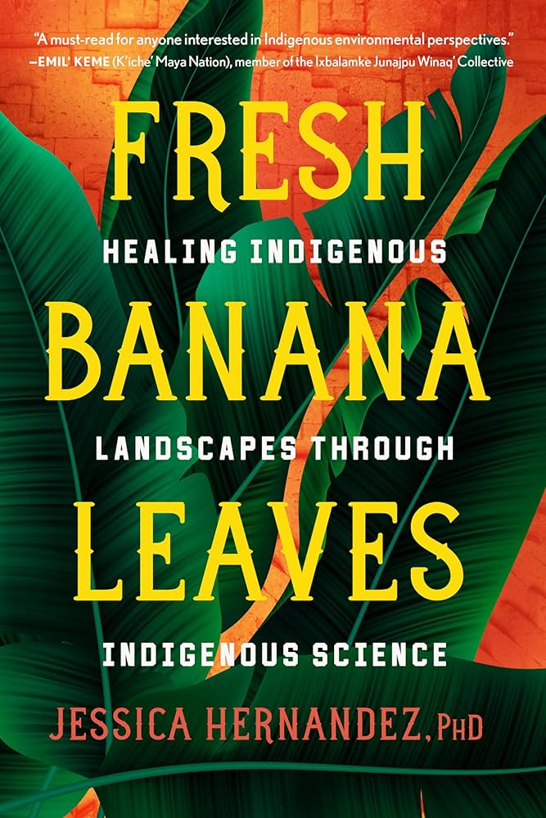
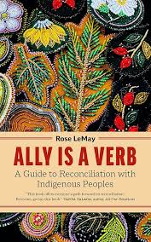
What does equitable partnerships look like in research with and by Indigenous Peoples?
Cede power and promote voice and truth-telling.
Build allyship skills.
Shape, embed and progressively hone the practice of nurturing epistemic diversity.
“Too often we are the frontline communities of the environmental, climate, food, and energy justice movements, yet when it comes to being granted a seat at the table, the table never has a reservation for us. On the contrary, we continue to have to create our own tables, but that is not where the political power sits”.

Slide 13
What have I learnt so far working in partnerships with Indigenous Peoples?

Slide 14
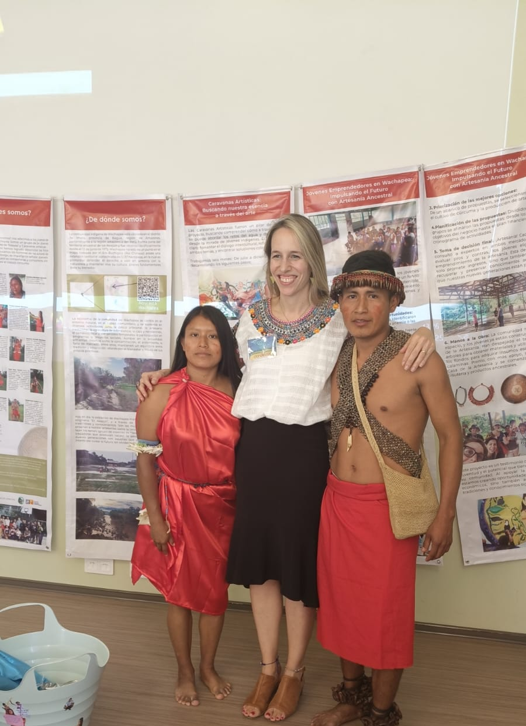
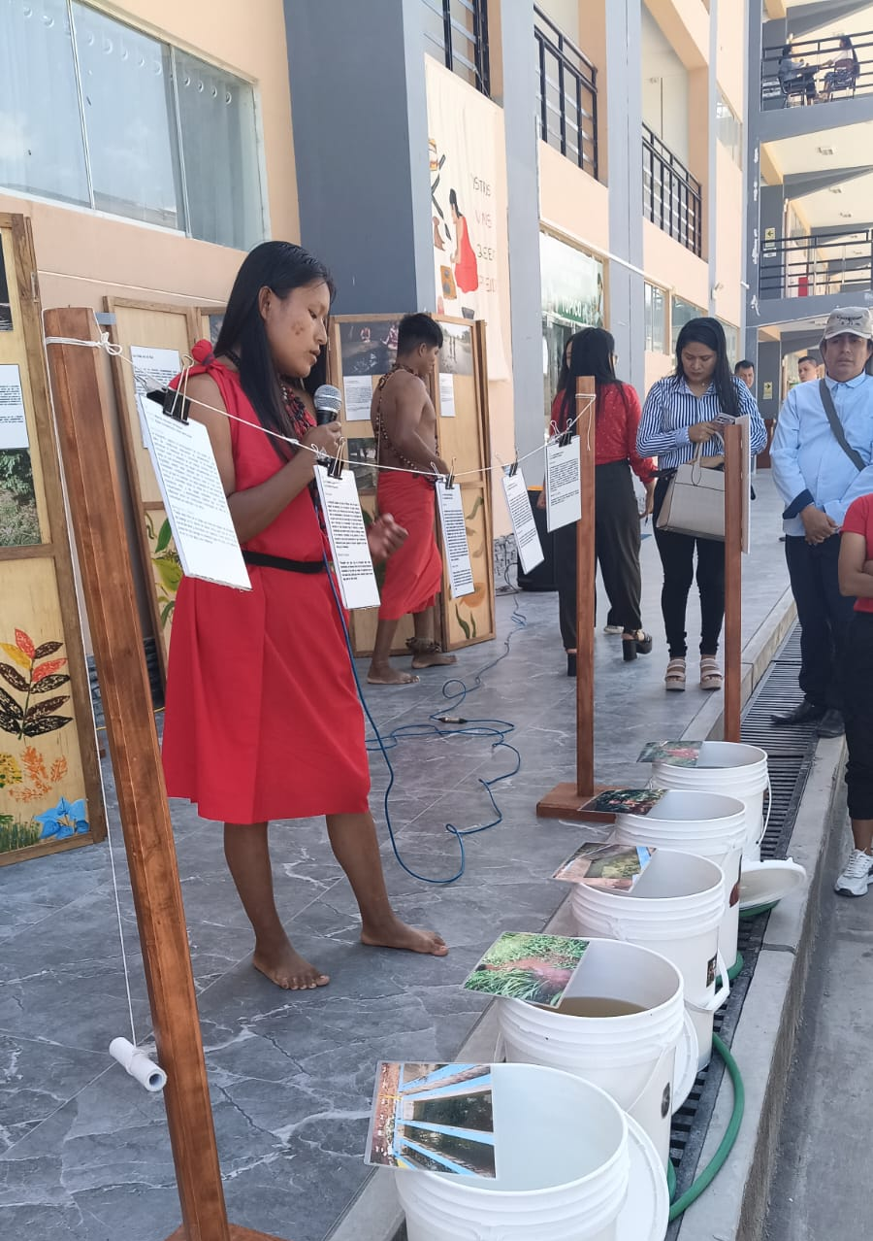
Awajun
Be prepared to re-define your concepts
Mutual benefits are co-defined.
Participants become co-researchers when you (really) step back.

Slide 15
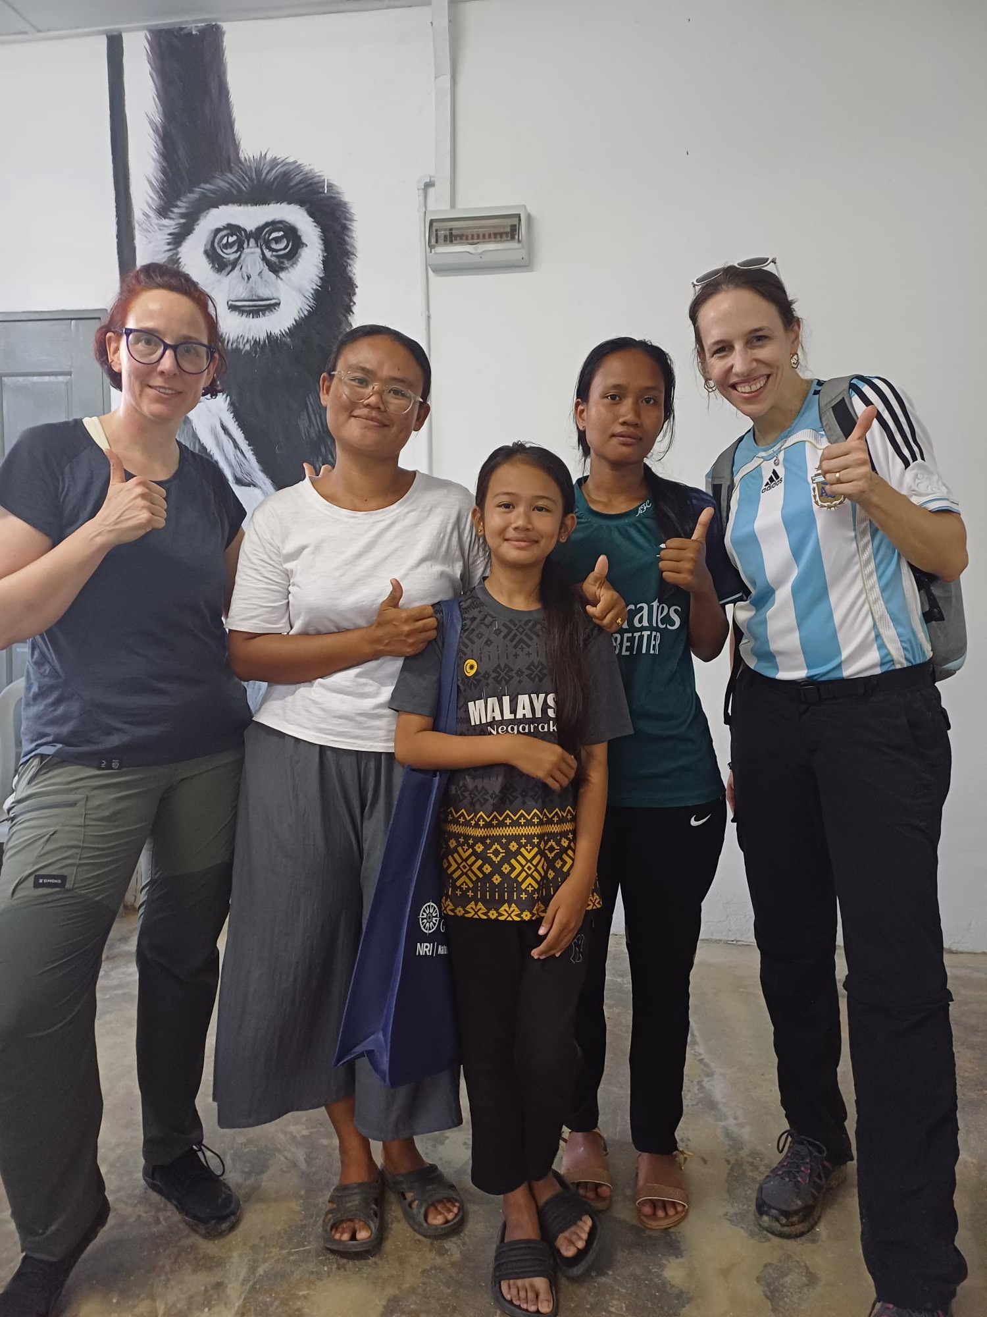
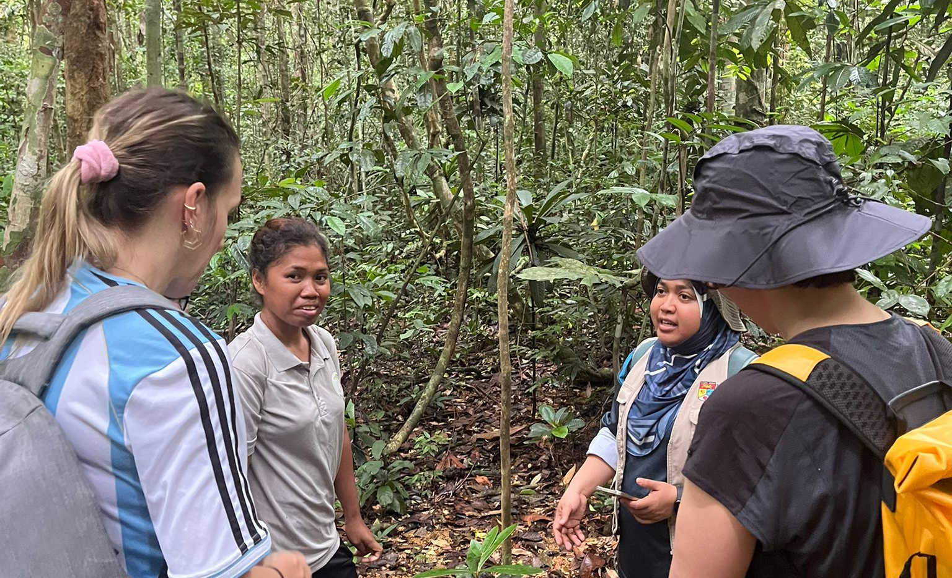
Jakun
Understand the impact of past research collaborations.
Hypocrisy and double standards in research can be really harmful.

Slide 16
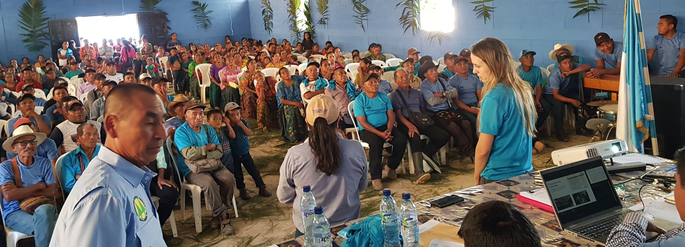
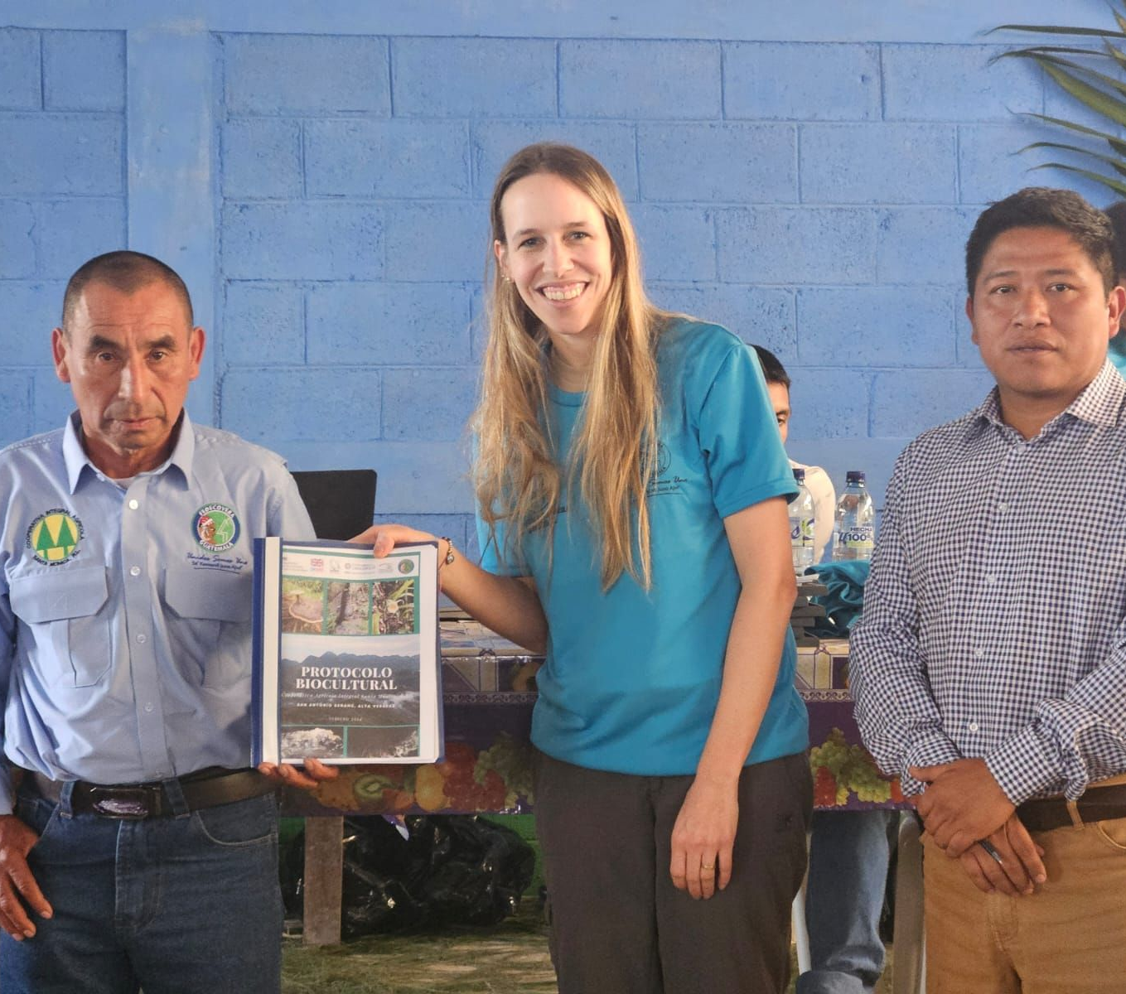
Q’eqchi
Research and data sovereignty are critical.
Push back on gate-keeping and “knowledge colonialism”.

Slide 17
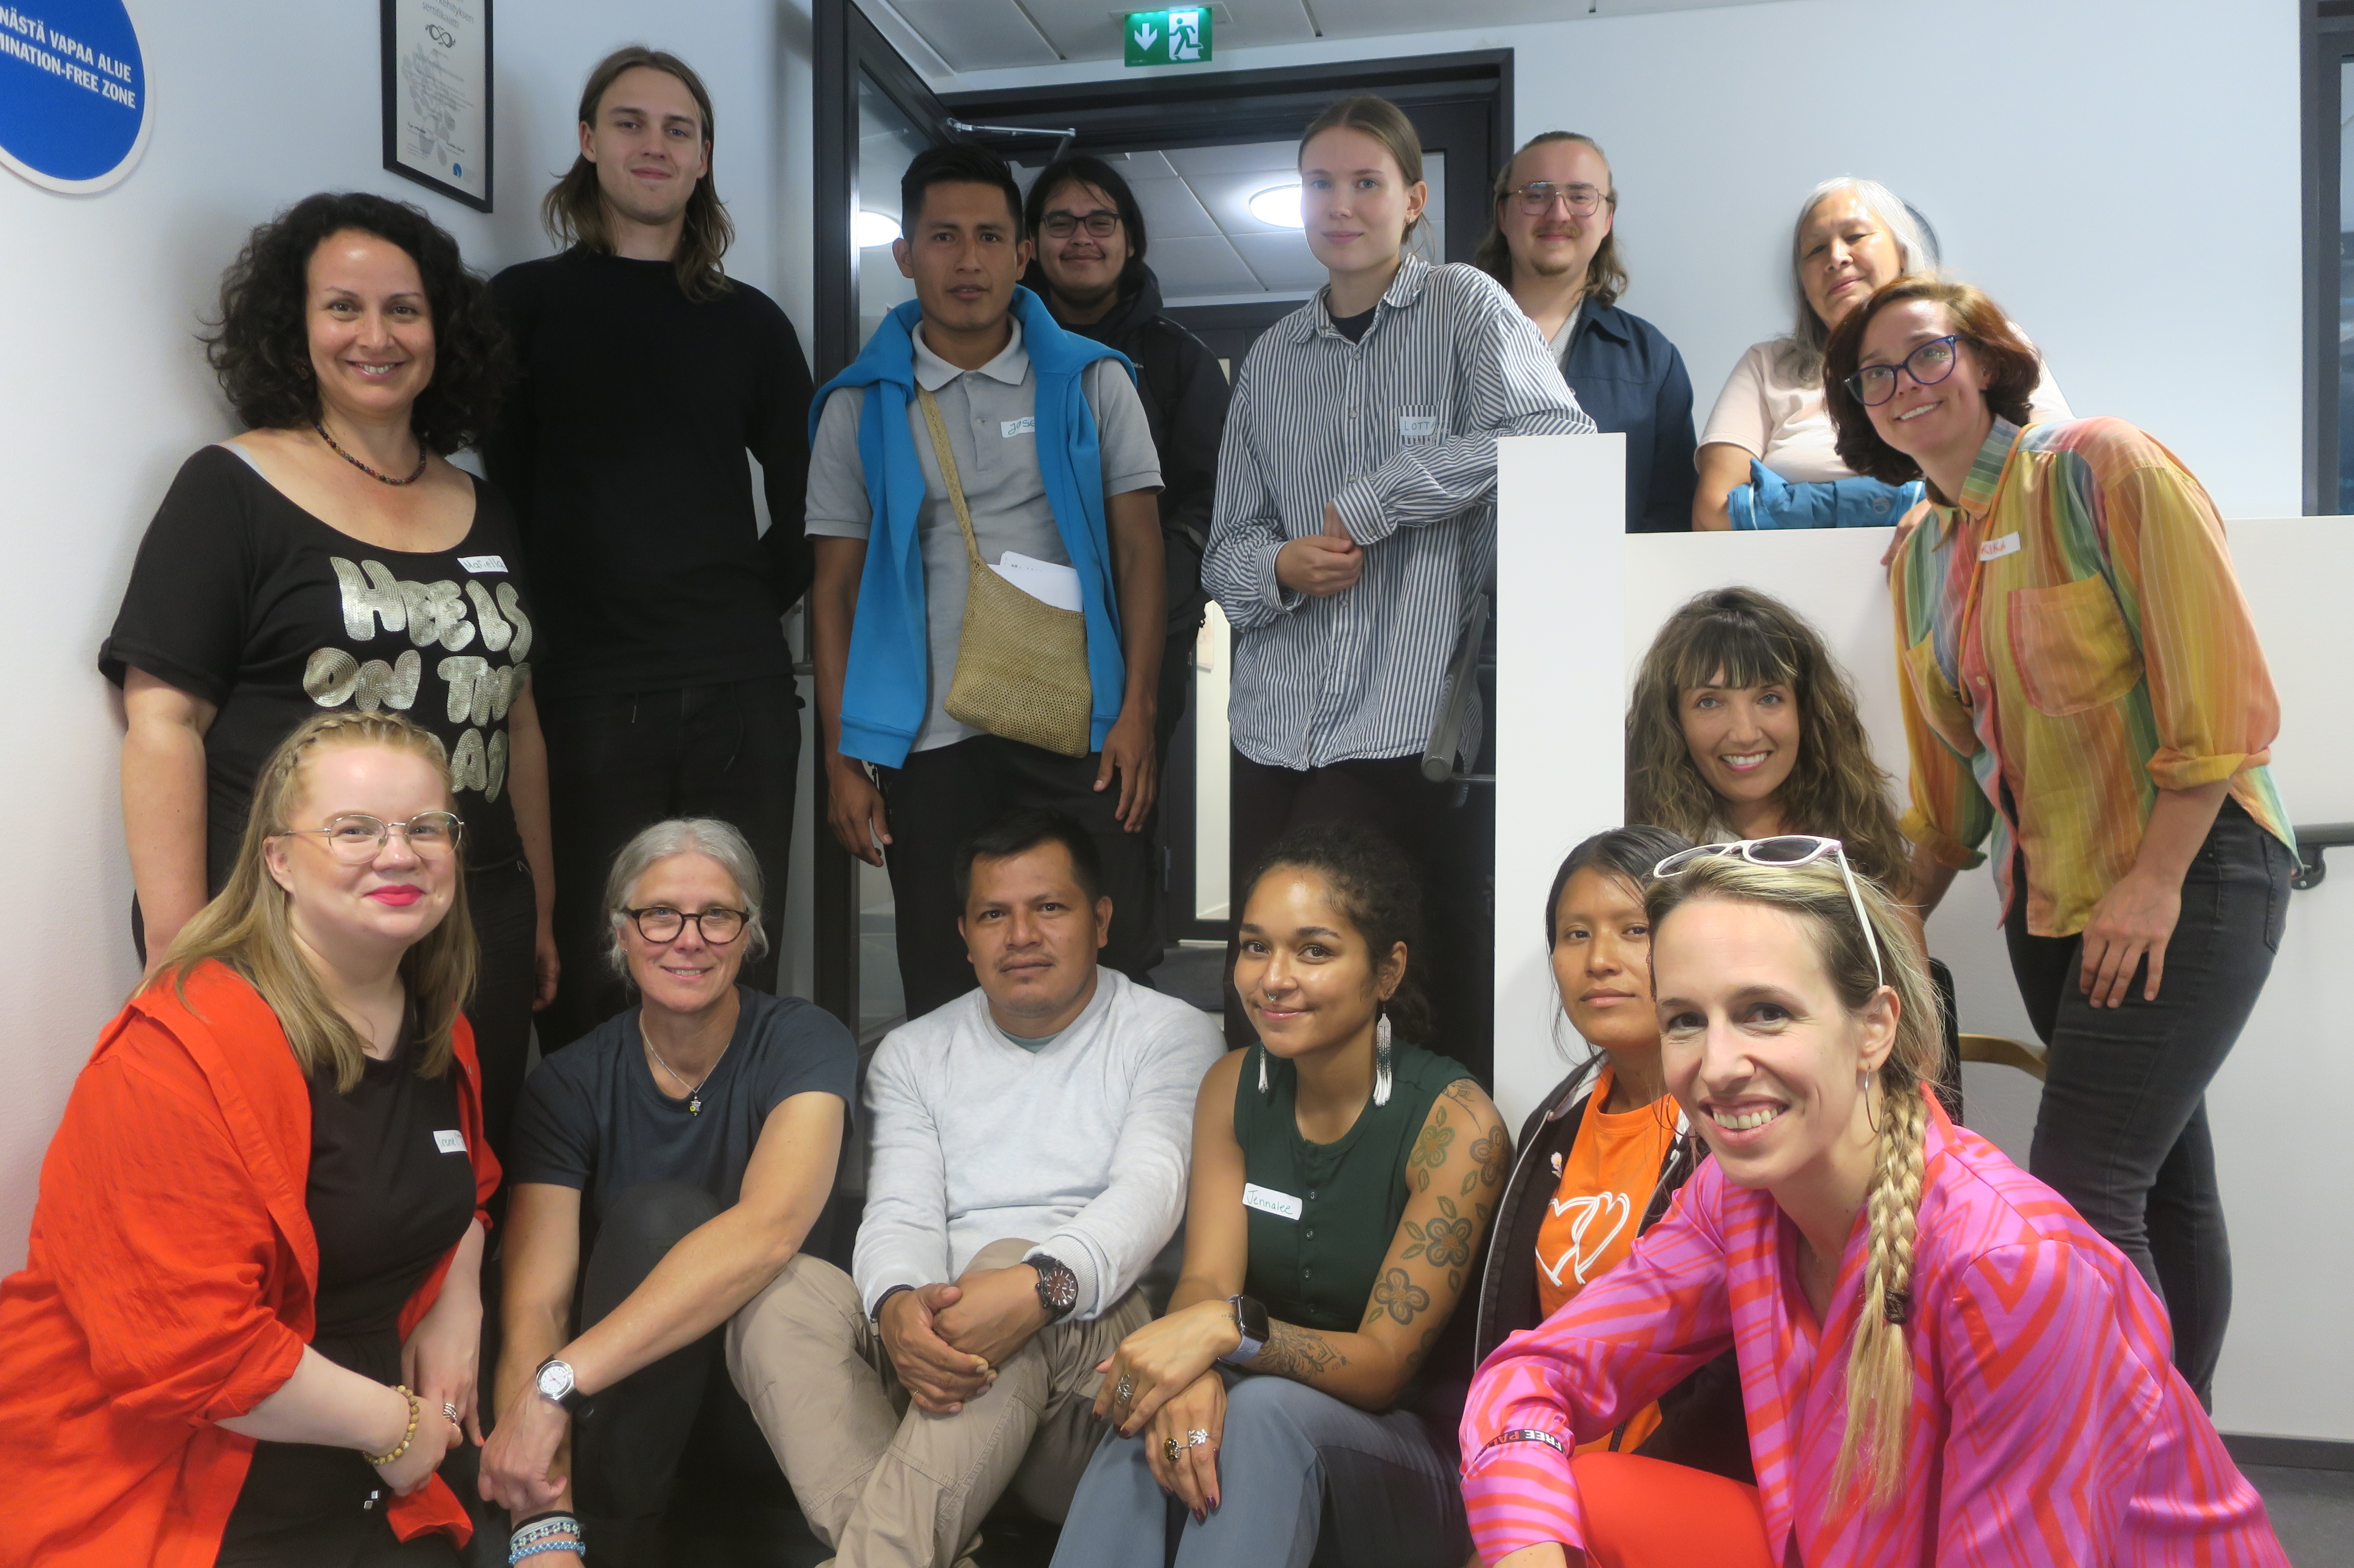
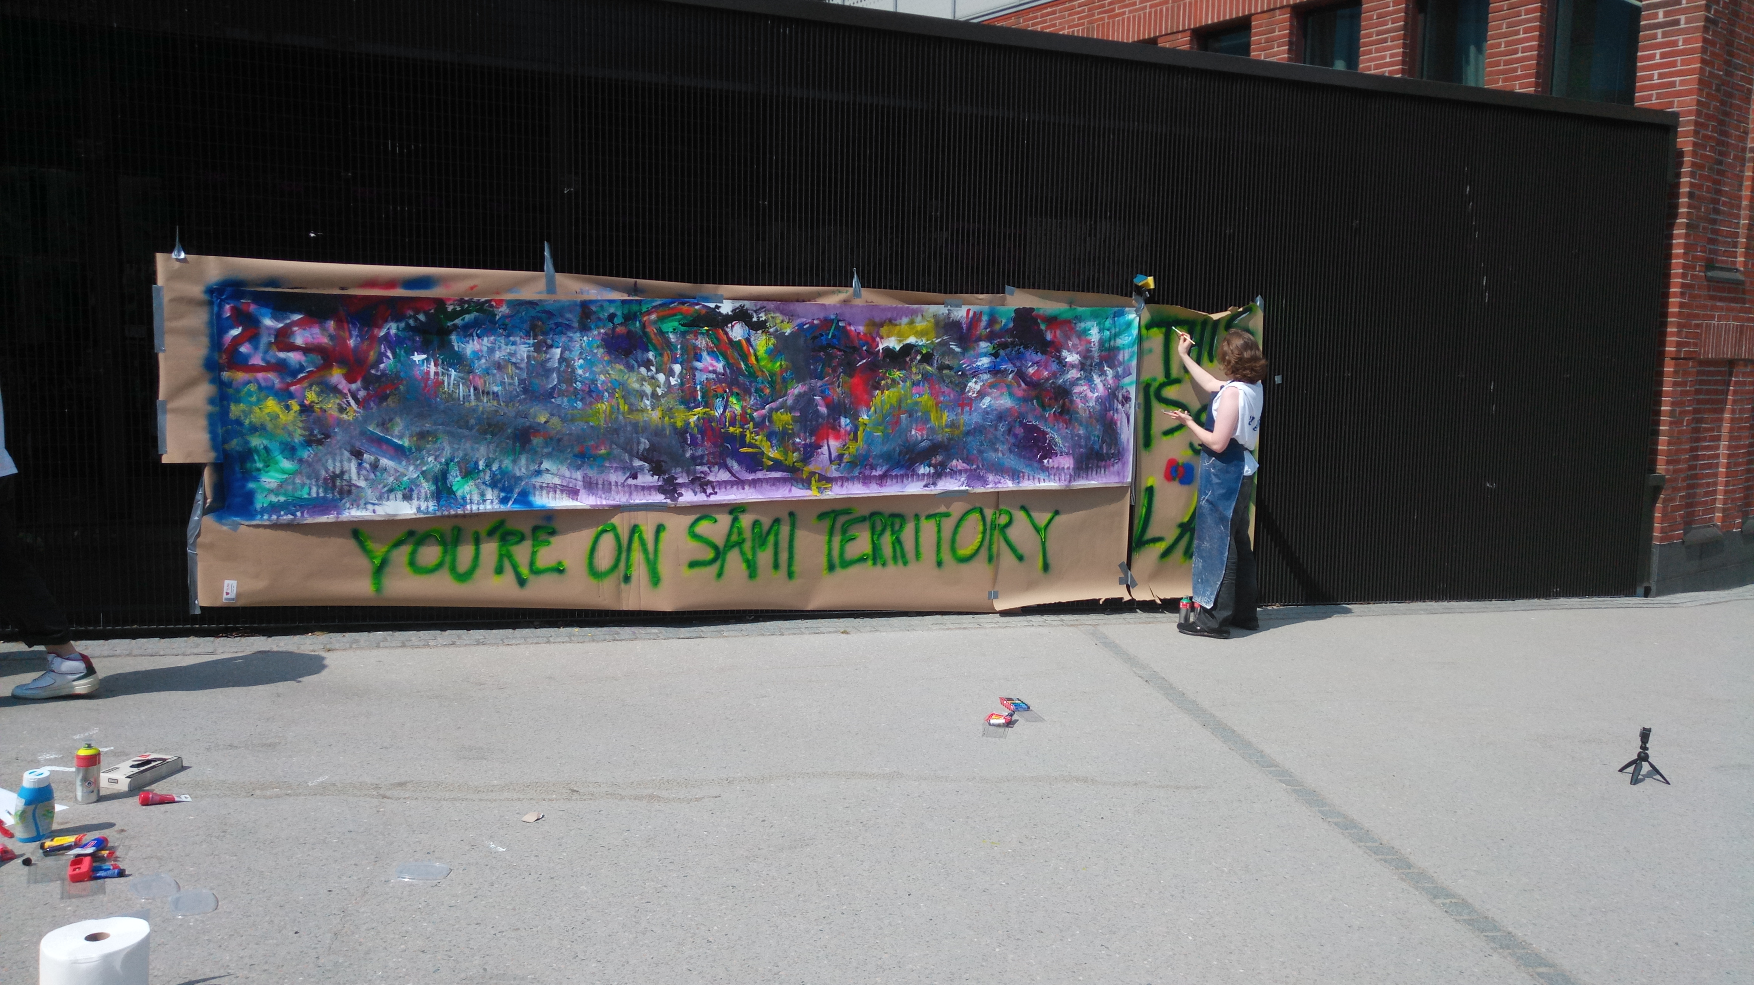
Sami
Personal engagement and Professional engagement.
Commitment vs. necessity.
What qualities can we cultivate as researchers? Conduct, positionality, humility, bravery?

Slide 18
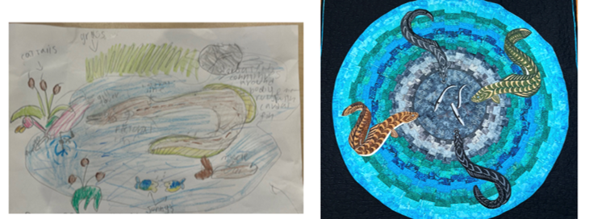
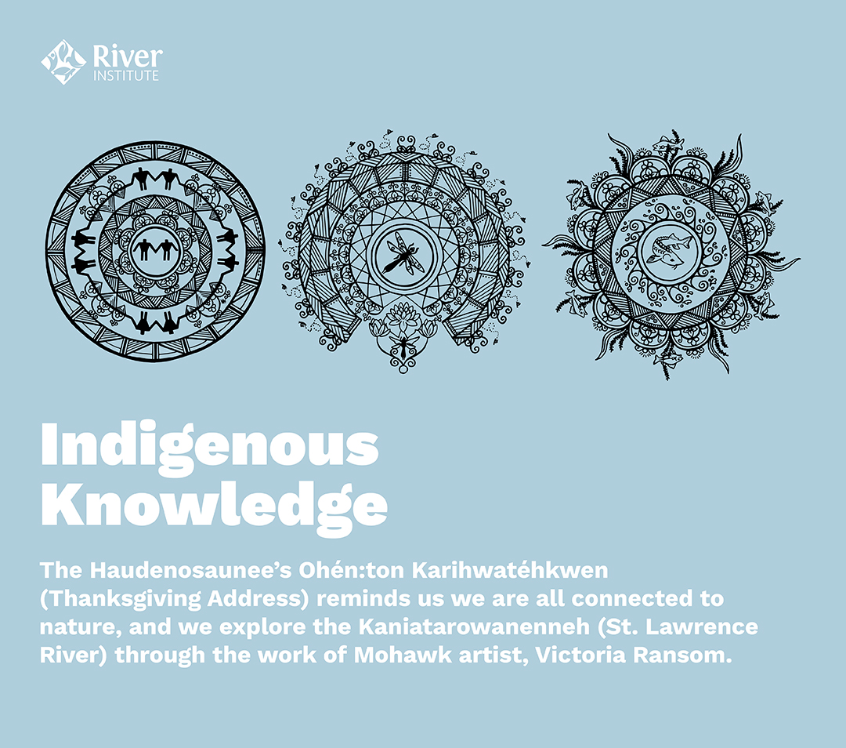
Mohawk Nation at Akwesasne
Rejection of established concepts and their foundations (e.g. “environmental management”).
Ceremonies, tranksgiving addresses and acknowledgements of country are KEY.

Slide 19
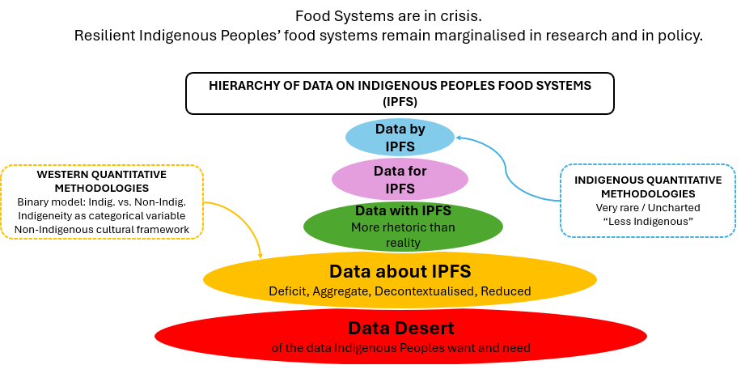
Cross-cultural
Indigenous Peoples Food Systems’ statistics: nurturing epistemic diversity in the configuration of quantitative data for the right to foods (IP-STATS)

Slide 20
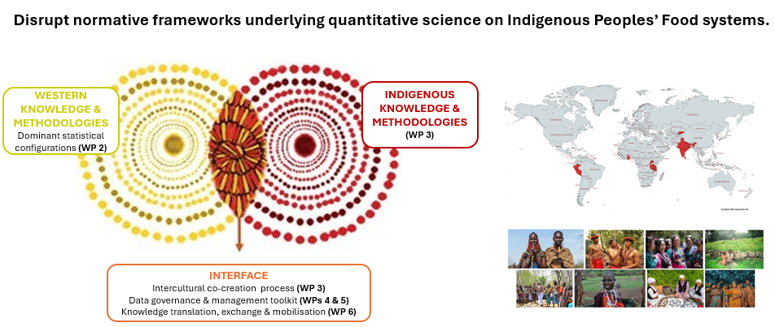
Cross-cultural
Indigenous Peoples Food Systems’ statistics: nurturing epistemic diversity in the configuration of quantitative data for the right to foods (IP-STATS)

Slide 21
Final recommendations
Lend your voice, influence and privilege (we can’t wait for governments to lead!)
Get comfortable with discomfort
Find hope (however you can!)

