Slide 1
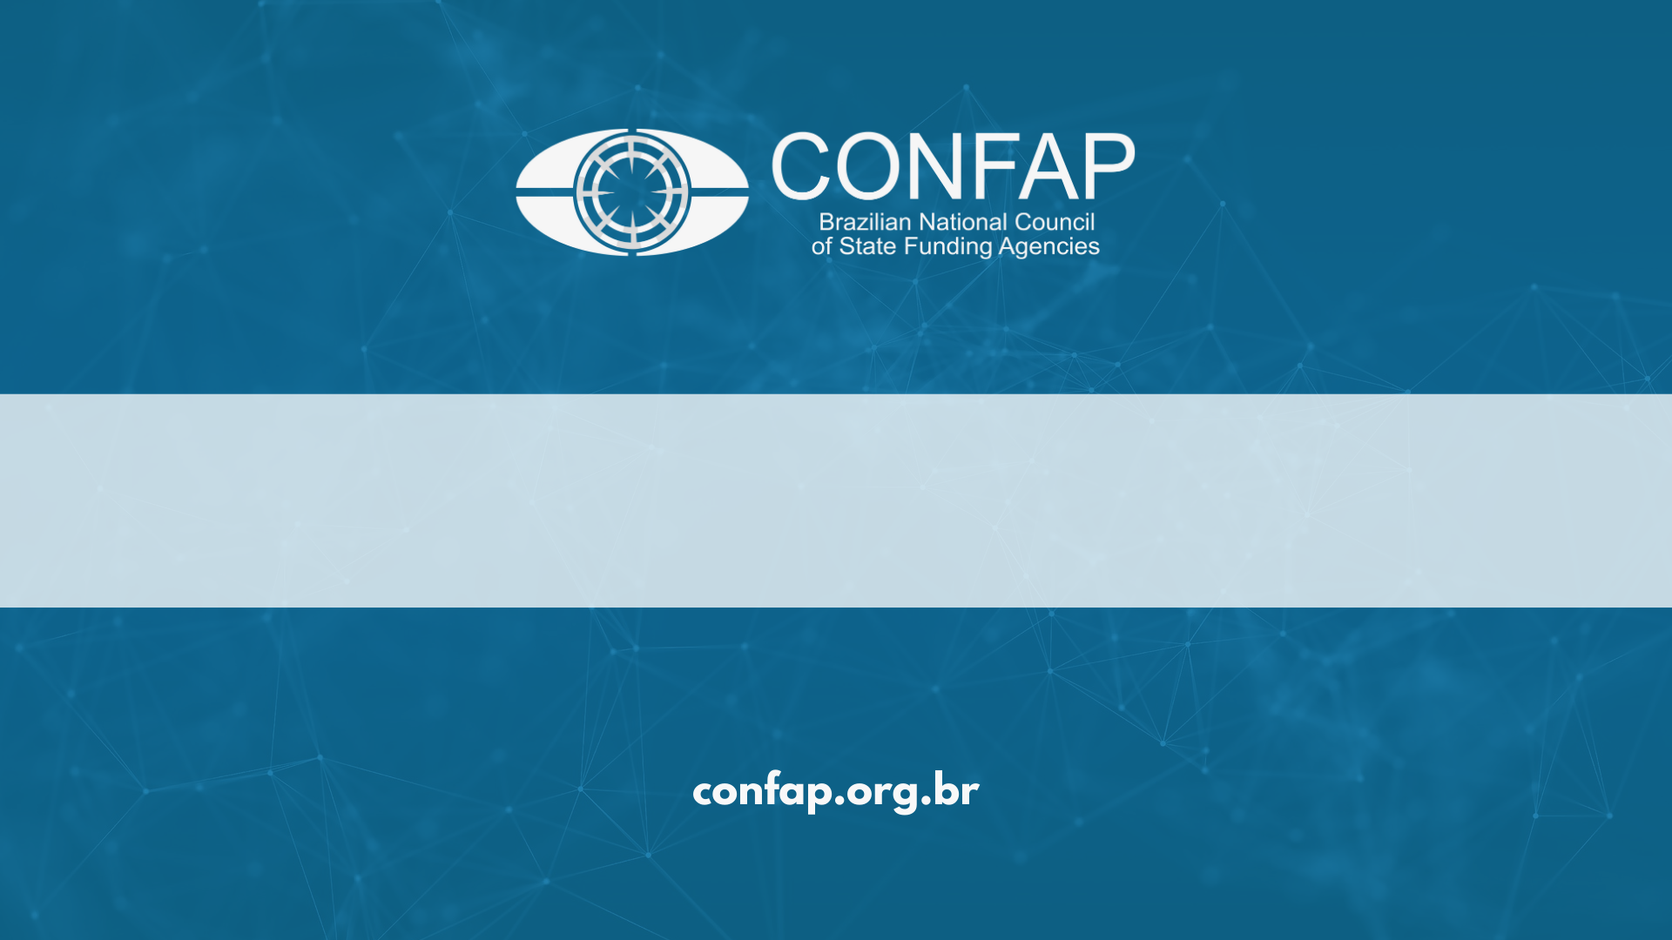
Towards More Equitable International Research Collaboration: Engaging State Funding Agencies in Brazil
February 05th, 2026

Slide 2

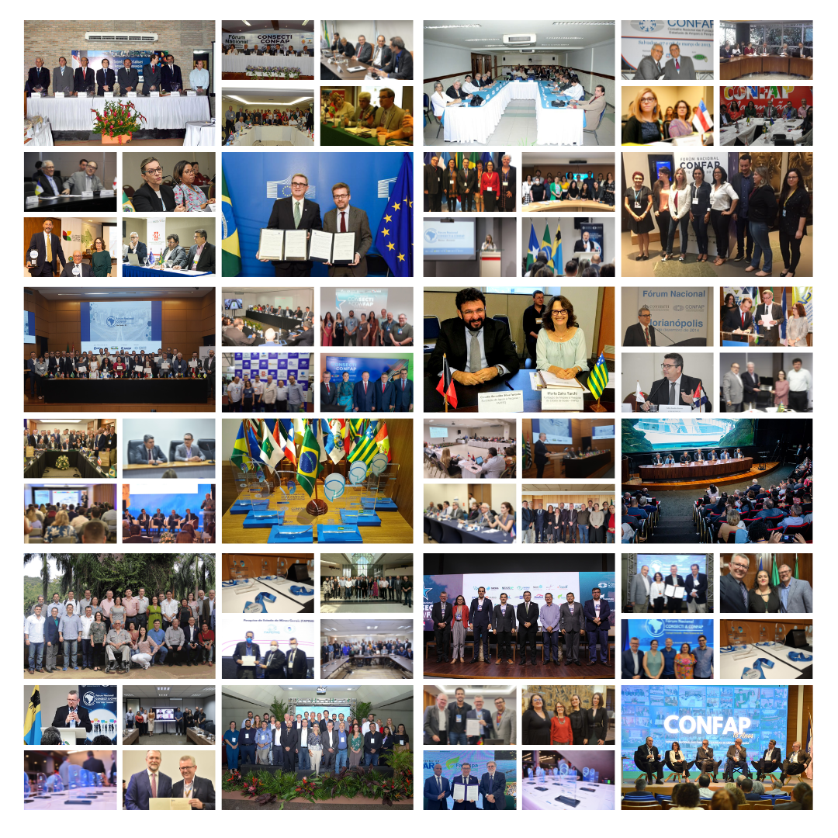
CONFAP
The Brazilian National Council of State Funding Agencies (CONFAP) is a non-profit organization that aims to promote better coordination among State Funding Agencies in the areas of scientific research, technology, and innovation in Brazil.
It was established on April, 28th, 2026, bringing together 27 State Funding Agencies (FAPs) and acts as an active member of the Brazilian System of Science, Technology, and Innovation (SNCTI).

Slide 3
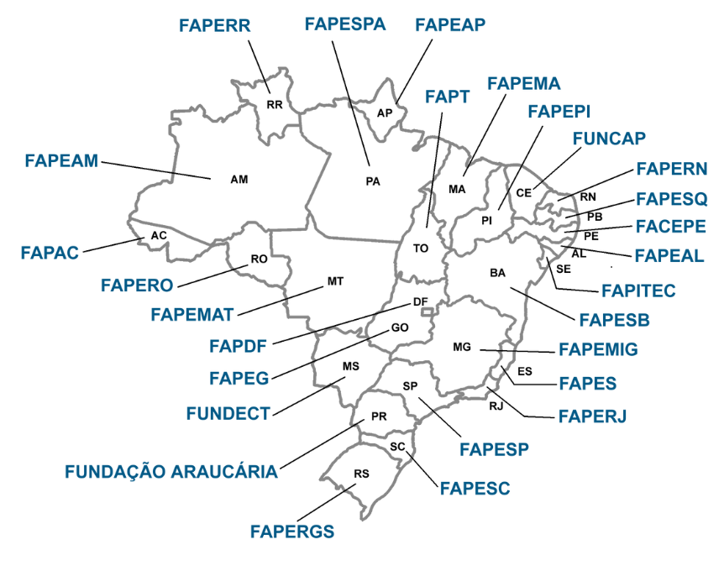
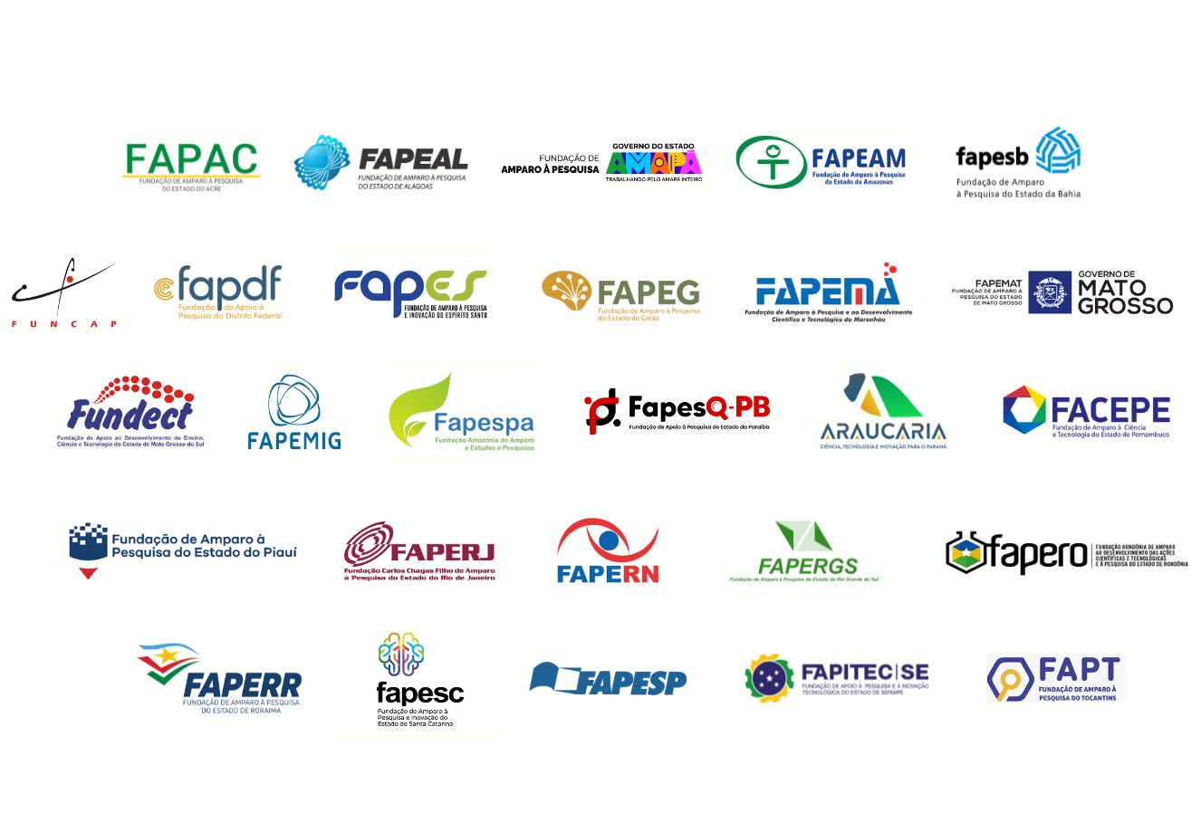
STATE FUNDING AGENCIES (FAPs)

Slide 4
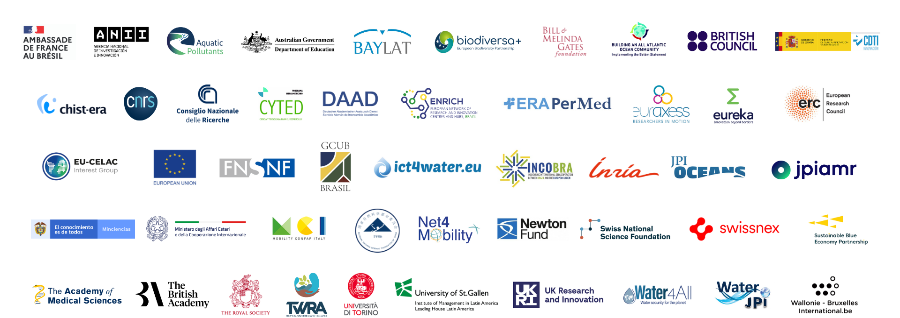
INTERNATIONAL PARTNERS

Slide 5





STRENGTHENING LONG-TERM EQUITABLE PARTNERSHIPS TO ENABLE GREATER INTERNATIONAL COOPERATION IN RESEARCH
Project supported by the British Academy – Equitable Partnerships Workshops Follow-On Call
Coordination: Fundação Getúlio Vargas, Brazil (Goret Pereira Paulo - Applicant) and CONFAP – Brazilian National Council of State Funding Agencies (Maria Zaira Turchi - Co-Applicant);
Other Participants: BRAMA – Brazilian Association of Research Managers and FINEP.
Objectives
Advance equitable partnerships in international research cooperation by strengthening institutional capacity and fostering strategic alignment among key stakeholders in Brazil;
Contribute to a more inclusive, transparent, and sustainable global research ecosystem, fostering long-term improvements in research collaboration practices.

Slide 6
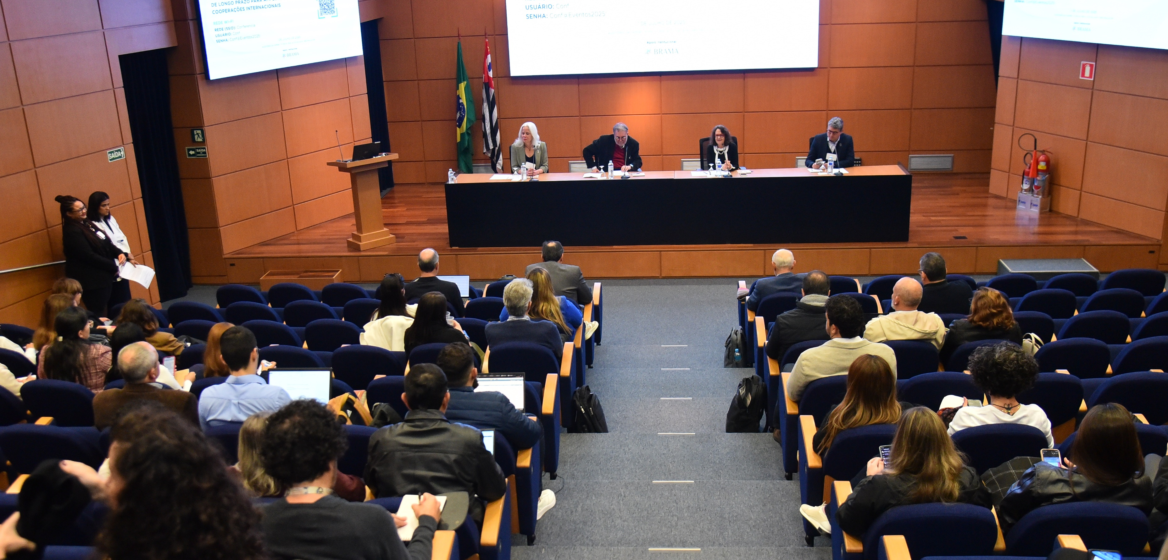
STRENGTHENING LONG-TERM EQUITABLE PARTNERSHIPS TO ENABLE GREATER INTERNATIONAL COOPERATION IN RESEARCH
Workshop Dynamics
Topics: Equitable Partnerships in Research Cooperation and Research Development Officers (RDO);
Presentations of UK and Brazilian representatives on the key topics (online and in-person);
Group Discussions;
Plenary Session.
Audience/Representatives
Brazilian Federal Agencies of Science and Innovation;
Brazilian Academy of Science (ABC);
State Funding Agencies;
Researchers from State, Federal, and Private Universities;
Representatives of International Relations Offices.
Speakers – UK
British Academy, UKRI, British Council and 4Science.
Speakers – Brazil
CONFAP, FGV, FAPESP, Araucária Foundation, BRAMA, Finep, Capes, ABC, PUC/PR and Fiocruz.

Slide 7



DATES AND VENUES IN BRAZIL
Workshop nº 01:
FAPESP (State of São Paulo)
July 1st, 2025
Workshop nº 02:
Fundação Araucária (State of Paraná)
September 3rd, 2025
Workshop nº 03:
FIOCRUZ (State of Bahia)
December 1st, 2025

Slide 8
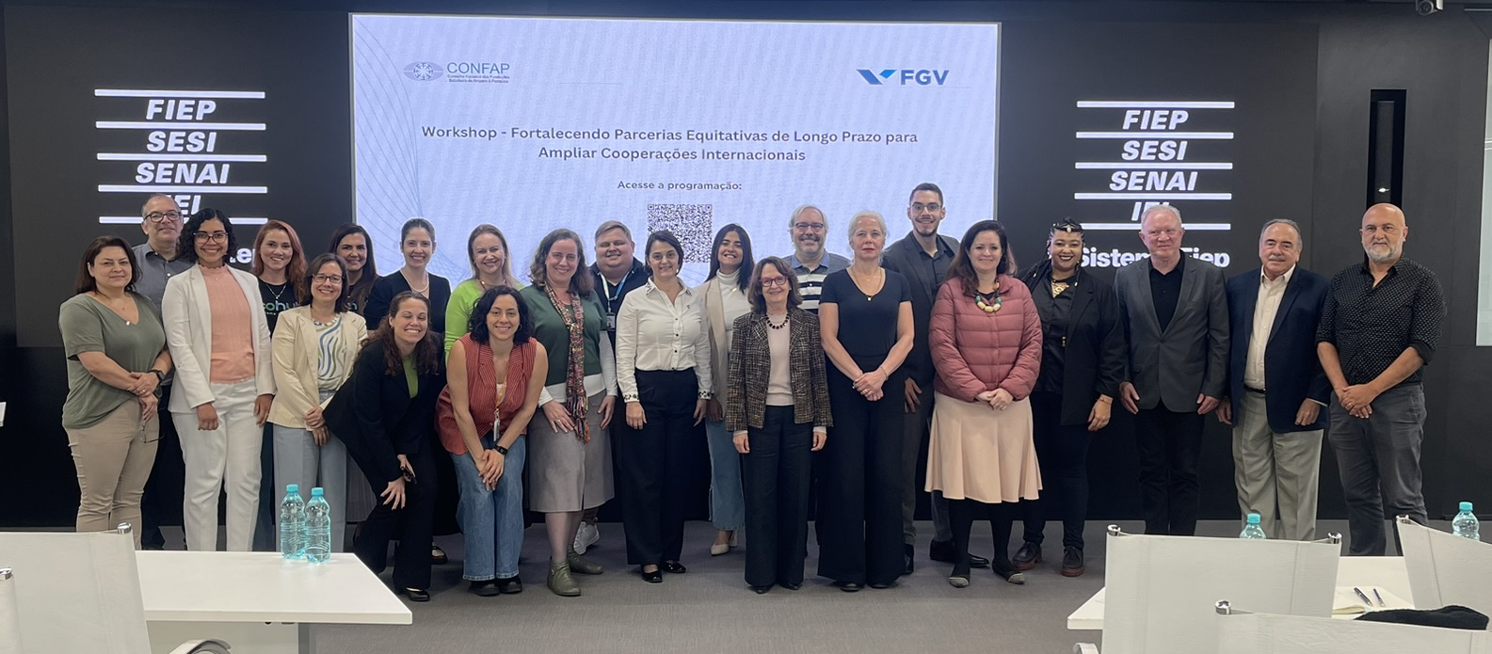
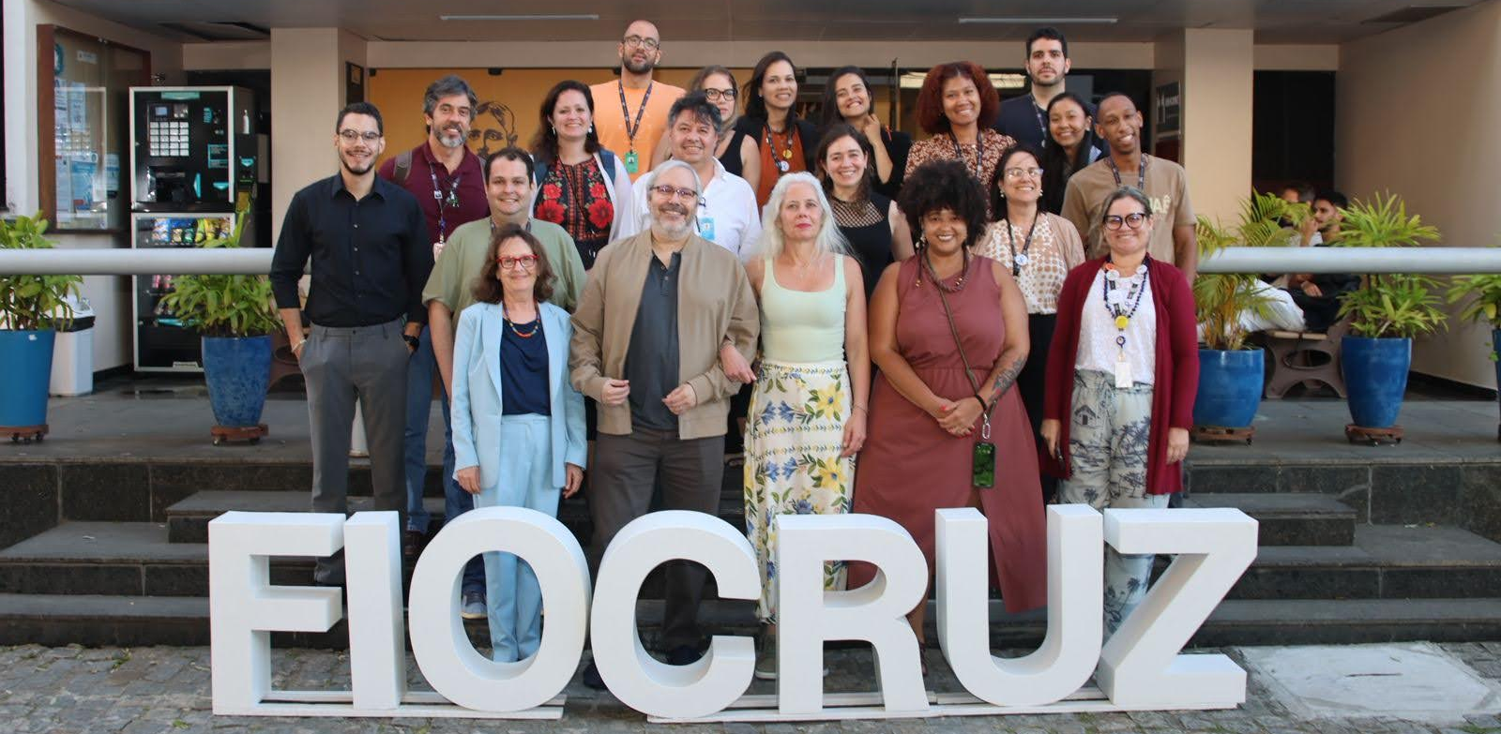
WORKSHOPS – MAIN APPROACHES
Presenting and discussing principles of equitability in international research cooperation;
Mapping regional strengths and challenges in international collaboration in R&D;
Identifying key strategies to support equitable partnership from the perspective of Funding Agencies;
Mapping the existence and role of RDOs in Brazilian institutions;
Inclusiveness ensuring regional perspectives, facilitating dialogue between researchers, funders, and governance bodies for policies towards more equitability in research.

Slide 9
WORKSHOPS – CHALLENGES & STRENGTHS
Challenges
Asymmetries of power in national and international research collaborations;
Complexity of funding arrangements;
Gaps in ensuring fair and equitable research partnerships, including challenges related to mutual accountability and the sharing of benefits;
Budgetary difficulties and discontinuity in funding;
Ensuring long-term sustainability;
Bureaucracy and legal frames from different parties.
Strengths
Diversity of Brazilian regions;
Active international research networks;
International interest to establish partnerships with Brazilian institutions and researchers;
Well-established universities and research institutions.

Slide 10
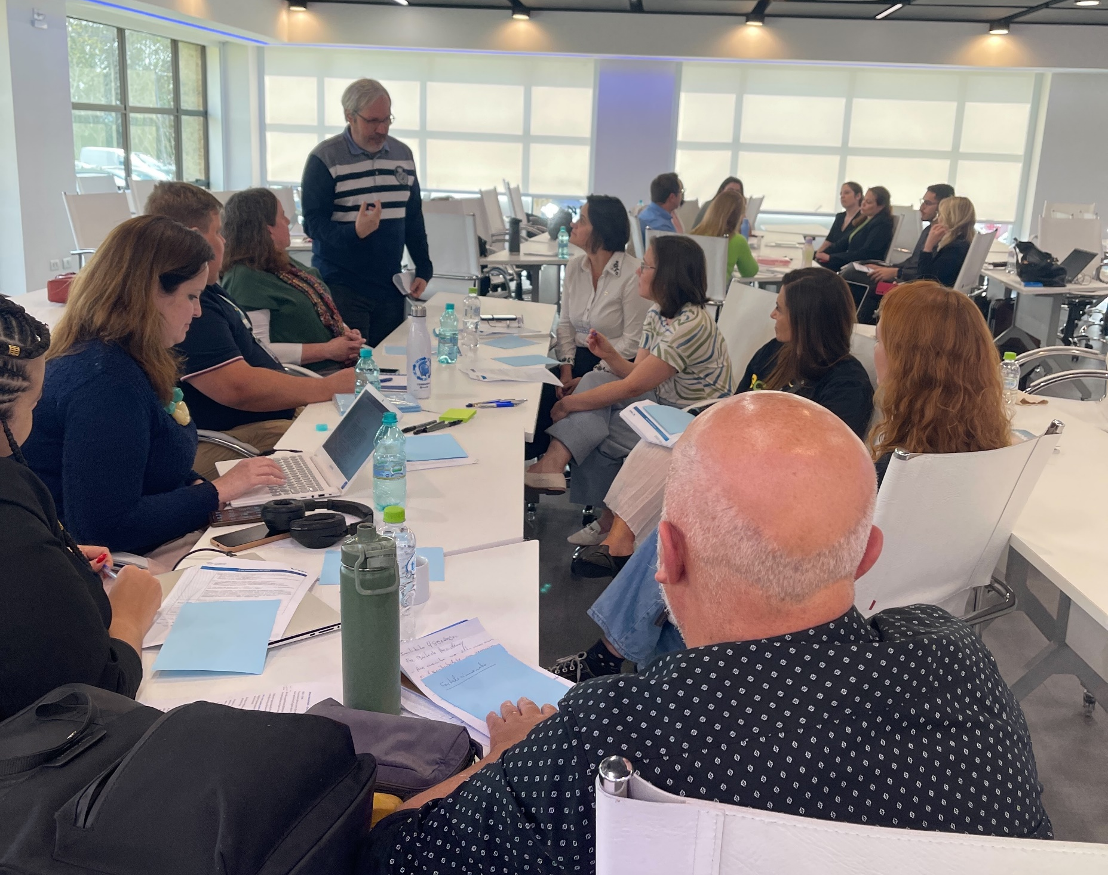
WORKSHOPS – KEY OUTCOMES
Importance of institutional support structures as enablers of equitable and sustainable international research partnerships;
Integration of equitable partnership principles into institutional policy and practice;
Increased policy-level visibility of Research Development Offices (RDOs);
Strengthened recognition of research managers as key actors in research governance.

Slide 11

EXAMPLE OF EQUITABILITY IN INTERNATIONAL COOPERATION:
AMAZON + 10 INITIATIVE
Scope
Initiative coordinated by CONFAP which supports research and technological innovation across the States of the Legal Amazon, fostering nature - society interactions and sustainable, inclusive development.
International participation
Engages international partners including BAYLAT (Germany), SNSF (Switzerland), the British Council (UK) and UK Research and Innovation – UKRI (NERC and AHRC), and remains open to expanded international participation.
Equitability – examples of inclusive cooperation:
Projects are implemented through research consortia that include holders of traditional territorial knowledge, ensuring the participation of Indigenous Peoples, Quilombolas and other Traditional Communities (PIQCTs).

Slide 12
CONFAP – THE NEW INSTITUTIONAL APPROACH IN BRAZILIAN ST&I SYSTEM
CONFAP plays a central governance role in articulating and coordinating Brazil’s 27 State Research Funding Agencies:
Building fair and equitable partnerships towards common goals;
Co-designing programmes for effective and intercultural research collaboration;
Establishing mutual responsibility and shared benefits for all partners;
Creating an enabling environment for effective research collaboration;
Contextualising scientific knowledge through strategic brokering;
Sharing best practices to reduce barriers and bureaucracy and improve the use of funding resources;
Fostering capacity building in research management;
Promoting equity in research through national and international partnerships and funding mechanisms.

Slide 13
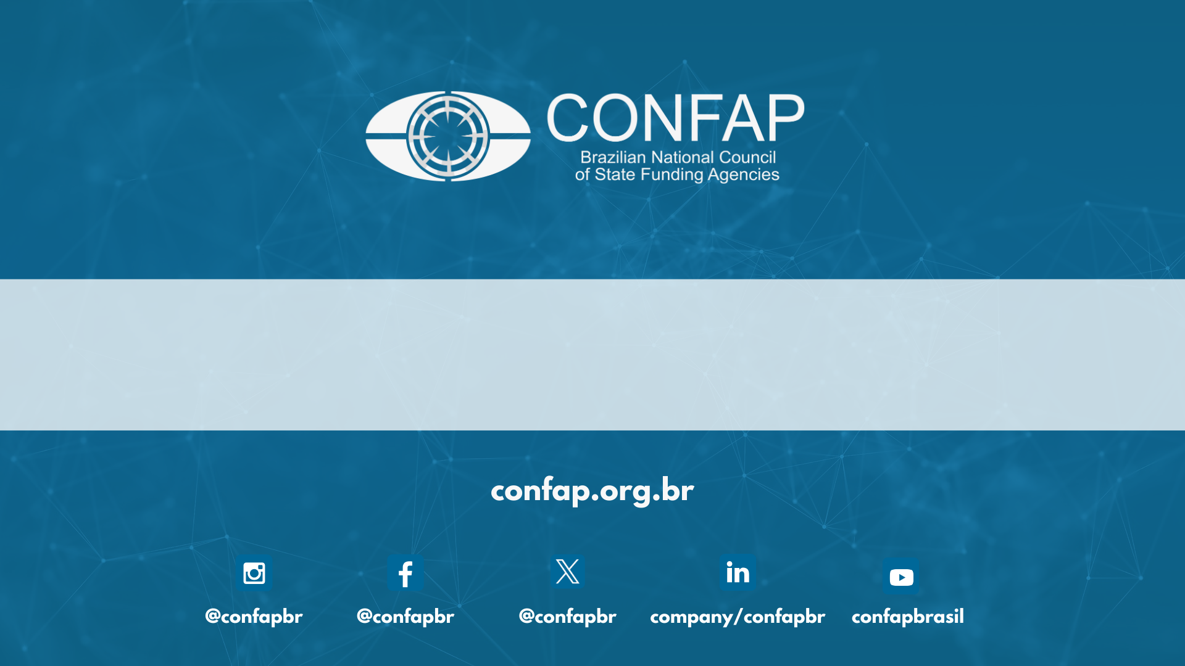
Thank you!
Maria Zaira Turchi, Director for International Cooperation
Flávia Cerqueira, Advisor of International Cooperation

