Slide 1
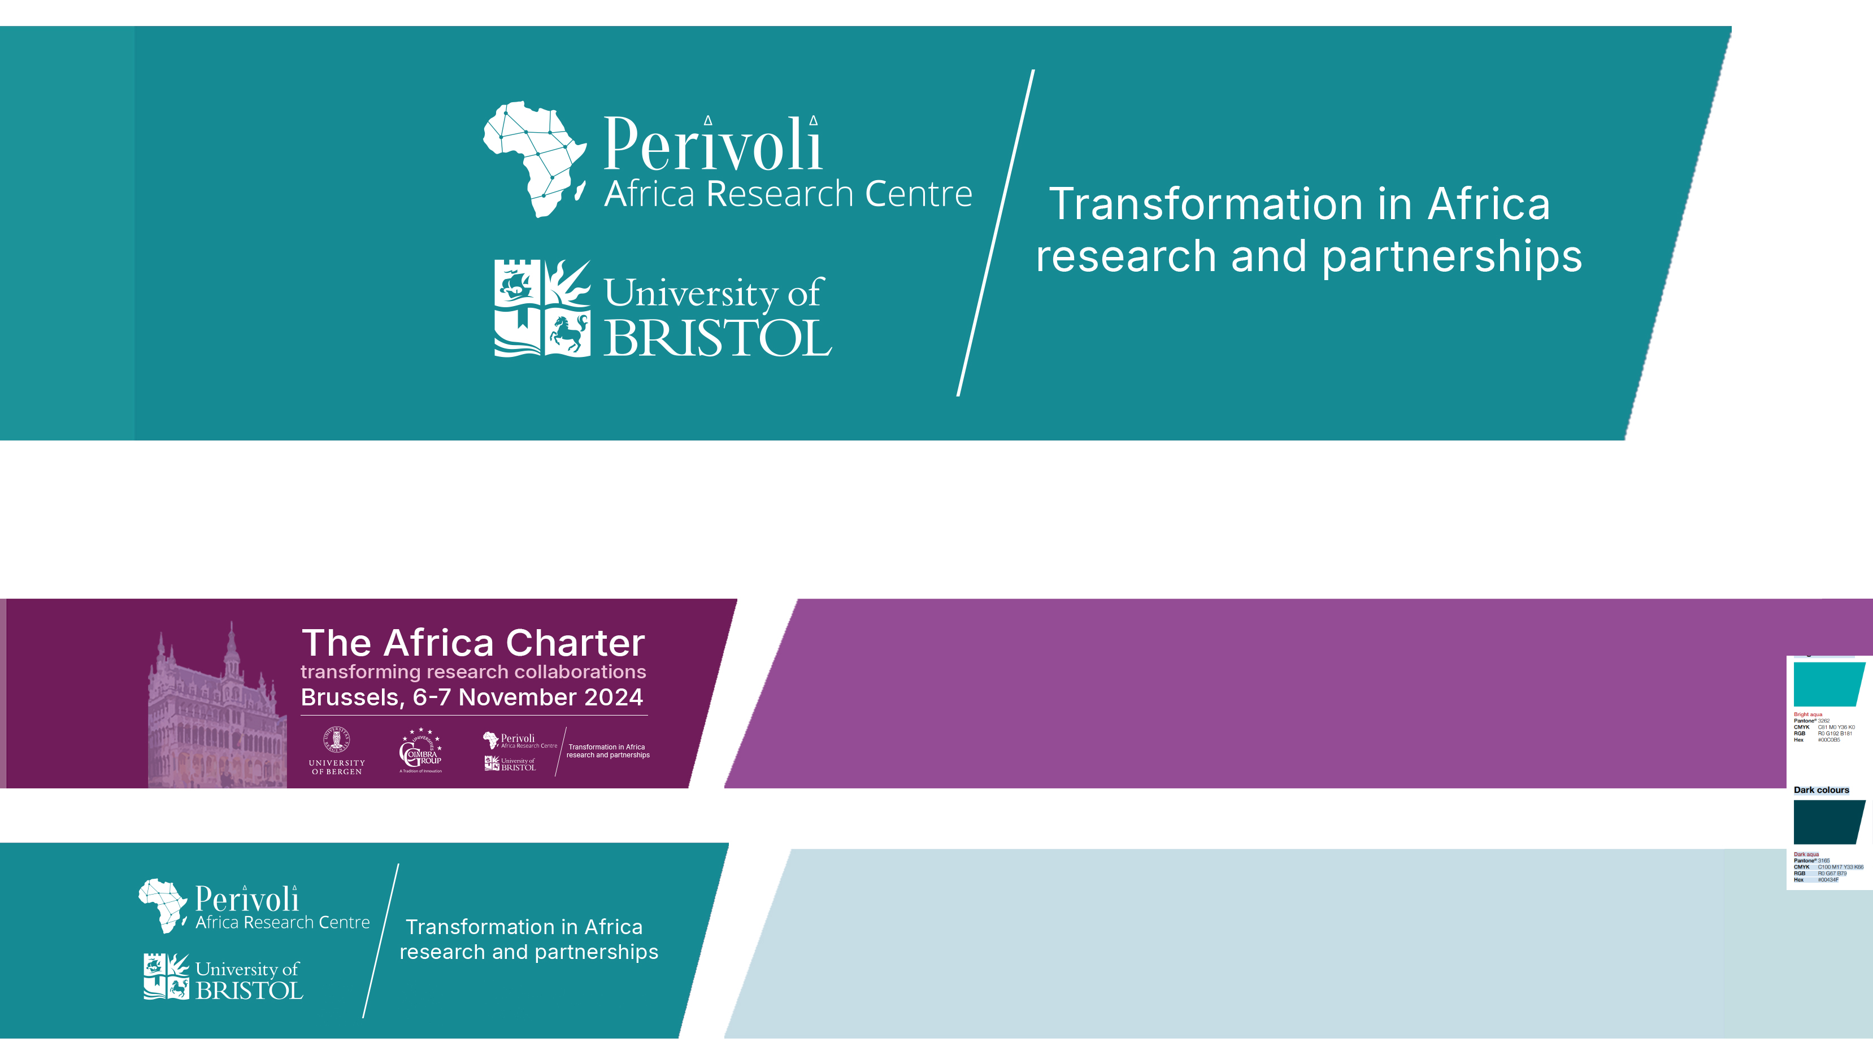
Putting Transformative Partnership Working into Practice: A Case Study of a Research-Intensive Northern University
Leon Tikly, Isabella Aboderin and Nina Ockendon-Powell

Slide 2
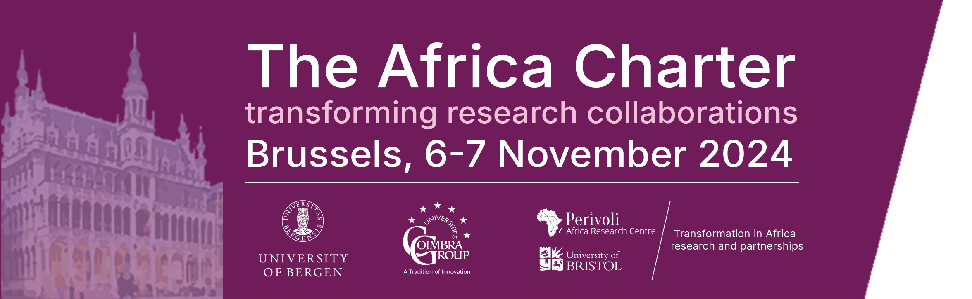
Background to the Africa Charter
2000s–2010s
Intellectual foundations
African & decolonial scholarship
2020–2021
Agenda formation
Led by UNISA (Luthuli Chair),
UCT (HUMA), Bristol (PARC)
2021–2022
Pan-African co-creation
ARUA, CODESRIA, AAS,
AAU, IUCEA, AWAU
Jan 2023
Accra consolidation meeting
Hosted by AAU
July 2023
Official launch of
Africa Charter
2023–Present
Institutional uptake & practice
African universities & networks

Slide 3
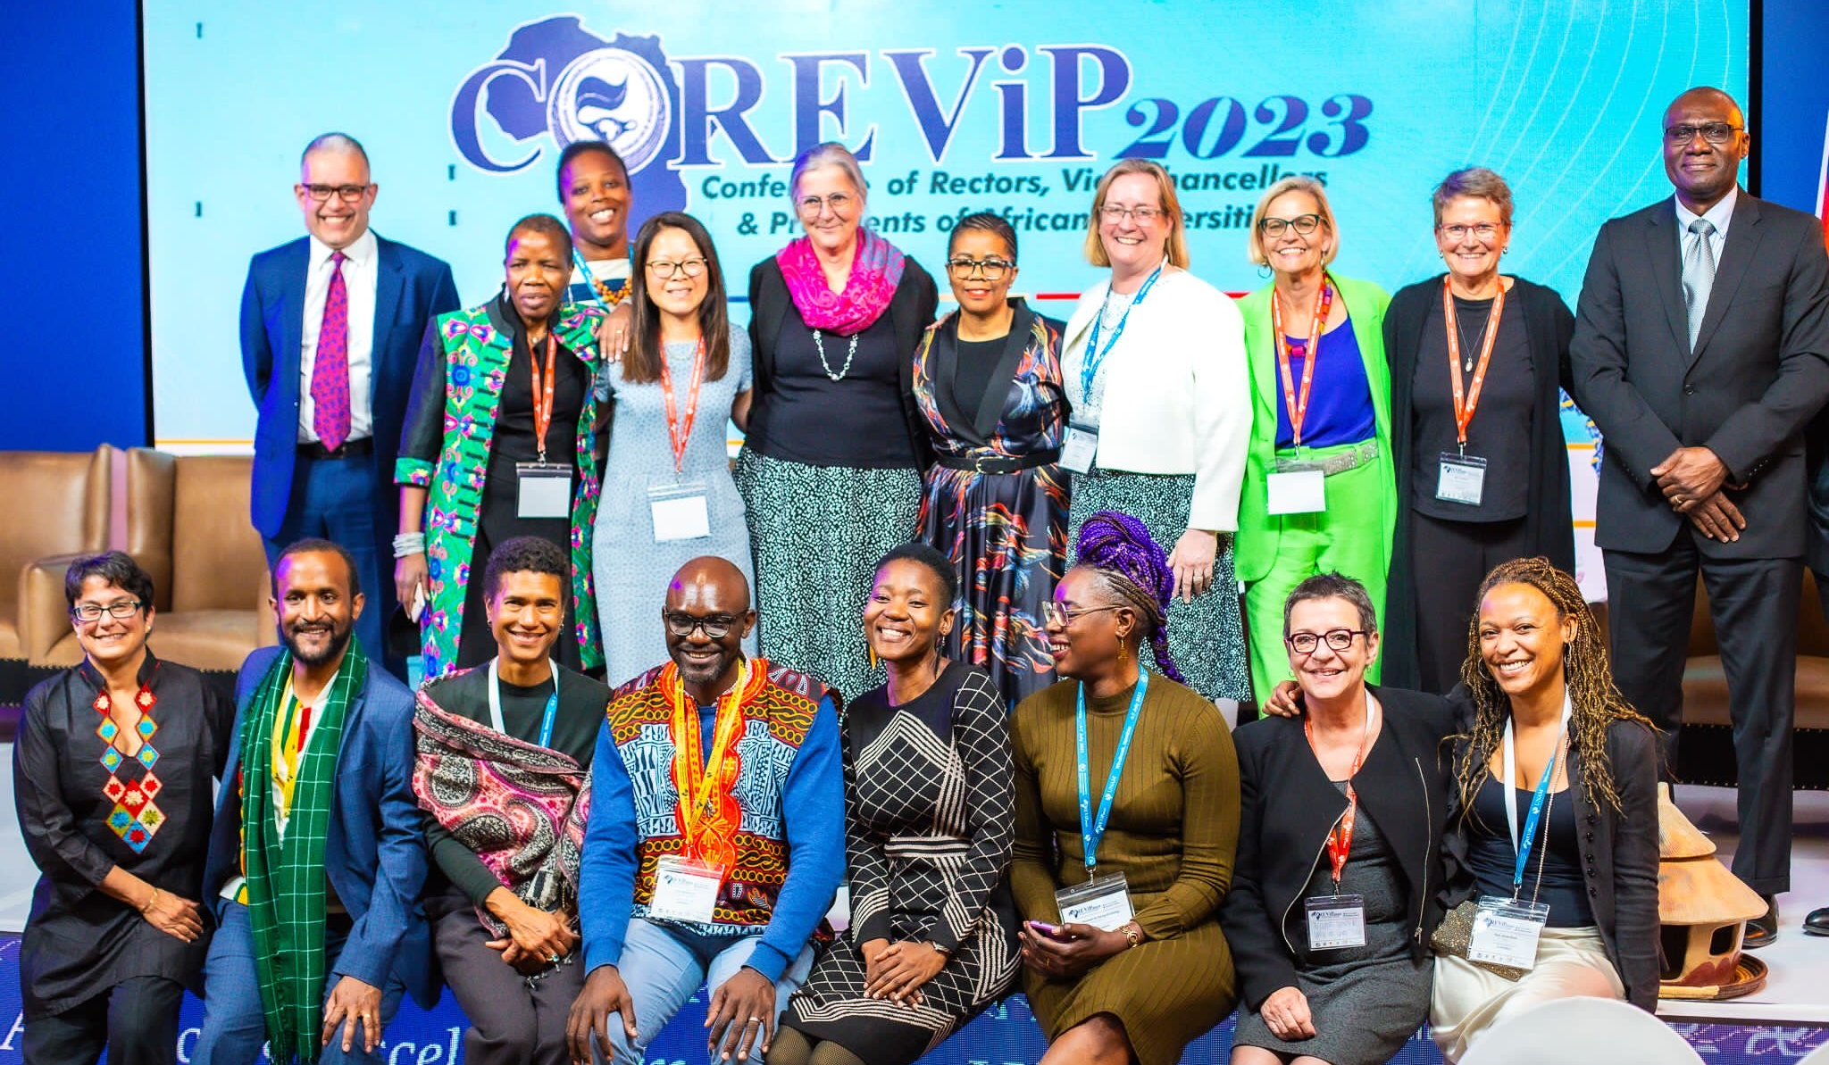

Slide 4
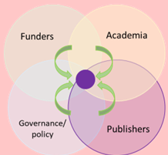
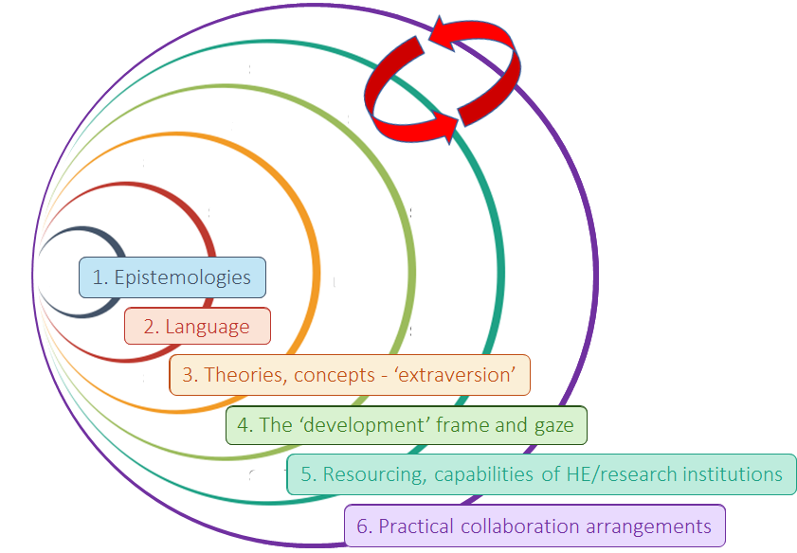
Layers of imbalance in Global North–Africa Research Partnerships
To be transformative, research collaborations must not only ensure equity in the concrete arrangements for joint inquiry - the division of labour, decision making, access to rewards, inclusion of non-academic stakeholders and the targeting of capacity building efforts. They must, in addition, actively redress the multiple underlying layers of power imbalances in the production of scientific knowledge, which constitute an uneven playing field in global science and which systematically disadvantage the continent as well as limit the potential of global scholarship.
The Charter sets out an analysis of the multi-layered power imbalances and asymmetries that characterise current modes in the generation of scientific knowledge:
1. Predominance of Western-centric epistemologies and the devaluing of other epistemologies, particularly African ones, in the generate of new knowledge.
2. The predominance of Western-centric languages, and…
3. Theories and concepts, which prompt an orientation to the global North as the natural site of scientific knowledge production.
4. 'Development' frame and gaze which underpins research conducted in/on or for Africa. The frame delimits the areas and predefines problematics and solutions deemed relevant for enquiry on the continent, rendering Africa as ‘deficient’ and in need of assistance.
5. Resourcing and capabilities asymmetries, including data infrastructures.
6. Practical collaboration arrangements that are asymmetrical and perpetuate the embedded power imbalances between African universities and global North universities.

Slide 5
Africa Charter Principles
Critical epistemic reflexivity – recognising the historical and ideological roots of knowledge production.
African epistemic centrality – placing African ways of knowing at the heart of research design and inquiry.
Centring African languages – validating and using African languages across the research process.
Challenging extraversion and deficit framing – decentring Global North theories and overcoming depictions of Africa as lacking.
Fair funding modalities – restructuring financial arrangements to empower African partners.
Strengthening African research infrastructures – investing in long-term capacity rather than temporary fixes.
Prioritising African institutional leadership – supporting African institutions to lead and coordinate research.
Ensuring fair authorship and recognition – acknowledging all contributions equitably in dissemination.
Promoting mutual trust and respect – addressing relational asymmetries in partnerships.
Enabling inclusive engagement with communities – embedding co-creation and participatory ethics throughout.

Slide 6
Africa Charter Aspirations
Building on these principles, the Charter articulates six aspirations for policy change aimed at fostering systemic transformation across the research ecosystem:
Shifting research governance to centre African leadership.
Valuing African languages and knowledges in research evaluation and metrics.
Ensuring equitable authorship and representation in publishing.
Reforming funding flows and incentives to remove Northern biases.
Investing in long-term research capacity within African institutions.
Embedding community engagement into all stages of research design and implementation.

Slide 7
Putting the Africa Charter Into Practice at the University of Bristol
IAA award 2024
Development of Africa-facing projects data base
Survey to learn from Africa-facing projects across the UoB about their research partnership models, procedures and processes of knowledge co-production
Workshop to identify problems/ gaps in implementing the charter principles
Case studies of successful practice
Development and piloting of Playbook

Slide 8
Putting the Africa Charter Into Practice at the University of Bristol
IAA award 2024
Development of Africa-facing projects data base
Survey to learn from Africa-facing projects across the UoB about their research partnership models, procedures and processes of knowledge co-production
Workshop to identify problems/ gaps in implementing the charter principles
Case studies of successful practice
Development and piloting of a Playbook

Slide 10
Africa Charter Playbook: Structure and Purpose
1. Setting the intention
Introduces the Africa Charter
Clarifies what ‘equitable and transformative’ means
Positions the Charter as a guide for institutional reflection
The Playbook is intended as a living document that is focused on Bristol in the first instance
2. Self-evaluation framework
Core reflective tool structured across the research lifecycle
Surfaces where institutional systems enable or constrain Charter principles
3. Bristol experiences: case studies
Empirical illustrations from CONNECTED, TESF and other projects
Highlights real institutional barriers and enablers in practice
4. Good practice vignettes
Concrete examples of how teams navigated finance, contracts, leadership and language
Shows what is possible within and beyond current systems
5. Roadmap to action
Supports translation from reflection to change
Encourages intention-setting, action planning and continuous improvement

Slide 11
The Core Tension Addressed by the Playbook
Core tension addressed by the Playbook
The Africa Charter calls for transformative change, but universities are structured to reproduce existing hierarchies.
Everyday institutional systems—finance, contracts, metrics, timelines, language and evaluation—often quietly undermine Charter principles, even where there is strong intent.
Key takeaway for institutions
The Playbook does not treat implementation failure as a problem of individual behaviour. It frames it as a symptom of misaligned institutional systems.
Its central contribution is to translate the Africa Charter from a normative statement into an institutional diagnostic—making visible where policies, processes, incentives and support structures must change if transformative partnership working is to be sustained.

Slide 12
Problems in institutionally embedding the Africa Charter and the Playbook’s response
Institutional problem | Why this undermines the Africa Charter | How the Playbook responds
Misalignment between Charter principles and university policies | Finance, contracts, ethics, due diligence and risk frameworks are designed for Global North contexts and often reproduce distrust and hierarchy when applied to Africa-based partners. | Makes institutional barriers explicit; provides reflective prompts that surface where policies (due diligence, contracting, payments) actively undermine equity and transformation, signalling where institutional reform is required.
Rigid due diligence and contracting processes | One-size-fits-all compliance regimes disproportionately burden Africa-based institutions, delaying projects and eroding trust. | Documents these barriers through case studies (e.g. CONNECTED, TESF) and highlights the need for proportionate, risk-sensitive and context-aware processes rather than uniform compliance.
Financial systems that disadvantage Africa-based partners | Paying in arrears, slow fund release, exchange-rate losses and narrow cost eligibility limit African partners’ ability to participate and lead. | Explicitly addresses payment schedules, upfront funding, resourcing of administration, and budgeting for hidden costs; provides practical guidance on negotiating flexibility within institutional systems.
Funding architectures that limit co-creation and African leadership | Short proposal timelines, eligibility rules and leadership constraints push agenda-setting and design back to Northern institutions. | Encourages early intention-setting using the Charter; prompts institutions to identify Charter-aligned funding and to advocate with funders for African leadership and longer co-creation phases.
Dominance of Northern epistemic norms | Eurocentric theories, methods, publication hierarchies and impact metrics marginalise African epistemologies and theory-building. | Embeds epistemology, theory and extraversion into the self-evaluation framework, pushing institutions to question default assumptions about rigour, theory and legitimate knowledge.
Language exclusion in institutional practice | English-only contracts, reporting and dissemination practices marginalise African languages and constrain epistemic justice. | Treats language as an epistemic and institutional issue, not just dissemination; prompts consideration of multilingual research design, outputs and institutional constraints on language use.

Slide 13
Problems in institutionally embedding the Africa Charter and the Playbook’s response
Inequitable distribution of leadership, labour and recognition | Africa-based partners are often confined to data collection, while leadership, synthesis and authorship accrue to Northern institutions. | Requires explicit reflection on leadership, decision-making, authorship and recognition at each project stage, encouraging more equitable allocation and transparency.
Deficit framings embedded in ‘capacity building’ | One-directional capacity narratives devalue existing African expertise and obscure structural causes of inequality. | Reframes capacity building as mutual capacity strengthening, explicitly challenging deficit assumptions and encouraging recognition of capacity gaps on all sides.
Lack of institutional support roles and infrastructure | Transformative partnerships depend on individual academics rather than being supported by professional systems. | Highlights the importance of dedicated project management, finance and contracts support, drawing on TESF and CONNECTED as examples of enabling infrastructure.
Monitoring, evaluation and metrics misaligned with Charter values | Compliance-driven M&E prioritises outputs over learning, relationships and epistemic justice. | Promotes values-led, co-designed MLE approaches that emphasise learning, reflexivity and partner-defined indicators alongside funder requirements.
Over-reliance on individual champions | Without institutional embedding, Charter-aligned practice is fragile and non-sustainable. | Positions the Playbook as an institutional learning tool (self-evaluation framework, case studies) to support organisational reflection, policy change and continuous improvement.

Slide 14
Africa Charter Playbook: Funder Briefing
Purpose of the briefing
Support funding bodies to enable equitable, transformative research partnerships
with Africa-based scholars, aligned with the Africa Charter
Why funders matter
Funding schemes shape leadership, timelines, costs and incentives
Current models can unintentionally reproduce power imbalances
Key barriers identified
• Restrictions on Africa-based leadership and funding eligibility
• Short application timeframes that prevent co-creation
• Misaligned cost and payment models across countries
• Limited support for multilingual dissemination and flexible due diligence
Key facilitators proposed
• Incentivising African leadership and fair funding shares
• Permitting partnership management and travel costs
• Investing in Africa-based institutional capacity
• Flexible funding models (e.g. Network+ approaches)
Next steps for funders
Use the briefing as a diagnostic and design tool
Engage in dialogue with HEIs and African partners to reform funding practice

Slide 15
Next Steps
We have funding to develop a staff development module targeted at academic and Professional services staff.
We will aim to continually update the Playbook, i.e. to treat it as a living document.
Thank you for listening and engaging!

