Slide 1

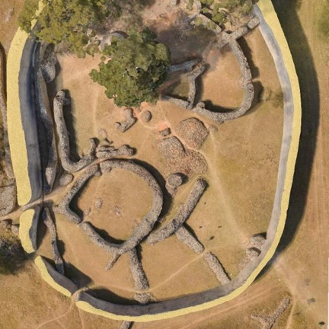
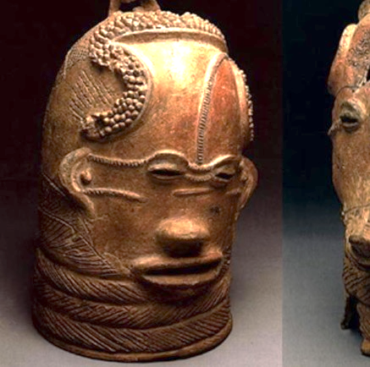
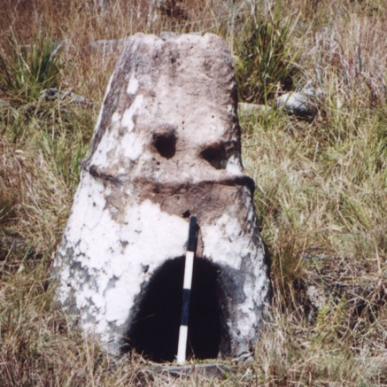

Sustaining Collaborations through Strategic Networks and Equitable Partnerships
Prof Shadreck Chirikure, Director: Research Laboratory for Archaeology & the History of Art
Notes:
Brief introduction, your background across South Africa and the UK, and frame the talk as a reflective, practice-based contribution.

Slide 2
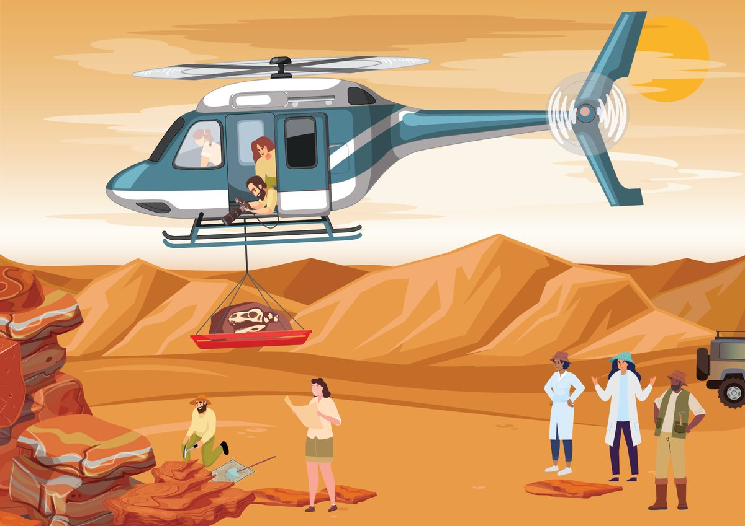
Why this conversation matters now?
Persistent cases of helicopter science
Extractive research collaborations
Uneven distribution of resources and skills
Notes:
not a new problem, but one that continues to surface across disciplines and regions. Emphasise that good intentions alone do not prevent extractive practices

Slide 3



Global North ↔ Global South disparities
Where Do Inequalities Arise?
Inequalities within the Global South
Funding, infrastructure, and skills asymmetries
Notes:
Highlight that the Global South is not homogeneous. Stress how elite institutions may unintentionally reproduce extraction when partnering with less-resourced institutions.

Slide 4

?
How can we build North–South and South–South collaborations that are:
Equitable
Transformative
Mutually beneficial
Sustainable
Notes:
Position this question as the anchor for the rest of the talk. Note that you are not offering a blueprint, but lessons learned from lived experience.

Slide 5



Positionality &
Experience
Research leadership in South Africa
Collaboration across Global South & Global North
Relocation to the United Kingdom
Navigating both systems
Notes:
Briefly reflect on how moving between contexts shaped your understanding of power, visibility, and access in global research systems.

Slide 6

British Academy Global Professorship
Project context and goals
Built-in capacity strengthening
Long-term partnerships,
not short-term outputs
Notes:
Focus less on technical details and more on design principles: how equity was intentionally embedded from the outset.

Slide 7
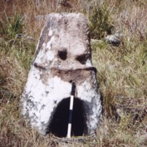
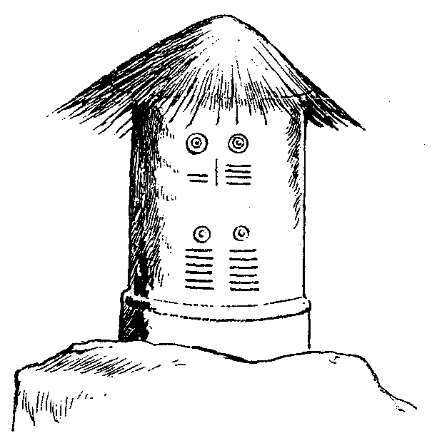

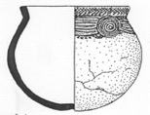
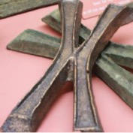
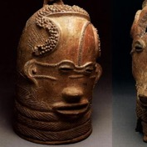
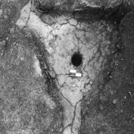

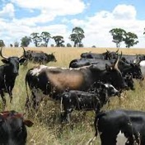


Case Study 2: ERC / UKRI-funded New Bantu Mosaics Project
High-resource funding environment
Managing skills and resource imbalances
Strategies for equitable benefit-sharing
Decorated iron
smelting furnace
Decorated
granary
Millet
Bantu
pottery
Medicine
hole
Copper
ingots
Lydenburg
Heads
Iron
Arrowheads
Cattle
Notes:
Discuss tensions openly: expectations, timelines, authorship, institutional pressures — and how these were navigated.

Slide 8
What Makes Research Transformative?
Investment in people, not just data
Capacity building as a core outcome
Shared ownership of research agendas
Knowledge transfer in multiple directions
Notes:
Stress that transformation is not automatic — it requires deliberate choices that may challenge standard academic incentives.

Slide 9

Strategic Networks: The Oxford Africa Initiative
Network-based rather than project-based collaboration
Focus on sustainable, reciprocal
partnerships
Building trust across institutions
Creating continuity beyond individual grants or leaders
https://www.afox.ox.ac.uk
Notes:
Explain why networks matter: they outlast grants, enable institutional memory, and reduce dependency on individual champions.

Slide 10
The Role of Leadership
Ethical and values-driven leadership
Willingness to redistribute power
Commitment to long-term change
Institutional—not just individual—impact
Notes:
Argue that leadership is not neutral. Equity requires leaders who are prepared to act, advocate, and sometimes disrupt.

Slide 11
Key Lessons Learned
Equity must be designed, not assumed
Resources alone do not guarantee fairness
Sustainable collaboration takes time
Mutual dependency is a strength, not a weakness
Notes:
Frame these as transferable lessons that apply across disciplines and regions.

Slide 12
Concluding Reflection
We need each other.
Knowledge is co-produced
Societal relevance requires collaboration
Geography should not determine value
Notes:
End on a reflective, inclusive note. Emphasise interdependence and the shared responsibility to generate problem-solving knowledge with societal impact.

