Slide 1

Equitable Partnerships in Practice
How Evaluation, Publishing, and Policy Shape Knowledge Impact
Similo Ngwenya
British Academy International Fellow | RoRI, UCL
2nd Conference on Equitable Partnerships
04 February 2026

Slide 2
Why this conversation matters
Calls for equitable research partnerships are growing
Yet inequalities persist in:
Who leads research
Whose research counts
Who benefits from impact
?
Why do these inequalities persist, even within well-intentioned partnerships?
Notes:
Over the past decade, there have been growing calls for equitable research partnerships, particularly in international collaborations involving Africa and the Global South. These calls have appeared in funding frameworks, policy documents and institutional strategies. Yet, despite this attention, inequalities persist in terms of who leads research, whose knowledge is recognised and who ultimately benefits from the impact of research. The key question I want to pose today is therefore this: Why do these inequalities persist, even within well-intentioned partnerships?

Slide 3
From people to systems
From
🧍People & Intentions
Trust
Communication
Behaviour
Goodwill
Ngwenya & Boshoff (2023)
To
⚙️ Systems
Evaluation
Publishing
Funding & Policy
🏛️ Partnership outcomes
Leadership
Visibility
Recognition
Impact
Systems shape Partnership outcomes regardless of individual intentions
Notes:
When partnerships are struggling, we often attribute the problems to the people involved. We talk about issues such as trust, communication, misunderstandings and individual behaviour. While these factors are important, they do not fully explain persistent patterns of inequality. What I want to suggest is that inequality is largely produced and stabilised by systems, particularly those relating to evaluation, publishing and policy, which shape partnership outcomes regardless of individual intentions.

Slide 4
What do we mean by partnerships? (some context..,)
Partnerships operate within systems
⚙️ Systems allocate
  Resources
  Authority
  Visibility
  Legitimacy
Systems often function independently of intentions
🏛️ Partnerships
International partnerships
(African institutions & global funders/universities)
Intra-African partnerships
(Within and across African countries)
Multi-level partnerships
(funders, publishers, policy institutions)
Notes:
Before I continue, I would like to clarify what I mean by 'partnerships’. I am using the term broadly. This includes international partnerships between African institutions and global funders or universities; partnerships within and across African countries; and multi-level partnerships involving funders, publishers, and policymakers. My focus is not on who partners with whom, but on how systems influence the nature and scope of partnerships. Partnerships are embedded in systems that allocate resources, authority, visibility, and legitimacy.
These systems determine whose work is recognised, who gets to lead, and which knowledge travels into policy spaces. Importantly, these dynamics can persist even when partners are committed to equity.

Slide 5
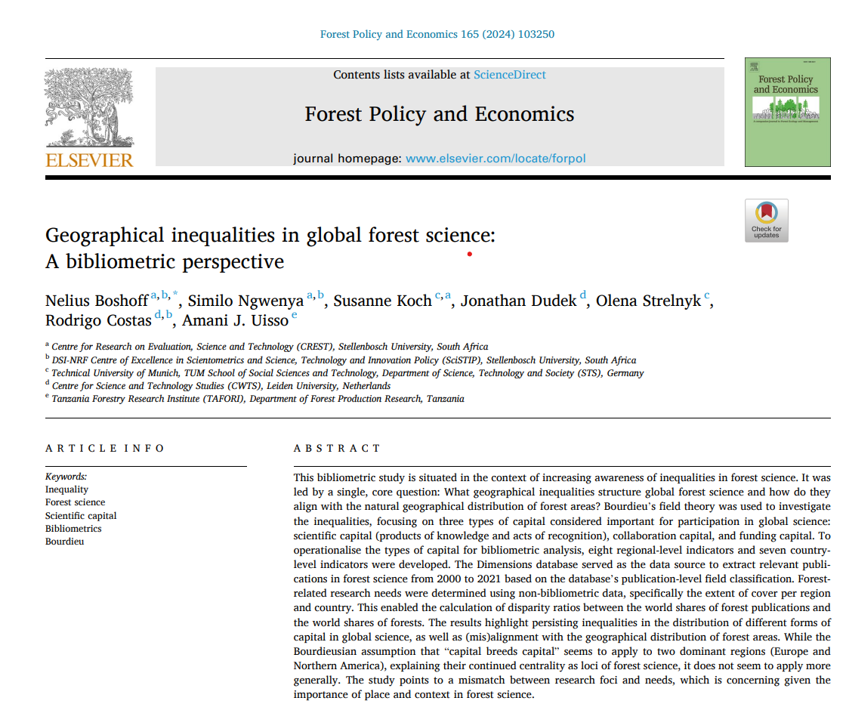
Why inequalities persist: A Bourdieusian lens
Science like any other societal sphere, is “a social field of forces, struggles, and relationships” (Bourdieu, 1991, p. 3)
Actors compete for the ascription of scientific authority as the “socially recognised capacity to speak and act legitimately (i.e. in an authorised and authoritative way) in scientific matters” (Bourdieu, 1975, p. 19)
Actors’ chances of success in this competition depend not only on their intellectual capacity but also on the amount and forms of capital they have at their avail.
Forms of capital
Economic capital (funding, infrastructure)
Scientific capital (publications, prestige)
Social capital (networks, collaborations)
Symbolic capital (recognition, legitimacy)
These capitals are unevenly distributed in global science
Notes:
To help explain this, I draw on Bourdieu’s sociology of science which is based on the premise that science, like any other societal sphere, is “a social field of forces, struggles, and relationships”. In the field of science, researchers and institutions possess different types of capital: economic, scientific, social and symbolic. These forms of capital are distributed unevenly across the global research system. Partners enter collaborations from very different starting positions, which influence how roles, authority and recognition are allocated.

Slide 6
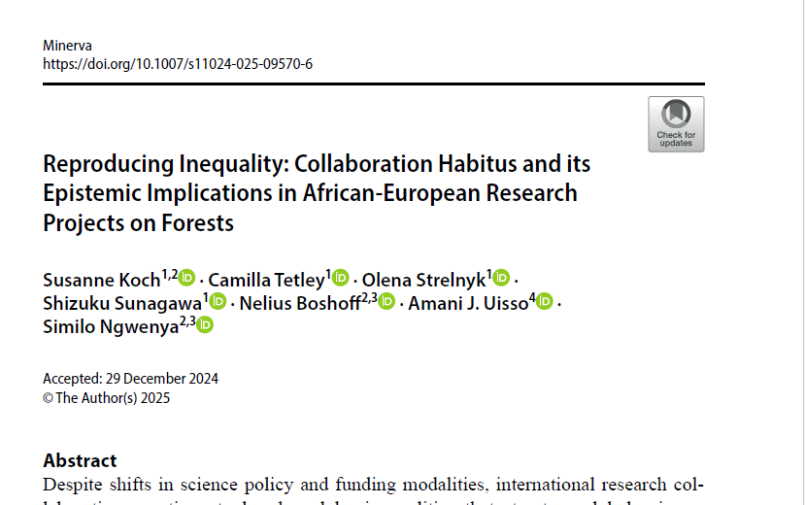
Bourdieusian lens continued:
Collaboration habitus
Bourdieu depicts as hierarchically structured spaces of dominant and subordinate positions.
Dominant positions set the standards of what is perceived as quality science: “The properties of their work (i.e., the method they use, the topic they investigate, the journals in which they publish, etc.) become understood as the legitimate features of ‘good’ scientific practices (…).
Doing quality work is doing work like theirs” (Albert Mathieu and Daniel Kleinman 2011: 266).
New entrants in the field start from ‘subordinate’ positions in which they are assessed against these standards.
Their chances of advancement depend on the conformity of their works to the prevailing norms of good scholarship and the extent to which they internalise these.
Bourdieu calls this feel for the game the habitus: a practical sense of doing ‘proper’ science “which propagates not only the existing rules of the field, but also one’s relative position within it” (Jeon 2019: 161).
In simple terms. the concept of 'collaboration habitus' refers to the practical sense of roles that scholars have internalised. These roles are the result of their positions within the global scientific community and the various forms of capital (economic, scientific, social and symbolic) with which they are endowed.
Roles become normalised:
Who leads
Who follows
Who publishes
Who translates to policy
Notes:
Over time, these unequal positions become internalised through what we call the 'collaboration habitus’. Researchers often unconsciously learn what roles are expected of them in partnerships. This includes who leads the proposal, who collects data, who writes, who publishes and who speaks to policy audiences. Inequality becomes normalised and routine, and is rarely questioned.

Slide 7
Building from habitus: from how roles are accepted to why they become institutionalised. (1) Evaluation systems
Evaluation systems
Evaluation criteria
Evaluation systems
Administrative evaluation
Ex-ante, interim, ex-post
Promotions, funding decisions, ratings
Within science evaluation
Peer review
Gatekeeping into the knowledge pool
Aligns with global metrics
Dominant positions set the standards of what is perceived as quality science: “The properties of their work (i.e., the method they use, the topic they investigate, the journals in which they publish, etc.) become understood as the legitimate features of ‘good’ scientific practices (…).
Metric driven (journals, citations, rankings)
Rewards
Prestige
International visibility
Effect: Some partners enter as leaders, while others enter as contributors.
Notes:
While Habitus explains how roles are accepted, Evaluation explains why they persist. Partnerships begin on unequal footing because evaluation has already ranked participants Evaluation systems play a central role here. Administrative evaluation governs promotions, funding decisions, and institutional rankings. Within-science evaluation, through peer review, determines what becomes recognised knowledge. These systems often rely on global metrics and standards, which may disadvantage researchers working in less resourced or context-specific settings.

Slide 8
Building from habitus: from how roles are accepted to why they become institutionalised. (2) Publishing systems
Publishing systems
Publishing criteria
Publishing systems
Publishing is a within-science activity
Is steered by evaluation criteria
Aligned with international visibility
Aligned with funding expectations
Shaped by Journal hierarchies and policy relevance
Effect: Unequal authorship positions, unequal recognition, unequal voices
Notes:
Although publishing is often presented as a neutral academic activity, it is in fact deeply shaped by evaluation pressures. Journals are organised hierarchically, and publication in certain outlets can lead to disproportionate visibility and prestige. Some forms of knowledge, particularly locally grounded or policy-oriented research, may be marginalised despite being highly relevant.

Slide 9
Building from habitus: from how roles are accepted to why they become institutionalised. (3) Policy systems
Policy systems
Policy uptake:
Structures and processes through which research informs decisions.
They decide
What knowledge is listened to
Whose evidence is structured
What becomes actionable
Policy for science
Policies that govern how science is funded, evaluated and organised
National research strategies; funding priorities; research assessment frameworks
Science for policy
Research being used to inform public policy decisions and to provide evidence for health, education, climate etc.
Depends on:
Institutional prestige
Policy actors rely on universities with global reputations, well known international organisations, trusted expert networks
Those from lesser institutes may be overlooked, filtered through international intermediaries, cited indirectly or not at all
Geopolitical position
Global policy spaces shaped by Global North institutions, Donor countries, Multilateral agencies headquartered outside of Africa
Proximity to power
Physical proximity (where meetings happen)
Network proximity (who knows whom)
Symbolic proximity (who is seen as authoritative)
Notes:
Policy systems also determine which knowledge is considered important. The uptake of research depends not only on its relevance, but also on institutional prestige, networks and geopolitical position. Even when African research directly addresses national challenges, it can find it difficult to gain traction in policy spaces compared to work produced by institutions that dominate the global landscape.

Slide 10
When funding enters the System
Funding configures the system in which research operates. International funding for example shapes:
What is evaluated
Where research is published
Which policy arenas matter
Notes:
Funding plays a critical role in shaping structures.International funding not only enables research, but also configures the systems within which it operates. Priorities for funding influence evaluation criteria, publishing strategies and expectations of impact. Once funding is in place, it shapes the trajectory of research far beyond the lifespan of a single project.

Slide 11
Putting it together: A Reproducing Loop
Funding priorities
(Funding priorities determine what counts as excellence, which topics are important and which institutions are considered reliable)
Evaluation criteria
(Evaluation criteria aligns with funder expectations: publication metrics, international collaboration, impact narratives)
Publishing norms
(Researchers publish where evaluation rewards them; in high impact journals and globally indexed outlets)
Policy uptake
(Policy draws on visible research, prestigious institutions and recognized journals)
Reinforced hierarchies
(Certain/Dominant institutions and actors gain more prestige, citations and policy influence)
(Feed back into funding priorities)
(Funders fund what already looks successful and the same actors are funded again)
Notes:
This is not a one-way process. These systems reinforce one another. Funding shapes evaluation, evaluation shapes publishing, publishing shapes policy uptake and policy visibility feeds back into who gets funded next. Over time, this loop stabilises inequality. So even when partnerships are well intentioned, they operate within a system that reproduces hierarchy

Slide 12
So, what can we change?
Evaluation:
Moving from narrow metrics to contextual, narrative assessment.
Consider value contributions, roles and context, not just numbers.
Funding:
Who designs the calls? Who reviews proposals? Who decides priorities?
Increase participation in agenda-setting and decision-making.
Publishing:
Expand legitimacy beyond elite, globally indexed outlets.
Recognise diverse publishing practices and knowledge forms.
Open access improves readership, but APCs shift the burden of exclusion onto authors.
Policy:
Value locally grounded knowledge and contextual expertise.
Strengthen the links between research and national and regional policy.
Notes:
(i) Open access has expanded who can read research, but not necessarily who can publish (ii) Openness requires infrastructure. Without it, openness can reproduce visibility gaps (iii) systems accumulate advantage over time

Slide 13
The question we should be asking ourselves is not whether partnerships are equitable, but whether the systems they operate in make equity possible.
Thank you

Slide 14
References
Albert, M., & Kleinman, D. L. (2011). Bringing Pierre Bourdieu to science and technology studies. Minerva, 49(3), 263–273. https://doi.org/10.1007/s11024-011-9174-2
Arvanitis, R., & Mouton, J. (2019). The structural effects of science funding on research systems in developing countries. Science, Technology & Society, 24(2), 201–220.
Boshoff, N., Ngwenya, S., Koch, S., Dudek, J., Strelnyk, O., Costas, R. & Uisso. J, A. (2024). Geographical inequalities in global forest science: A bibliometric perspective. Forest Policy and Economics, 170, 103250. https://doi.org/10.1016/j.forpol.2024.103250
Boshoff, N., & Esterhuyse, L. (2023). The use of bibliometrics in science policy and research evaluation in Africa. Research Evaluation, 32(2), 123–135.
Bourdieu, P. (1975). The specificity of the scientific field and the social conditions of the progress of reason. Social Science Information, 14(6), 19–47. https://doi.org/10.1177/053901847501400602
Bourdieu, P. (1991). The peculiar history of scientific reason. Sociological Forum, 6(1), 3–26. https://doi.org/10.1007/BF01112725
Chataway, J., Ochieng, C., & Hanlin, R. (2019). Including the excluded: The role of science, technology and innovation in inclusive development. Research Policy, 48(3), 789–803.
Coalition for Advancing Research Assessment (COARA). (2022). Agreement on reforming research assessment. https://coara.eu/agreement
Declaration on Research Assessment (DORA). (2012). San Francisco Declaration on Research Assessment. https://sfdora.org/read/
Fortunato, S., et al. (2018). Science of science. Science, 359(6379), eaao0185. https://doi.org/10.1126/science.aao0185
Gaillard, J. (1997). The characteristics of R&D in developing countries. Science, Technology and Society, 2(1), 1–32.
Havemann, J., et al. (2020). Open science in Africa: Challenges and opportunities. Information Services & Use, 40(1–2), 1–15.
Hicks, D., Wouters, P., Waltman, L., De Rijcke, S., & Rafols, I. (2015). Bibliometrics: The Leiden Manifesto for research metrics. Nature, 520, 429–431.
Koch, S., Tetley, C., Strelnyk, O., Sunagawa, S., Boshoff, N., Uisso, A. J., & Ngwenya, S. (2025). Reproducing inequality: Collaboration habitus and its epistemic implications in African–European research projects on forests. Minerva. https://doi.org/10.1007/s11024-025-09570-6
Wilsdon, J., Allen, L., Belfiore, E., Campbell, P., Curry, S., Hill, S., Jones, R., Kain, R., Kerridge, S., Thelwall, M., Tinkler, J., Viney, I., Wouters, P., Hill, J., & Johnson, B. (2015). The metric tide: Independent review of the role of metrics in research assessment and management. Higher Education Funding Council for England.

