Slide 1
(Re)centering Indigenous Knowledge for equitable partnerships: A movement away from ‘research on’ to ‘research with’ indigenous peoples
Justine Sikuku, Moi University

Slide 2
Introduction
The historical landscape of research involving Indigenous communities has often been characterized by extractive practices, where indigenous knowledge has been appropriated without adequate recognition or benefit to the knowledge holders.
This has led to a deep-seated mistrust and a perpetuation of colonial power dynamics within academic and scientific endeavors.
Achieving true equity in research partnerships therefore necessitates a fundamental shift in approach, moving from "research on" to "research with" indigenous peoples.

Slide 3
Aim of the Presentation
This presentation draws lessons from an African Multiple funded project; 'Pots, fire and gourds: A representation of cultural knowledge systems among the Bukusu, Sabaot, Iteso and Yoruba'
We argue that engaging with indigenous material culture and their custodians offers a unique and powerful pathway to achieving this shift.

Slide 4
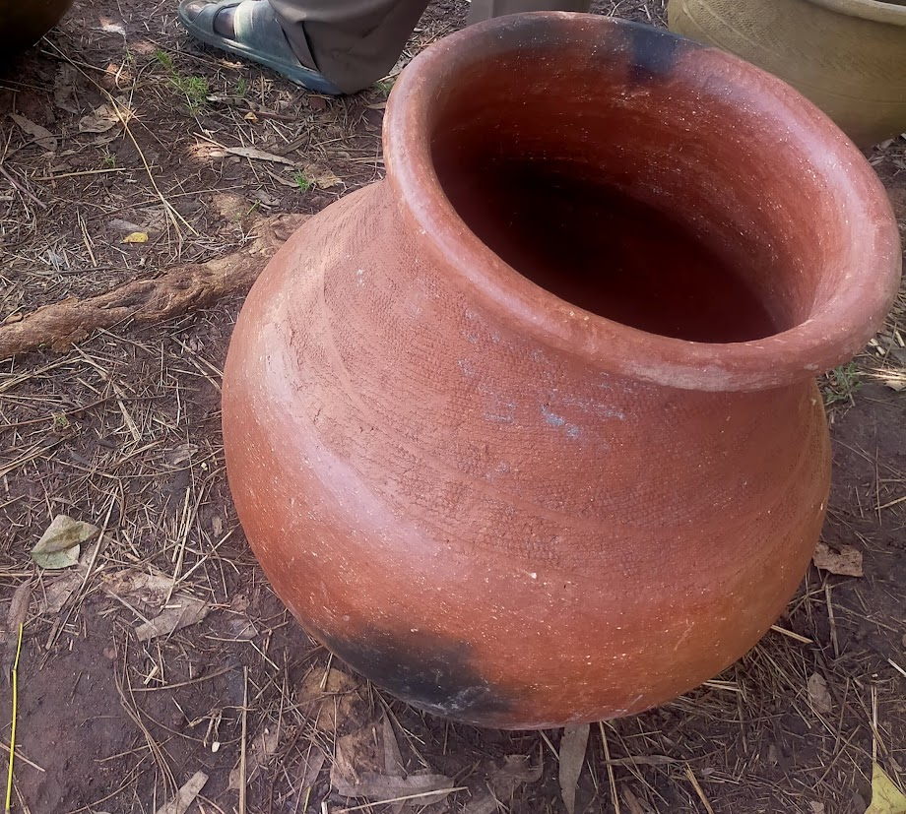
Pots Project
This project investigated how instantiations of pots, fire and gourds in rituals and ceremonies represent social cultural practices as a system of knowledge among the Bukusu, Sabaot, and Iteso of Kenya and Yoruba of West Africa. The Project had three objectives:
1)To trace the varied instantiations of pots, fire and gourds among the Bukusu, Iteso, Sabaot, and Yoruba as represented in related folklore and names.

Slide 5
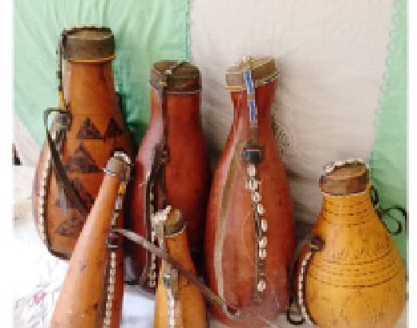
Methodology
Research sites- Bungoma county, Busia county(Kenya) Osun and Oyo States (Nigeria)
Fieldwork activities done over a period of eight months and included: inception meeting, preparation of tools, training meeting, reconnaissance, Fieldwork, data transcription, translation and organization, data analysis and preliminary report writing.
Purposive and snowball sampling techniques were used to identify the informants according to age, gender, level of education, period of residency in the study area, religion, ethnicity and role played in community.
An in-depth informant interview tool that contained battery of questions on the items was used collect data. Face-to-face interview was employed to capture information on the names of pots, fire and gourds in each of the communities. The questions were probed as much as possible to generate valid and detailed data

Slide 6
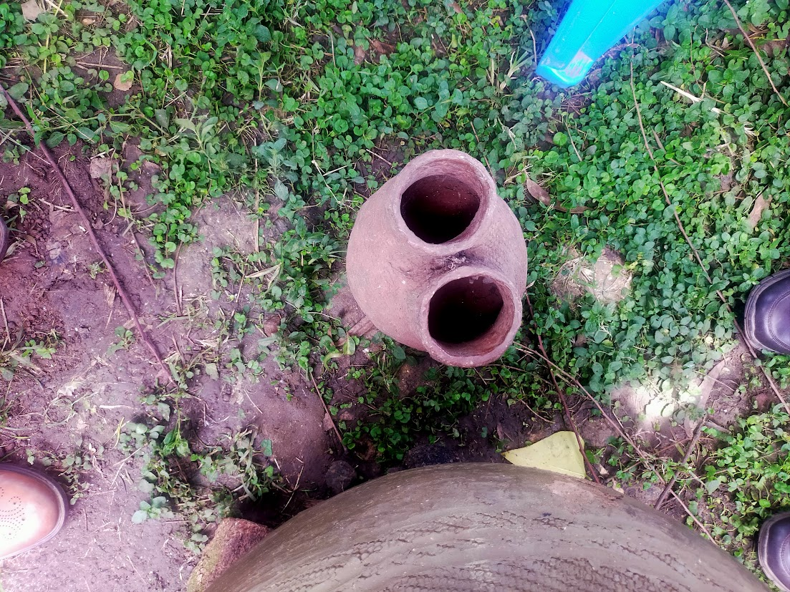
Objectives Contd..
2)To evaluate the names and folklore associated with pots, fire and gourds and demonstrate how they depict societal knowledge systems in the communities.
3)To establish pot, fire and gourd motivated patterns of interaction across the four communities in order to determine the nature of knowledge multiplicity and relations

Slide 7
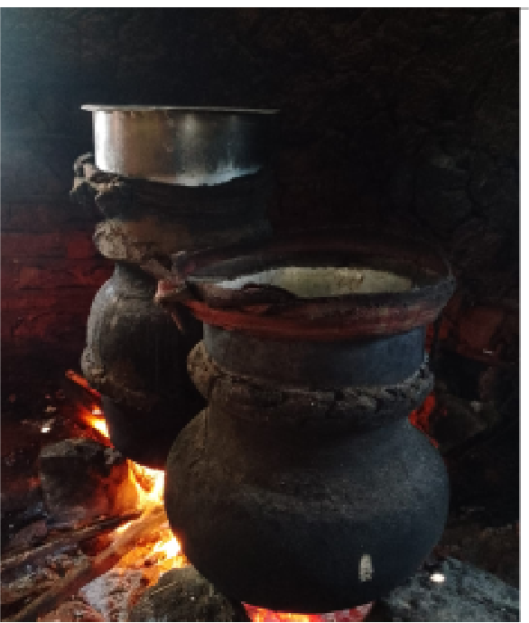
Project lessons for Partnerships
Targeting Co-production
Fostering Mutual respect
Appreciating prior imbalances and working on empowerment.
Establishing Long term impact and accountability

Slide 8
Targeting Co-production
requires recognizing indigenous peoples’ and traditional communities’ rights and value, and respecting knowledge plurality and complexity right from inception. No knowledge is inferior.
For instance, the intricate designs and firing techniques of African pottery reflect deep understanding of material science, thermodynamics, and artistic expression, often passed down through generations without formal Western schooling. The artistic decorations on gourds, their use in homes, and spiritual connections tell stories of a deeper understanding and awareness of art and aesthetics, science, and cosmology in ways that must be appreciated.

Slide 9
Fostering Mutual Respect
openness in fostering mutual respect for genuine collaboration
moving beyond hierarchical models where external "experts" dictate terms and solutions, often overlooking local needs and expertise.
Recognizing that local communities are knowledge holders not subjects or informants or respondends
In the project, we tried to do this by spending time with the communities observing activities, sharing in social life and showing genuine interest in the terminologies and the stories they told.
Noted incidences of gendered secrecy and stranger suspicion. We tried to use research assistants from the communities to enhance confidence.

Slide 10
Appreciating prior imbalances and working on empowerment
understanding the historical context of exploitation and power imbalances as essential for building truly equitable partnerships based on the principle of reciprocal benefit and sustainability.
Local communities have been marginalized, excluded from decision making about their own knowledge, and exploited through artifact relocation and denied accrued benefits from their knowledge.
The imbalances need to be deliberately confronted and dealt with.
In our project, we tried to involve communities in decision making, extending benefits to them (giving tokens of appreciation), and recognizing their expertise. We had seminars for experts to give suggestions on how communities could benefit.

Slide 11
Establishing Long term impact and accountability
Commit to life beyond the life cycle of the project to establish trust and build long term relations that eventually benefit communities.
Support community initiatives that promote IK propagation
In our project we committed to sharing outcomes with community cultural centres.
A follow up project to use digital tools to archive cultural information on pots, fire, and gourds is in the pipeline.
We need to find a way to find a balance between community needs and our own needs. Regular engagement is key.

Slide 12
Takeaways
Indigenous knowledge systems
Co-production
Mutual respect
Appreciating imbalances
Long term impact
The lessons form the framework for building partnerships founded on respect, equity, and shared prosperity.
Recognizing the profound value of African cultural knowledge.
Staying alive to challenges associated with suspicion and exclusionist beliefs
Building trust as a long term effort
Viewing local communities as partners not subjects and encouraging conversations on best practices

