Slide 1

Equitable Partnerships for African Research Infrastructure and Capacity (EP for AfRICa): International collaborations explored through the lens of research management
Presenters: Tshegofatso Seabi and Odile Masia
Date: February 2026

Slide 2
Overview
Introduction
Collaborating partners
Project background
What we have done
What’s next

Slide 3




Introduction
Collaborative programme designed to strengthen research management capacity at the University of Manchester (UoM), Addis Ababa University (AAU), Makerere University (MU), and Mkwawa University College of Education- affiliated to Dar es Salaam University (MUCE).

Slide 4
Collaborating partners

Slide 5
UoM
Large Institution, multiple teams; UoM 2035 strategic ambition to strengthen and work more effectively with global partners and collaborators
AAU
Large Institution, five-year strategic plan for 2024 -2028, current ongoing restructuring; challenges related to efficiency, coordination
MU
Donor research investment translating in investment in research management, establishing research management support unit
MUCE
Small and relatively young institution.
Recently began building a research capacity and management function

Slide 6
Project background

Slide 7
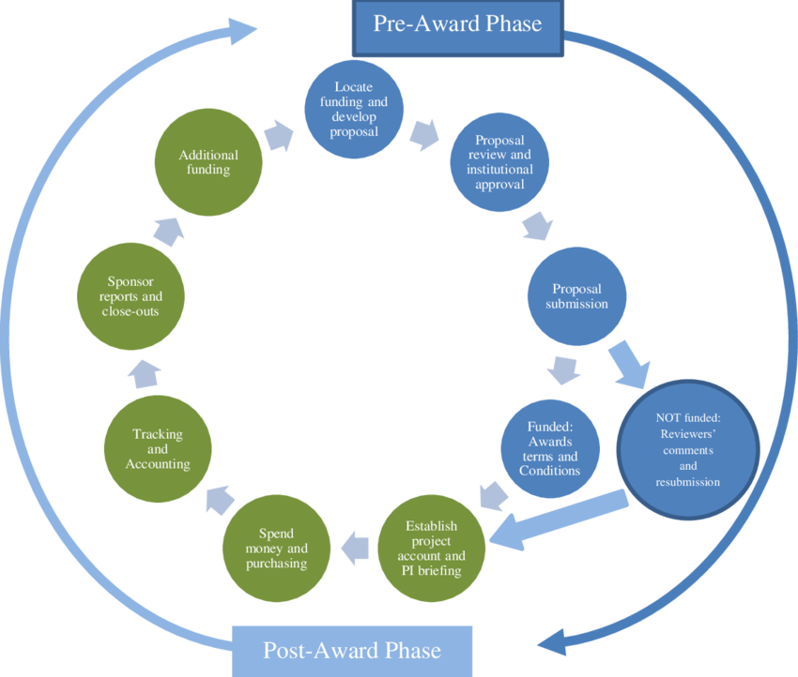
Growing research ambition and funding
Strengthening research management is increasingly recognised as a pillar of equitable international research collaboration.
The initiative responds to shared challenges:
    some institutions have little or no dedicated resources for research management. Where systems do exist, misalignment between policies and processes across research functions often creates inefficiencies and barriers.
We take a full research lifecycle approach

Slide 8
What have we done

Slide 9
Define equitable partnerships
Understand Institutional research infrastructure
Identify opportunities for better engagement across research supportive roles
Identify shared challenges

Slide 10
What came out of the first workshop
Defining equitable partnerships
“Equitable partnership is a relationship where all parties are valued, respected and have fair access to resources, opportunities and decision-making power” (Iddy,’25)
The ambition to lead on applications responding to a mandate to be research led institutions
Acknowledged shared challenges in research support
The importance of the full research life cycle approach
Best practice sharing on various research functions and areas of opportunity to cross learn

Slide 11
Collaborative programme (monthly sessions)
Each organisation leads 3-4 sessions
Various members of staff related to the topic join virtual sessions monthly to share best practice
Documented learnings from each discussion and refinement of topics in the toolkit
Best practise templates or frameworks are to shared

Slide 12
What’s coming out of the virtual sessions
Time as resource is limited
Research managers/functions stretched thin
Communication
Dual roles for academics (researcher vs research support)
Misalignment with research time allocation for researchers
Connectivity during virtual sessions
Language matters
Different forms of communication

Slide 13
What’s next
Continue virtual sessions
Embedding learnings within institutions
Final in-person workshop in July 2026

Slide 14
Embedding learnings within institutions
UoM- Improving cohesion across pre- and post-award research support teams to enhance grant delivery and equitable collaboration
AAU- Introduction of staff time buy-outs for research activity and strengthened due diligence practices informed by partner learning
MU- Enhanced research governance coordination, diversified funding strategies, strengthened ethics and compliance systems, and institutionalised researcher development pathways
MUCE- Practical tools for funding identification, budgeting, HR and finance integration, and alternatives to staff buy-outs in low-salary contexts

Slide 15
Further project plans
Launch final toolkit
Expand knowledge to other partners/collaborators
Collaborative Funding applications supported by the toolkit

Slide 16
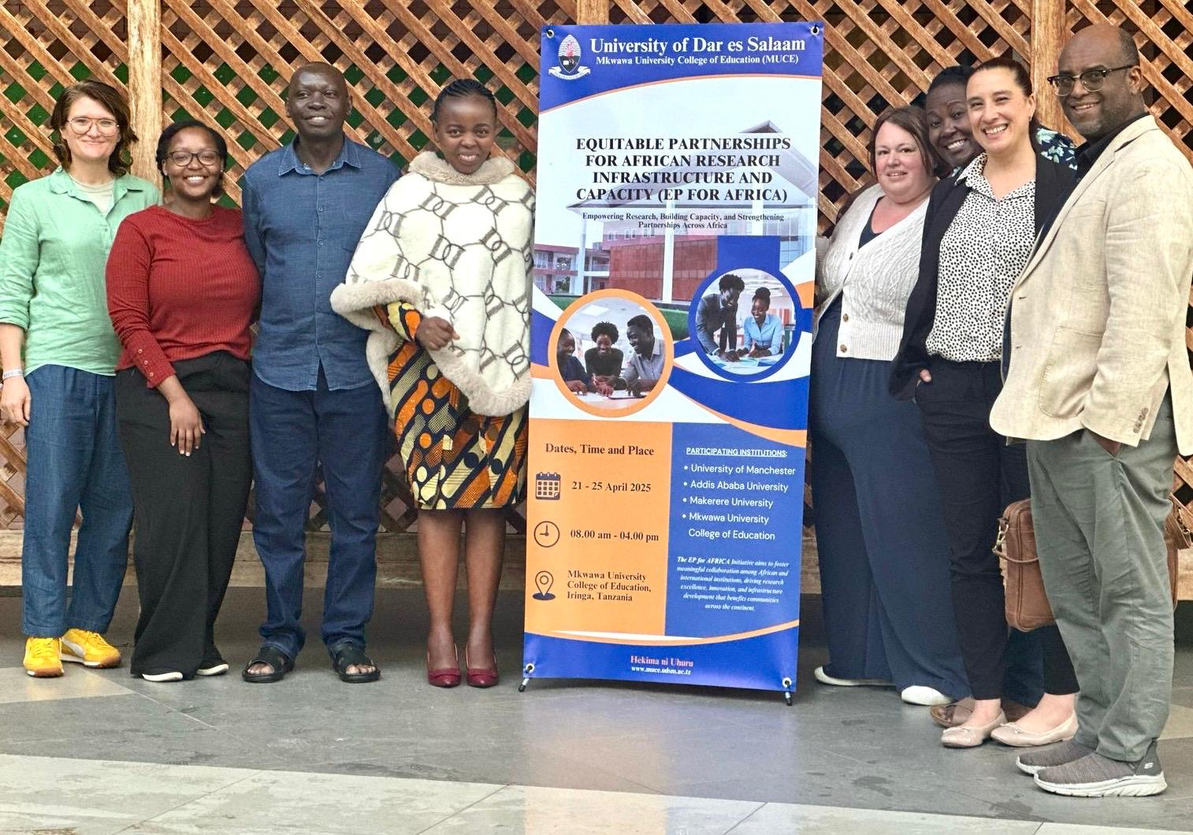
To connect with us, contact us: EPforAfrica@manchester.ac.uk

