Slide 1

Re-imagining Africa to Africa partnerships: The University of
Fort Hare partnerships experience with three African universities
Willie Chinyamurindi
University of Fort Hare
wchinyamurindi@ufh.ac.za

Slide 2
Introduction
The University of Fort Hare encourages partnerships between partners across the Globe.
This quest has been embedded with the strategic document “Decade of Renewal”.
The responsibility of setting these partnerships is not just that of the International Office but a joint and collaborative effort across the entire University.
As a Senior member of the University, I set it upon myself to be part of the process of seeking for partners.
What follows is my reflective journey.

Slide 3
Some trends to note:
Growth of African-led research, but uneven collaboration
Several bibliometric and descriptive studies show rapid growth in African research output, particularly since 2010, but with persistent structural inequalities in authorship, institutional leadership, and collaboration density.
A need exists to ask directed questions around these inequalities: authorship, institutional leadership and collaboration density.
Concerns around inter-institutional collaboration within Africa and a dominance of Global North co-authorship.
(Ezeani et al., 2025; Holliman et al., 2025).

Slide 4
Some trends to note:
2. Partnerships as capacity-building ecosystems (not just projects).
Successful partnerships function as ecosystems, combining training, research, governance, and sustainability.
A need exists for an intentional design for equity to address the structural inequalities: authorship, institutional leadership, and collaboration density.
We must remember that partnerships by nature and the issue of capacity to be relational, cumulative, and networked.
(Bade et al., 2026; Petr et al., 2026; Ratner et al., 2025)

Slide 5
Some trends to note:
3. Power, governance, and asymmetry in partnerships
How is institutional power and geopolitical positioning shaping partnerships?.
Even when partnerships are South – South: how is institutional fragmentation, cultural distance and regulatory asymmetries shaping partnerships?.
Partnerships as thoughtful, intentional and strategic not an after thought of a necessary compliance check.
(Bentum-Micah et al., 2025; Vandome, 2026)

Slide 6
Some trends to note:
4. Partnerships as size and number (re-imagined against scale & impact)
Multi-stakeholder partnerships outperform siloed, top-down arrangements when addressing complex development challenges.
Catchment partnerships in South Africa show that smaller, inclusive, bottom-up collaborations often outperform large, rigid structures, an insight transferable to university partnerships.
It could be more South to South engagements (Africa to Africa) may potentially produce better developmental returns than externally driven mega-consortia.
(Otieno, 2026; Ngarava, 2024).

Slide 7
Some trends to note:
5. Capacity building works best when contextualised
Pan-African training initiatives succeed when curricula, methods, and delivery are adapted to African realities rather than imported wholesale.
Even South–South collaborations involve power asymmetries and strategic positioning, reinforcing the need to analyse partnerships as agentic and reflexive, not romanticised.
Get everyone involved and to own the partnership.
(Petr et al., 2026; Bentum-Micah et al., 2025; Vandome, 2026).

Slide 8
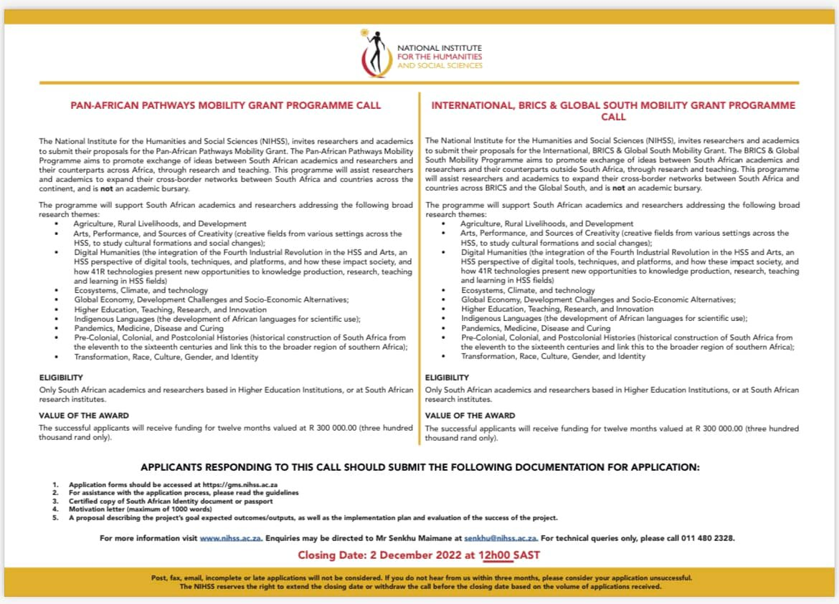

So how it all started:
1. The spark that makes the light glow:

Slide 9
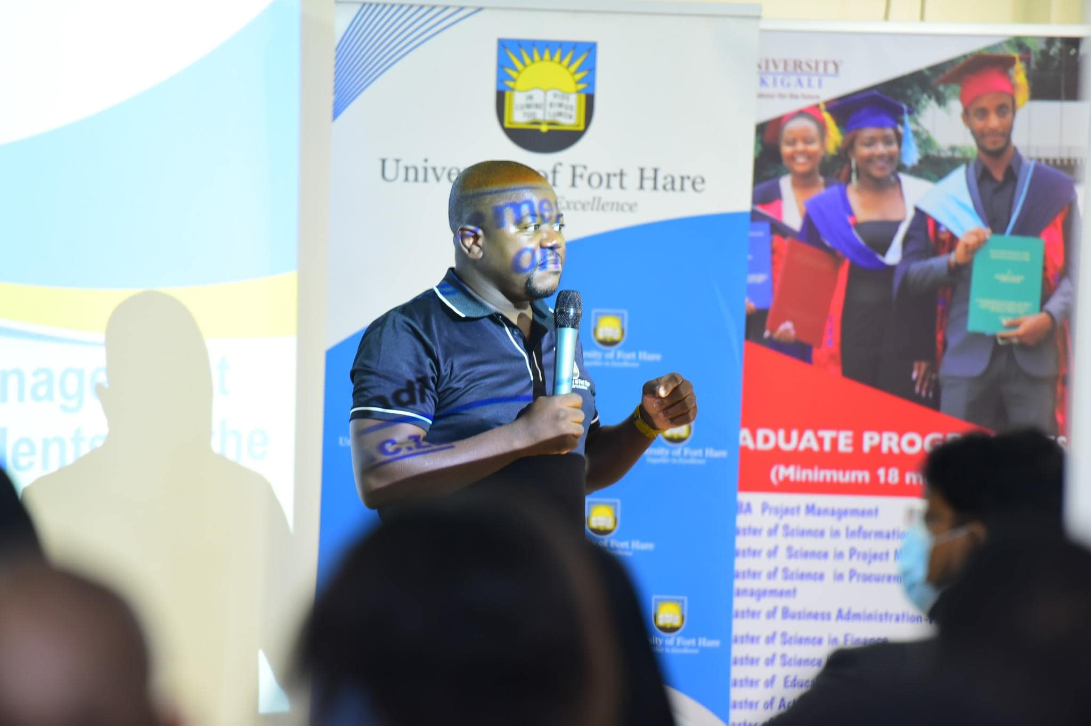
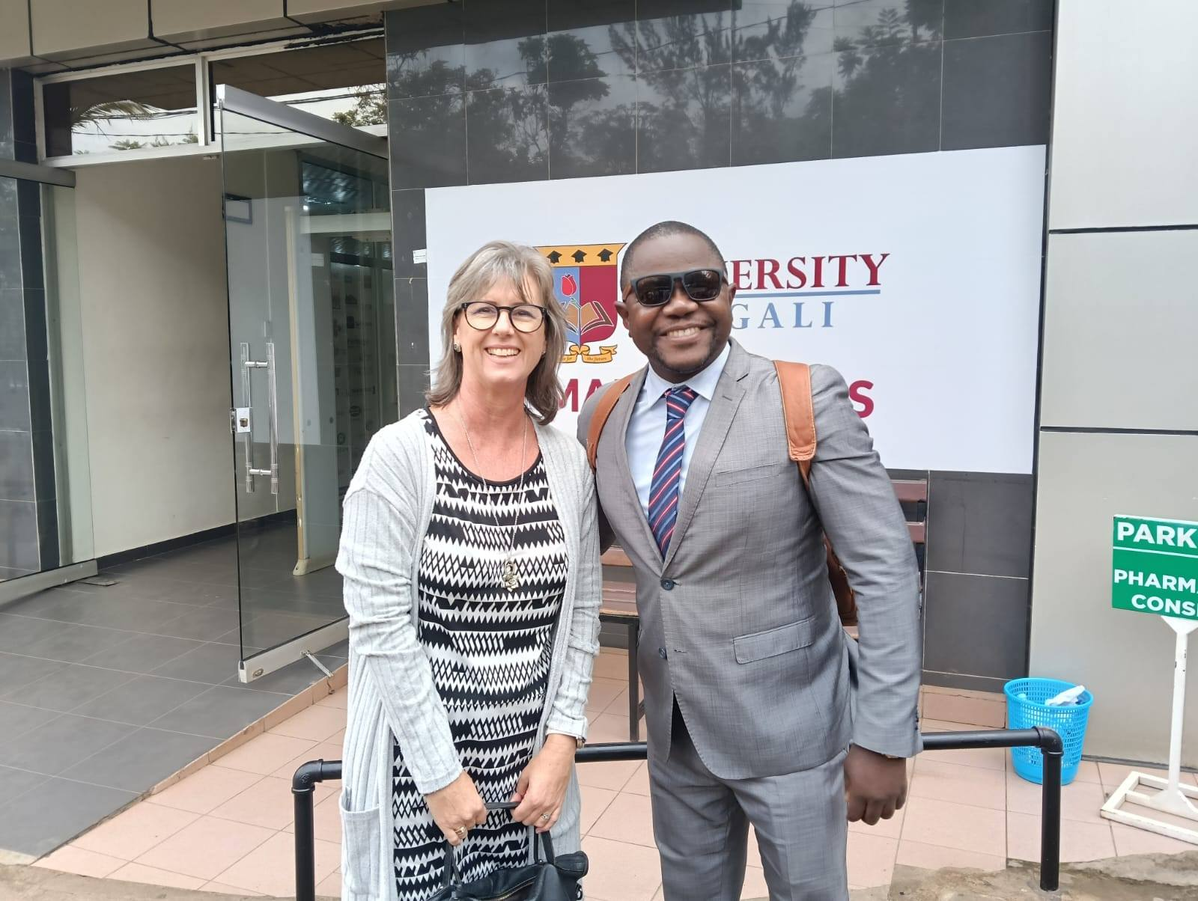
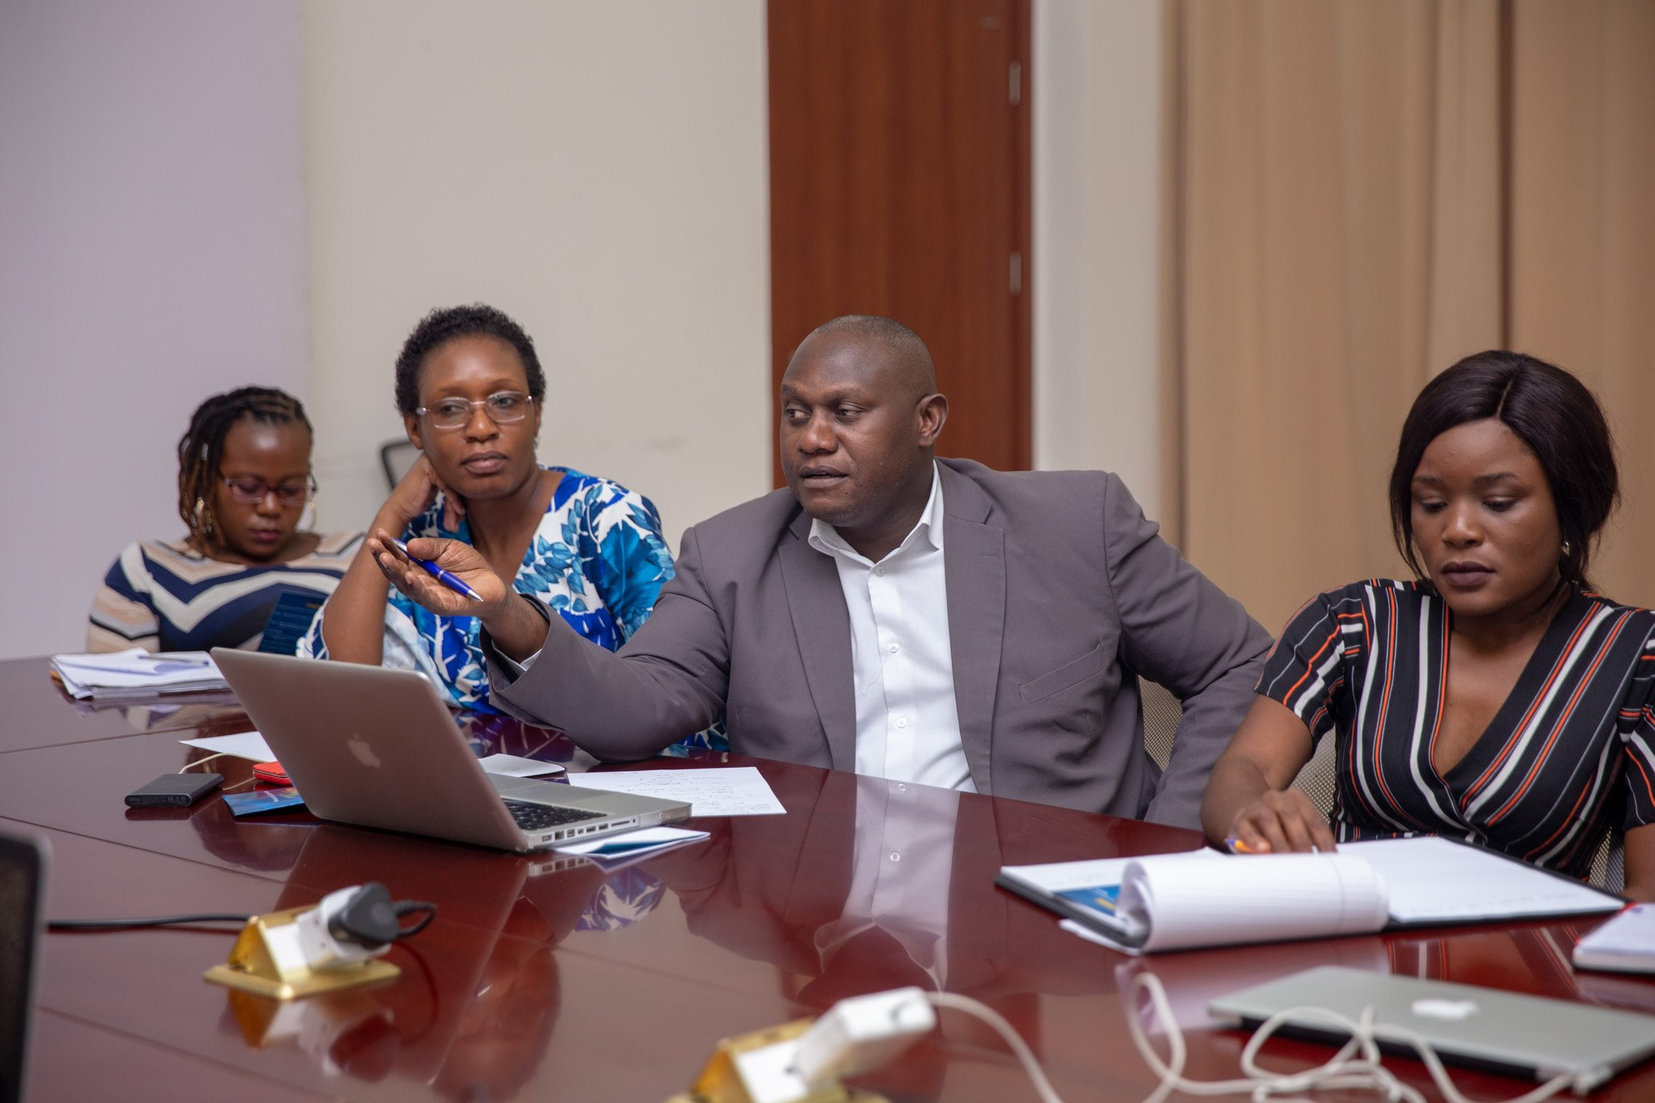
So how it all started:
2. Inception meetings to physical sites:

Slide 10
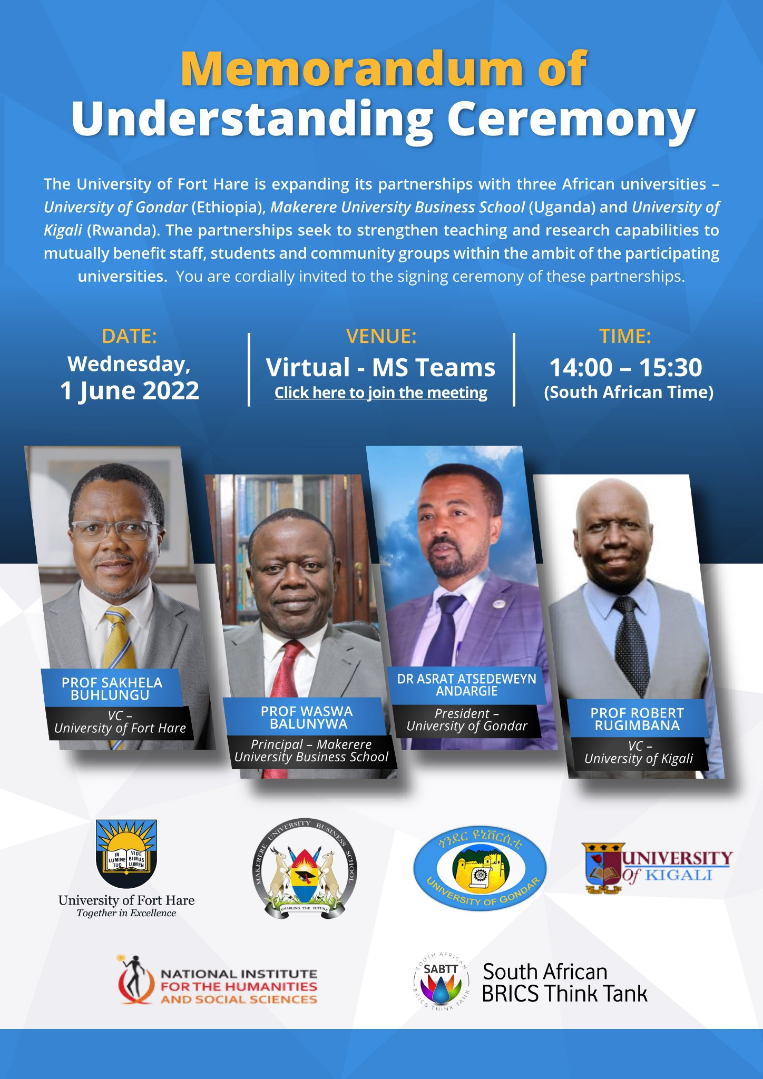



So how it all started:
3. Memorandum of Understanding:

Slide 11
So how it all started:
Strengths:
Partnerships were pioneering – a useful starting point.
Mobility was achieved.
Partnership received support on both sides from an institutional leadership position.
Published output emerged from the partnership
Weaknesses:
Partnership not received well by members of the faculty in terms of support.
Outside UFH institutions struggled to contributed financially.
Differing perceptions of what the partnership was and should be.
4. Reflections:
SWOT
Opportunities:
- UFH assisted with financial support for mobility of partners.
NRF Twinning Grant
More efforts for joint collaborative funding.
Graduation of PhD student this year.
Threats:
“New” life needed into the partnership – rejuvenation.
Change of mind-set, forget Global South lets look to the North.
Take the relationship to the next stage and the ensuing challenges.

Slide 12
Re-imagining Africa to Africa partnerships: The University of
Fort Hare partnerships experience with three African universities
Willie Chinyamurindi
University of Fort Hare
wchinyamurindi@ufh.ac.za

