Slide 1


Building Equitable Partnerships for Transformative Higher Education in the Global South
Professor Emmanuel Ojo
Deputy Head of School: Wits School of Education
& Chair: Transformation, Internationalisation & Partnerships
Faculty of Humanities, University of the Witwatersrand
Johannesburg, South Africa
Emmanuel.Ojo@wits.ac.za
+27 11 717 3017
5 February 2026
Notes:
This presentation reflects a long scholarly and leadership journey interrogating how Global South universities participate in global knowledge production.

Slide 2
What this 20-minute presentation is about?
To shift the understanding of ‘equitable partnerships’ from a moral, relational, or compliance concern to a systems-design and institutional agency challenge.
To demonstrate that this argument is not speculative, but grounded in a sustained scholarly trajectory shaped by multiple crises (internationalisation, COVID-19, and AI), and by leadership practice within a research-intensive university.
To advance pathways for concrete collaboration, through the co-design and piloting of frameworks with universities and funders aimed at embedding equity in partnership practice.

Slide 3
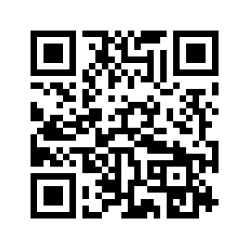
Why I Am Making This Argument (I)
Sustained scholarly trajectory: over two decades (20+ years) of research on internationalisation, governance, and transformation in higher education, with a consistent focus on participation, power, and institutional agency in the Global South.
Evidence across systemic disruptions: peer-reviewed research conducted across multiple crises, including internationalisation reform, COVID-19, and the integration of digital technologies and AI into higher education systems.
Professor Emmanuel Ojo:
https://orcid.org/0000-0003-3809-5503

Slide 4
Why I Am Making This Argument (II)
Institutional leadership from within the system: Deputy Head of School at a research-intensive university, with responsibility for transformation, internationalisation, postgraduate governance, and global partnerships.
Externally recognised and funded work: NRF C-rated researcher with competitive international funding and sustained collaboration with universities, funders, and policy actors across Africa, Europe, and North America.
Professor Emmanuel Ojo:
https://orcid.org/0000-0003-3809-5503

Slide 5

SLIDO.com Session: Current Locus of Agenda-Setting Power

Slide 6
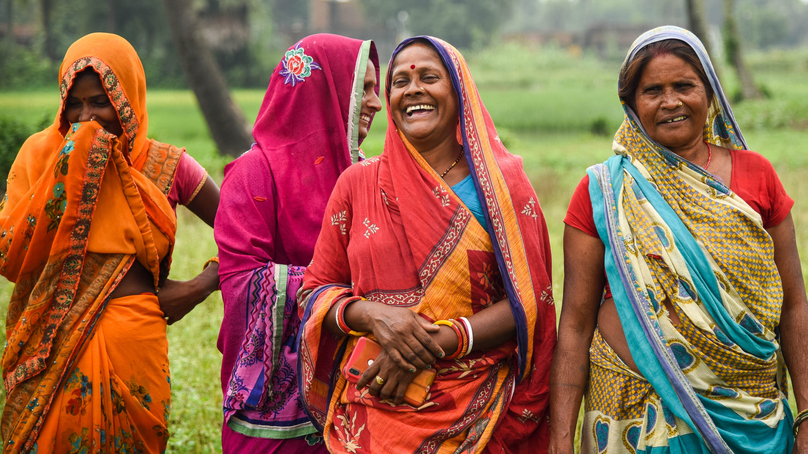
From Participation to Power
1
Introduces my academic journey
Diagnoses the structural asymmetry
Establishes the core problem

Slide 7
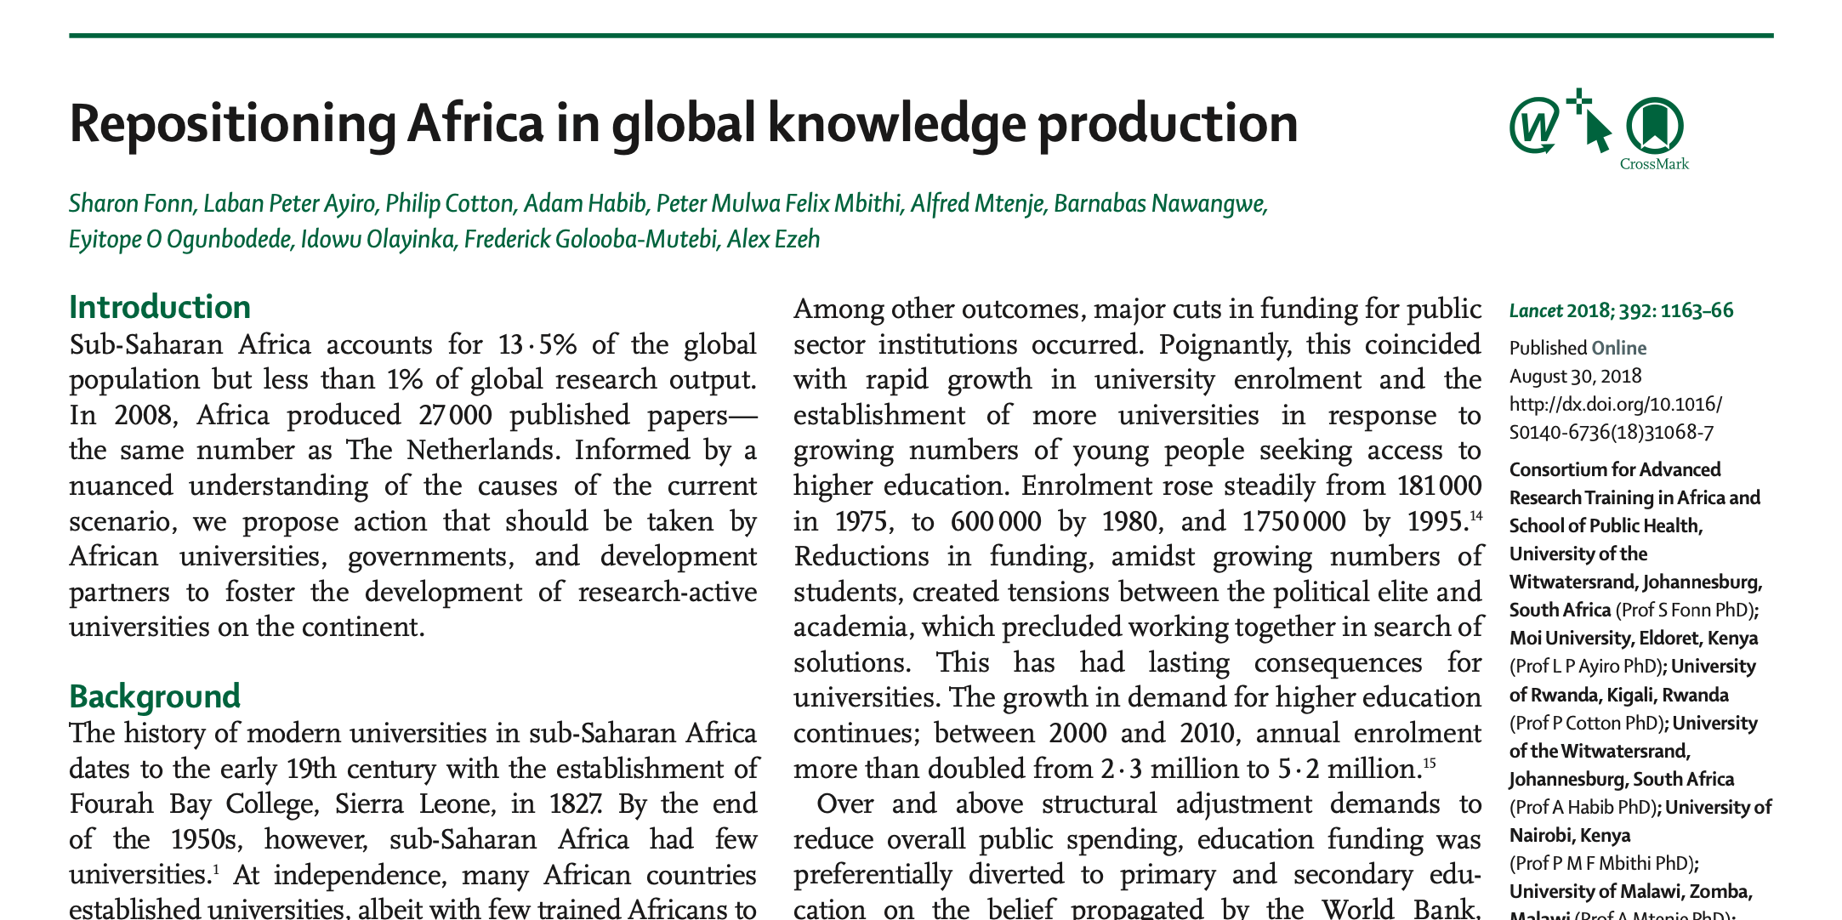

Sub-Saharan Africa has 13% of the world's population but less than 1% of research output. Africa published 27000 papers in 2008, the same as the Netherlands. The authors proposed actions that African universities, governments, and development partners should do to foster research-active universities across the continent.
Fonn, S., Ayiro, L. P., Cotton, P., Habib, A., Mbithi, P. M. F., Mtenje, A., ... & Ezeh, A. (2018). Repositioning Africa in global knowledge production. The Lancet, 392(10153), 1163-1166.

Slide 8
The origin story
How do students and academics in African universities experience internationalisation? (Ojo & Booth, 2009)
Who defines curriculum authority, mobility, and partnership priorities? (Ojo, 2016; Ojo, Booth & Woollacott, 2019).
What counts as ‘participation’ versus ‘power’? (My 2009-2016 body of work)
My early work began with everyday institutional questions that revealed deeper structural asymmetries
Notes:
Looking back at my early work on internationalisation and curriculum, I realise that I was already grappling with a question we are now naming more directly: how Global South universities can be fully present in global systems, yet structurally absent from power.”

Slide 9
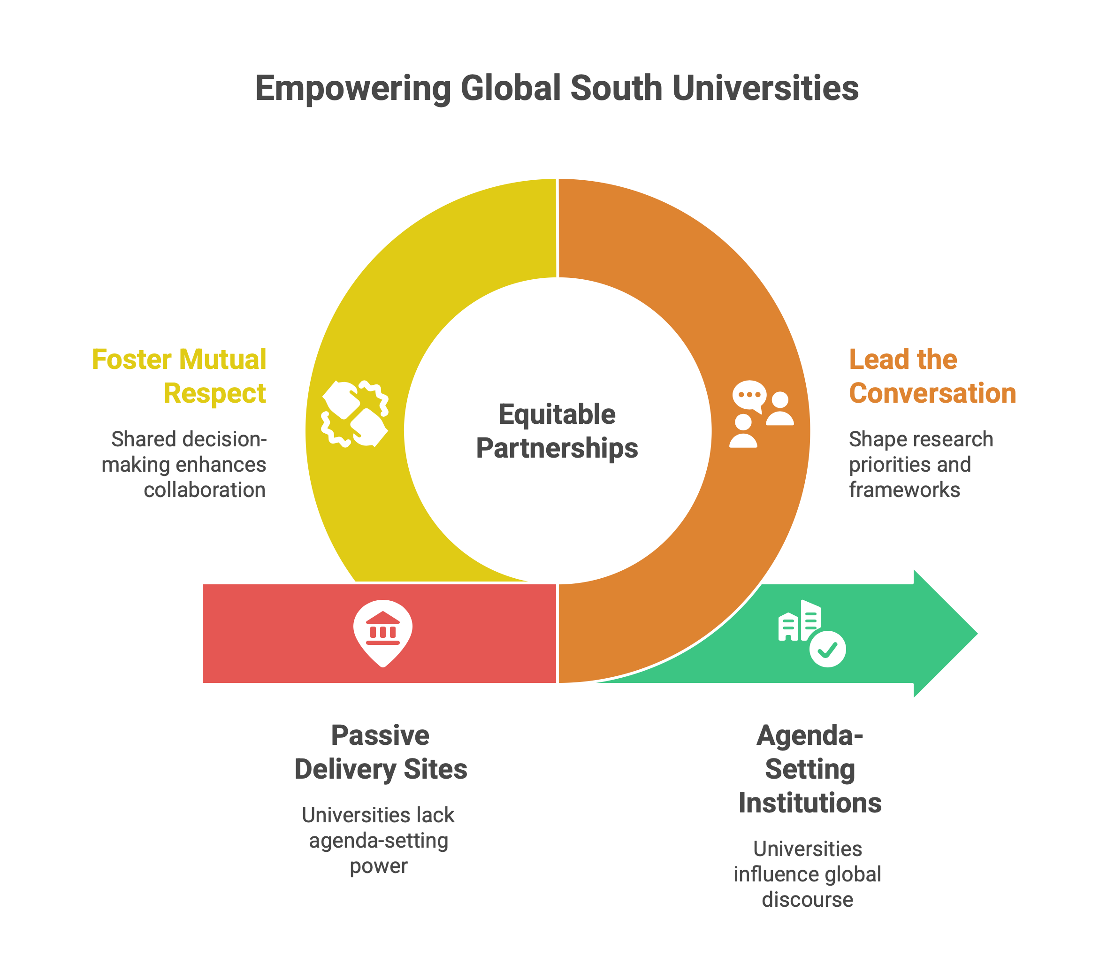
The Central Question
What would equitable partnerships look like if Global South universities were agenda-setters rather than delivery sites?
Agenda-setting
Governance and decision-making
Long-term institutional benefit
Notes:
This question frames everything that follows.

Slide 10
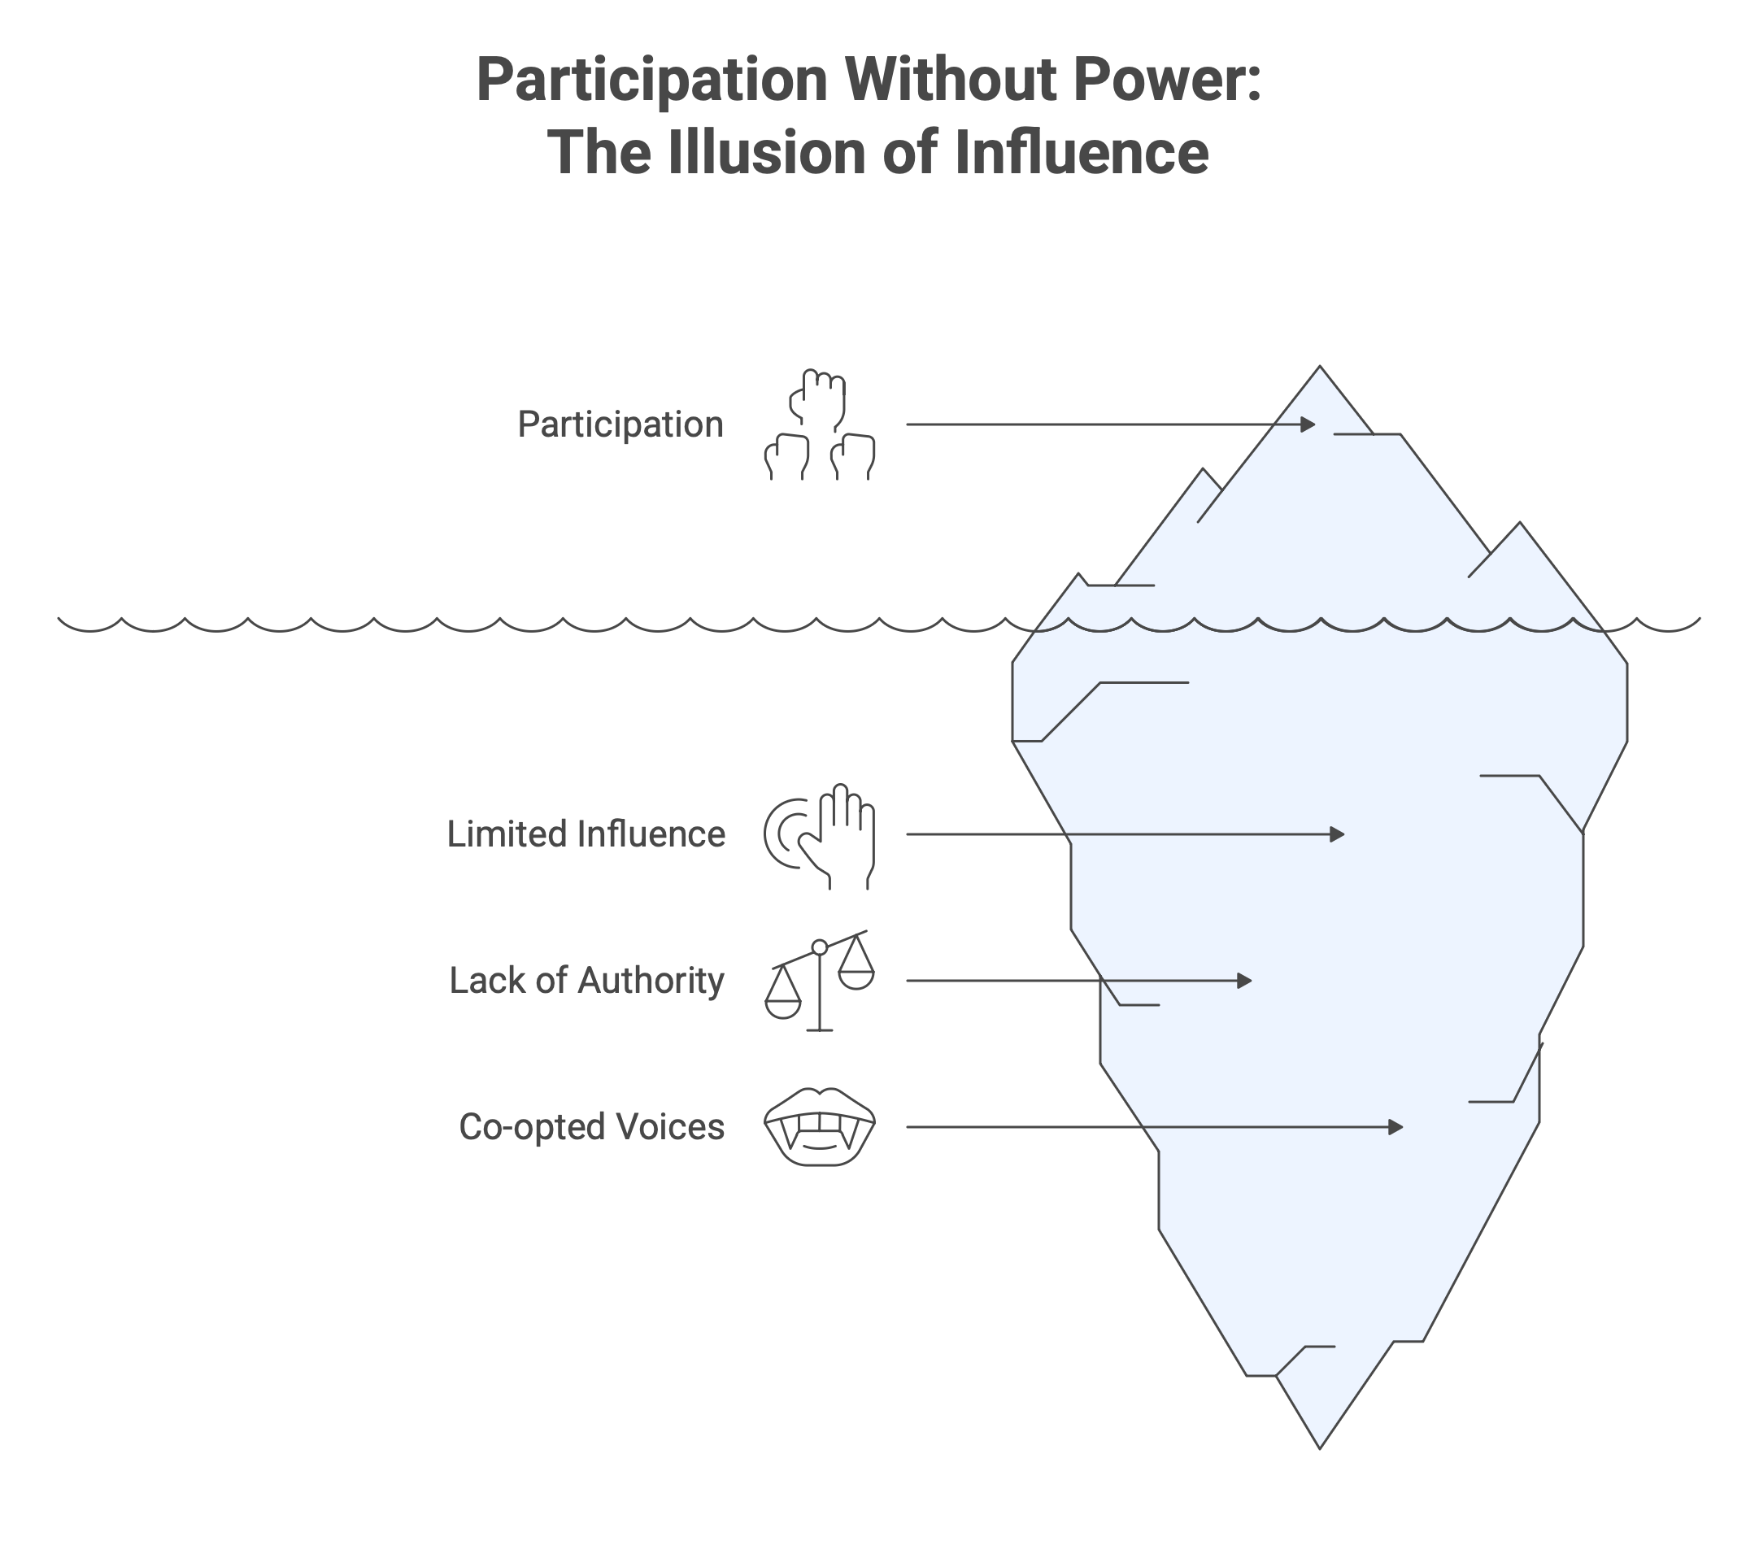
Seeing the System: Participation Without Power
Structural asymmetries in:
internationalisation
mobility
curriculum authority
Global South institutions positioned as implementers

Slide 11

Crisis, Technology, and the Limits of Good Intentions
2
Uses COVID-19 and AI as stress tests
Shows why goodwill and partnerships rhetoric are insufficient
Lands my core thesis

Slide 12
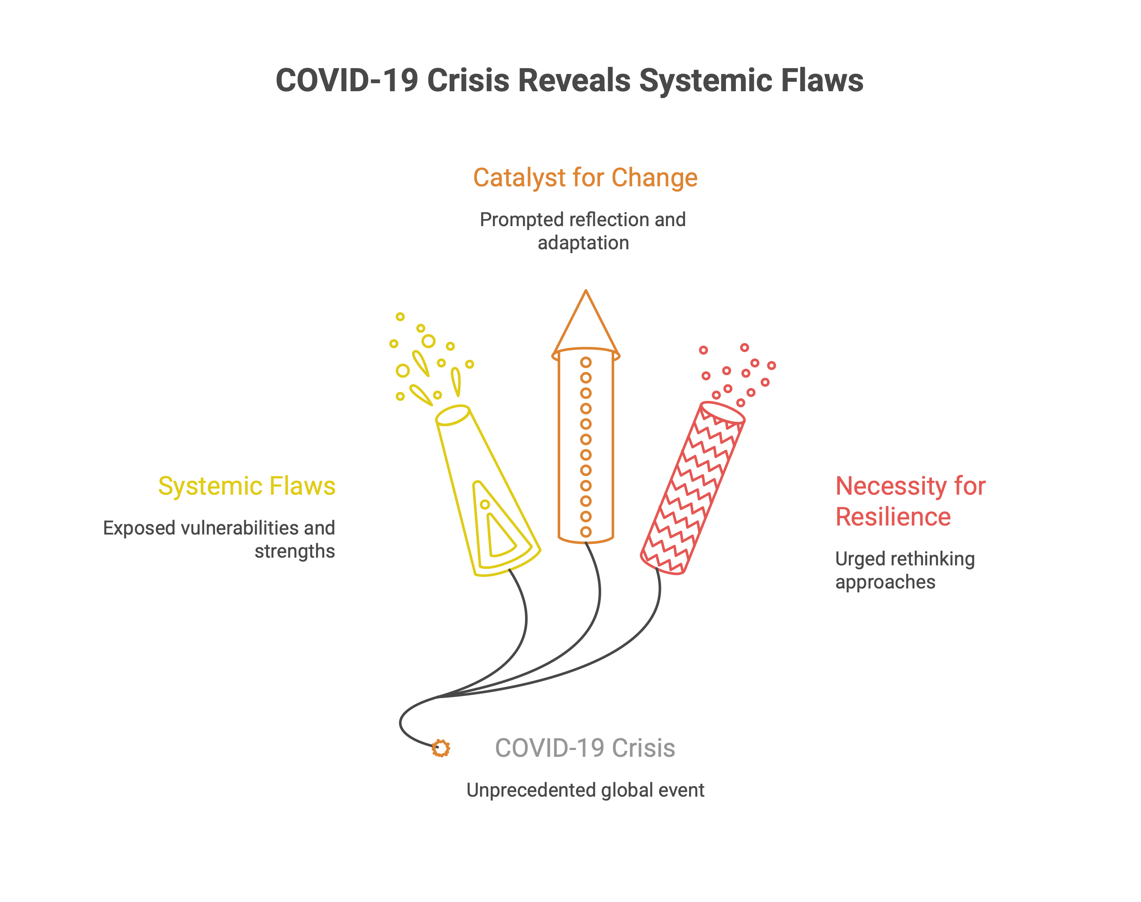
Crisis as Revelation: COVID-19 as a Stress Test
Unequal partnerships externalised risk
Digital continuity masked structural inequity
Global South institutions absorbed systemic shocks

Slide 13
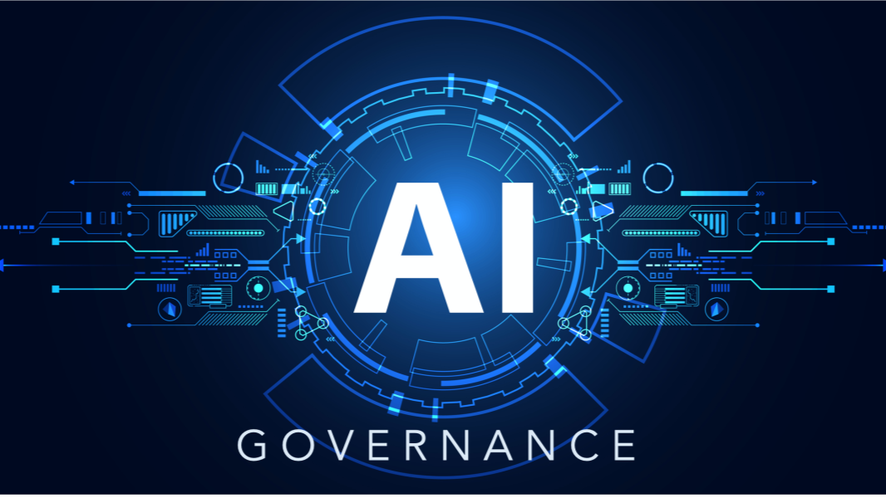
Knowledge, Technology & Power:
AI and the Governance Question
Who governs AI use in teaching, research, and assessment?
Who controls data, ethics, and accountability?
Technology intensifies existing asymmetries
Notes:
Technology does not democratise by default. It amplifies design choices.

Slide 14
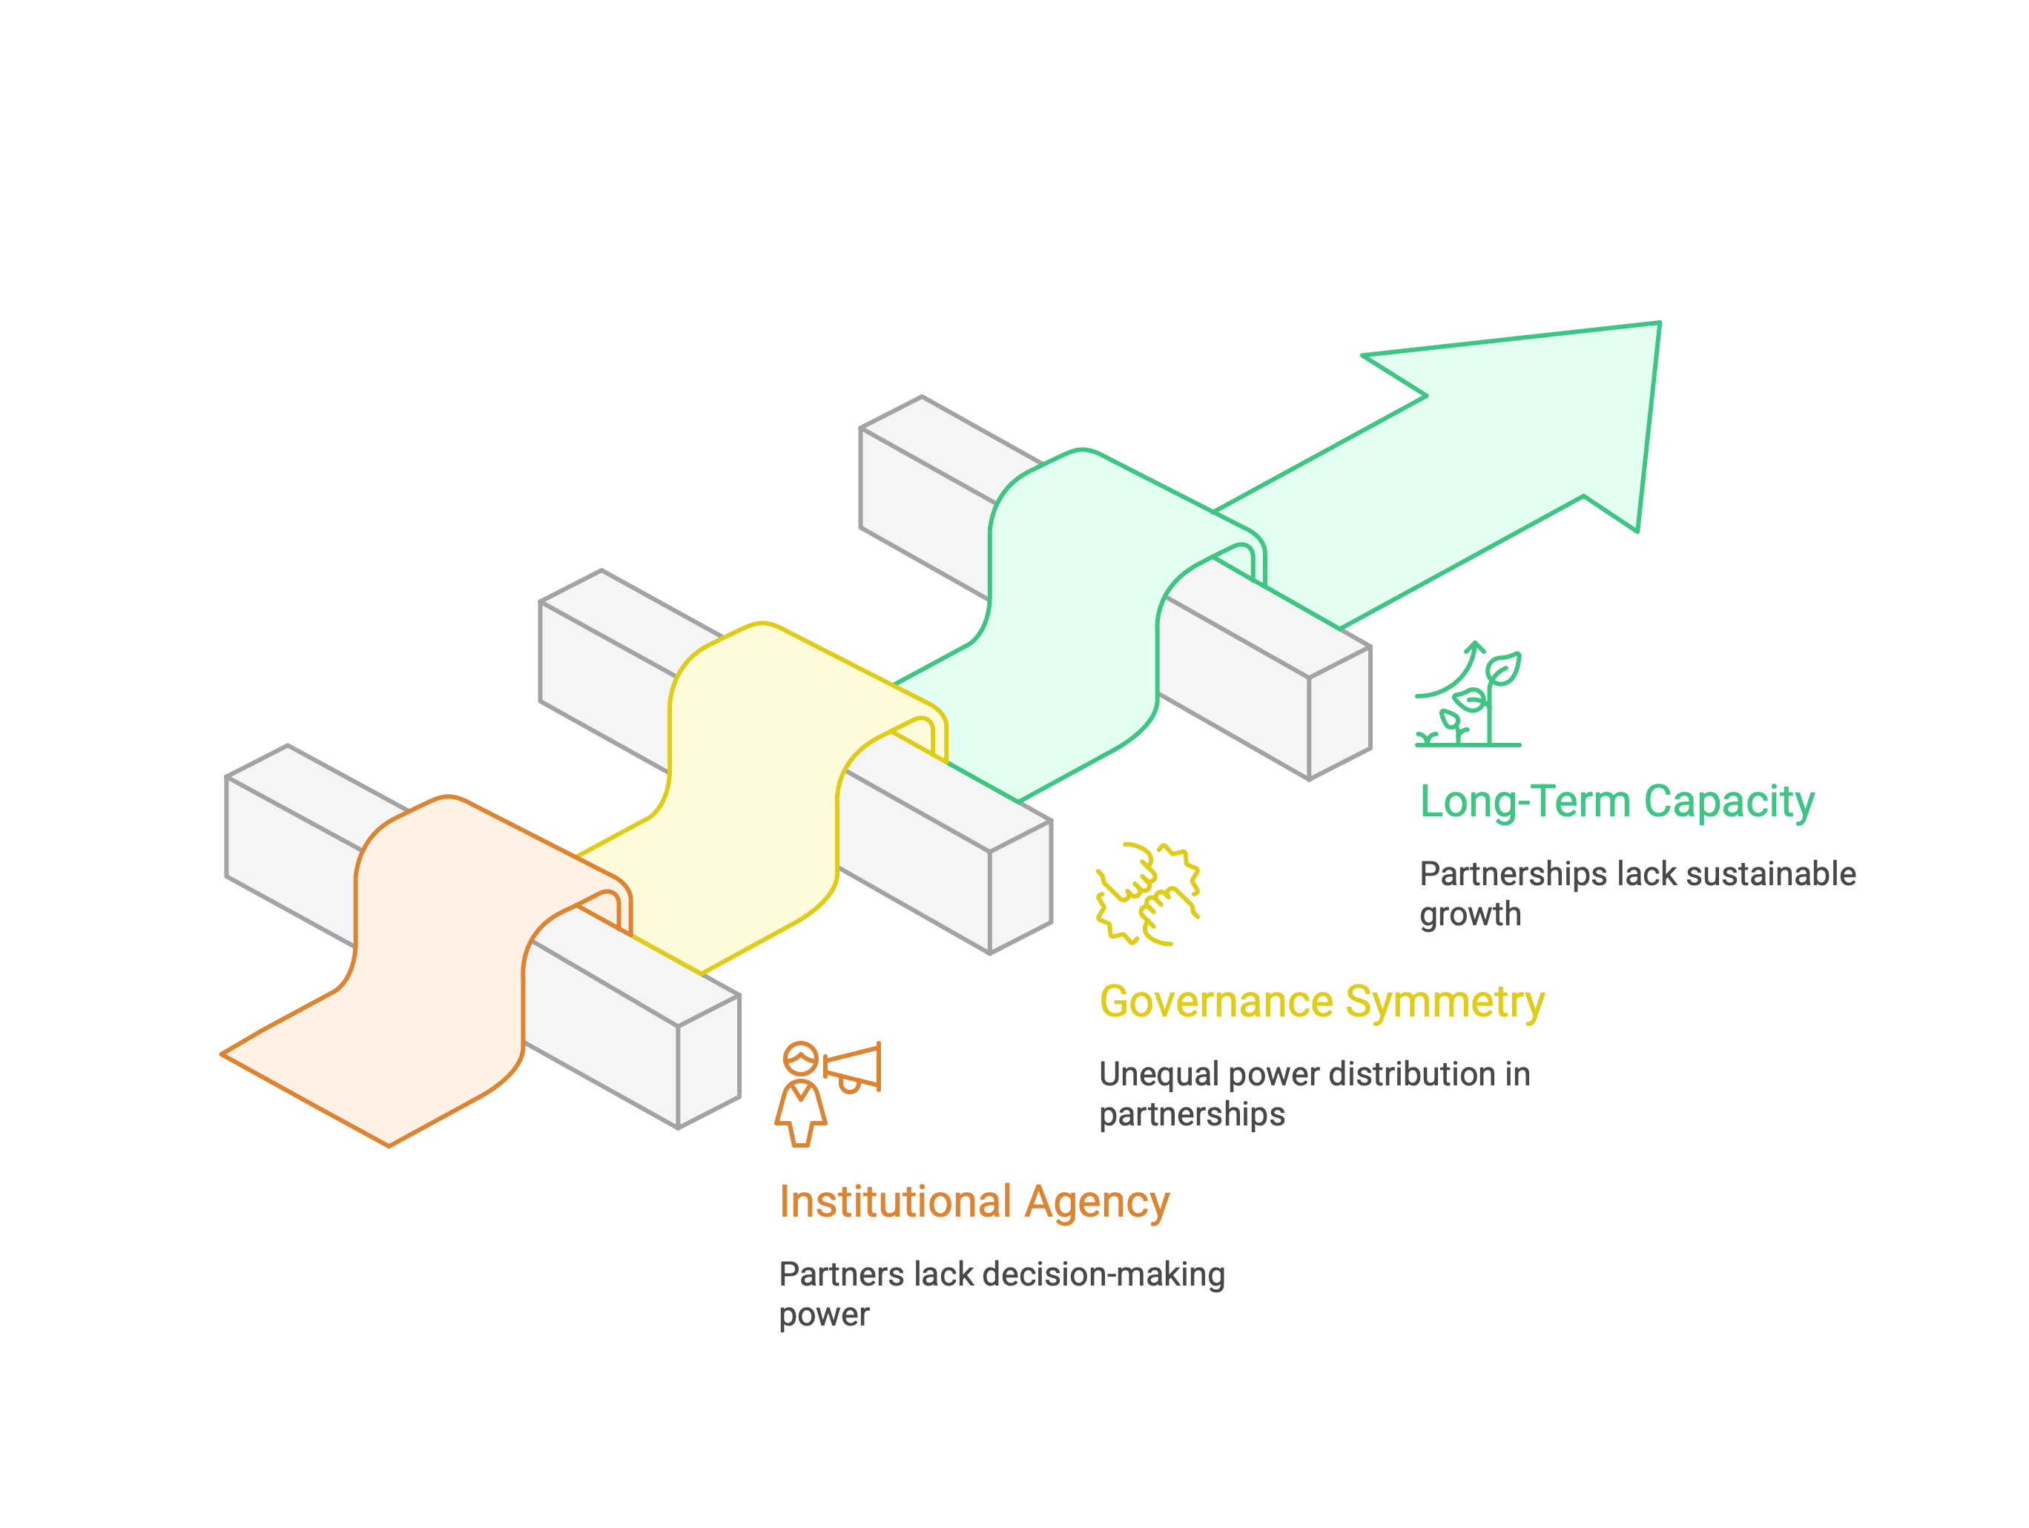
Synthesis Insight : The Design Failure
Equity failures persist not because of intent.
But because partnerships lack:
institutional agency
governance symmetry
long-term capacity logic
Notes:
This is a systems failure, not a relational one.

Slide 15
My core thesis, my core argument
Equitable partnerships are a systems-design challenge,
not a relationship problem.
Design determines power
Governance determines equity
Institutions determine sustainability
Notes:
This is a systems failure, not a relational one.

Slide 16
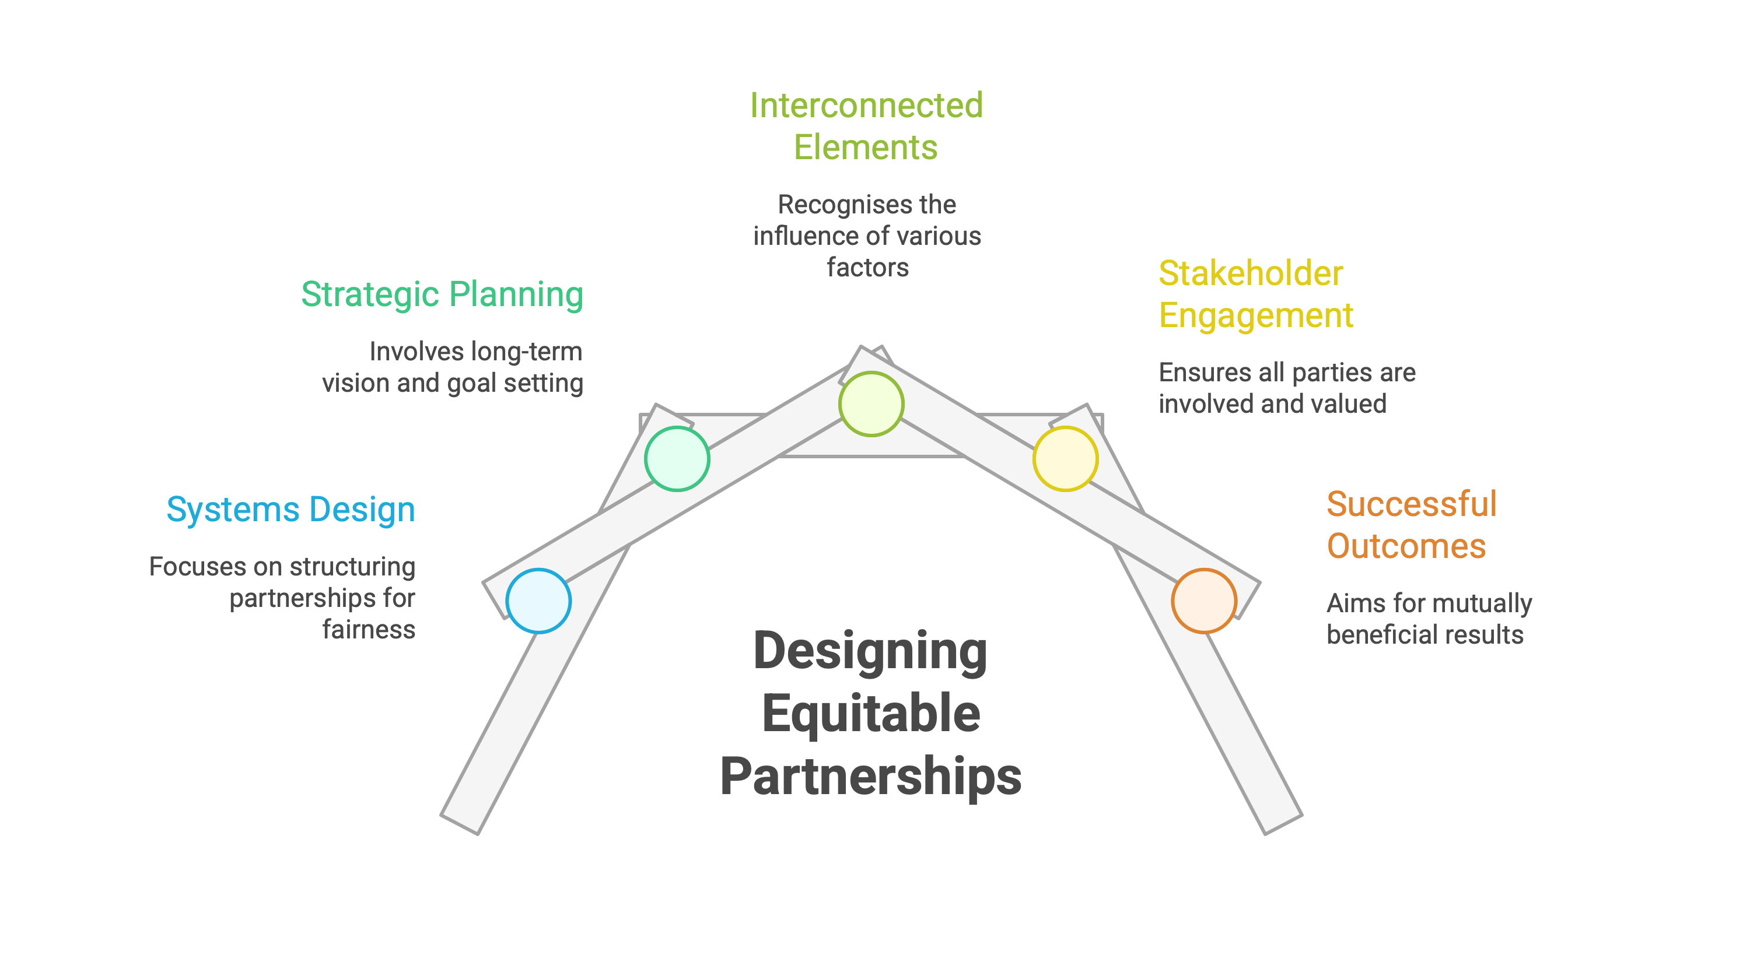
Equitable partnerships are a systems-design challenge, not a relationship problem.

Slide 17
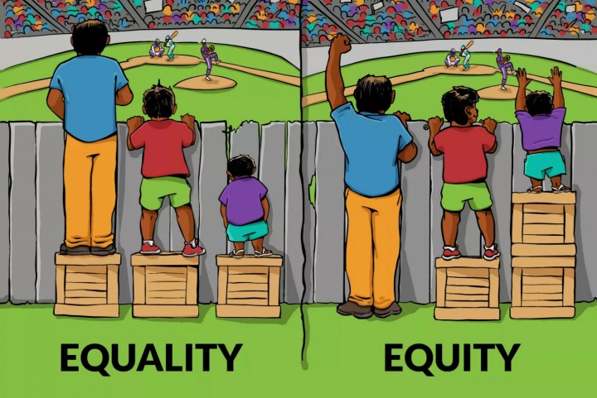
Designing for Equity
3
Introduces my triad framework
Applies it to higher education
Makes the invitation to act

Slide 18
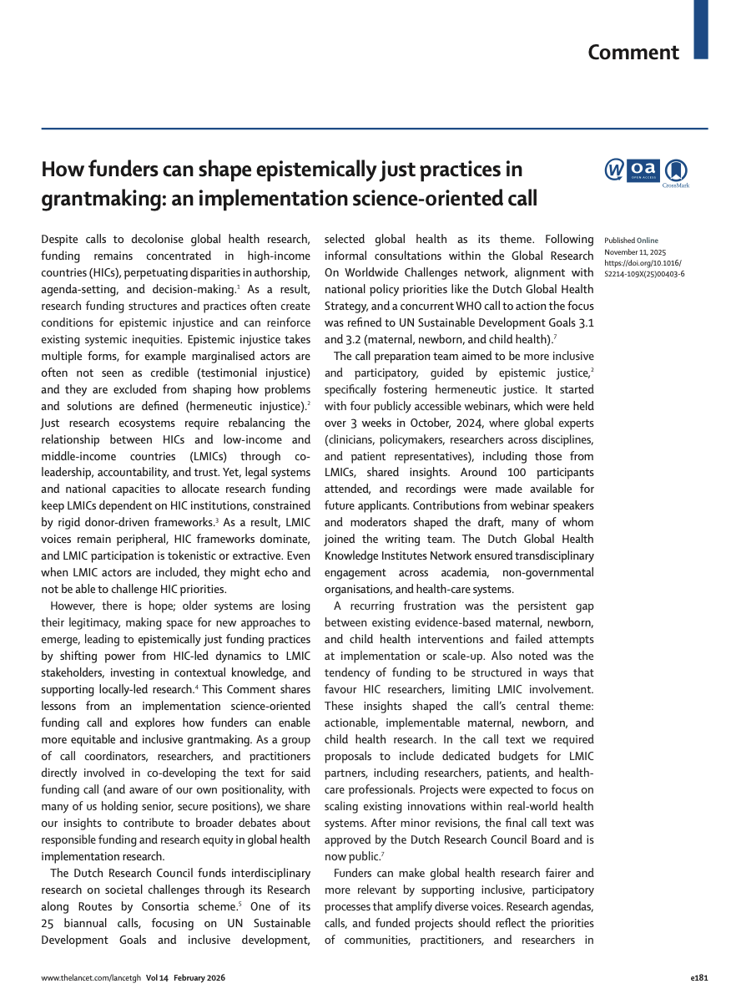
The Triad Framework: how do we design for equity?
Three non-negotiables::
Agenda equity
Governance equity
Benefit equity
Equity must be designed across
all three dimensions.
Kolpa, N. E. M., Kamerling, R., Chattopadhyay, S., Ojo, E. O., Biru, M., Bonfrer, I., de Kok, B., van Heteren, G., Bloemenkamp, K. W. M., Stikkers-Muller, B., Jerene, D., Bailey, A., Koi-Larbi, K., Roseboom, T., Voskuijl, W., Lange, I. L., Filippi, V., Murni, I. K., Beyuo, T. K., van de Klundert, M. A. W., Hinrichs-Krapels, S., & Browne, J. L. (2026). How funders can shape epistemically just practices in grantmaking: An implementation science-oriented call. The Lancet Global Health, 14(2), e181–e183. https://doi.org/10.1016/S2214-109X(25)00403-6
Notes:
Equity must be designed across all three dimensions.

Slide 19
What This Means for Higher Education
Universities as Epistemic Anchors
From compliance partners → agenda-setters
From project sites → governance actors
From short-term delivery → long-term institutional capacity
Notes:
This is a shift in institutional self-understanding.

Slide 20
The Gap in Current Practice: What Current Frameworks Miss
Inputs and outputs audited
Power, decision rights, and legacy ignored
Equity treated as procedural, not structural
Notes:
This is where most partnership models fall short.

Slide 21

The offer: A Governance-First Partnership Framework
A governance-first partnership framework must be:
co-designed with universities and funders
piloted across diverse institutional contexts
evaluates (1) agenda-setting, (2) governance, and (3) benefit distribution
Notes:
This is not a finished model. It is a collaborative proposition.

Slide 22
SLIDO.com Session: Current Locus of Agenda-Setting Power

Slide 23
A call to action: From Rhetoric to Redesign
Co-design partnership governance
Pilot equity-focused frameworks
Publish institutional learning
If we are serious about equity, we must redesign the system.
Notes:
This is a shift in institutional self-understanding.

Slide 24
My closing reflection
Equity is not generosity.
It is architecture.
And higher education must help design it.
Equality distributes the same support.
Equity redesigns support to achieve fair outcomes.
Again, equity is not generosity. It is architecture!
Notes:
Entire scholarly and leadership trajectory.

Slide 25
Recommended core readings (I)
Cross, M., Mhlanga, E., & Ojo, E. (2011). Emerging concept of internationalisation in South African higher education: conversations on local and global exposure at the University of the Witwatersrand (Wits). Journal of Studies in International Education, 15(1), 75-92.
Kolpa, N. E. M., Kamerling, R., Chattopadhyay, S., Ojo, E. O., Biru, M., Bonfrer, I., de Kok, B., van Heteren, G., Bloemenkamp, K. W. M., Stikkers-Muller, B., Jerene, D., Bailey, A., Koi-Larbi, K., Roseboom, T., Voskuijl, W., Lange, I. L., Filippi, V., Murni, I. K., Beyuo, T. K., van de Klundert, M. A. W., Hinrichs-Krapels, S., & Browne, J. L. (2026). How funders can shape epistemically just practices in grantmaking: An implementation science-oriented call. The Lancet Global Health, 14(2), e181–e183. https://doi.org/10.1016/S2214-109X(25)00403-6
Ojo, E. (2024). Education in the eye of the storm: A bibliometric review of research on global crises and their impact on Southern African education (2000–2024). Southern African Review of Education, 29(1), 15-40.
Ojo, E. (2026). Ethical integration of technology in teacher education: A global perspective. In K. Wild, T. Grummel, & N. Dasouqi (Eds.), Internationalising teacher education: Concepts, approaches and research (pp. 105–108). V&R unipress. https://doi.org/10.14220/9783737018036

Slide 26
Recommended core readings (II)
Ojo, E., & Booth, S. (2009). Internationalisation of higher education in a South African university: A phenomenographic study of students’ conceptions Education as Change, 13(2), 69-83
Ojo, E., & Onwuegbuzie, A. J. (2020). University Life in an Era of Disruption of COVID-19: A Meta-Methods and Multi-Mixed Methods Research Study of Perceptions and Attitudes of South African Students. International Journal of Multiple Research Approaches, 12 (1), 20-55.
Ojo, E., Booth, S., & Woollacott, L. (2019). Faculty's Conceptions of Teaching Introductory Economics in Higher Education: A Phenomenographic Study in a South African Context. International Review of Economics Education. https://doi.org/10.1016/j.iree.2018.05.001

Slide 27


