Slide 1





Equitable Partnerships and
Research Capacity in Brazil:
Lessons from a UK-Northeast Brazil Partnership
Dr. Ricardo Santos Oliveira

Slide 2
Outline of my presentation
Who are we and why research capacity strengthening matters?
The partnership grant
15 months into the grant: What have we achieved and challenges
Next steps
Lessons learned and how to make the trajectory smoother

Slide 3
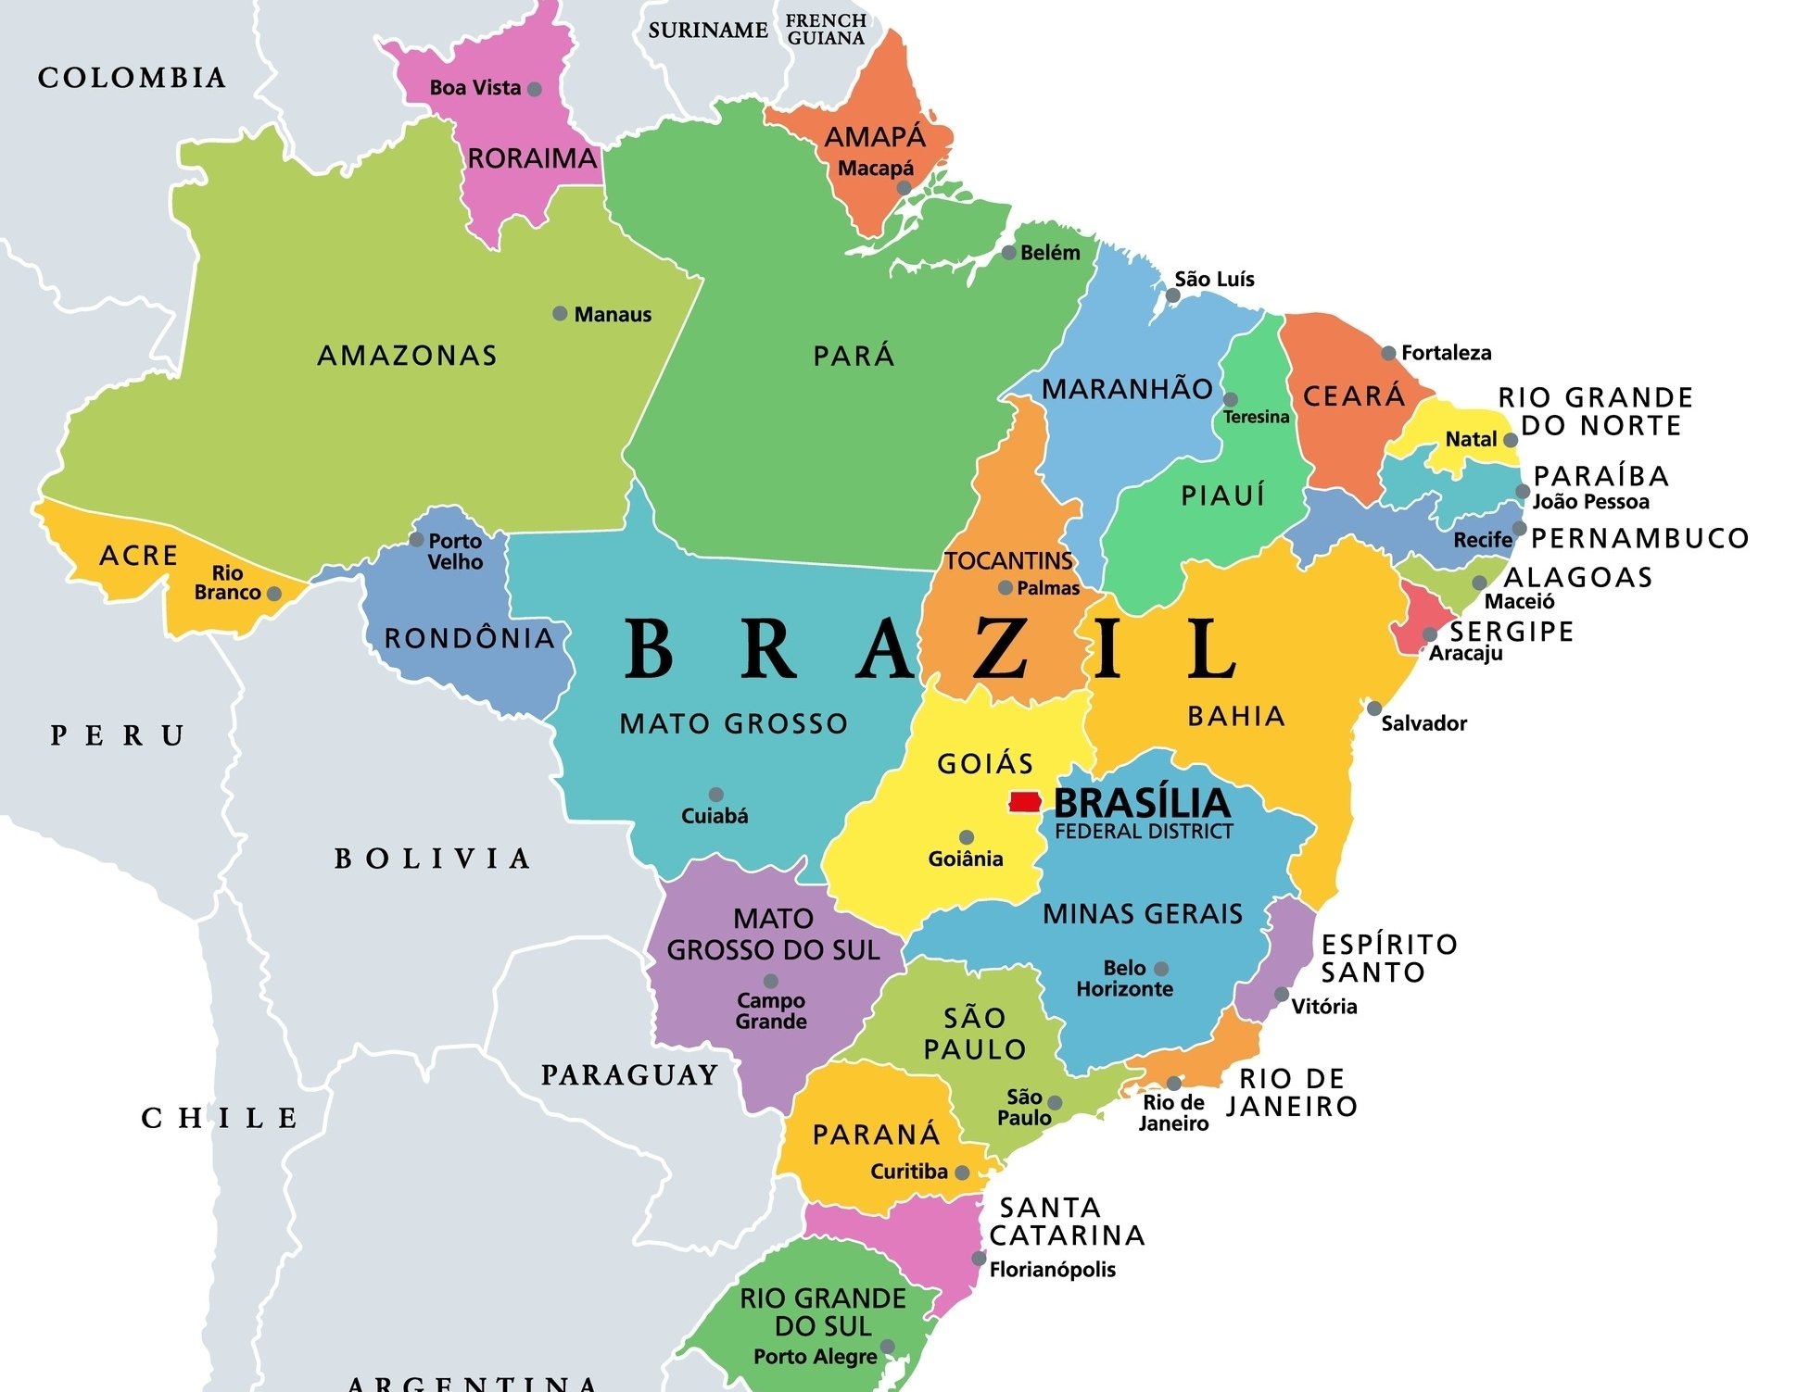
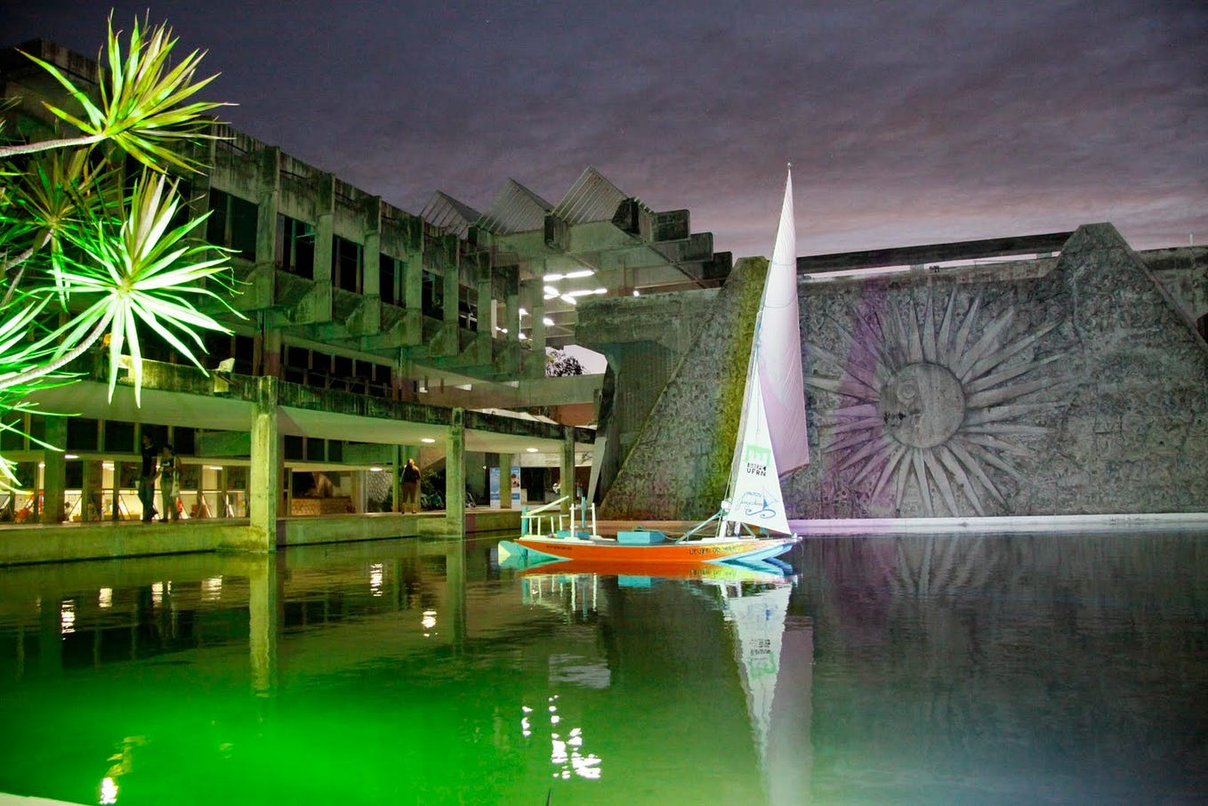
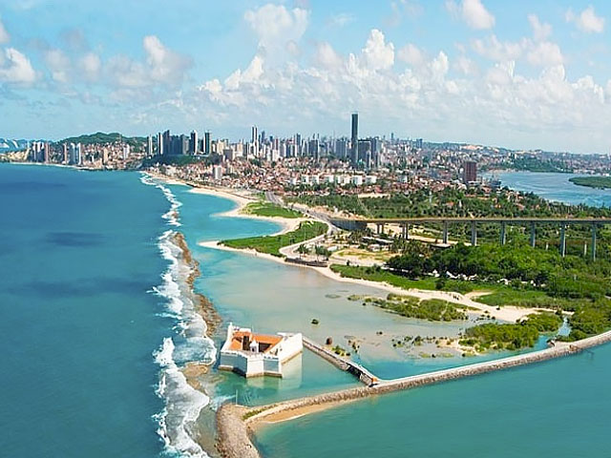
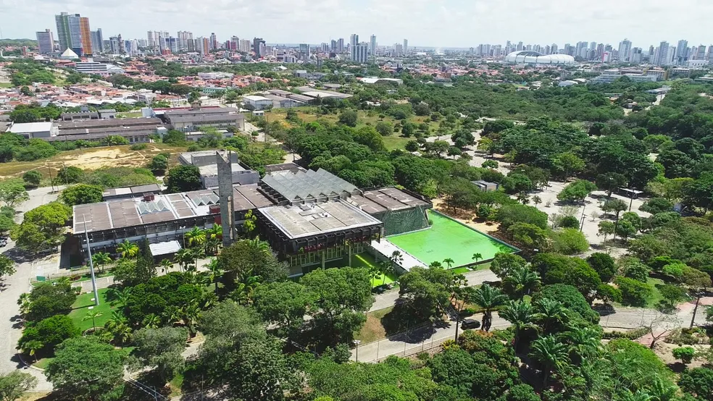

Natal - RN

Slide 4
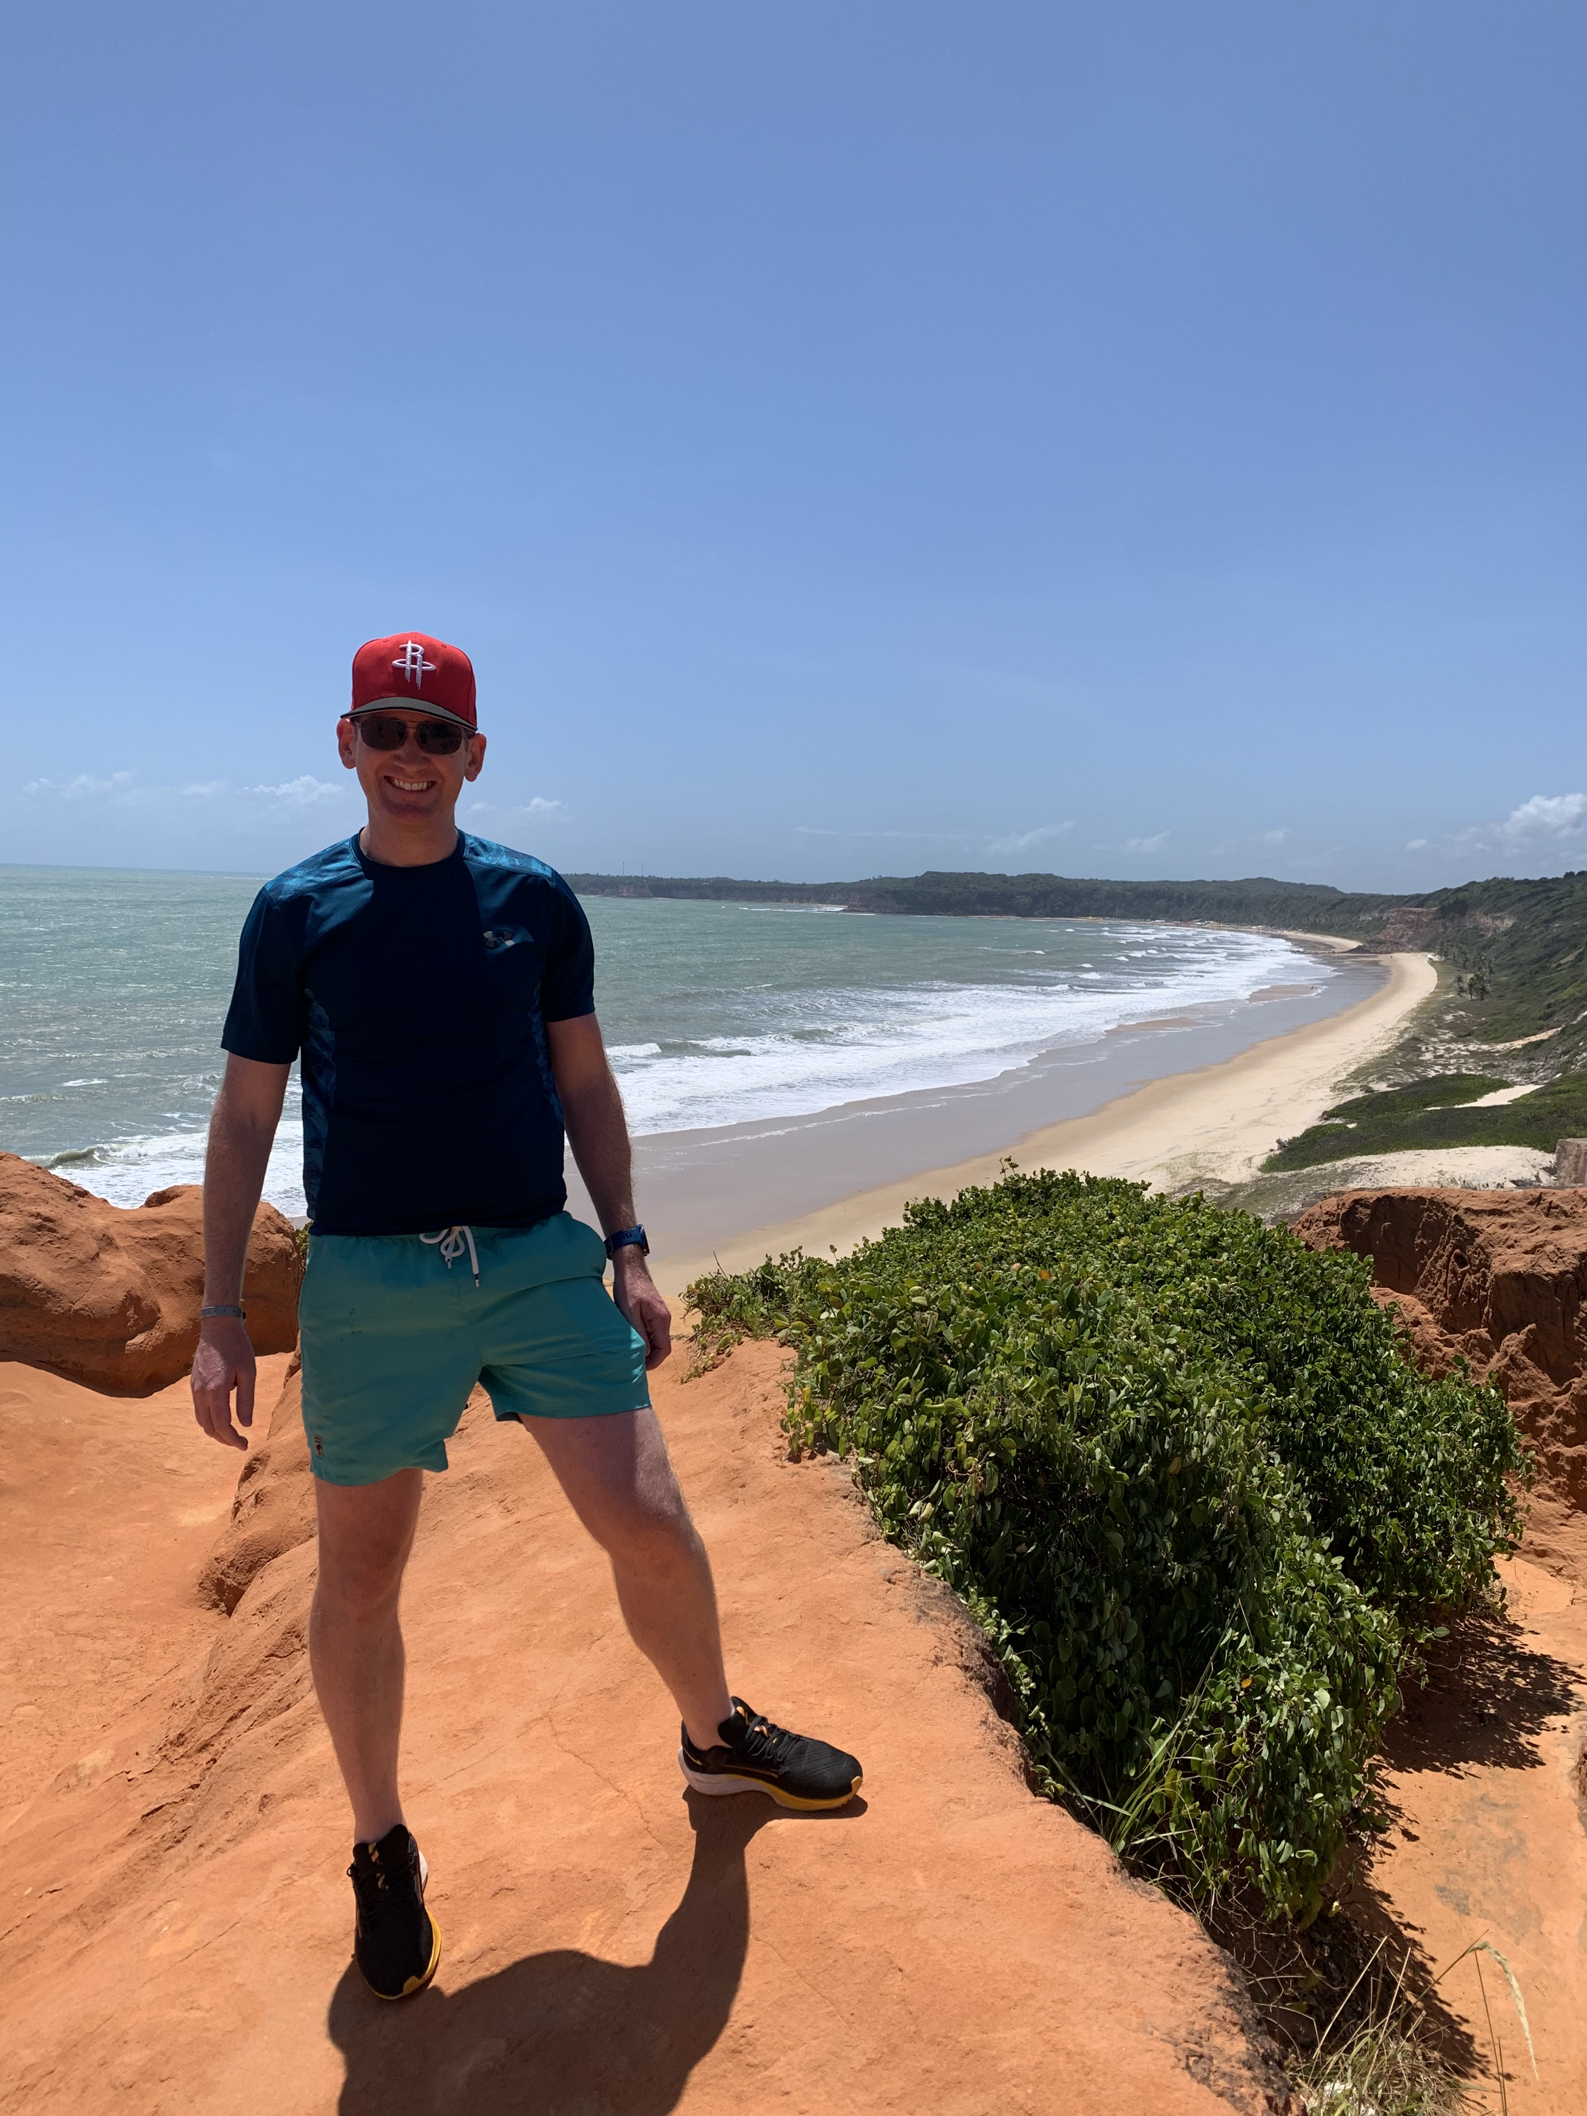
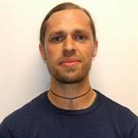

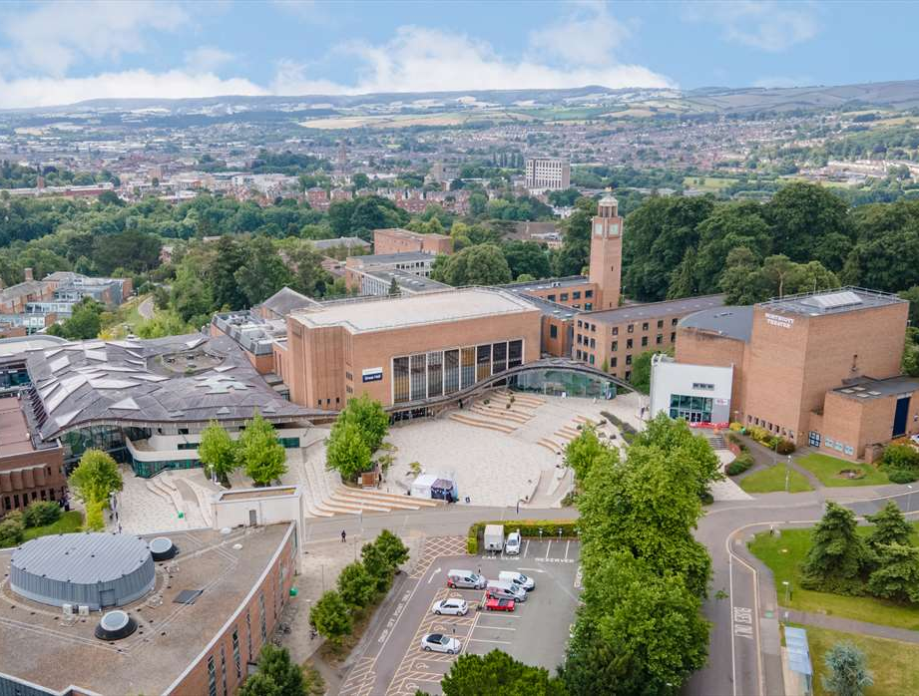

Slide 5
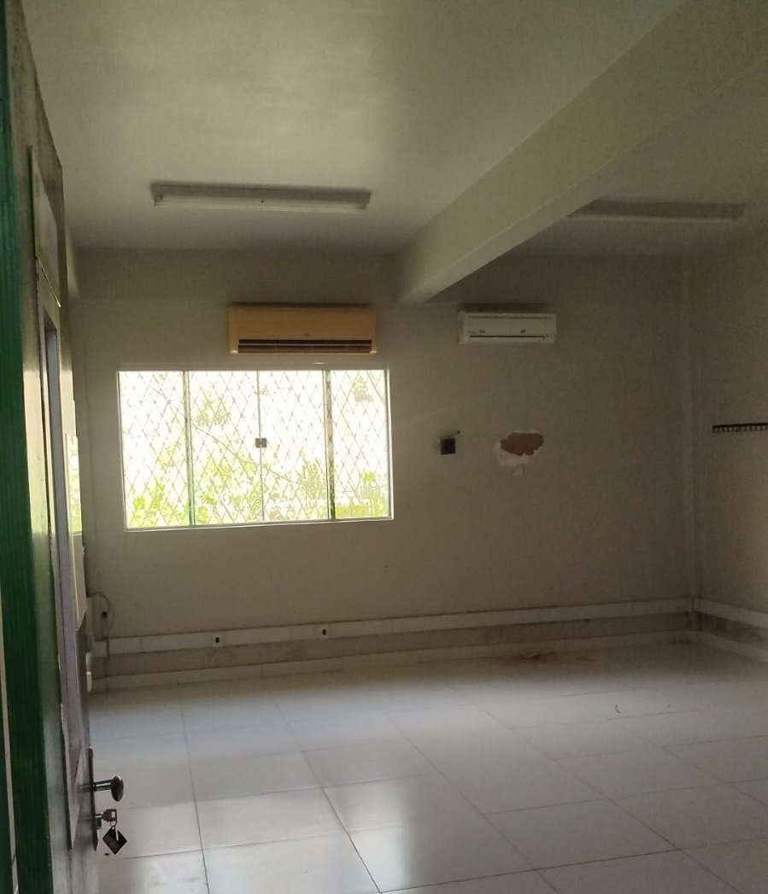
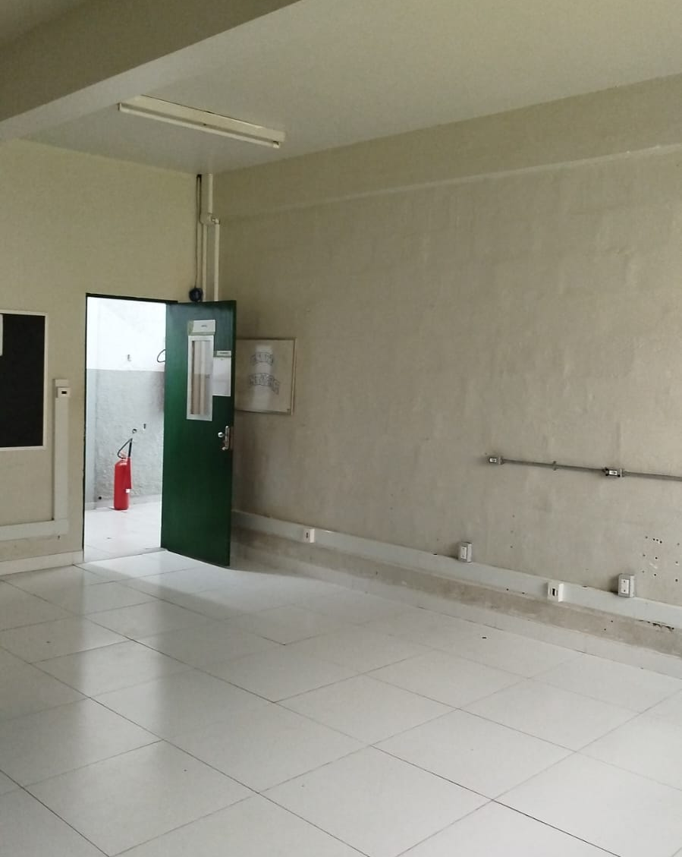
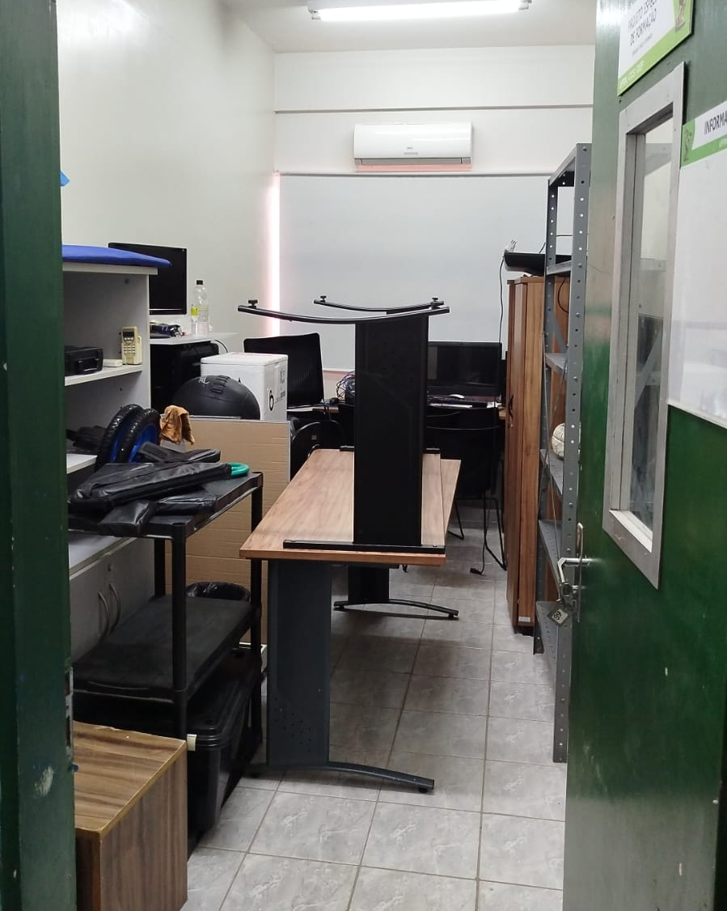
Why research capacity matters?
FamilyID=Office_ArchiveTorn

Slide 6
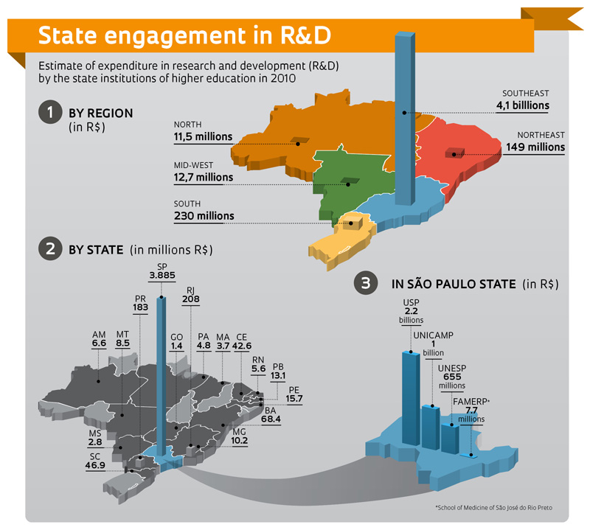
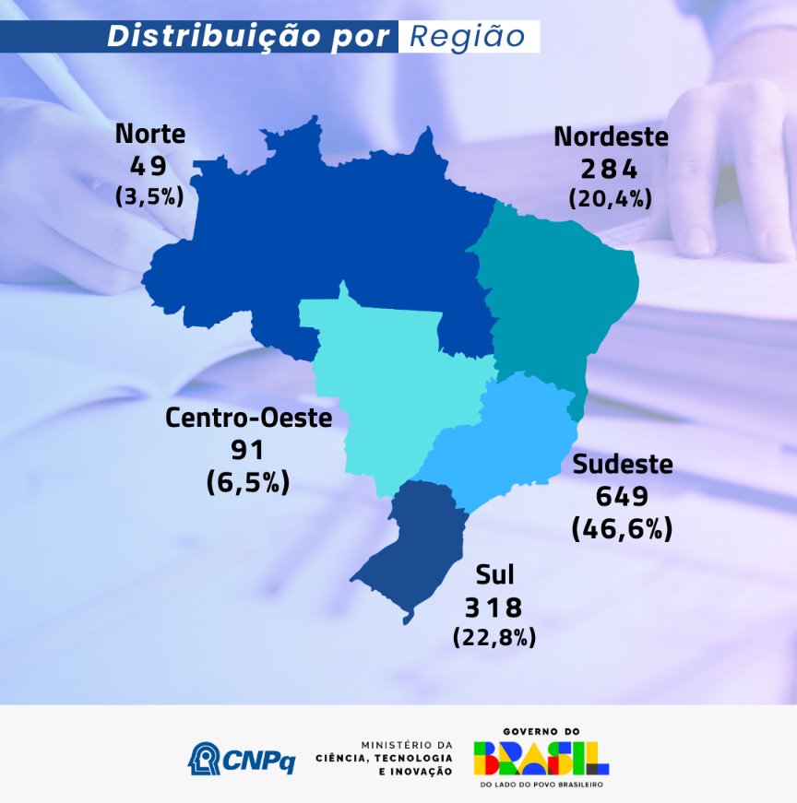
Post-doc funding
Distribution by region
North
Northeast
Mid-west
Southeast
South
R&D expenses

Slide 7





Increase research capacity and investigate vascular health and physiology in the transition to adolescence.
A diverse SES from Natal, as this group is under-represented.
Outreach activities are also proposed to place children/adolescents at the centre of health research

Slide 8
The Expectation: Immediate start of research activities.
The Reality: 14 months of administrative navigation and academic progress just starting to be made.

Slide 9

Journey Overview
A 15-month timeline revealing institutional challenges beyond science.
M10-12
M13+
M1
M2-5
M6-9
Starting
Archaeology
Legal Puzzle
Registration
Lift-off
Award letter received.
Navigating UFRN other offices
Identifying restrictions and solutions
Final details and registration
Invoice and starting scientific
14+
5
Months Duration
Key Phases

Slide 10
Challenge: #1 Due diligence
The Challenge: No single department to answer the comprehensive set of legal, financial, and ethical questions required by the UK funder
International Office → institutional history/agreements
Planning Office → financial systems
Research Office → ethics and final signature
FUNPEC
It is a long exercise in institutional archaeology performed by the researcher because no dedicated support team exists

Slide 11
Challenge: #2 Legal aspects
The Funding difference – Individual vs. Institutional
UK - Funds are awarded to the Institution
Brazil: Funds the individual researcher
The FUNPEC. UFRN must "outsource" grant management to a non-profit foundation
Fees
Legal Barrier: Brazilian law/internal rules made it impossible to pay these fees
The Equitable Solution: UFRN demonstrated institutional commitment by covering FUNPEC’s fees.

Slide 12
The Institutional Gap: "Legal Shield" vs. "Legal Support"
Feature | The Research Office (UK Model) | The Procuradoria (Brazilian Model)
Primary Client | The Researcher / The Project | The University Administration (The Provost)
Goal | To make the research happen safely. | To protect the University (and the Union) from legal risk.
Relationship | Collaborative / Facilitative | Supervisory / Consultative
Direct Access | Open to all faculty and PIs | Open to all faculty and PIs

Slide 13
Challenge: #2 The legal aspects
Legal Engineering – Two Agreements
A single "tripartite” (UoE, UFRN, FUNPEC) agreement proved legally unworkable
The solution:
Contract A: UoE ↔ UFRN
Contract B: UFRN ↔ FUNPEC
Key Insight: This complexity requires researchers to act as legal architects

Slide 14

Lessons Learned
01
02
03
Anticipate Complexity
Map Legal Early
Seek Creative Solutions
Administrative navigation can take months. Plan for institutional friction from day one
Identifying hurdles early prevents significant rework and allows for strategic planning of alternative routes
Collaboration between international and local partners can overcome legal restrictions
04
05
Attention to Detail
Persistence
Minor administrative errors can cause disproportionate delays
Patience, diplomacy, and consistent persistence across all levels
Building Institutional Experience for future collaborations.

Slide 15
Where are we now?
Shared Problem Solving: Regular meetings with the UoE team were not just about science; they were "administrative therapy" and shared strategy.
Co-Designing the Team:
Post-doc Recruitment
Mentorship
The Win: The partnership built a physical and intellectual foundation that is more robust than a simple "cash transfer" project.

Slide 16
Challenge #3 – Executing the funds
Once in Brazil they are tied to Brazilian rules
Reports and justification to everything
Importation and budget administration

Slide 18
Moving forward
Fund a "Year Zero": The first 12 months may be purely administrative. Build this into the grant lifecycle without penalising scientific output.
Allow for "Administrative Overhead": FUNPEC fees
Standardized Legal Templates
Setup time is not "lost time"—it is the foundational work of building a sustainable partnership.
Notes:
Diminuir texto… divide em mais slides

Slide 19
Moving forward
Future projects should explicitly budget for and schedule an "Administrative Year Zero.”
We need to distinguish research funds from general government procurement.
Universities should decrease the number of justifications and reports.
Notes:
Diminuir texto… divide em mais slides

Slide 20
Obrigado
Dr Bert Bond
ricardo.oliveira@ufrn.br

