Slide 1


Association of African Universities (AAU)
Harmonizing Quality
Assurance in Africa:
Trust, Communication, and Leadership for Sustainable South–South Collaboration
Prof. Adewale Olusegun Obadina

Slide 2
Why Quality Assurance (QA) Matters for
Equitable Partnerships
Leadership for Sustainable South–South Collaboration
The African Quality Assurance Landscape
South–South Collaboration: Opportunities and Value Addition
Presentation Outline
Harmonization as a
Trust-Building Process
Case Illustrations and Emerging Good Practices
Communication:
The Missing Link
in QA Systems
Pathways Forward:
From Policy to Practice
2

Slide 3
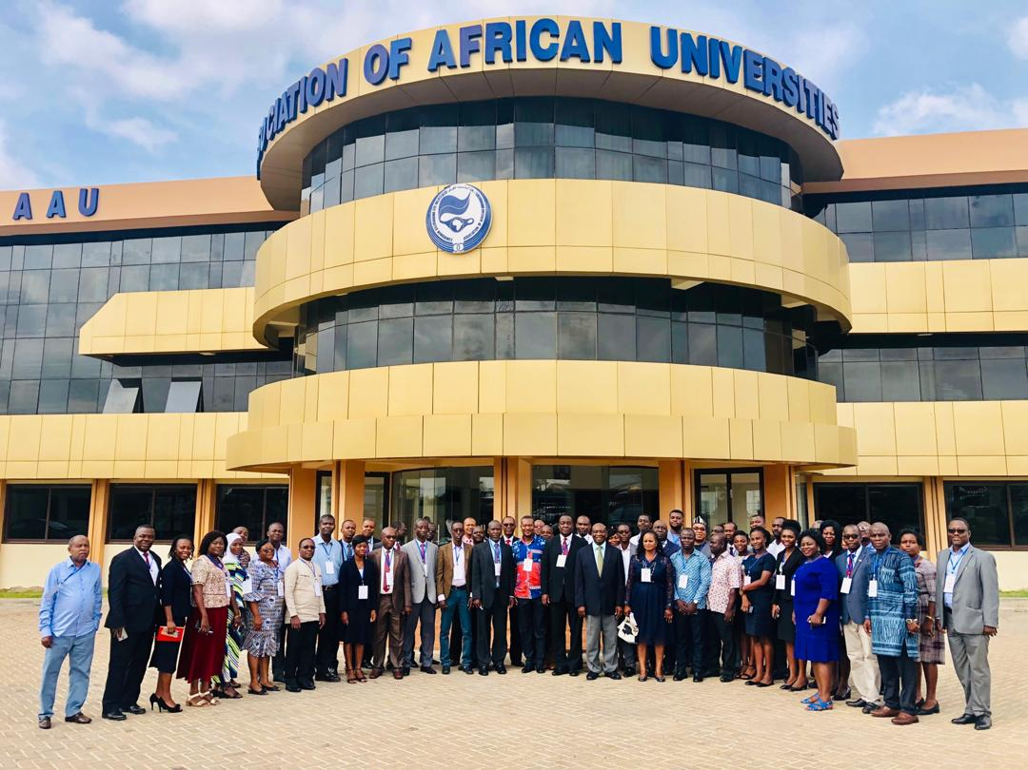
Association of African Universities (AAU)
The Association of African Universities (AAU) is the apex higher education organization in Africa, serving as the collective voice of African universities.
  Established: 1967
  Headquarters: Accra, Ghana
  Membership: 450+ universities and higher education institutions across Africa
  Mandate: Promote cooperation, quality, relevance, and innovation in African higher education
3

Slide 4



Introduction
Why Quality Assurance (QA) Matters for Equitable Partnerships
Quality assurance as the currency of trust in cross-border collaboration
Growing South–South academic,
research, and innovation partnerships in Africa
Persistent challenges: fragmentation, uneven standards,
weak mutual recognition
4

Slide 5

Framing the Conversation
  QA beyond compliance → QA as an enabler of equity, mobility, and sustainability
  Link to conference theme: equitable partnerships require trust, communication, and leadership
5

Slide 6



National QA agencies with varying mandates and capacities
Regional QA frameworks and networks (e.g. AfriQAN, regional QA networks)
Continental initiatives (PAQAA, African Credit Transfer System – ACTS)
The African Quality Assurance Landscape
Current State of QA in Africa
6

Slide 7
Key Gaps and Tensions
  Limited harmonization and mutual recognition
  Capacity asymmetries between institutions and countries
  North-driven benchmarks vs African realities
7

Slide 8

Harmonization as a
Trust-Building Process
What Do We Mean by Harmonization?
  Not uniformity, but alignment, comparability, and transparency
  Respect for diversity while ensuring minimum agreed standards
8

Slide 9
Harmonization as a Trust-Building Process
Trust as the Foundation
  Trust between institutions, QA agencies, and regions
  Predictability and credibility of QA decisions
  Role of peer review and shared evaluation cultures
9

Slide 10








Communication:
The Missing Link in QA Systems
Communication Challenges
Technical QA language inaccessible to many stakeholders
Weak feedback loops between
QA agencies and universities
Limited student, industry,
and community engagement
10

Slide 11
Strengthening Communication for Equity
What Do We Mean by Harmonization?
  Transparent QA processes and criteria
  Clear articulation of learning outcomes and competencies
  Digital platforms for sharing QA data, reviews, and good practices
11

Slide 12


Leadership for Sustainable
South–South Collaboration
Leadership Beyond Administration
Strategic leadership at
institutional and system levels
QA leaders as brokers of collaboration, not just regulators
12

Slide 13

Enabling Conditions for Strong Leadership
  Political commitment at national and continental levels
  Institutional ownership of QA reforms
  Investment in human capacity for QA professionals
13

Slide 14



South–South Collaboration:
Opportunities and Value Addition
Why South–South QA Collaboration?
Shared contexts, challenges, and development priorities
Co-creation of standards relevant
to African realities
Reduced dependency on
external validation
14

Slide 15
Practical Areas
for Collaboration
  Joint programme accreditation
  Mutual recognition of qualifications
  Shared QA training and peer-review pools
15

Slide 16
Case Illustrations and
Emerging Good Practices
Examples from Africa (Illustrative)
  Joint programme accreditation
  Regional QA peer-review mechanisms
  Pan-African initiatives supporting harmonization (e.g. ACTS pilots)
  University consortia aligning internal QA systems
16

Slide 17

Lessons Learned
  Incremental progress works better than big-bang reforms
  Trust grows through repeated, transparent engagement
Option 1
Option 2
  Ownership matters more than formal frameworks
17

Slide 18



Pathways Forward:
From Policy to Practice
Strategic Actions
Strengthen continental–regional–national QA coherence
Institutionalize trust-based
peer learning
Embed equity and inclusiveness
in QA criteria
18

Slide 19



Role of Key Actors
Universities: internal QA ownership
QA agencies: facilitative and developmental roles
Continental bodies (AAU, AU): coordination and advocacy
19

Slide 20

Key Messages for Equitable Partnerships
  Harmonized QA is a means, not an end
  Trust is built through consistency, transparency, and dialogue
  Communication determines legitimacy and buy-in
  Leadership sustains reforms and partnerships
20

Slide 21
Conclusion and Call to Action
  Reframe QA as a shared African public good
  Invest in people, systems, and relationships
  Advance South–South collaboration grounded in trust and equity
21

Slide 22
Closing Thought:
Without trust, standards remain paper; without communication, trust cannot grow; without leadership, harmonization cannot last.
22

Slide 23
Thank you
for Listening
23

