Slide 1

TRUST AND DUE DILLIGENCE
Palinji Mungoni
2nd Equitable Partnerships Conference, Pretoria
February 2026

Slide 2

From Risk to Resilience: Case Studies on Due Diligence and what the future holds
Tech-Enhanced trust in Partnerships
Notes:
---

Slide 3
Introduction and Agenda
Notes:
Conference Context and Presentation Overview

Slide 4
Conference Context and Presentation Overview
Conference (Session) Theme
The session focuses on 'Experiences and Practice' to enhance equitable international research collaborations.
Case Studies Overview
Three case studies highlight institutional risk management and technology-enabled partnership models in research collaborations.
Technology in Risk Management
Technology, including Governance, Risk, and Compliance applications, facilitates enterprise-wide risk management in resource-limited settings.
Notes:
This presentation is part of the Equitable Partnerships Conference 2026, under the theme 'Experiences and Practice.' The session explores how due diligence and technology-driven strategies can strengthen international research collaborations. The title, 'From Risk to Resilience: Case Studies on Due Diligence and Tech-Enabled Partnership Models,' reflects a journey from identifying institutional risks to implementing holistic solutions. The agenda includes three case studies: (1) a British Academy of Sciences award that brought together five institutions to address equity through institutional risk management; (2) Kamuzu University of Health Sciences (KUHeS) and its evolution from a basic risk register to an enterprise-wide risk management (ERM) framework; and (3) the complexity of implementing ERM in resource-limited settings and how technology, specifically a Governance, Risk, and Compliance (GRC) application, can facilitate this process. These discussions aim to provide practical insights into fostering equitable partnerships through robust governance and innovative tools.

Slide 5
Case Study 1: British Academy of Sciences Award
Notes:
Institutional Risks and Collaborative Approach

Slide 6
Institutional Risks and Collaborative Approach
Institution | Identified Risk
Institution 1 | Lack of clear reporting tools and pathways; risk of undetected policy breaches
Institution 2 | Low staff awareness of regulatory elements; risk of non-compliance
Institution 3 | Limited operational flexibility; risk to oversight of expanding research portfolio
Institution 4 | Gaps in staff awareness of IP and consultancy policies; risk to commercialization
Institution 5 | Lack of awareness of updated Advance Payment Policy; risk of non-compliant payments
Notes:
The first case study examines a British Academy of Sciences award that convened five institutions to strengthen international research collaboration through equity-focused risk management. The institutions included Ifakara Health Institute (IHI, Tanzania), Kilimanjaro Clinical Research Institute (KCRI, Tanzania), Kamuzu University of Health Sciences (KUHeS, Malawi), Malawi University of Science and Technology (MUST, Malawi), and the University of Glasgow (UofG, UK). Each institution faced unique governance challenges: IHI lacked clear reporting tools and pathways, creating risks of undetected policy breaches; KCRI struggled with staff awareness of regulatory elements, risking non-compliance; KUHeS had limited operational flexibility in its Research and Consultancy Policy, hindering oversight; MUST faced gaps in staff awareness of Intellectual Property and Research & Consultancy Policies, jeopardizing commercialization initiatives; and UofG encountered risks due to insufficient staff awareness of its updated Advance Payment Policy. These vulnerabilities underscored the need for a collaborative framework to address systemic governance gaps and promote equitable partnerships.

Slide 7
Case Study 2: KUHeS ERM Development
Notes:
From Risk Register to Enterprise Risk Management

Slide 8
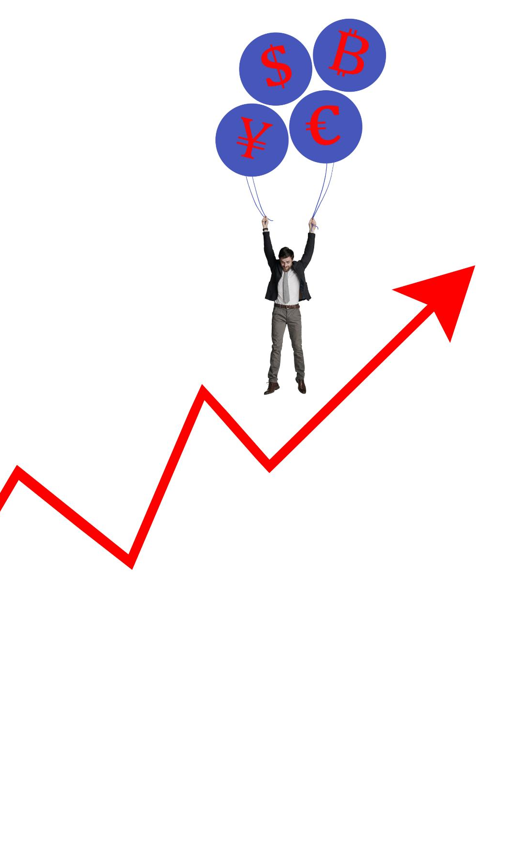
From Risk Register to Enterprise Risk Management
Initial Risk Register Use
  KUHeS started with a basic risk register to document risks and meet sponsor requirements.
Limitations of Compliance Approach
  The risk register approach was insufficient for managing complex, expanding research portfolios.
Shift to ERM Framework
  KUHeS adopted an enterprise-wide risk management framework integrating governance and strategic risks.
Cultural and Capacity Changes
  Successful ERM implementation required leadership commitment, cultural change, and capacity building.
Notes:
The second case study focuses on KUHeS and its transformative journey from implementing a basic risk register to adopting an enterprise-wide risk management (ERM) framework. Initially, KUHeS aimed to meet sponsor requirements by documenting risks in a register. However, this approach proved insufficient for managing the complexities of an expanding research portfolio. Recognizing the limitations of policy-driven compliance, KUHeS shifted toward a holistic ERM model that integrates governance, operational, and strategic risks. This evolution required cultural change, capacity building, and leadership commitment. The ERM framework introduced systematic risk identification, assessment, and mitigation processes across all departments, ensuring alignment with institutional objectives and equitable partnership principles. This case illustrates how moving beyond compliance to proactive risk governance can enhance institutional resilience and foster trust among collaborators.

Slide 9
Case Study 3: Technology and ERM Implementation
Notes:
Complexity of ERM and Role of GRC Applications

Slide 10
Complexity of ERM and Role of GRC Applications
GRC App Component | Function
Strategy Management to Policy Management | Centralized repository for institutional policies
Risk Taxonomy - Risk Reporting | Tools for identifying and evaluating risks
Performance Tracking (KRIs, Breaches, Assessments, Risk Register, Heatmaps) | Monitoring adherence to governance frameworks
Integration and direction | Connectivity with Microsoft services for reporting and collaboration, process flow ensures all elements of ERM are covered but scaled
Notes:
The third case study addresses the challenges of implementing ERM in resource-limited institutions and explores how technology can bridge these gaps. Establishing an enterprise-wide ERM system involves complex processes, including policy harmonization, risk prioritization, and compliance monitoring. To overcome these hurdles, KUHeS developed a Governance, Risk, and Compliance (GRC) application designed to guide, facilitate, and host ERM initiatives. The GRC app includes modules for policy management, risk assessment, compliance tracking, and integration with Microsoft services for seamless reporting and collaboration. By digitizing governance processes, the app reduces administrative burdens, enhances transparency, and supports informed decision-making. This technology-driven approach demonstrates how innovation can empower institutions to meet global research standards while maintaining equity and accountability.

Slide 11
Key Takeaways and Closing
Notes:
Lessons Learned and Future Directions

Slide 12

Lessons Learned and Future Directions
Strategic Due Diligence
  Due diligence serves as a strategic tool to build trust and resilience beyond mere compliance.
Integrated Risk Management
  Risk management must evolve to integrated frameworks covering governance, operational, and strategic levels.
Technology in ERM
  Digital solutions like GRC applications streamline processes and enhance transparency in resource-limited institutions.
Future Priorities
  Institutions should focus on capacity building, scalable technology investment, and shared responsibility culture. The protitype of this application has been developed with hope that further development can be funded and the system is made available toupcoming universities (e.g. REIMS)
Notes:
The case studies presented highlight critical lessons for fostering equitable research partnerships. First, due diligence is not merely a compliance exercise but a strategic tool for building trust and resilience. Second, institutional risk management must evolve from fragmented approaches to integrated frameworks that address governance, operational, and strategic dimensions. Third, technology can play a transformative role in enabling resource-limited institutions to implement robust ERM systems. The development of GRC applications exemplifies how digital solutions can streamline processes, enhance transparency, and support equitable collaboration. Moving forward, institutions should prioritize capacity building, invest in scalable technologies, and cultivate a culture of shared responsibility to sustain equitable partnerships in an increasingly complex research landscape.

Slide 13
Thank You.

