Slide 1

Global Perspectives on Research Security
Sapna Marwaha
Webinar - December 2025
© FORMATION CONSULTANCY

Slide 2
Introduction

Slide 3
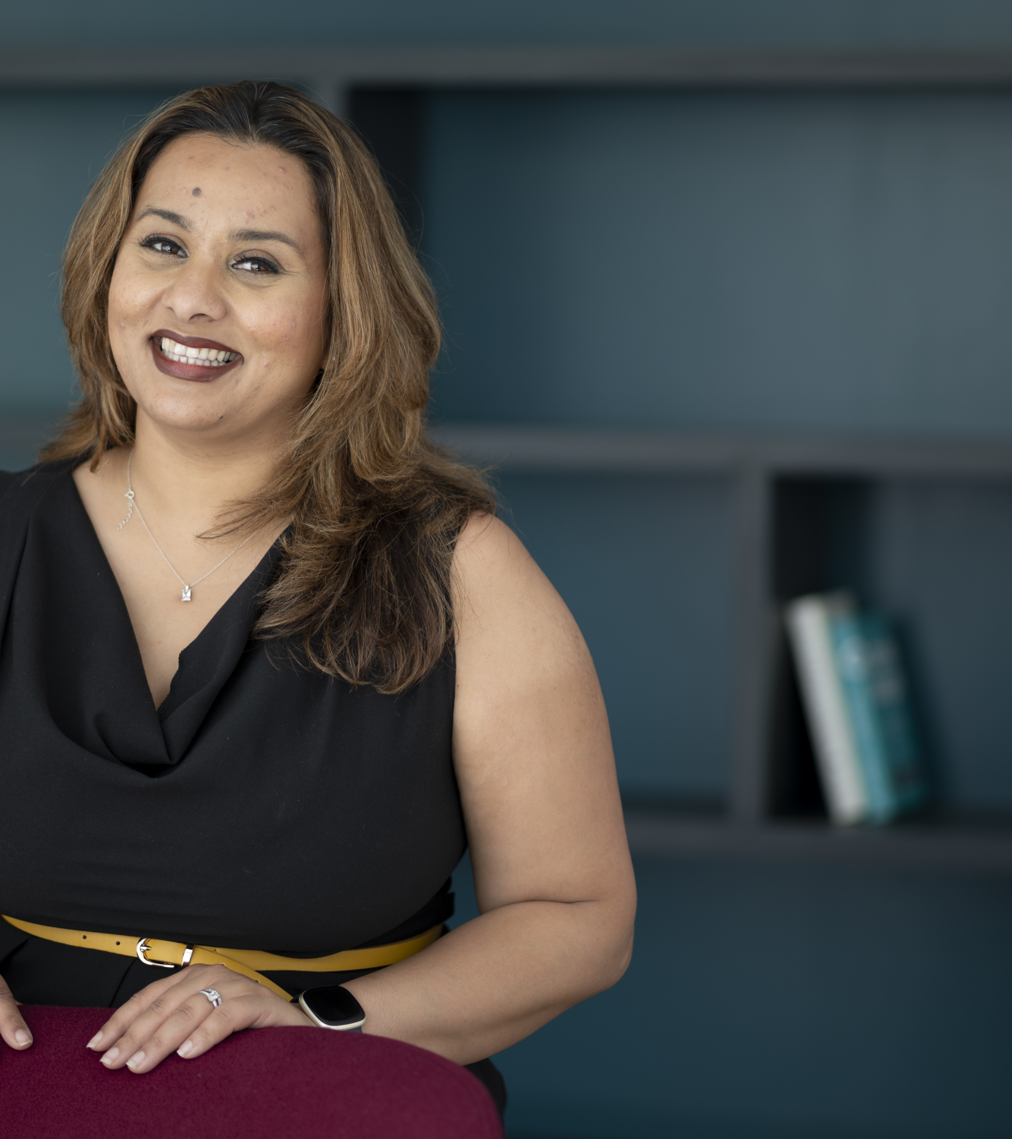
Our Company
Formation was founded in 2022 by Sapna Marwaha to support universities and non-profits to drive sustainable cultural change in the face of an increasingly complex regulatory environment.
With a background in law and track record in organisational transformation, Sapna combines her expertise in research governance, compliance and culture.
We work proactively to identify and mitigate risks to research environments, including threats to intellectual property, data protection, and international collaboration with an ethical and equitable approach.
© FORMATION CONSULTANCY

Slide 4
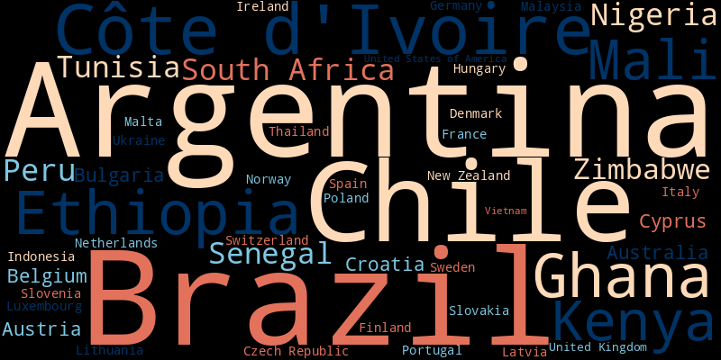
Notes:
Argentina
Australia
Austria
Belgium
Brazil
Bulgaria
Chile
Croatia
Cyprus
Czech Republic
Côte d'Ivoire
Denmark
Ethiopia
Finland
France
Germany
Ghana
Hungary
Indonesia
Ireland
Italy
Kenya
Latvia
Lithuania
Luxembourg
Malaysia
Mali
Malta
Netherlands
New Zealand
Nigeria
Norway
Peru
Poland
Portugal
Senegal
Slovakia
Slovenia
South Africa
Spain
Sweden
Switzerland
Thailand
Tunisia
Ukraine
United Kingdom
United States of America
Vietnam
Zimbabwe

Slide 5
What is motivating the emergence of research security?

Slide 6

The Foreign Investors
A UK precision engineering company agreed an £8m deal with a foreign investor in October 2017. On receipt of the first £3m, the company shared sensitive details and committed to training the company’s engineers.​
According to press reports in January 2020, the investor subsequently cited difficulties in securing approval through national authorities and withdrew from the deal without paying remaining £5m balance.​
The competitive advantage and intellectual property may have already been compromised. Their links to the investor also reportedly cost them their licence to make military equipment for other nations. The company was left facing administration in February 2020, citing the alleged theft of their IP and the reneging on the deal by the foreign investor as the cause.
© FORMATION CONSULTANCY

Slide 7

The “Russian House”
A PhD graduate at the Danish Technological University was convicted of espionage in 2020 after passing sensitive information about Danish energy technologies to Russian intelligence, acting as a conduit for technological know-how. He was sentenced to five years.
This case brought new urgency to the insider threat discussion, pressing universities and security services to recognise the dangers of in-person infiltration and the use of foreign students or visiting researchers as intelligence assets.
© FORMATION CONSULTANCY

Slide 8

The $2 million Fine
In October 2023, Stanford University agreed to pay nearly $2 million to settle allegations that it violated the False Claims Act by failing to disclose foreign research funding in 16 grant proposals submitted to U.S. federal agencies between 2015 and 2020.
The undisclosed support involved 11 faculty members who had received funding from foreign institutions, which was not reported in applications to agencies such as NASA, the Army, and the National Science Foundation.
The case was investigated by the U.S. Department of Justice alongside multiple federal inspector generals and military investigative bodies. While Stanford did not admit wrongdoing, the settlement included restitution and a commitment to strengthen its compliance procedures.
© FORMATION CONSULTANCY

Slide 9

The Lab Results At Risk
In June 2024, the National Health Laboratory Service (NHLS) in South Africa was hit by a severe ransomware attack. The incident caused major disruptions, rendering laboratory information systems, backup servers, and internal communications inoperable for weeks. Millions of blood and pathology tests were delayed, and hospital care was affected as clinicians were forced to rely on manual results and phone communications. Portions of system backups were deleted, requiring a full rebuild and urgent cybersecurity upgrades. This attack exploited technological and resource gaps.
© FORMATION CONSULTANCY

Slide 10
Critical and Emerging Technology Areas
Advanced Materials
Advanced Robotics
Artificial Intelligence
Civil Nuclear
Communications
Computing Hardware
Critical Suppliers to Government
Cryptographic Authentication
Data Infrastructure
Defence
Energy
Military and Dual-Use
Quantum Technologies
Satellite and Space Technologies
Suppliers to the Emergency Services
Synthetic Biology
Transport
Autonomous Systems
Virtual and augmented reality
Sustainable Technologies
Genetic Engineering
© FORMATION CONSULTANCY

Slide 11
Push factors
Regulation and national policy
Geopolitical threats
Reputational risks
Rising knowledge leakage
Funder requirements
© FORMATION CONSULTANCY

Slide 12
Pull factors
Investment and capacity strengthening
Building trust and integrity
Protecting strategic advantage
Increased economic opportunities
Reduced bureaucracy
© FORMATION CONSULTANCY

Slide 13
How are the emerging responses?

Slide 14
Diverse approaches to managing research risk
Hard v soft regulation
Nationality v technology led
Regulator v funder v institution led
Defence v diplomatic initiatives
© FORMATION CONSULTANCY

Slide 15
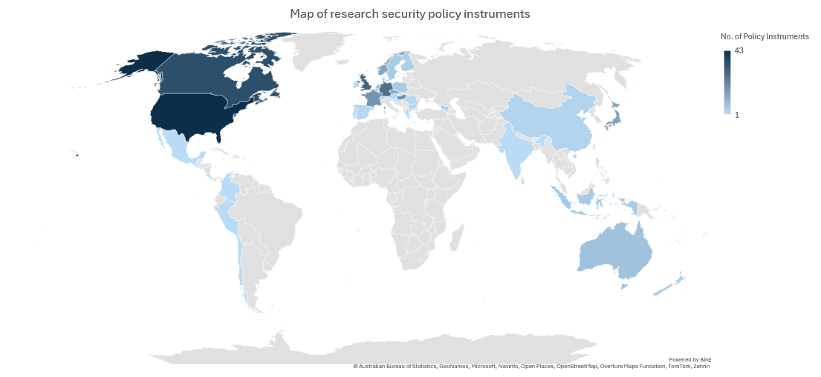
OECD STIP Database of Research Security Policy Instruments

Slide 16
Regulatory areas
Counter-Terrorism
Dual-Use and Export Control
Cyber Security
Sanctions and Money Laundering
Freedom of Information
Modern Slavery
Freedom of Expression
Anti-Bribery
Data protection
Foreign influence registration
Border Security – Enhancements for Researchers
© FORMATION CONSULTANCY

Slide 17
Where does research security meet other agendas?

Slide 18
The balancing act
Open research
Academic freedom and institutional autonomy
Innovation and knowledge creation
Equitable partnerships
Bureaucracy
© FORMATION CONSULTANCY

Slide 19
LMIC landscape
Values are not universal
Nor the assets we value
Passive recipients of risk
Power dynamics
Infrastructure and resources
© FORMATION CONSULTANCY

Slide 20
Key principles for safer, fairer collaboration

Slide 21
Principles for safer, fairer cultures of collaboration
Avoid broad-based assumptions
Invest in training, tools, and institutional capacity
Build around positive messages and positive actions
Explore the unintended consequences of new measures
Foster open dialogue on diverse perspectives of value and risk
© FORMATION CONSULTANCY

Slide 22
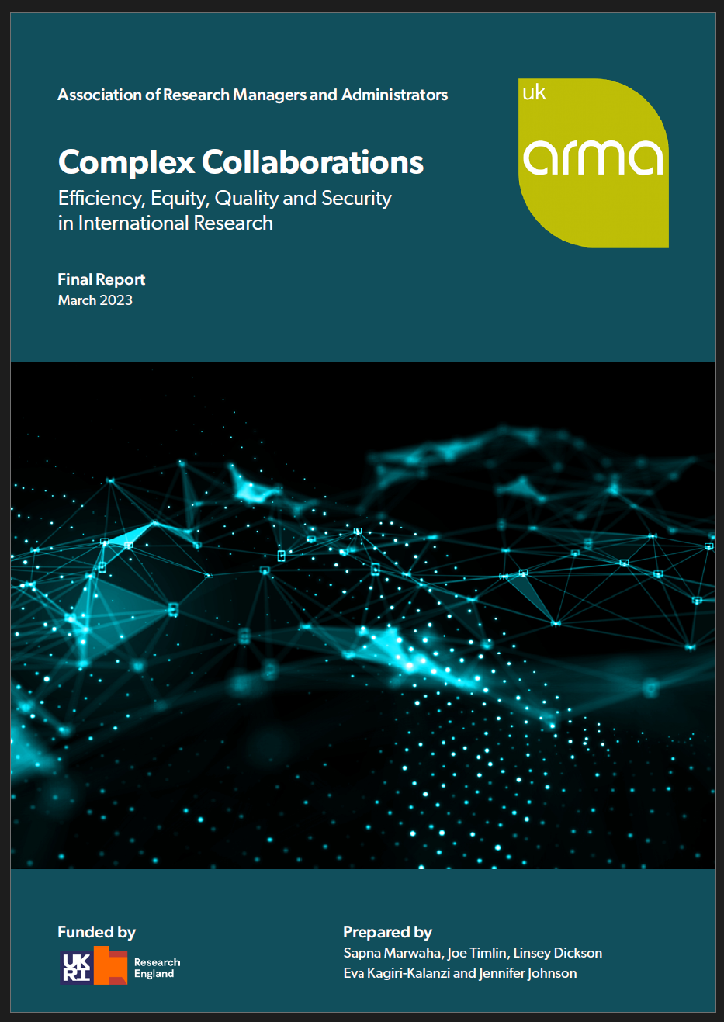
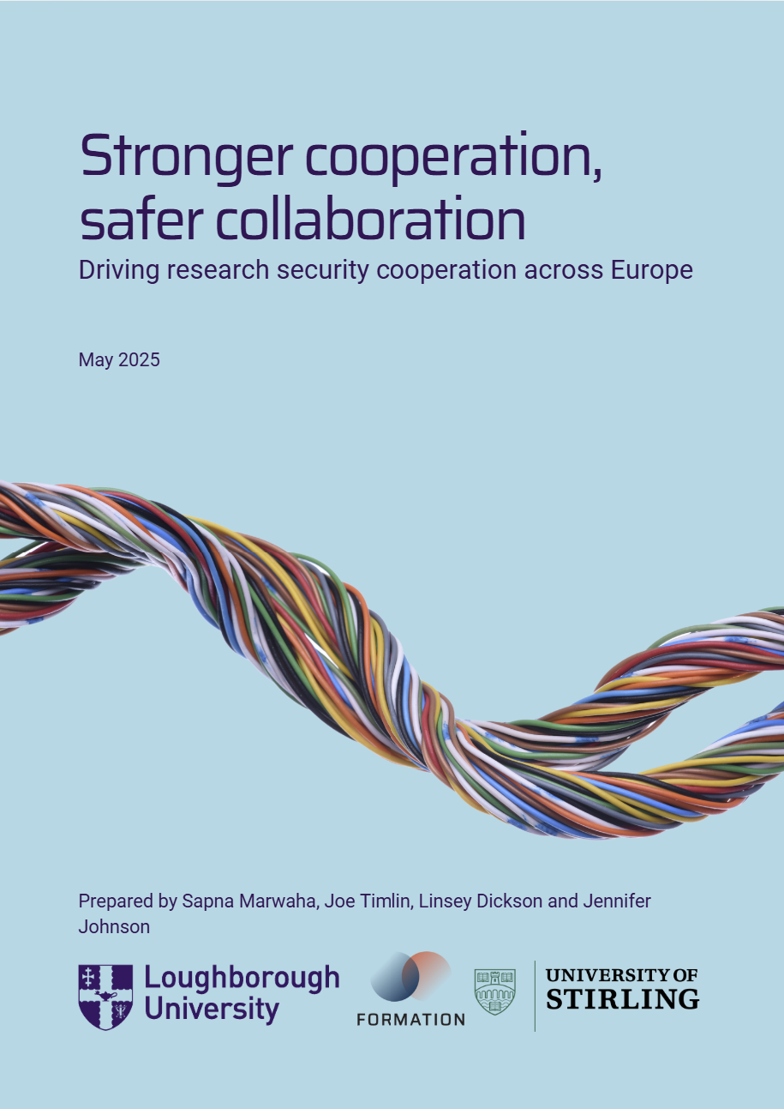
Exploring research security in the UK and Europe
Research is global and so are the security challenges we are all managing
While there are differences in policy approach, there are also similarities in the risks that lead to commonalities in local approaches
These commonalities create significant scope for knowledge sharing and cooperation
© FORMATION CONSULTANCY

Slide 23



Slide 24
More insights from the Formation team
Are we reducing research security risk, or just shifting it around? | Wonkhe
The challenge of pursuing research security when nationality becomes a shorthand for risk | Wonkhe
Stronger Cooperation Safer Collaboration | ARMA
Complex Collaborations | ARMA
Insights | Formation Consultancy
© FORMATION CONSULTANCY

Slide 25
Thank you!
Connect:
www.formationconsultancy.co.uk
sapna@formationconsultancy.co.uk
www.linkedin.com/in/sapnamarwaha/

