Slide 1



Equitable Research Impact:
Mapping Fair Assessment Within Equitable Research Partnerships
Date: 3-5 February 2026
Location: CSIR International Convention Centre in Pretoria
Mohd Amiruddin Abd Rahman
Deputy Director of Research Management Centre
Universiti Putra Malaysia

Slide 2

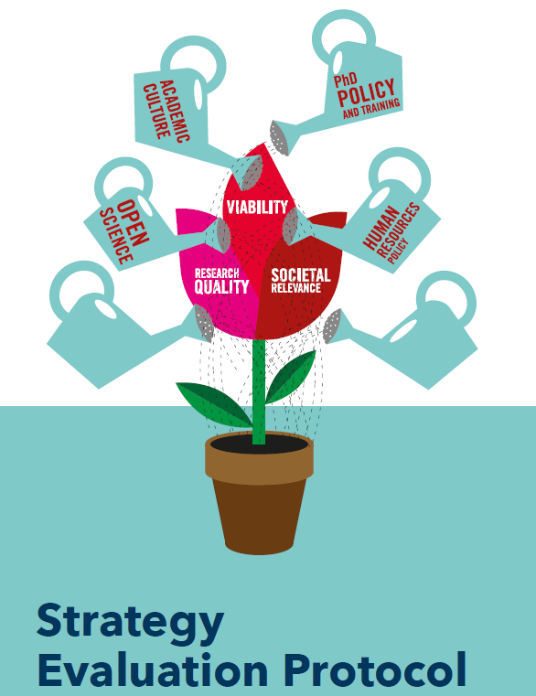



Research Impact Assessment Framework Around the World

Slide 3
Similarities among those assessment
Encourage interdisciplinarity, industry engagement, societal relevance, and research integrity and governance
Structured impact narratives with evidence of benefits outside academia
Increasing emphasis on real-world societal value by recognizing policy impact, community engagement, and economic and environmental outcomes.

Slide 4

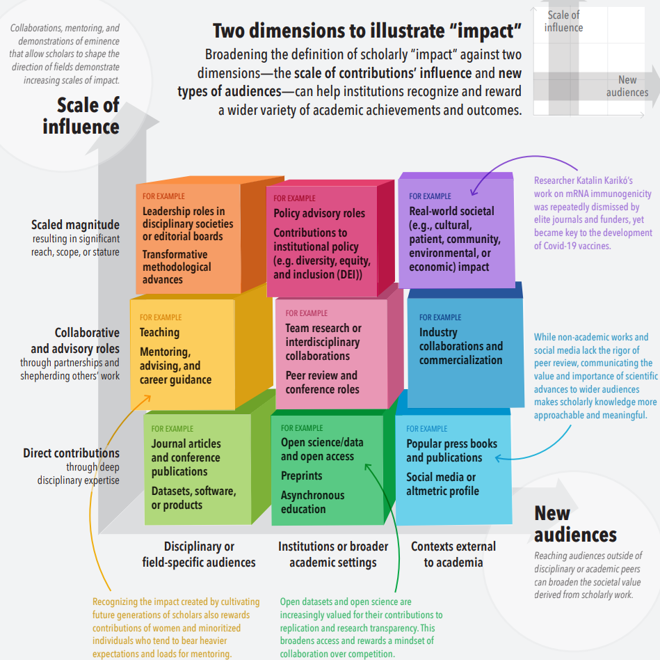
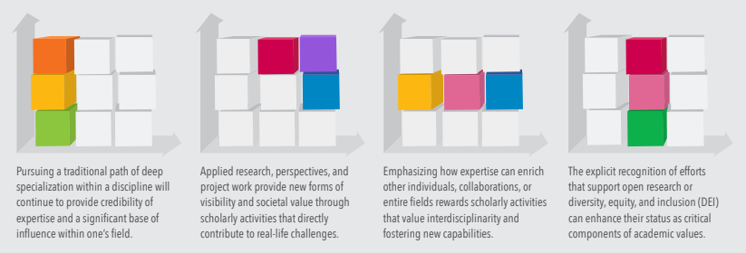
San Francisco Declaration on Research Assessment
Impact Rubric
Rubric is made based on scale of influence vs new audience
Best is being regarding impacting both industry and community in real-world
Lowest is the research output

Slide 5
Challenges on establishing impact
Many researchers across countries tend to find partners within same field of research, resulting to limited impact.
Inequitable contributions among different parties
Bilateral issues among countries
Mismatched objectives among researchers or towards personal benefits rather than community or industry benefits
Publications driven mindset rather than towards impact mindset
Proactiveness of the partners on deep collaborative work
Weak capacity among partners on field of expertise

Slide 6
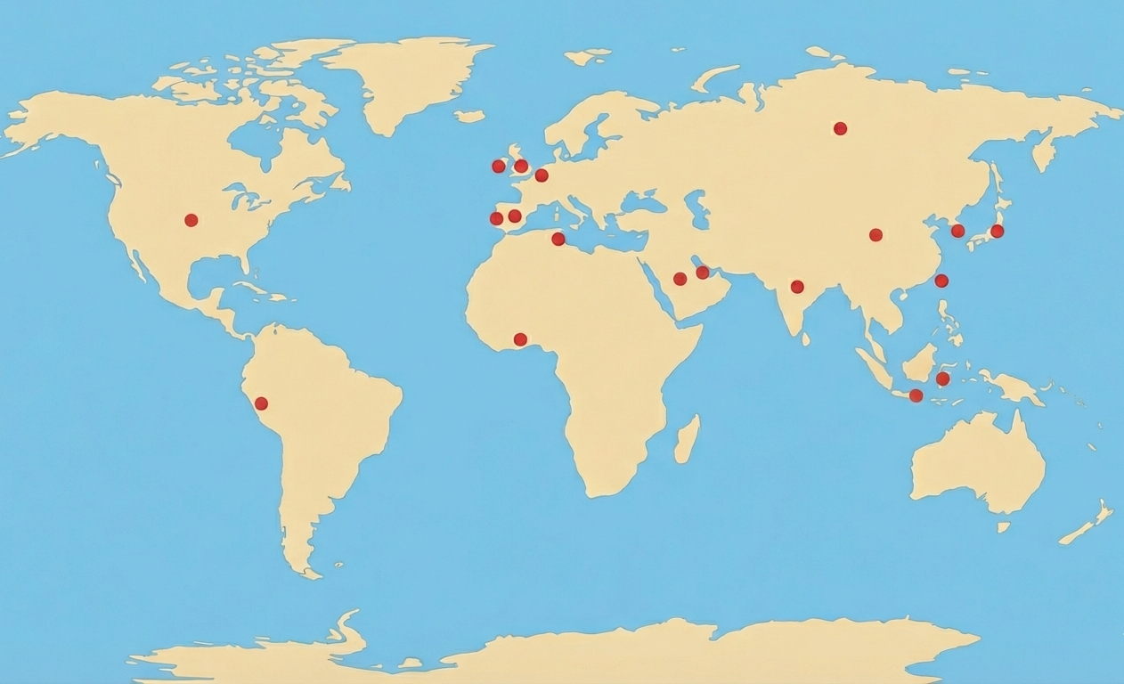

















My partnerships across the world

Slide 7
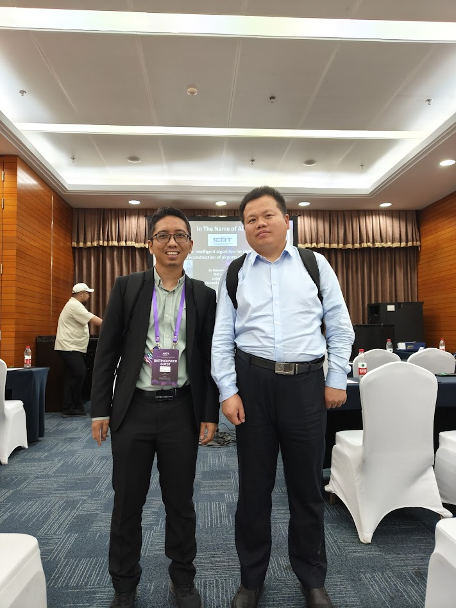
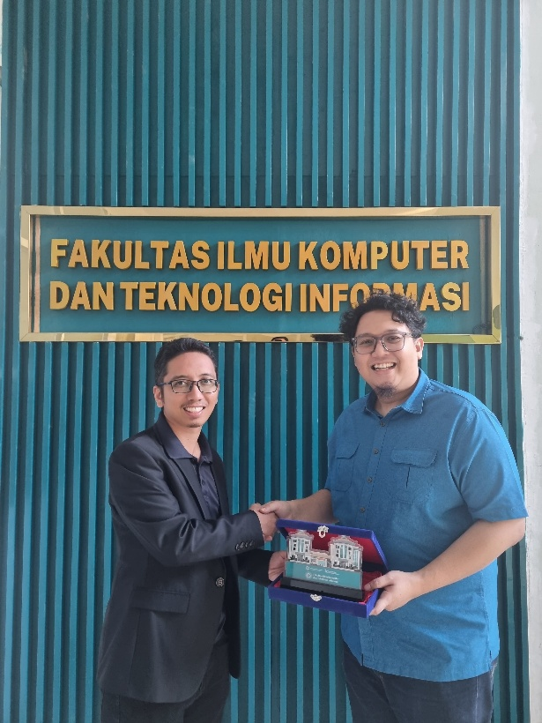
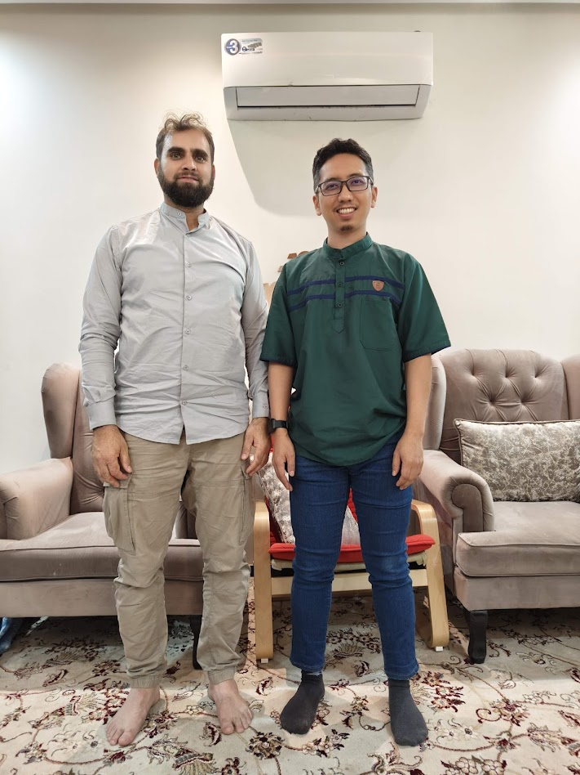
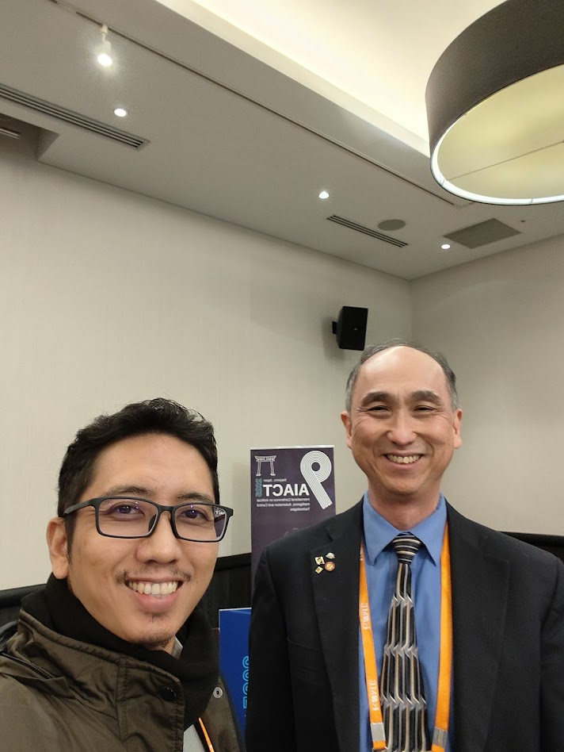
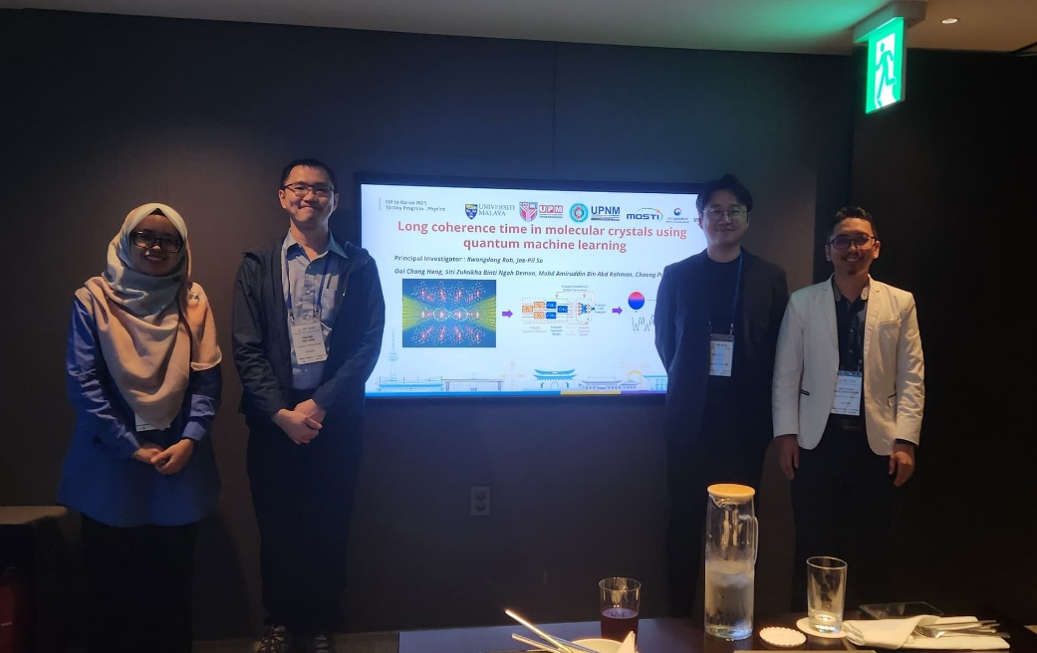
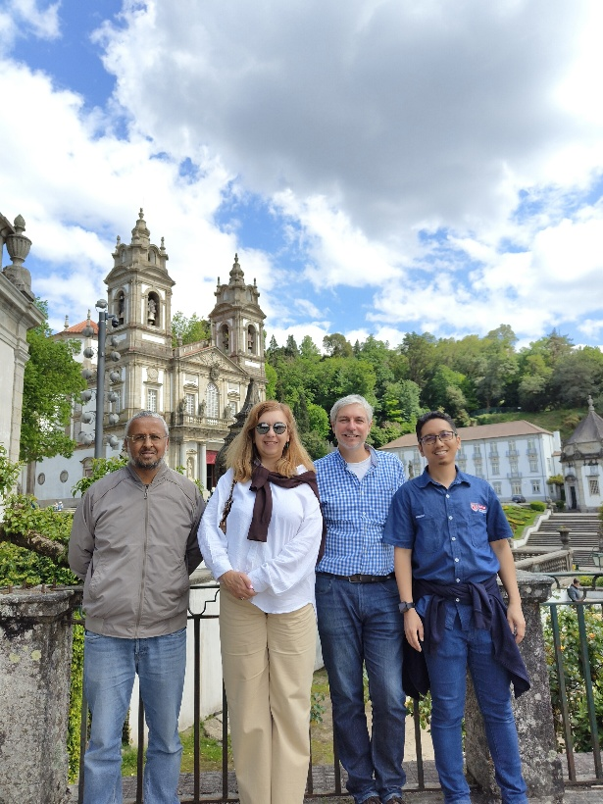
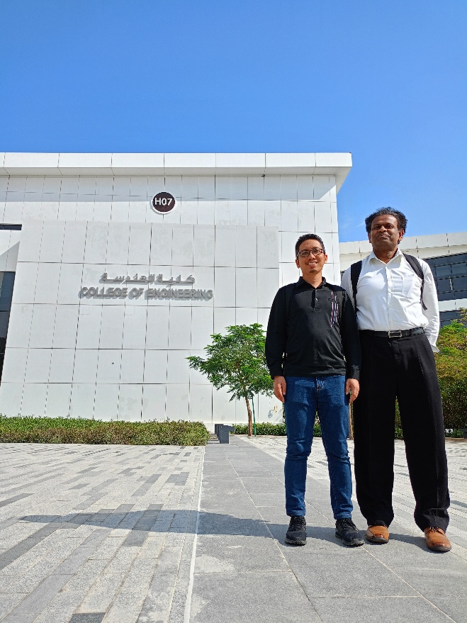
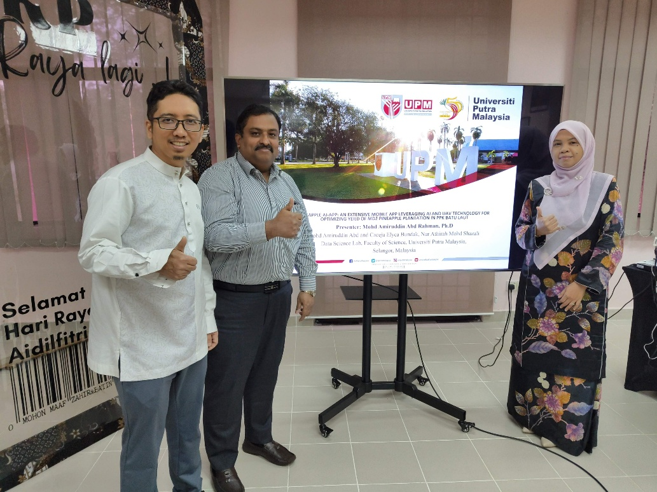
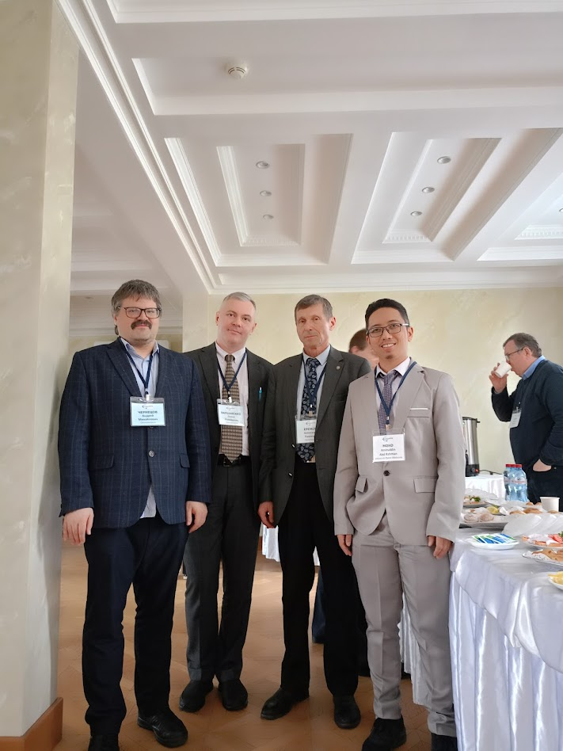
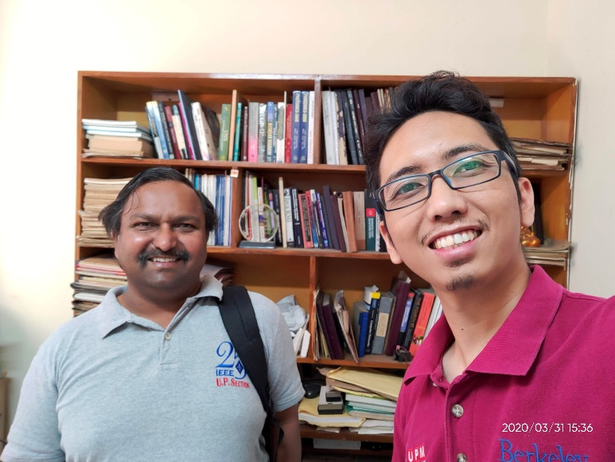

Slide 8
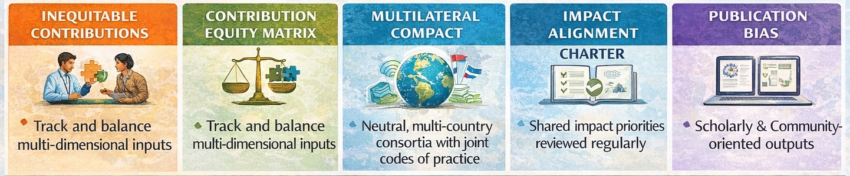

Proposed Cross-Domain Equity
Partnership (CDEP) Framework with 5 key pillars
TRANSDICIPLINARY CONVERGENCE CONSORTIA
HYBRID IMPACT: SCHOLARLY AND PRACTICAL PATHWAY

Slide 9
Transdisciplinary Convergence Consortia (TCC)
Establish structured “Convergence Consortia” where researchers from different disciplines co-design projects aligned with societal challenges (e.g. climate resilience, equitable healthcare, AI in rural education).
Consortia include non-academic actors (industry, civil society, community leaders) to broaden perspectives and shape research objectives towards impact.
Outputs include not just publications but cross-sectoral solutions, prototypes, and policy white papers.
Pillar 1

Slide 10
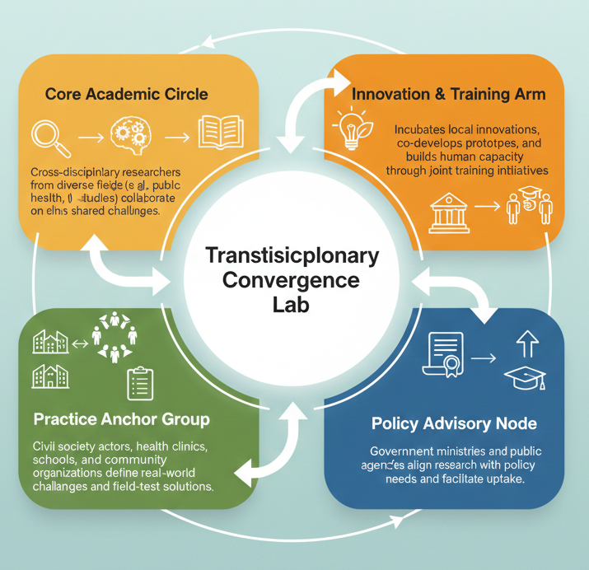
Consortia Structure
Consortia coordination could be rotated among partners to ensure leadership diversity and distributed stewardship.
Community actors are co-leaders, not just beneficiaries.
Integrated capacity building e.g. short courses, paid internships, and staff exchanges.
Incubates local innovations, co-develops prototypes, and builds human capacity through joint training initiatives
Cross-disciplinary researchers from diverse fields (e.g. AI, Public Health) collaborate on shared challenges
Transdisciplinary Convergence Consortia (TCC)
Civil society actors, health clinics, schools, and community organizations define real-world challenges and field-test solutions.
Government ministries and public agencies align research with policy needs and facilitate uptake.
Pillar 1

Slide 11
Contribution Equity Matrix (CEM)
Create clear jointly-develop equity matrix template to capture contributions across multiple domains:
  Intellectual leadership
  Fieldwork and data
  Budget/resource ownership
  Knowledge production (writing, analysis)
  Community translation/engagement
  Capacity strengthening
Review at project kickoff, midpoint, and close to ensure adaptive equity
Pillar 2

Slide 12
CEM Template
Contribution Domain | Partner A (e.g., Ghana) | Partner B (e.g., Malaysia) | Partner C (e.g., Peru) | Comments/Details
1. Intellectual Leadership | Lead WP1 | Co-lead WP2 | Advisory role | Specify lead/co-lead roles
2. Fieldwork & Data Access | Supportive | Lead | Lead + Community Gatekeeper | Detail local permissions
3. Budget Ownership | 20% | 50% | 30% | Disbursement by phase
4. Writing & Knowledge Production | Lead 2 papers | Lead 1 paper, blog | Co-author 2 papers | Include local-language outputs
5. Capacity Strengthening | Receives training | Delivers AI workshop | Hosts 2 interns | Define capacity KPIs
6. Community Engagement | Fieldwork | Policy brief | Community forum | Engagement mapped to impact plan
7. Policy or Practice Uptake | Health policy input | Ministry roundtable | NGO network | Capture pathways to influence
Pillar 2

Slide 13
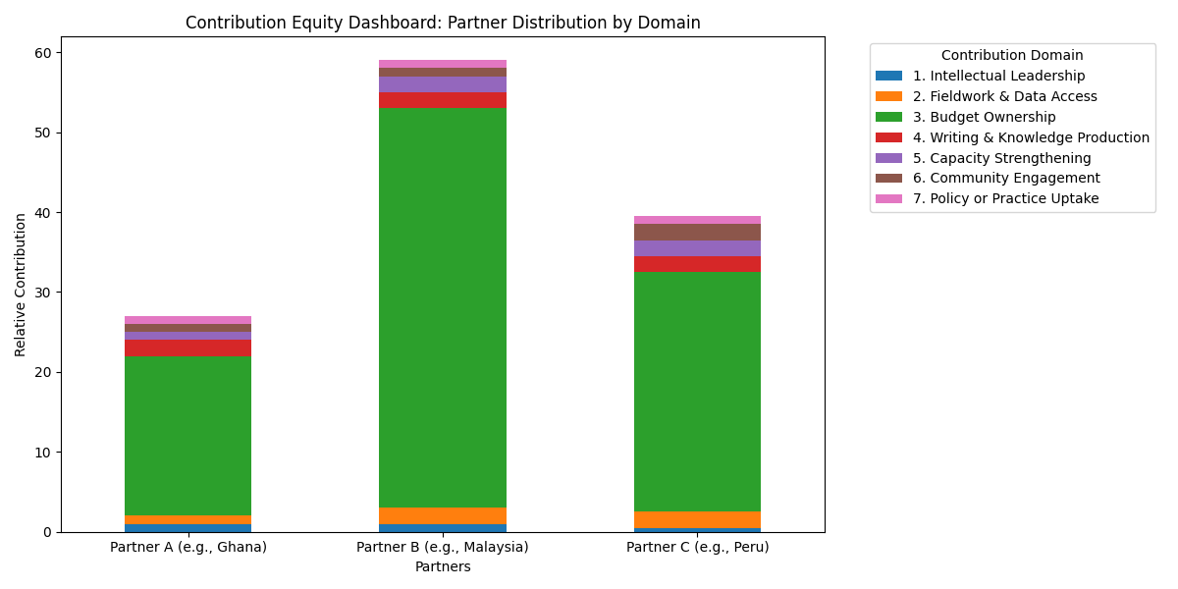
CEM Distribution Dashboard
Domain | Unit of Measurement | Example Metric
Intellectual Leadership | Role Weight (e.g., Lead = 1.0, Support = 0.5) | Lead WP = 1.0, Advisory = 0.3
Fieldwork & Data Access | Level of involvement | Primary data collector = 1.0
Budget Ownership | % of total funds managed | 30%, 50%, etc.
Writing & Knowledge Production | # of papers led or co-authored | Lead = 1.0, Co-author = 0.5
Capacity Strengthening | Training sessions led or attended | Led = 1.0, Attended = 0.5
Community Engagement | # of events, reach, or hours contributed | Forum = 1.0, Public talk = 0.5
Policy/Practice Uptake | # of engagements, influence level | Policy cited = 1.0, brief = 0.5
Precautions
Discuss whether all domains are equally weighted or some matter more
Use this as a reflection tool, not for penalizing partners
Validate all inputs during co-design sessions
Pillar 2

Slide 14
Multilateral Compact Framework (MCF)
Move from bilateral to multilateral consortia that include neutral governance nodes (e.g. yearly rotating secretariat).
Use multi-country codes of practice co-developed with stakeholders, not just institutions.
Cross-cultural facilitation embedded in the codes of practice
Pillar 3

Slide 15
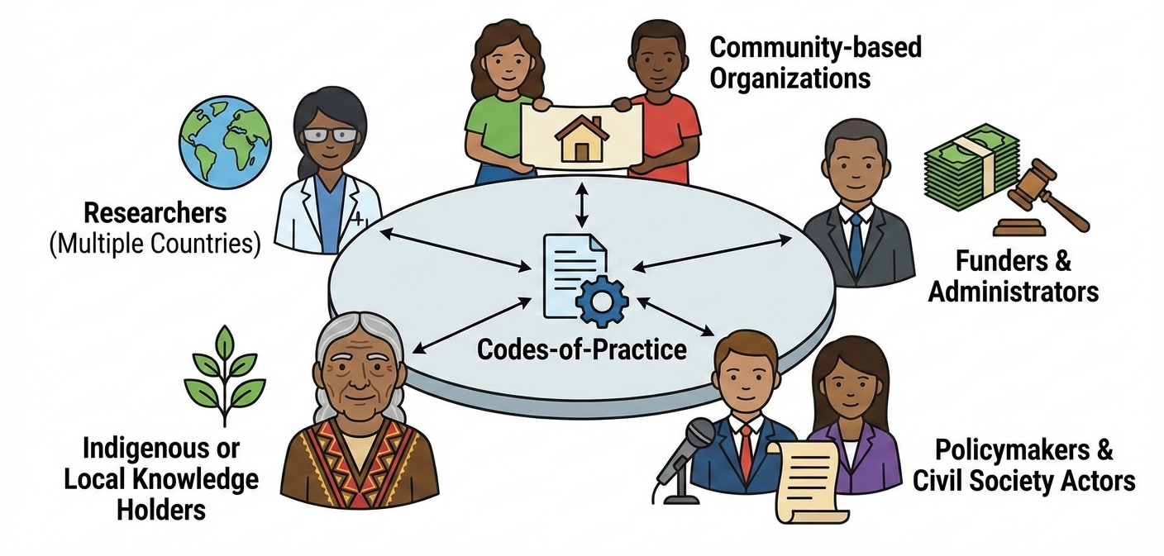
Co-Developed Multi-Country Codes of Practice (Step-by-Step)
Form a Diverse Codes-of-Practice Working Group
  Ensure balanced representation from:
    Researchers (from multiple countries),
    Community-based organizations,
    Funders and administrators,
    Policymakers and civil society actors,
    Indigenous or local knowledge holders
Initiate with Story-Based Dialogues
  Use facilitated storytelling sessions where partners share:
    Past experiences of harm or success in collaborations
    What “respect,” “ownership,” and “benefit” meant to them
Pillar 3

Slide 16
MCF Co-Developed Multi-Country Codes of Practice (Step-by-Step)
Identify Core Practice Areas
Conduct Country-Level Consultations
  Run focus groups or roundtables in each participating country:
    Translate drafts into local languages
    Validate for cultural sensitivity, legal fit, and relevance
    Collect feedback via annotated versions or structured surveys
Domain | Sample Code Principle
Authorship & IP | Recognition must align with contribution, not prestige or affiliation
Data Ownership | Data must be governed by those who generate or host it
Budget Control | A minimum % of the budget should be managed in-country
Governance | Shared leadership and rotating coordination is expected
Capacity & Training | Equity includes fair access to research opportunities
Pillar 3

Slide 17
Co-Developed Multi-Country Codes of Practice (Step-by-Step)
Draft, Test, and Iterate Together
  Pilot the draft code on at least one active project
  Revise based on: What was followed or ignored? What caused friction? What worked better than expected?
Ratify Through a Shared Declaration
  Use a multi-stakeholder charter signed by Individuals, Community groups, and Partner institutions
Build in Accountability & Learning
  Annual learning reviews: “How did we live our code this year?”
  Allow for regional adaptations to reflect legal or political realities
  Make room for community updates or new voices over time
Pillar 3

Slide 18
MCF Consultation Feedback Tracker Template
Country | Stakeholder Group | Consultation Date | Feedback Summary | Suggested Revisions | Concerns Raised | Follow-Up Actions | Status
Malaysia | University Researchers | 2024-09-01 | Emphasized the need for data governance clauses and joint authorship standards. | Include specific language on shared authorship protocols. | Risk of publication hijacking by Northern partners. | Schedule co-drafting workshop for publication protocols. | Reviewed
India | Community Health Workers | 2024-09-03 | Requested more context-sensitive ethical practices and recognition in outputs. | Add clause on vernacular language inclusion and field staff co-authorship. | Lack of visibility of local facilitators in past projects. | Integrate recommendations into next ethics board draft. | Actioned
Indonesia | Local NGOs | 2024-09-05 | Suggested clearer benefit-sharing mechanisms with Indigenous communities. | Insert explicit expectations for data-sharing, community feedback loop. | Past experiences of data extraction without feedback. | Translate revised code into Bahasa Indonesia for validation. | Reviewed
Peru | Policy Makers | 2024-09-07 | Called for clearer alignment with national research regulations and public impact. | Align data policies with national data privacy laws. | Disconnect between academic and policy timelines. | Policy advisor to co-lead code alignment with ministry. | Pending
Ghana | University Researchers | 2024-09-09 | Requested stronger guidance on equitable budget allocations. | Include Contribution Equity Matrix in annex. | Perception of financial decisions made externally. | Host a joint finance roundtable with all lead institutions. | Reviewed
Taiwan | CSO Representatives | 2024-09-11 | Highlighted the need to define community ownership over long-term project assets. | Add clause on community governance of shared outputs and tools. | Concerns over extractive technologies in past digital health projects. | Add appendix on open-source and community IP frameworks. | Actioned
Pillar 3

Slide 19
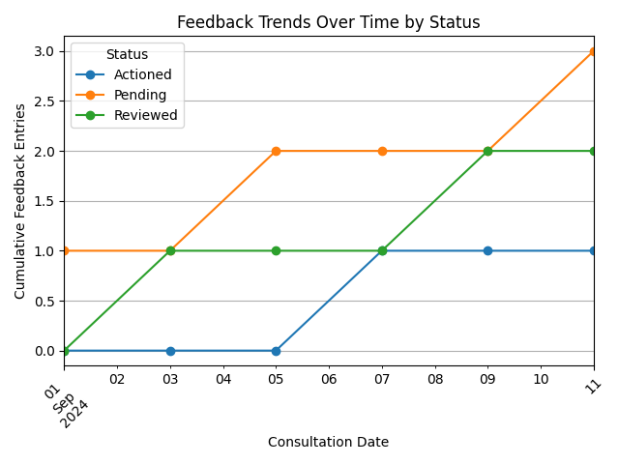
MCF Consultation Feedback Trends Dashboard
Cumulative number of feedback entries over time
Track how quickly consultations are being addressed
Spot delays in response or review
Monitor pacing of stakeholder engagement across a project timeline
Pillar 3

Slide 20
Impact Alignment Charter (IAC) Definition
🧭 Impact Alignment Charter
A shared declaration of values, beneficiaries, and intended change which is co-created at project initiation and revisited throughout the partnership.
🧩 Challenge Addressed
In many partnerships, researchers prioritize individual academic outputs (e.g. publications, career metrics) while communities or industry partners expect practical or policy benefits. This results in misalignment, broken trust, and reduced uptake of research outcomes.
Pillar 4

Slide 21
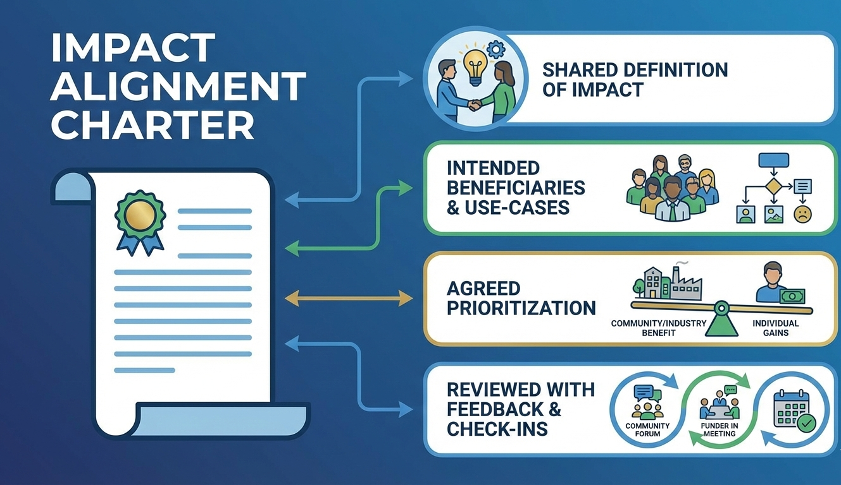
IAC Concept
All projects begin with a co-signed Impact Alignment Charter including:
  Shared definition of impact
  Intended beneficiaries and use-cases
  Agreed prioritization of community/industry benefit over individual gains
Reviewed with community feedback loops and funder check-ins.
Pillar 4

Slide 22
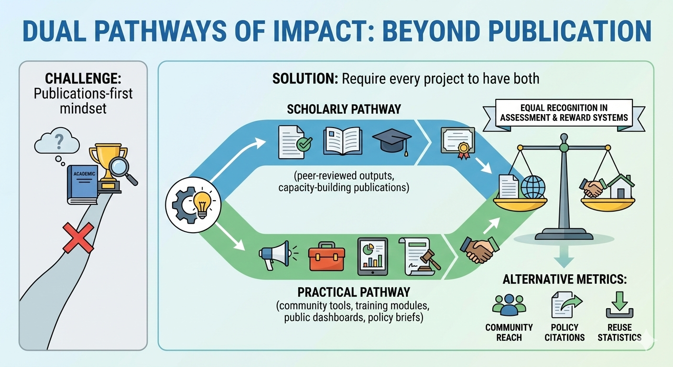
Hybrid Impact Pathways
Pillar 5

Slide 23
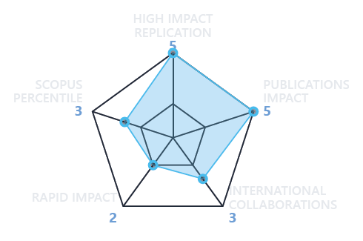
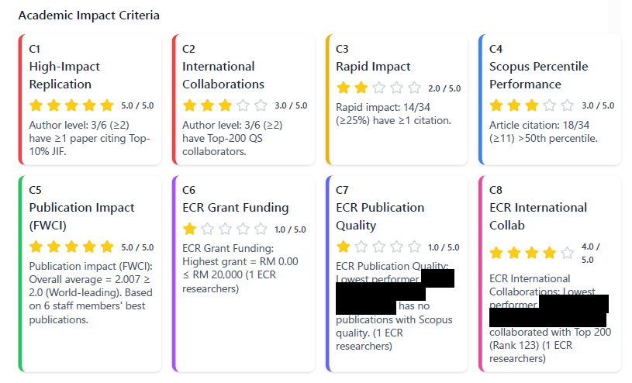
Scholarly/Academic Impact
Measured in terms of:
How the project impacted to academia
How the work is gain interests to other academia
Involvement of early career researcher in the project
Pillar 5

Slide 24
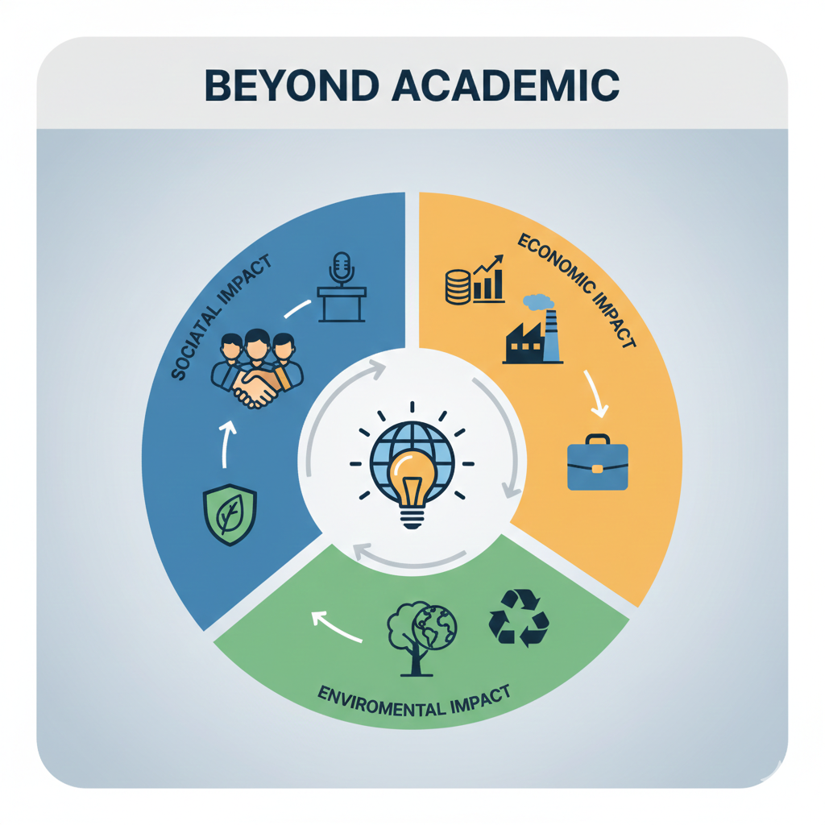
Practical Impact
Measured in terms of:
How society could benefits from the project
How the project helps industry to thrive
Could project generate new jobs
How the project could give sustainable resource to the community
How the project could provide capacity to the community
Pillar 5

Slide 25
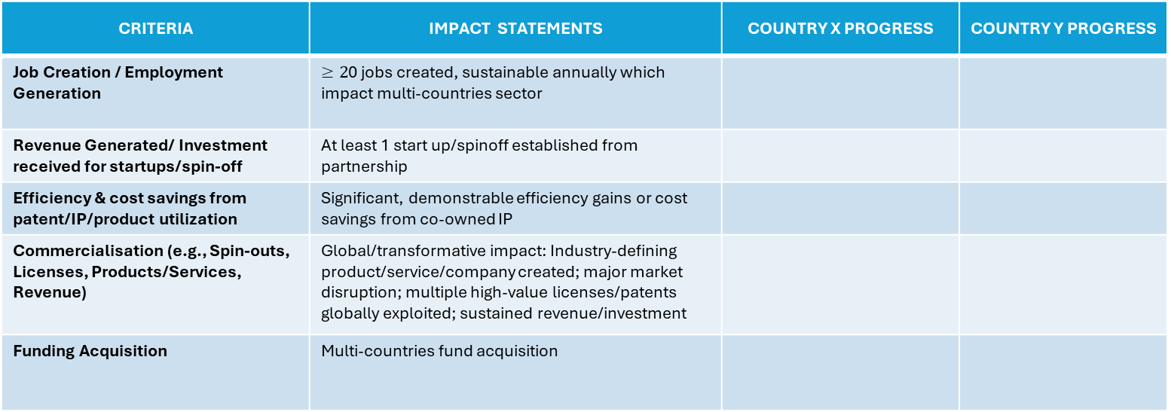
ECONOMIC IMPACT TEMPLATE
CRITERIA | IMPACT STATEMENTS | COUNTRY X PROGRESS | COUNTRY Y PROGRESS
Job Creation / Employment Generation | $≥2$0 jobs created, sustainable annually which impact multi-countries sector
Revenue Generated/ Investment received for startups/spin-off | At least 1 start up/spinoff established from partnership
Efficiency & cost savings from patent/IP/product utilization | Significant, demonstrable efficiency gains or cost savings from co-owned IP
Commercialisation (e.g., Spin-outs, Licenses, Products/Services, Revenue) | Global/transformative impact: Industry-defining product/service/company created; major market disruption; multiple high-value licenses/patents globally exploited; sustained revenue/investment
Funding Acquisition | Multi-countries fund acquisition
Pillar 5
Notes:
Minimum 2 kriteria - 0.2 x FTE
Start-up (within how many years)
Every criteria (OR)
How many years to quantify the revenue
Refer pd PSP sekiranya ada Cadangan penambahbaikan

Slide 26
ENVIRONMENT IMPACT TEMPLATE
CRITERIA | IMPACT STATEMENTS | COUNTRY X PROGRESS | COUNTRY Y PROGRESS
Environmental Policy & Practice (Legislation, Standards, Management Strategies) | Major, demonstrable contribution influencing regional environmental policy, standards, or industry practices with significant positive outcomes at least at both partner countries.
Biodiversity Conservation/ Enhancement (Species, Habitats, Ecosystems) | Major contribution to multi-countries species/ecosystem recovery efforts (e.g., >1000 ha restored/protected; key role in improving IUCN status of internationally significant species).
Pollution Reduction/Control (Air, Water, Soil, Noise, Light) | Significant, measurable reduction across multi-countries significant sector (e.g., 15%-25% reduction pollutant Y regionally; wide adoption of tech leading from multi-SME in region).
Climate Change Mitigation/ Adaptation (Greenhouse Gas reduction, Resilience, Policy) | Significant contribution to achieving regional climate goals (mitigation/adaptation); influencing at least 1 international policy/practice.
Pillar 5

Slide 27
ENVIRONMENT IMPACT TEMPLATE
CRITERIA | IMPACT STATEMENTS | COUNTRY X PROGRESS | COUNTRY Y PROGRESS
Sustainable Resource Management (Water, Energy, Materials, Waste, Circular Economy) | Transformative change setting international benchmarks adopted multi-countries (e.g., new ISO standard based on research; globally adopted circular economy model demonstrably reducing virgin resource use between 15%-25% in sector)
Environmental Policy & Practice (Legislation, Standards, Management Strategies) | Major, demonstrable contribution influencing international policy, standards, or industry practices with significant positive outcomes (e.g., foundational research for major regional environmental law/policy at multi-countries level)
Environmental Awareness & Behaviour Change | Widespread, demonstrable national or international behaviour change in multi-countries (e.g., national campaign based on research leading to measurable behaviour shift; international adoption of guidelines changing professional practice)
Pillar 5

Slide 28
SOCIETAL IMPACT TEMPLATE
CRITERIA | IMPACT STATEMENTS | COUNTRY X PROGRESS | COUNTRY Y PROGRESS
Health & Wellbeing (Physical, Mental; access to care, quality of life related to health) | Significant improvements in multi-countries health outcomes, wellbeing indicators, or healthcare access/deliver
Public Policy & Public Services (Effectiveness, access, equity, efficiency of services e.g., social care, justice) | Major improvements in multi-countries public policy effectiveness, service delivery, access, or equity for large populations.
Social Welfare & Equality (Reducing inequality, inclusion, human rights, poverty reduction) | Significant multi-countries contribution to achieving regional social justice, equality goals, or poverty reduction targets.
Pillar 5

Slide 29
SOCIETAL IMPACT TEMPLATE
CRITERIA | IMPACT STATEMENTS | COUNTRY X PROGRESS | COUNTRY Y PROGRESS
Culture & Heritage (Enrichment, preservation, access, understanding, creative economy contribution) | Defining multi-countries cultural understanding, setting international heritage standards, or creating globally significant cultural forms in across different countries in the world.
Education & Public Understanding (Skills, literacy, public engagement, pedagogical practice, curriculum development) | Transforming multi-countries educational practice or public understanding in a field, leading to fundamental shifts in knowledge.
Community Development & Quality of Life (Cohesion, regeneration, safety, civic participation, infrastructure use) | significant approaches to community development, safety, or quality of life improvements adopted multi-countries transforming living conditions for many
Pillar 5

Slide 30

Way Forward
Not necessarily all pillars to be actioned, combination of two pillars is enough for equitable impact partnership
Action plan and execution required, some hurdles are fine.
Keep strengthening capacity across partners and expand!
Looking forward to success stories towards societal impact
Sustaining and expanding the partnership with equity in mind

Slide 31



Thank you
Terima kasih
Ngiyabonga kakhulu 🙏

