Slide 1
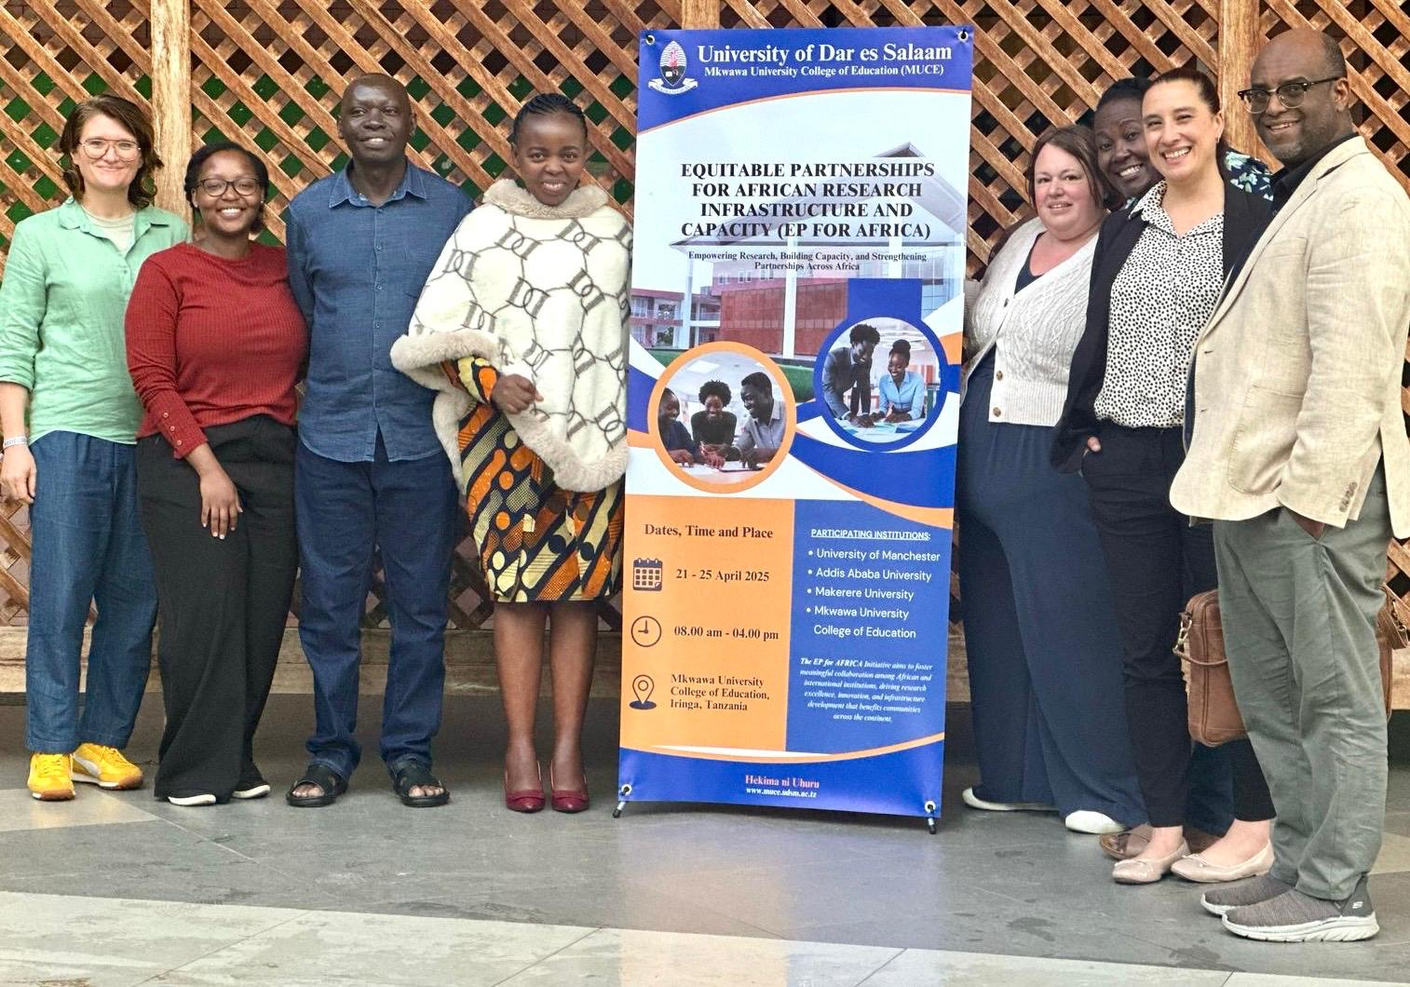




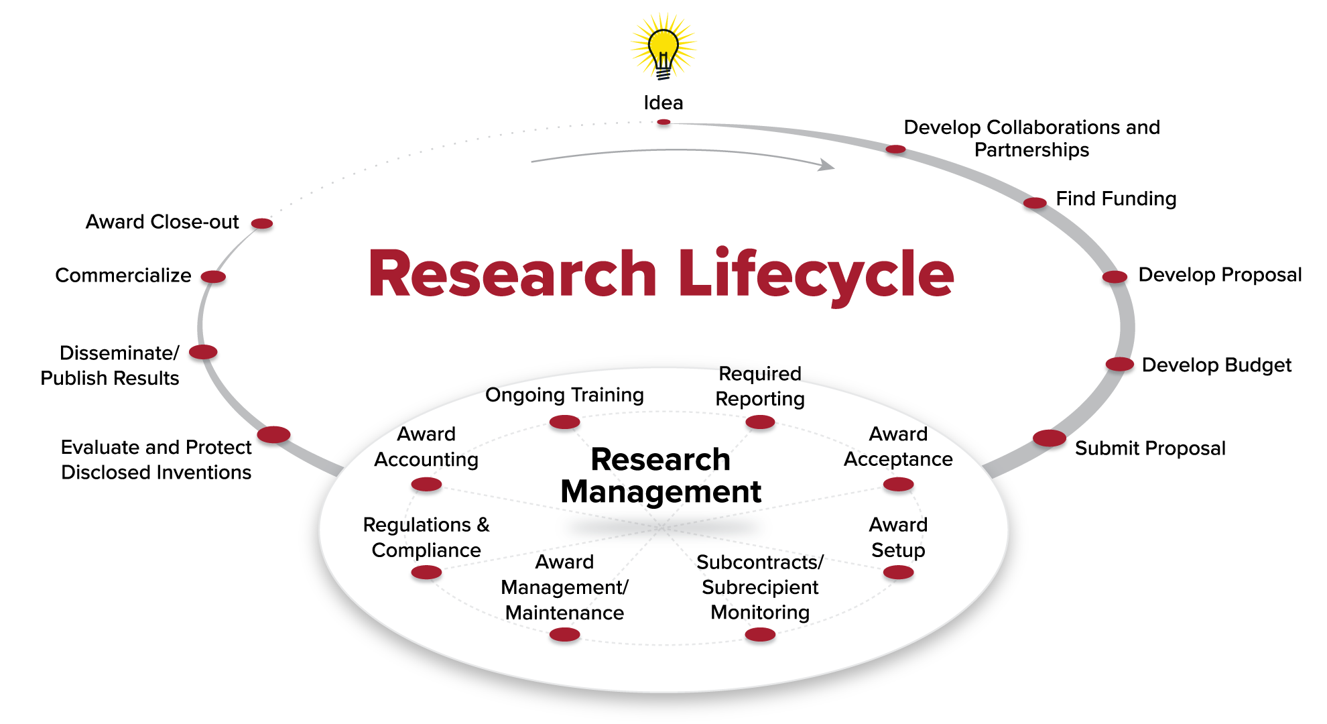
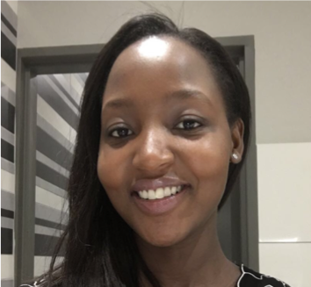
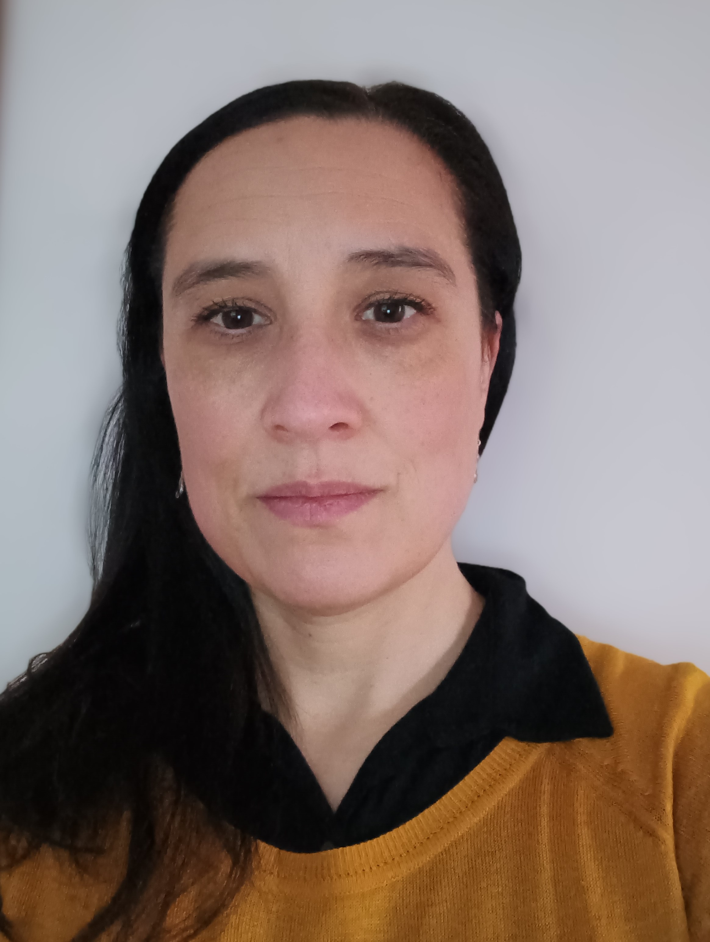
Equitable Partnerships for African Research Infrastructure and Capacity(EP for AfRICa): International collaborations explored through the lens of research management
Project team: Seabi T, Masiá O¹, Rwehumbiza D², Mukwaya P³, Amdework⁴, Walker P¹,Zevnik A¹ , Mkimbili S², Ishengoma E² and special acknowledgement to research function professionals across all institutions for supporting this British Academy funded project.
¹University of Manchester (UoM); ²Mkwawa University College of Education (MUCE) affiliated to the University of Dar Es Salaam); ³ Makerere University (MU); ⁴Addis Ababa University (AAU)
Aim of the project
The programme aims to establish a more productive and equitable research management environment, addressing challenges such as inefficient administrative processes, limited funding management, and inadequate data systems.
Activities
Two In person workshop (April 2025 and July 2026)
Monthly best practice virtual sessions
Production of a toolkit to embed within each institution
Key Insights from first workshop:
All institutions have identified similar challenges: grant writing, finances, budgeting, contracts, ethics, procurement and degree of administrative support.
One of the most significant differences between UoM and the three African partner institutions (AAU, MU and MUCE) is the limited support for researchers at pre-award stage.
“…lack of centralized research related data management, need for structured peer review, and more formalized funding criteria support…” (MUCE)
“… Principal Investigators (PIs) play dominant role in grant sourcing…” (MU)
“…No systematic grant search system or access to grant databases
PI writes grants with no formal help; support limited to providing letters and due diligence forms…” (AAU)
As a collective collaborative group, we have discussed the importance of equitable partnerships and agreed on a definition that forms the ethos of the project:
“…Equitable partnership is a relationship where all parties are valued, respected and have fair access to resources, opportunities and decision-making power…” (Iddy,MUCE)
Background
In recent years, strengthening research management systems has been recognised as a critical pillar of equitable international research collaboration.
Despite growing research ambition and funding, many institutions face gaps in managing the full research lifecycle. Particularly for some African institutions as they have limited resources for research management.
Where systems exist, misalignment between policies and processes often creates inefficiencies and barriers, undermining collaboration and research impact.
Key challenges span the entire research lifecycle, including grant management, financial oversight, ethics, data governance, contracts, and human resources amongst others.
Setting
This work is in collaboration with four institutions - the University of Manchester (UoM), Addis Ababa University (AAU), Makerere University (MU), and Mkwawa University College of Education (MUCE) affiliated to the University of Dar es Salaam.
Approach
Collaborative programme designed to strengthen research management capacity, approaching it from a full research lifecycle lense.
Dr Tshegofatso Seabi
University of Manchester
Tshegofatso.Seabi@manchester.ac.uk
Get in touch with us: EPforAfrica@manchester.ac.uk
Ongoing
Monthly best practice virtual sessions.
Production of specific frameworks on international partnerships and guidance to embed within each institution
Launch finalised toolkit.
Expand to other collaborators/partners.
*Project Lead
Ms Odile Masiá
University of Manchester
odile.masia@manchester.ac.uk
Acknowledgements:
Research management professionals across all institutions. The contributions from all researchers involved.
Institutional leadership support to embed toolkit and best practice.
This work forms part of a British Academy ODA Capacity strengthening for research management grant.
*Co-Investigator

