Slide 1


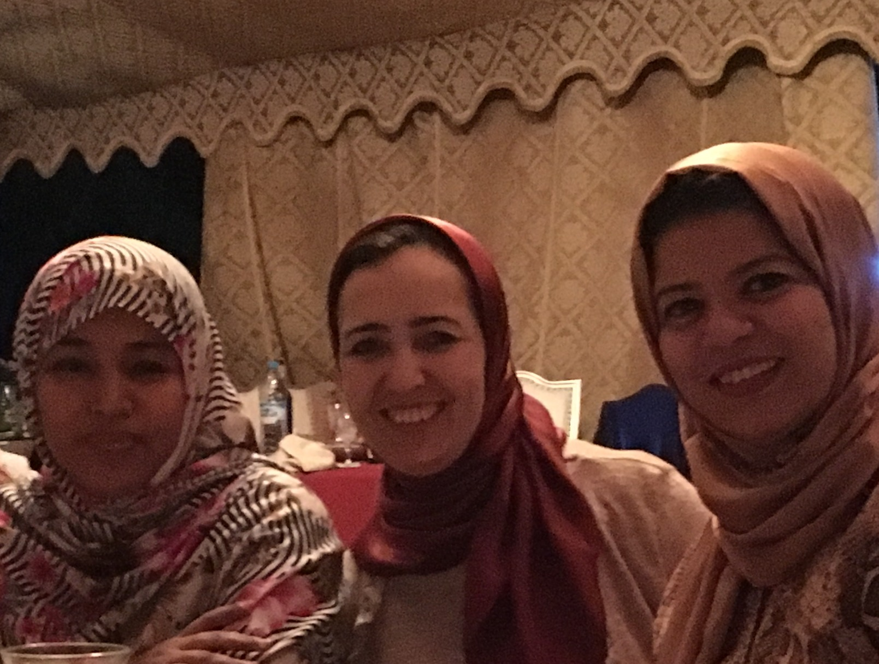
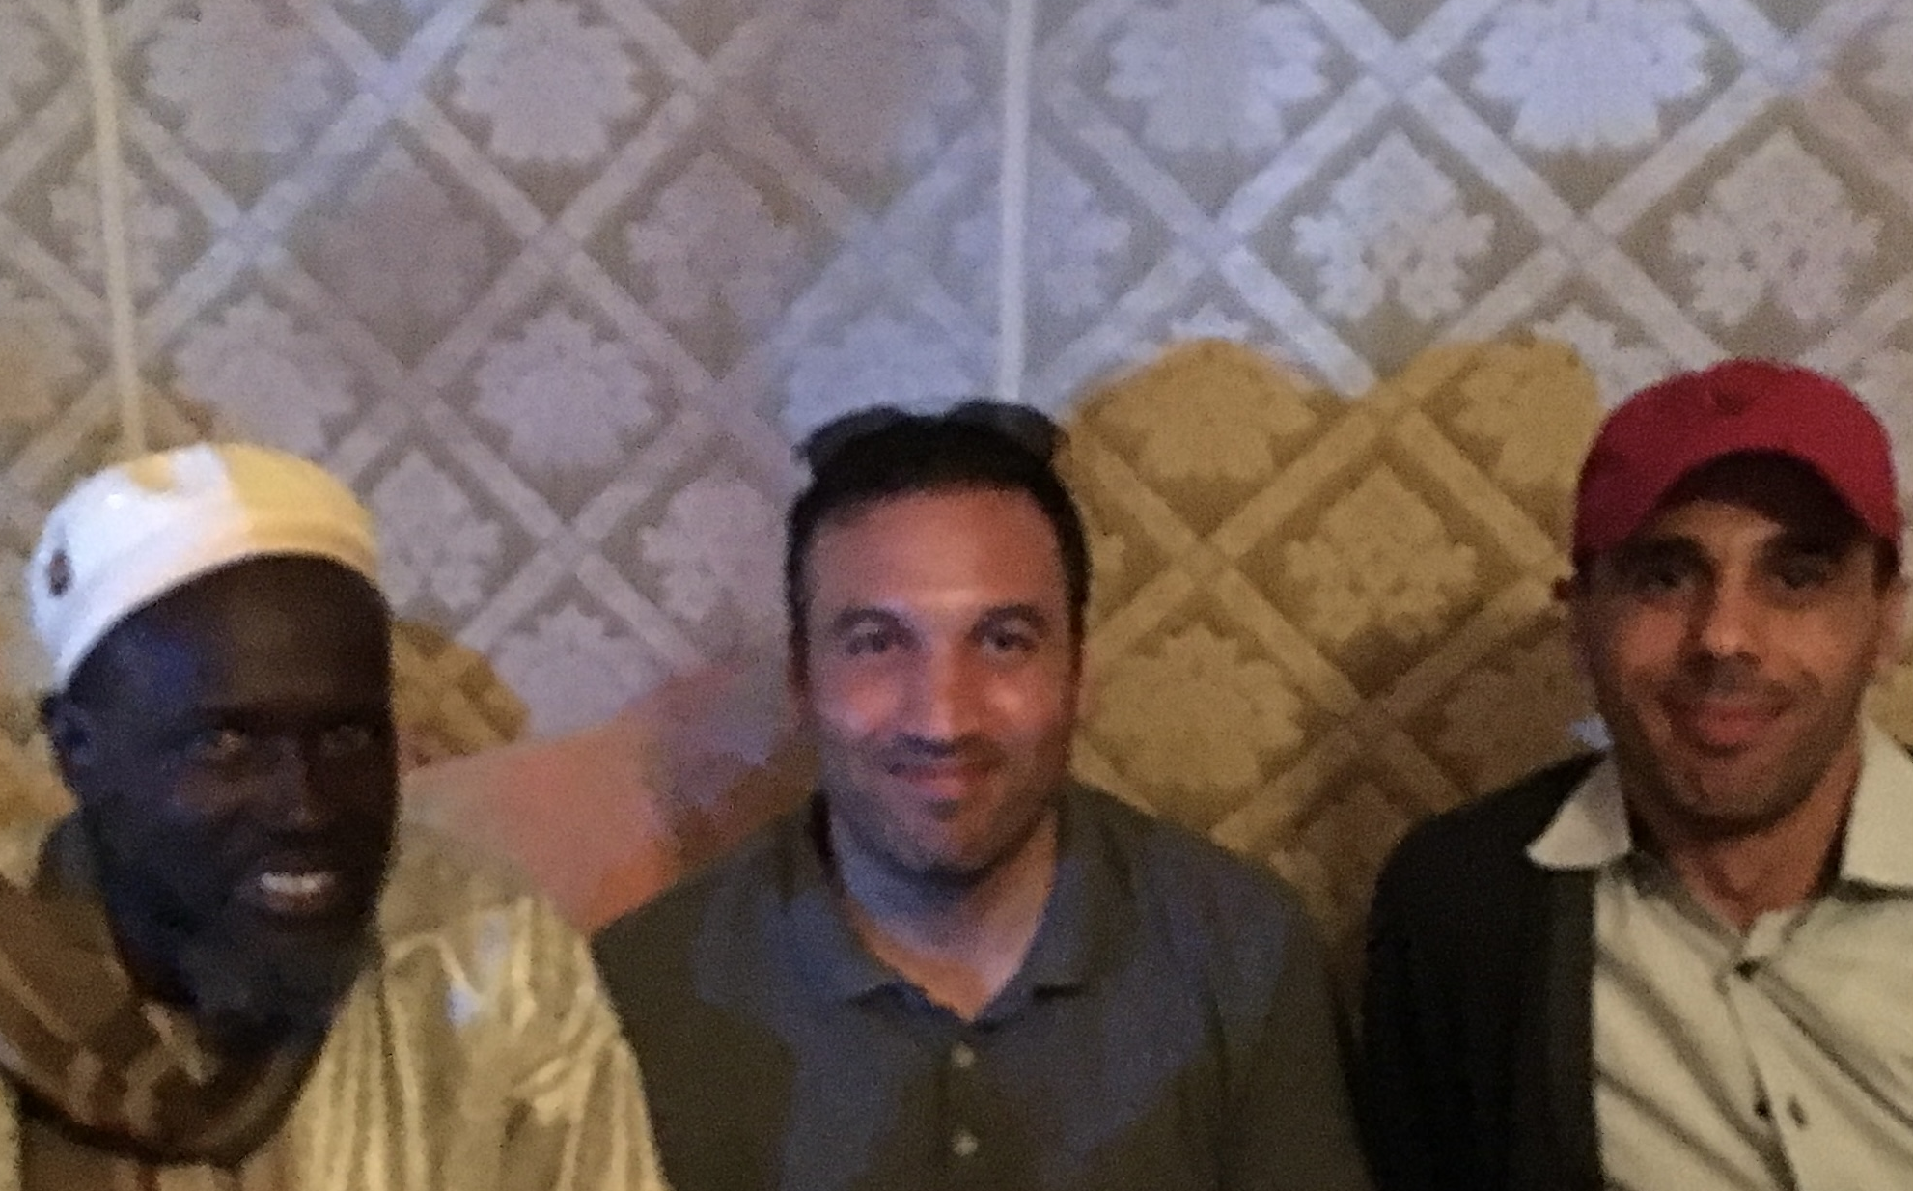
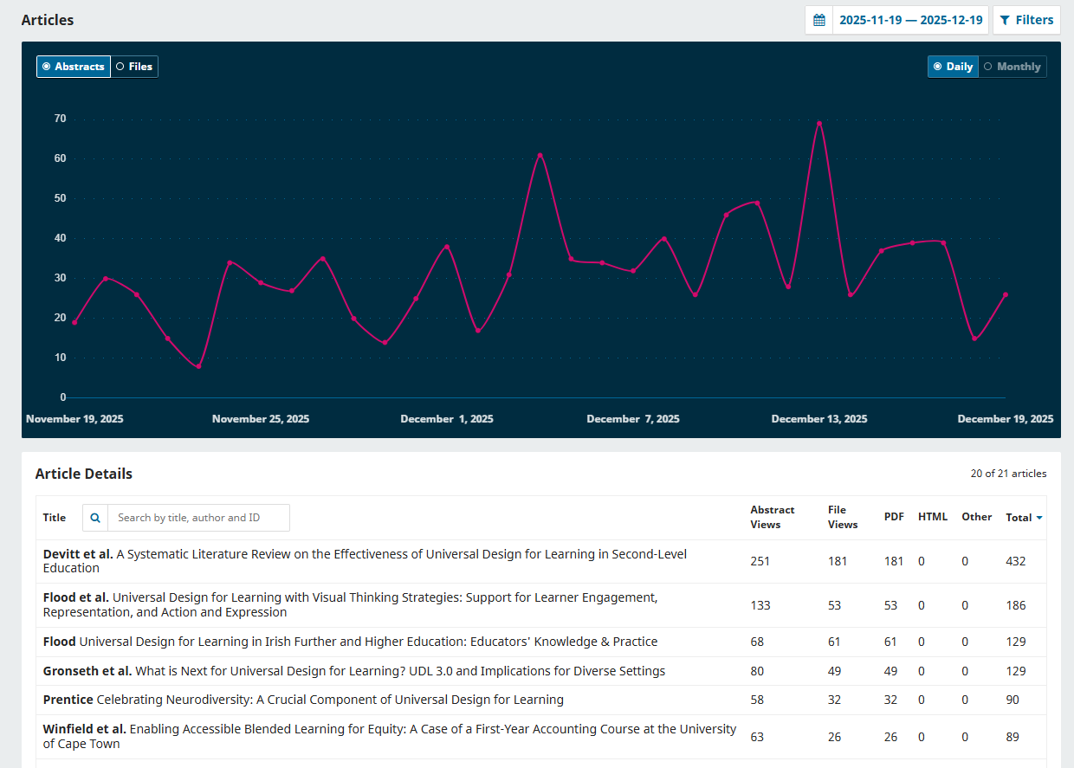
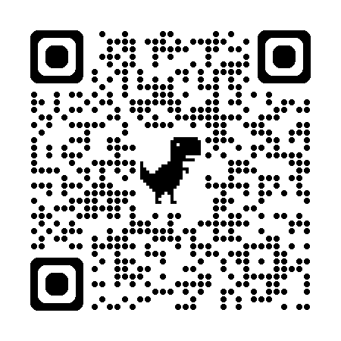







Promoting Transnational Partnership Equity by Enabling Inclusive Research for All :
The transformative role of the IJUDUDL.
Context and Rationale
A systematic review of 40 studies using Elicit GenAI highlights that Author Processing Charges (APCs) for Global South researchers is a major barrier to research publication (See resources QR Code at the end of the poster).
APCs commonly range $1,500–$3,700, often more, creating a primary barrier to Open Access (OA) publishing for Lower and Middle Income Country (LMIC) authors (Gallado et al, 2024).
Affordability gap: When adjusted for purchasing power, publishing costs are 2–15× higher for LMIC scholars and can equal several months of salary (Gupta et al, 2018)
Measurable inequity: In health journals, each $500 APC increase links to a 0.7% drop in LMIC first authorship; surveys show 58–91% of LMIC researchers say APCs limit their ability to publish (Hyman et al, 2024)
Partial waivers underperform: Middle‑income countries remain under‑served; waiver processes can be slow or stigmatising.
Diamond OA (no fees to read or publish) emerges as a strong corrective.
Why does this matter for equitable partnerships?
The realisation and continued sustainability of IJUDUDL is premised on the core Shared Principles for Equitability in Partnership (British Academy, 2025). For instance, Principles 6 and 7. These principles are advanced practically and theoretically because IJUDUDL:
Removes financial gatekeeping by eliminating APCs and submission fees, particularly benefiting unfunded and middle‑income scholars who are often excluded from waiver lists.
Builds South‑anchored infrastructure and governance (Moroccan national portal and Ibn Zohr leadership) while sustaining North–South collaboration, a partnership model that does not outsource control from the Global South.
Strengthens research capacity building within stakeholder institutions for instance by purposefully prompting scope for mentoring and coaching of PGR students who are pivotal to continued Journal sustainability. Students adopt roles providing technical and supportive responsibilities and are thereby inducted into a wider transnational collaborative research culture.
Amplifies Global South knowledge in UD/UDL, enabling policy‑relevant dissemination without the APC-induced deflection seen in many LMIC publication patterns (Bracken & Novak, 2019) See the chart below for emerging engagement.
The International Journal for Universal Design and
Universal Design for Learning
The journal’s vision is to continuously enhance our shared social, technological, learning and built environments so that spaces and resources become increasingly accessible to individuals and communities. In doing so, the aim is to drive the global research agenda on inclusion to promote mutual learning from a diversity of contexts. The journal aims to reflect and respect diverse cultural contexts whilst challenging systemic inequities locally, nationally and internationally.
Diamond Open Access model — no APCs, no submission fees, no paywalls directly removes the most-cited barrier in the systematic review and avoids waiver stigma.
Hosted on IMIST PRSM, the national portal of Morocco’s Ministry for Higher Education, Scientific Research and Innovation, ensuring visibility, DOI management, and indexing pathways within a state-backed infrastructure.
Interdisciplinary scope strengthens theorising, practice and research across pedagogy, technology, architecture, and social design, aligned with UD and UDL.
Equity, co‑design and community voice editorial vision emphasises marginalised communities’ perspectives, and invites research, practice insights, and think pieces.
Early signal of reach: the inaugural issue (Vol. 1, No. 1, 2025) features global author contributions and UDL applications; example article entries are being indexed in institutional repositories and portals.
Overcoming the APC barrier: A Collaborative Journey
2019 — British Academy Writing Workshop, Agadir, Morocco, a collaboration between UIZ and the University of Worcester, set the determination to establish a peer‑reviewed, free‑to‑publish, free‑to‑access interdisciplinary journal to counter APC barriers and provide a welcoming host space especially for emerging researchers
June 26–28, 2024 — Launch at the joint INCLUDE & 7th ICEQ Conference (University of Worcester). The conference explicitly linked accepted submissions to the inaugural issue and hosted the public launch of the journal.
October 2025 — Website and Issue 1 published on Morocco’s national open‑access journals’ portal, editorial governance spanning Morocco, the UK, and international partners.
SHARE ONE ACTION OR INSIGHT
you’ll take away from this poster &
ACCESS ADDITIONAL RESOURCES
NOTE YOUR ACTION OR INSIGHT HERE
GET YOUR ADDITIONAL RESOURCESHERE
References
Bracken, S., & Novak, K. (Eds.) (2019). Transforming Higher Education Through Universal Design for Learning: An International Perspective London: Routledge
British Academy (2025) Equitable Partnership in International Collaboration (EqPIC – A Call to Action. Available from British Academy Website Accessed 09/01/26
Gallardo, O., Milia, M., Appel, A. L., Team, G. A., & van Schalkwyk, F. (2024). When researchers pay to publish: Results from a survey on APCs in four countries. arXiv preprint arXiv:2410.12144.
Hyman, G. Y., Wurdeman, T., Kumar, N., Alty, I. G., Forbes, C., Riviello, R., & Raykar, N. P. (2024). Article Processing Charges Threaten Global Health Equity: Open Access is Closed Science. medRxiv, 2024-11.
Poster authors and contact details:
Dr Seán Bracken, University of Worcester, s.bracken@worc.ac.uk
Professor Mustapha Aabi, Ibn Zohr University, m.aabi@uiz.ac.ma
Dr Elizabeth Dalton, DESI elizabethmdalton@gmail.com
Sanae El Jamyly, Ibn Zohr University, sanaeeljamyly@gmail.com

