Slide 1
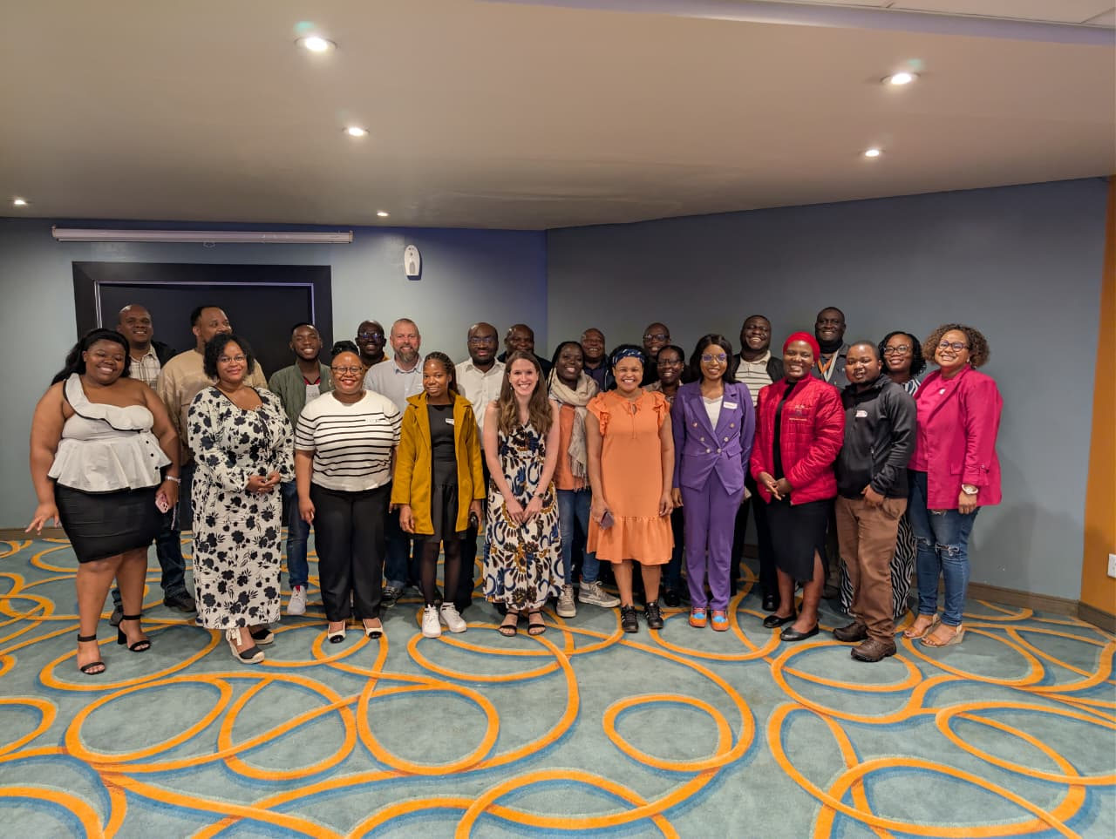
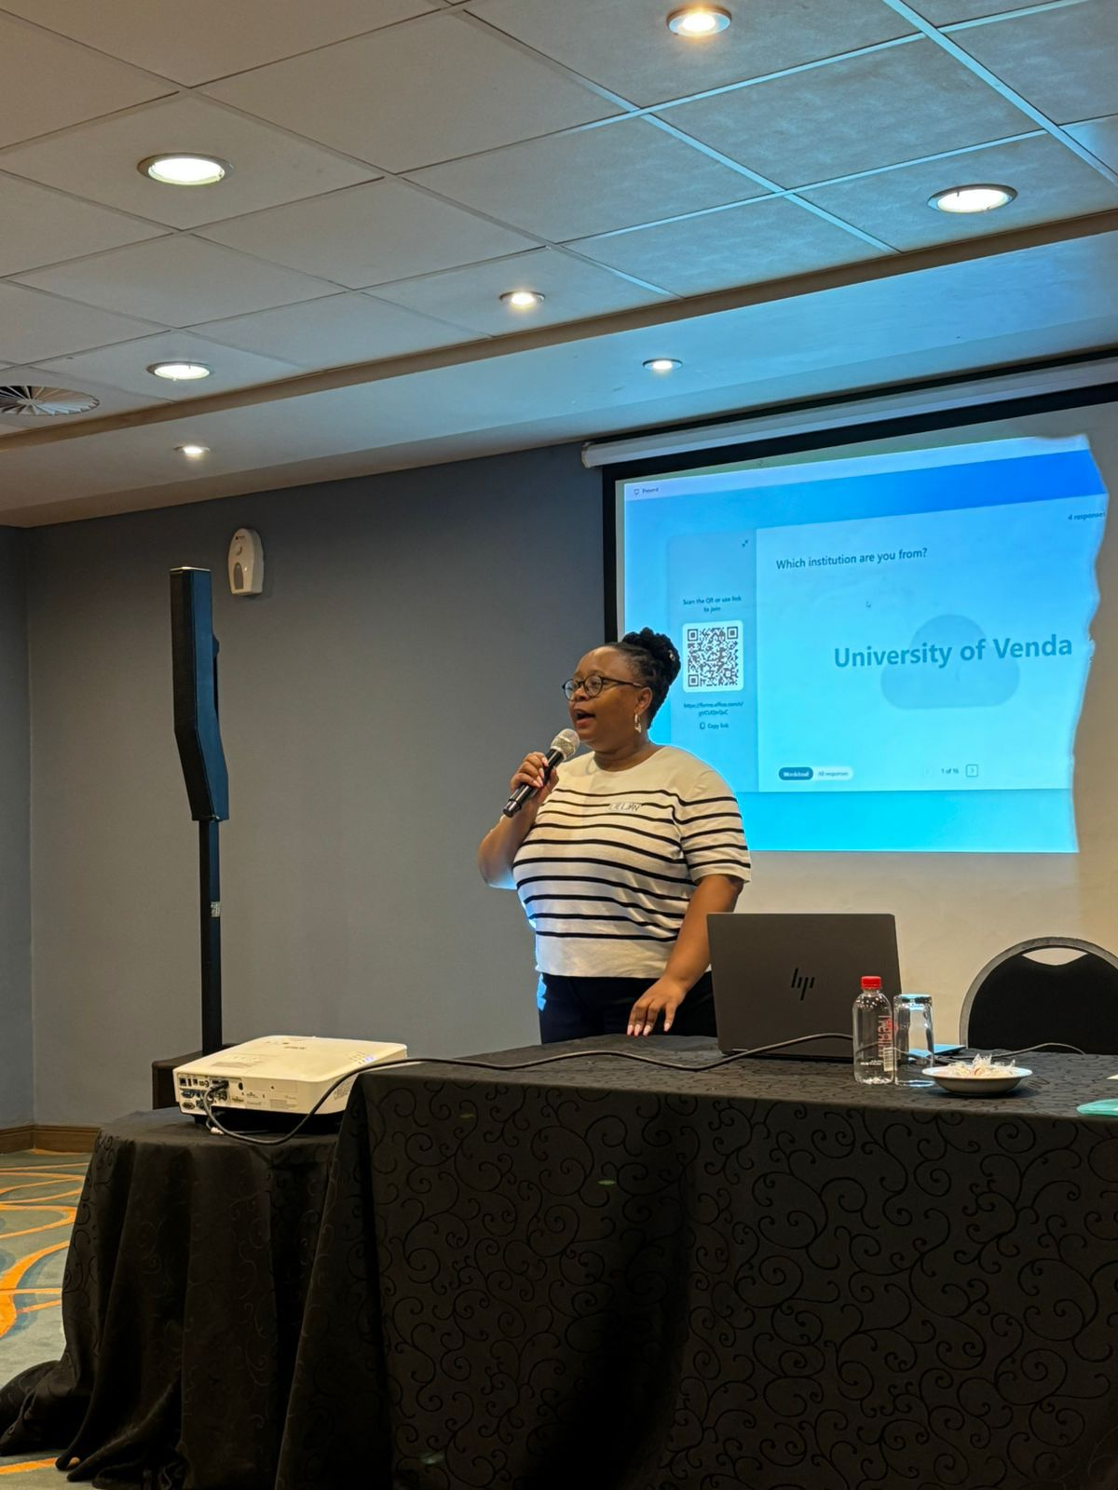
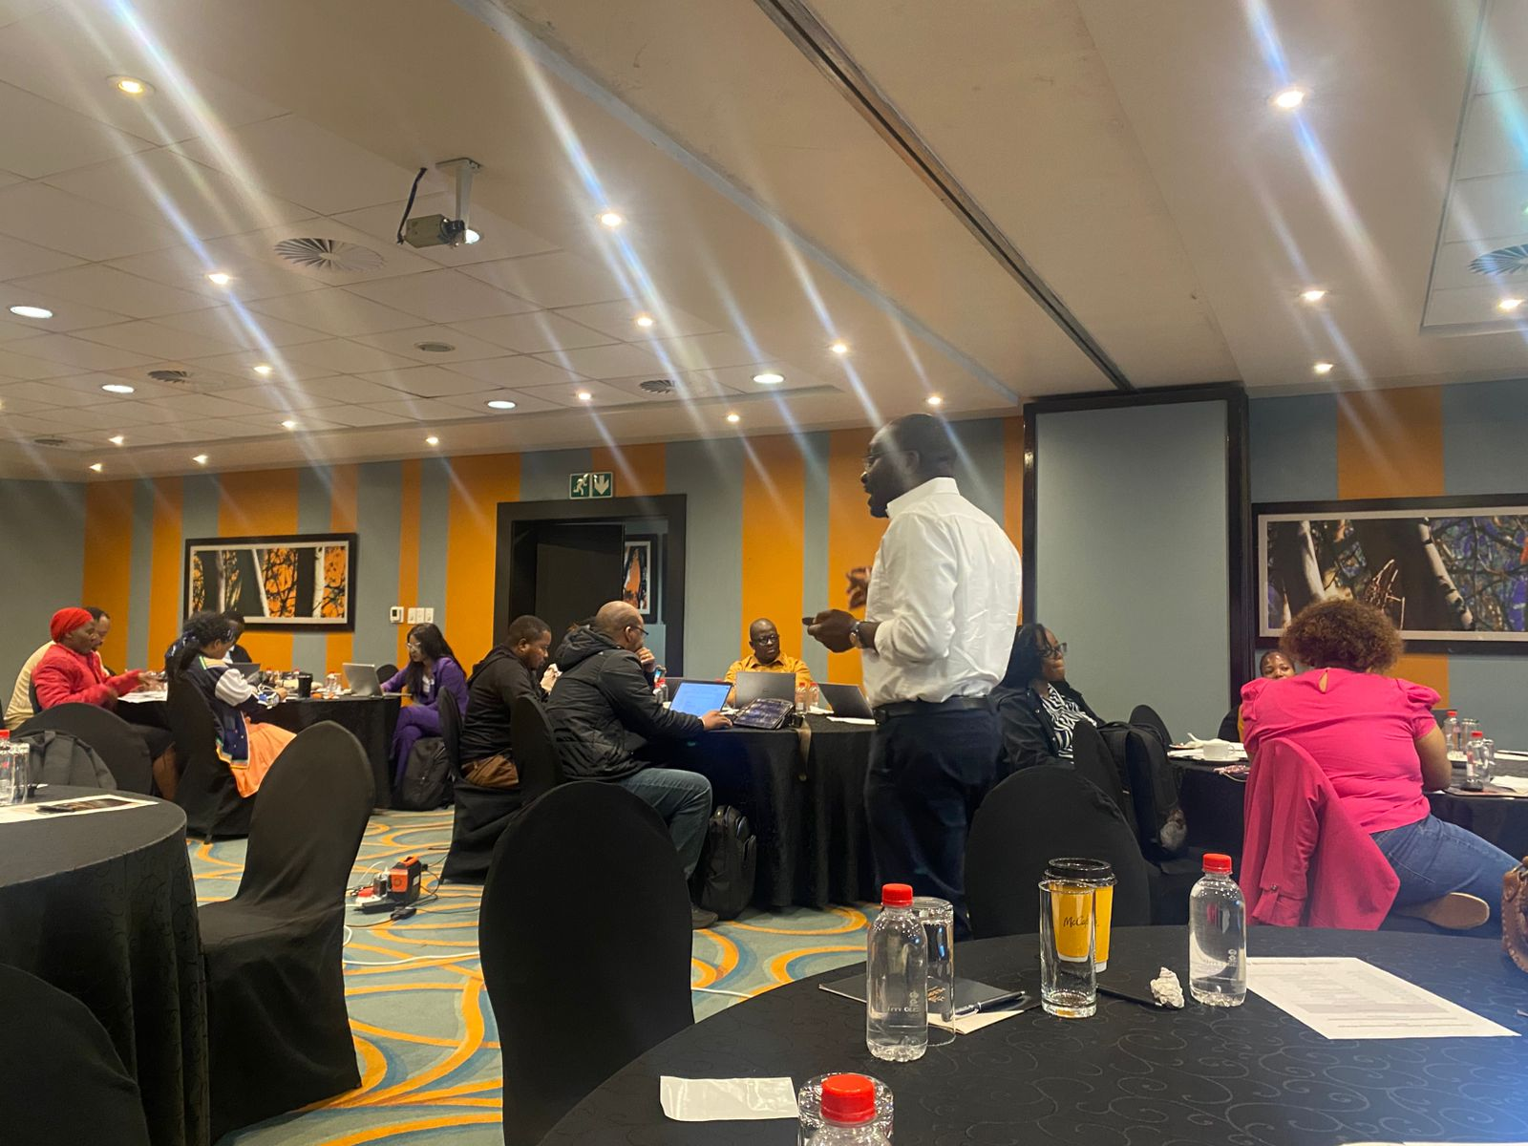
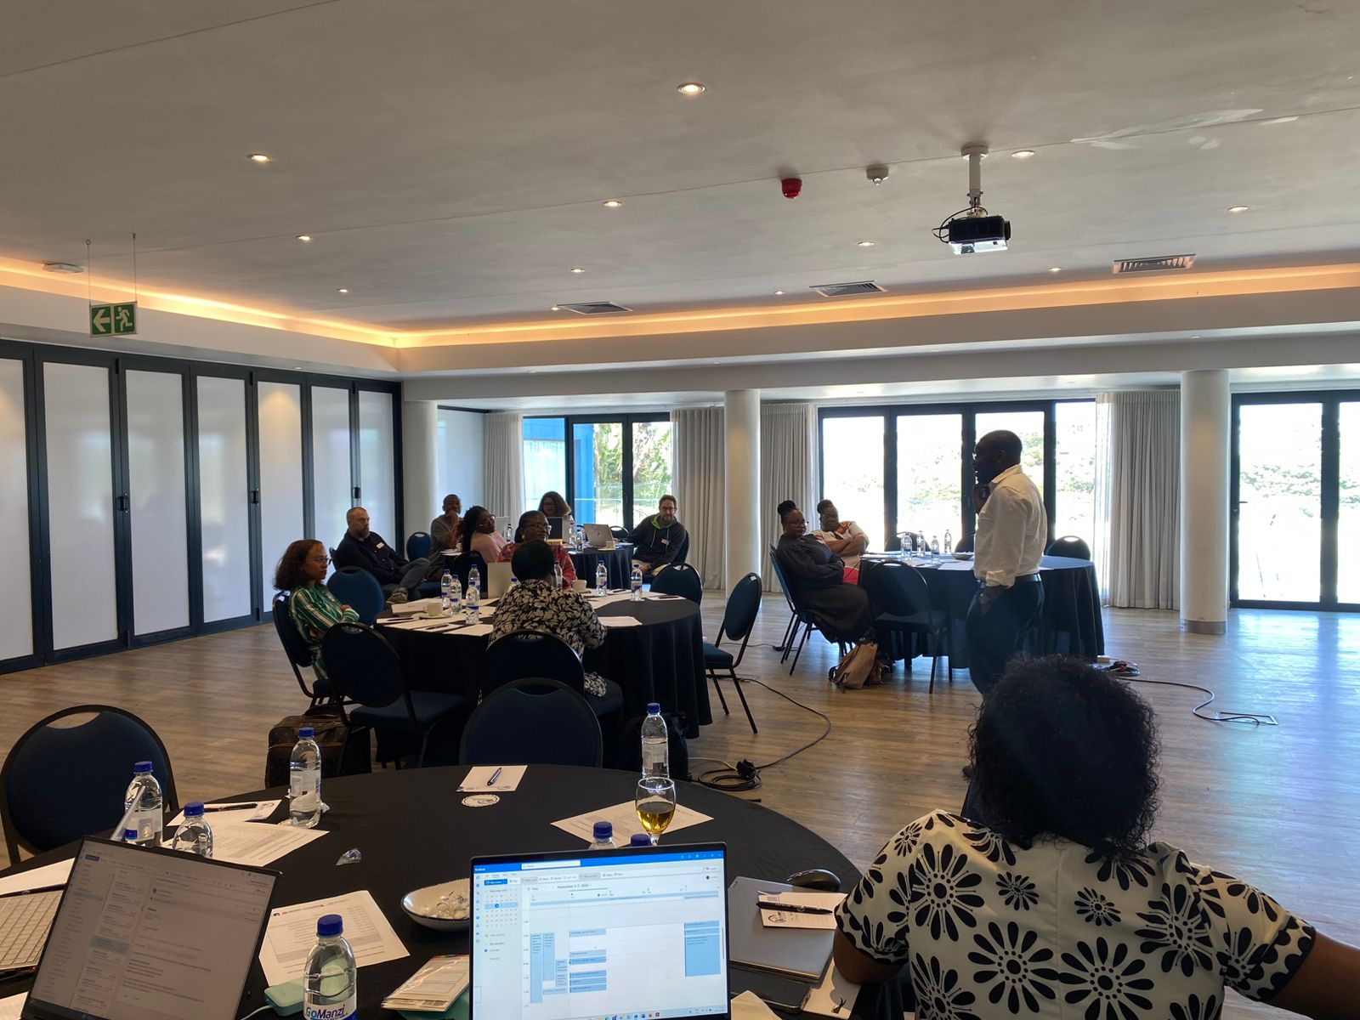
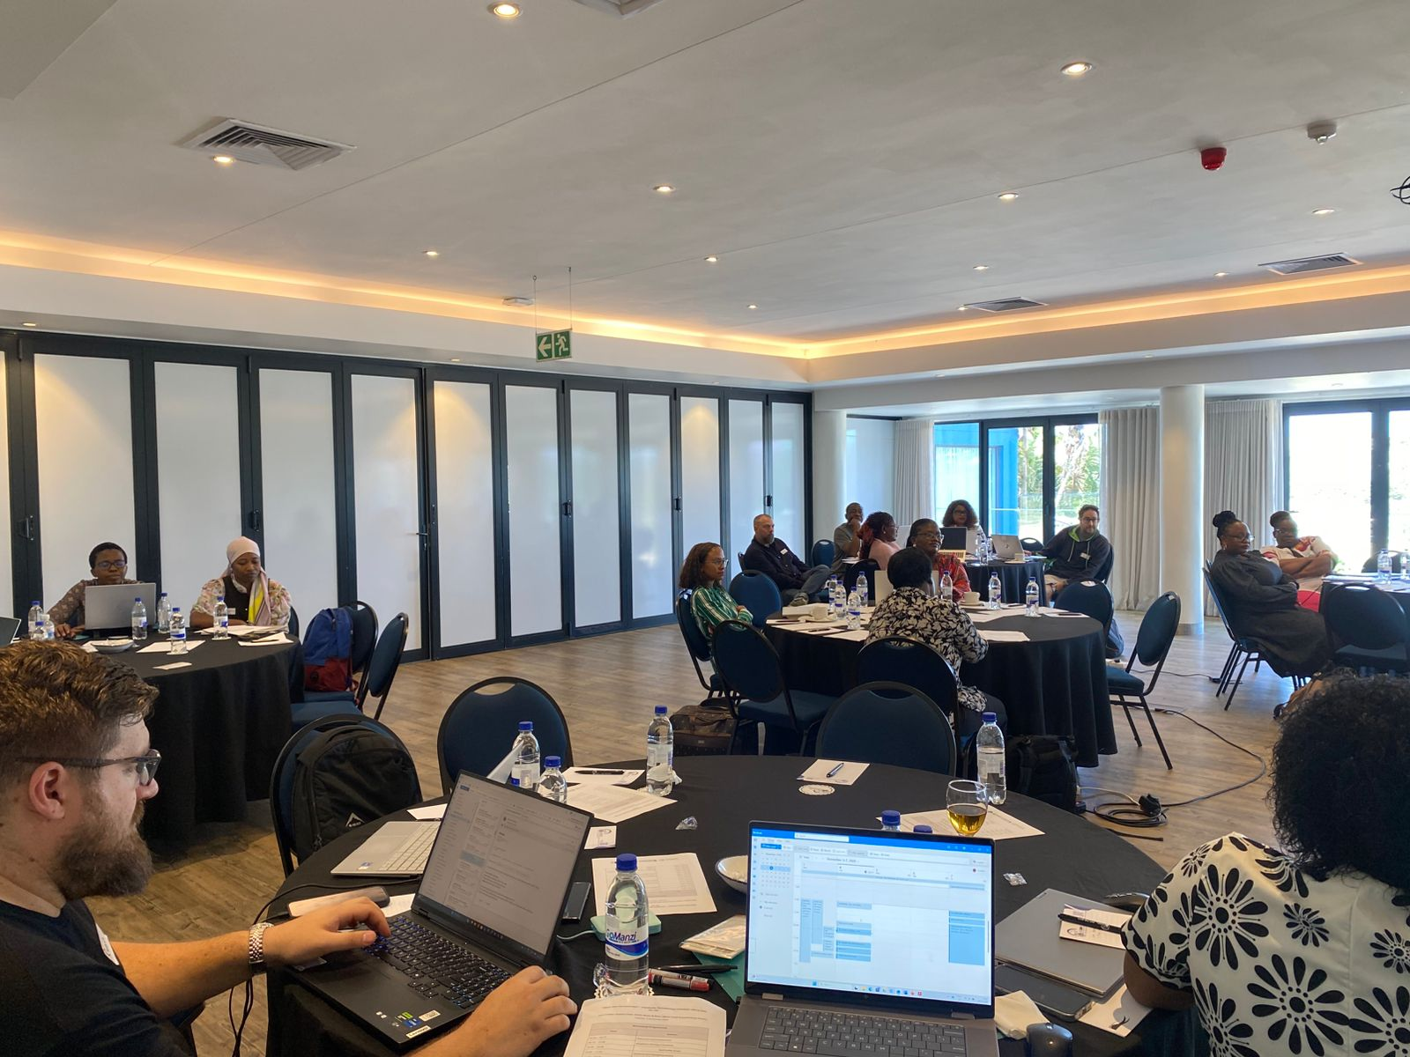
Next-Gen Partnerships: Advocacy and Sensitisation of Equitable Research Collaboration Principles to New Actors
British Academy Grant EPWFF\00033
Leani van Vuuren; Ashley Gunter; Melis Cin; Parvati Raghuram; Manu Lekunze
Project Outcomes and Impact
Building on the BA Workshops, Conference and recent work on Equitable African-led Partnerships, this project widens the audience for such initiatives through advocacy in the global North and extending the reach in the global South. Through workshops with the UK and Historically Black Universities in South Africa (University of Fort Hare, University of Venda and Walter Sisulu University), the project invites new collaborations and distributes seed corn funding to three new UK-RSA partnerships that produce a live testbed for equitable partnership principles.
Increasing awareness of equitable partnership guidelines
Testing and refining equitable partnership guidelines
Fostering new networks and inclusive international research collaborations
Facilitating knowledge exchange and capacity building
Project Progress
1 X Online UK Workshop (September, 2025)
2 X in-person RSA Workshops: Eastern Cape (East London) and Limpopo (Thohoyandou) (November, 2025)
Seed corn funding allocated to 3 projects (December, 2025 – March 2026)
Building and Managing Grants
Academic Writing in Practice
Working in International Teams
Global Opportunities and Networks
Writing for a Global Audience as an African Scholar
SEED CORN FUNDED PROJECTS
Consent and Gender Based Violence Awareness
(University of Venda)
Urban Sustainability and Ecosystem Preservation
(University of Venda)
School Gardens and Food Security
(University of Fort Hare)

