Slide 1





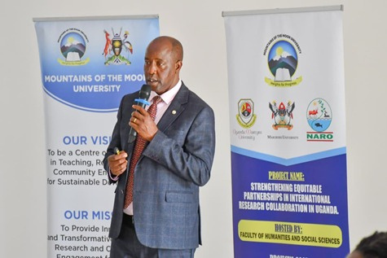
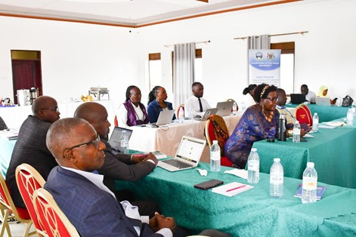
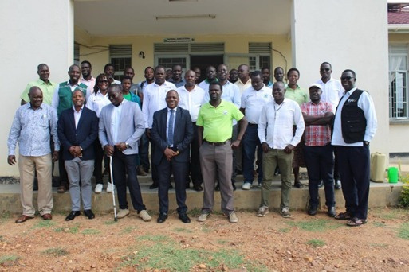
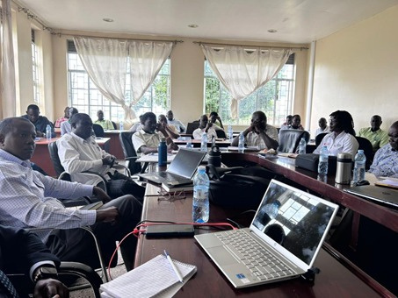
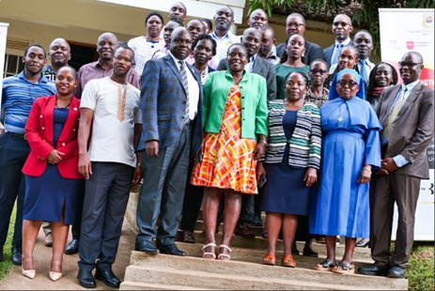
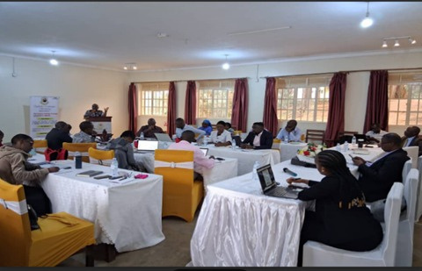
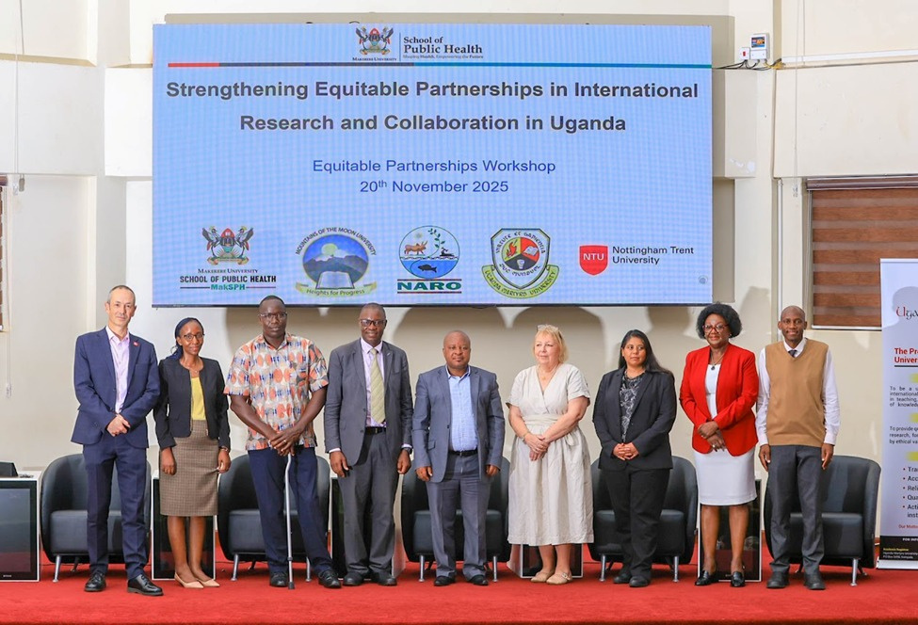
Strengthening Equitable Partnerships in International Research Collaboration in Uganda: Key Lessons and Experiences
1
2
3
4
5
David Musoke , Albert Luswata , Fredrick Mutabaruka , Walter Odongo, Linda Gibson
2 - Uganda Martyrs University, Uganda
3 - Mountains of the Moon University, Uganda
4 - National Agricultural Research Organisation, Uganda
Background
1 - Makerere University School of Public Health, Uganda
5 - Nottingham Trent University, UK
Background
Project Pictorial
Makerere University School of Public Health in collaboration with Uganda Martyrs University, Mountains of the Moon University, the National Agricultural Research Organization, and Nottingham Trent University (NTU) are implementing a project to strengthen equitable partnerships in international research collaboration.
Achievements
Institutional workshop at Mountains of the Moon University
3 webinars and 5 workshops conducted
Strengthened collaboration across the 5 partner institutions
Enhanced understanding of equitable partnership principles through shared learning
Implemented a South-South-North collaboration model
.
Institutional workshop at National Agricultural Research Organisation
Key lessons learnt
Regular partner meetings were crucial
Institutional systems and processes vary
Strong leadership from the partners enabled timely implementation
Regular communication through various channels was instrumental
Institutional workshop at Uganda Martyrs University
Challenges
Delayed signing of sub‑agreement between some partners
Project coordination across multiple partners
Joint workshop organised by Makerere University
This project is funded by the British Academy’s Equitable Partnerships Workshops Follow‑on Funding Programme, supported under the UK Government’s International Science Partnerships Fund.

