Slide 1


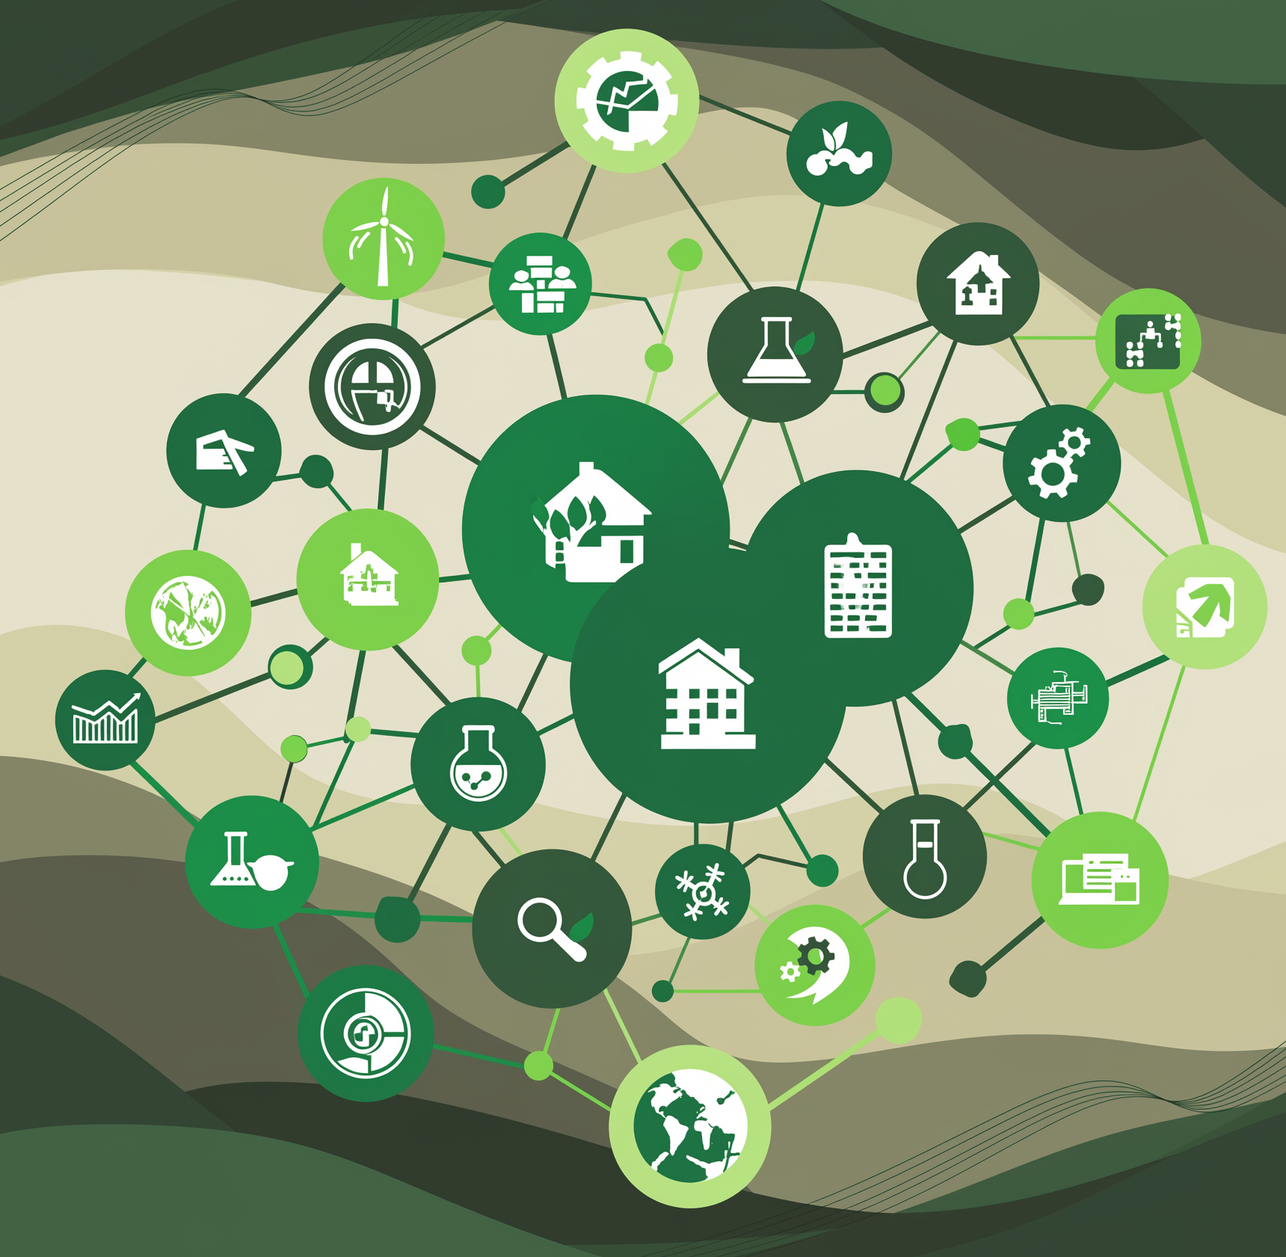







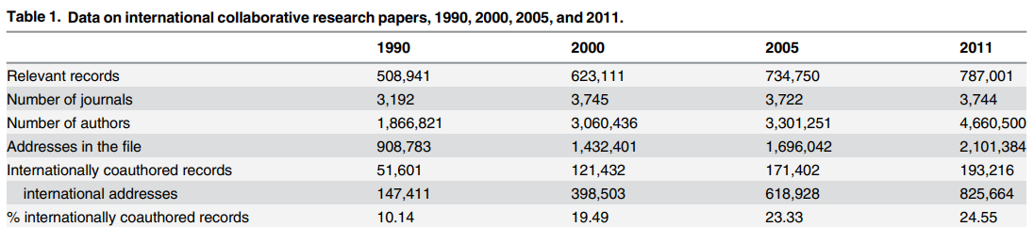






Maximising Knowledge Building Through International
Research Collaboration
Olubisi Ige, School of Construction, Property and Surveying, London South Bank University
Introduction
International research collaboration is critical to addressing complex global challenges such as climate change, pandemics, and technological transformation (Adams, 2013).
Core Pillars
SHARED VISION & GOALS
- Aligning objectives for mutual benefit
- Co-defining research questions
EQUITABLE PARTNERSHIPS
- Fair recognition & credit
- Joint decision-making
OPEN COMMUNICATION & DATA SHARING
- Transparent protocols
- Fair data principles
- Secure platforms.
(Wagner et al., 2015)
Outputs & Benefits
Increased funding and grant opportunities
Sustainable research networks & consortia
High – impact joint publications
New innovations and technologies
Enhanced academic reputation
Why Collaboration Matters
Advances innovative solutions to global challenges
Shares pools of expertise and resources
Fosters cross-cultural understanding & interdisciplinary.
Expands academic horizons and networks
“Together, we build knowledge that transforms the world”
Reference
Wagner, C. S., Park, H. W., & Leydesdorff, L. (2015). The continuing growth of global cooperation networks in research: A conundrum for national governments. PloS one, 10(7), e0131816.
Adams, J. (2013). The fourth age of research. Nature, 497(7451), 557-560.
Further information
igeo4@lsbu.ac.uk
https://www.linkedin.com/in/olubisi-ige-phd-mciob-76b75063/
https://www.researchgate.net/profile/Olubisi-Ige-2?ev=hdr_xprf
2nd Conference on Equitable
Partnerships, Pretoria, SA.

