Slide 1


A framework to integrate indigenous knowledge into disaster risk reduction to build disaster resilience: insights from rural South Africa
Dr MM Motsumi
11:15 am
Room 3
WEDNESDAY 4 FEBRUARY 2026

Slide 2




Presentation Roadmap
Context and policy problem
Conceptual and theoretical grounding
Methodological approach
Empirical findings
Framework for IK–DRR integration
Policy and implementation implications

Slide 3

Context and policy problem
Disaster impacts are increasing in frequency and complexity
Rural and marginalised communities experience disproportionate losses
DRR systems remain dominated by technocratic and top‑down approaches
Local capacities and knowledge systems remain underutilised

Slide 4
Indigenous Knowledge in DRR
IK represents cumulative, place‑based knowledge developed over generations
Embedded in livelihoods, culture, spirituality, and environmental interaction
Historically effective in anticipating, coping with, and recovering from hazards
Marginalised by dominant Western scientific paradigms

Slide 5
The Policy and Practice Problem
IK is often acknowledged rhetorically but excluded operationally
Limited frameworks guiding systematic integration of IK into DRR
Weak participation of communities in DRR governance
Resulting interventions often lack legitimacy and sustainability

Slide 6
Purpose and Contribution of the Study
To generate empirical evidence on the role of IK in DRR
To examine perceptions of integration from communities and practitioners
To identify barriers to IK inclusion in DRR systems
To propose a context‑sensitive integration framework

Slide 7
Study Area and Research Philosophy and Design
Northern Cape Province, South Africa
John Taolo Gaetsewe District Municipality
Joe Morolong Local Municipality
Five rural villages characterised by semi‑arid conditions and isolation
Research philosophy:
  Grounded in pragmatism
  Focus on actionable knowledge and real‑world outcomes
  Phenomenological qualitative approach
  Centred on lived experiences of disaster‑affected communities

Slide 8

Sampling and Participants: Data Collection and Analysis
Multi‑stage sampling strategy
20 Focus Group Discussions with 100 community members
9 Key Informant Interviews with DRR institutions and traditional leadership
Total sample size: 109 participants
Data Collection and Analysis
Structured FGDs and semi‑structured KIIs
Thematic analysis using deductive coding
Themes informed by literature and DRR integration debates
Ethical clearance obtained from North‑West University

Slide 9

Findings: Integration as an Imperative
Strong support for complementary use of IK and modern DRR
IK viewed as cost‑effective and locally legitimate
Integration strengthens trust and community ownership
Communities reject exclusive reliance on external expertise

Slide 10

Findings: Mechanisms for Integration
Inclusive DRR planning involving local communities
Engagement of traditional leadership structures
Use of vernacular languages in DRR communication
Collaborative platforms for mutual knowledge exchange

Slide 11
Findings: Barriers to Integration
Mutual distrust between experts and communities
Lack of documentation and systematisation of IK
Generational tensions within communities
Highly localised and context‑specific nature of IK

Slide 12

From Evidence to Framework
Empirical findings reveal both opportunities and constraints
Need for a structured yet flexible integration model
Framework informed by data and existing scholarship
Designed to support policy and operational decision‑making

Slide 13
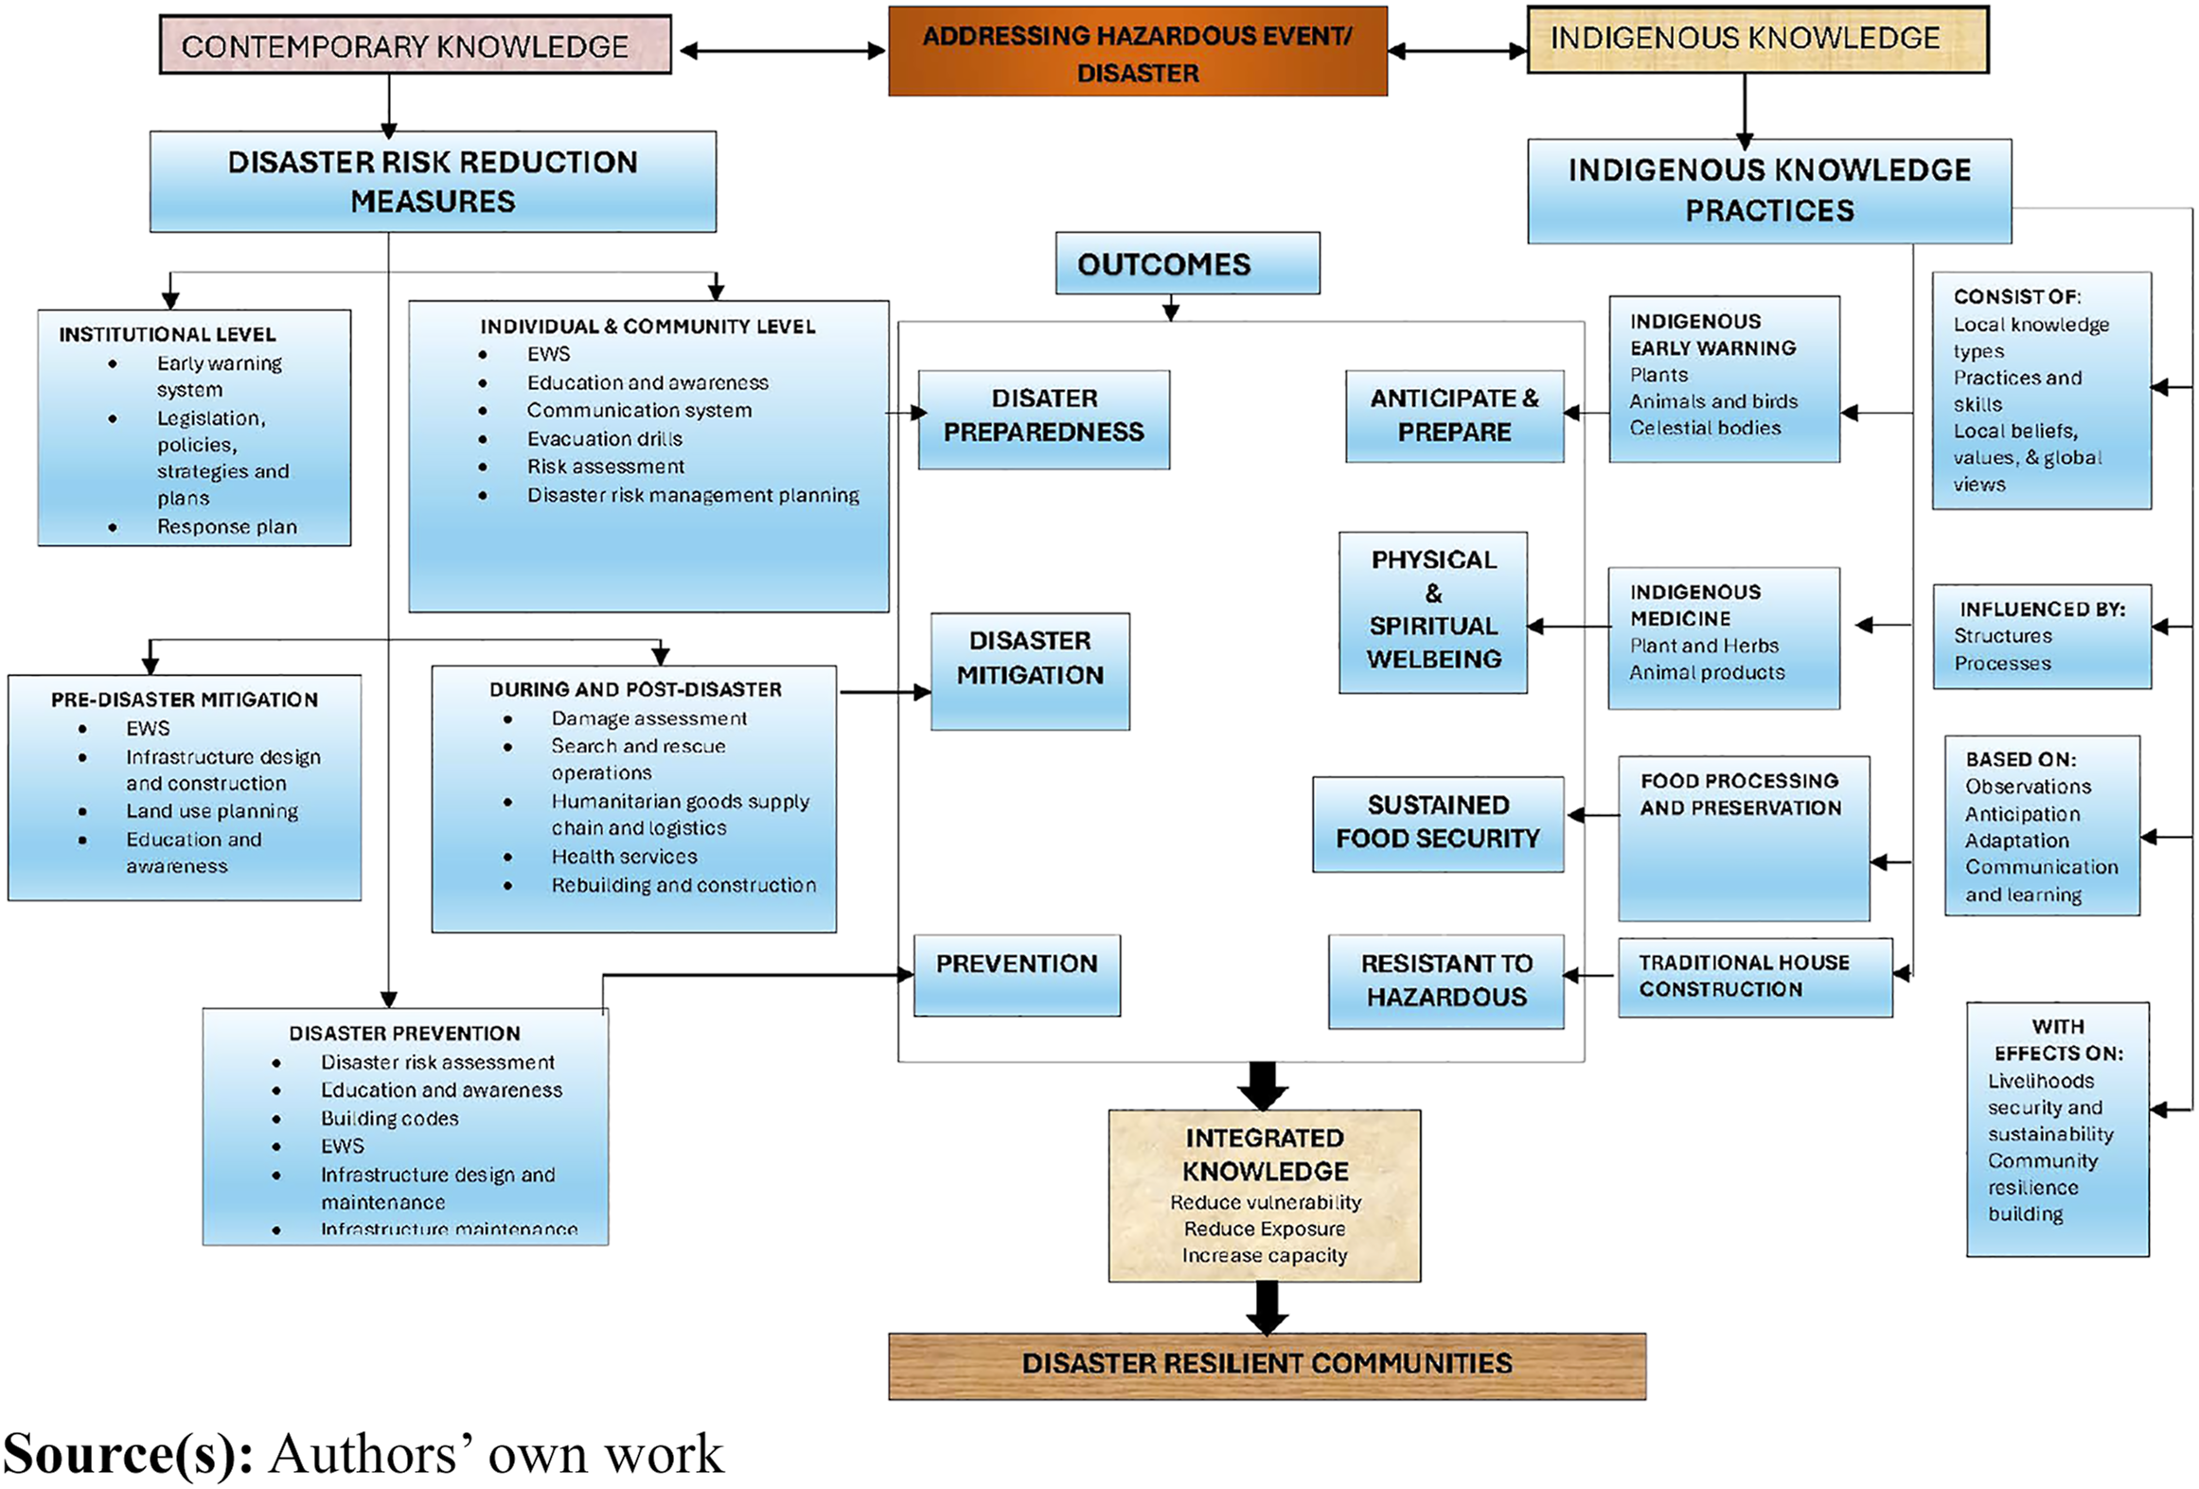
Framework to integrate disaster risk reduction and indigenous knowledge

Slide 14
Policy Relevance of the Framework
Moves IK from symbolic recognition to operational integration
Supports decentralised and participatory DRR governance
Enhances legitimacy and uptake of DRR interventions
Aligns with Sendai Framework priorities

Slide 15
Key Recommendations for Decision Makers
Formally institutionalise IK within DRR policy frameworks
Mandate community participation in DRR planning
Integrate IK into early warning and risk assessment systems
Support capacity building for hybrid knowledge systems

Slide 16
Conclusion
IK remains a critical but underutilised DRR resource
Empirical evidence supports complementary integration
The framework offers a practical, scalable policy tool
Balanced knowledge systems are essential for resilient futures

