Slide 1

Building and sustaining long lasting partnerships around gender and education
Relelbohile Moletsane (University of the Witwatersrand and Elaine Unterhalter (University College London)

Slide 2

A very long set of conversations

Slide 3

1. What were our research concerns and out conditions of work when we first started working together? What was the nature of the partnership in that phase?
2. What shifted in our partnership over the years? And why?
3. What lessons can we draw from our partnership and its implications for building sustainable, equitable and respectful partnerships?

Slide 4
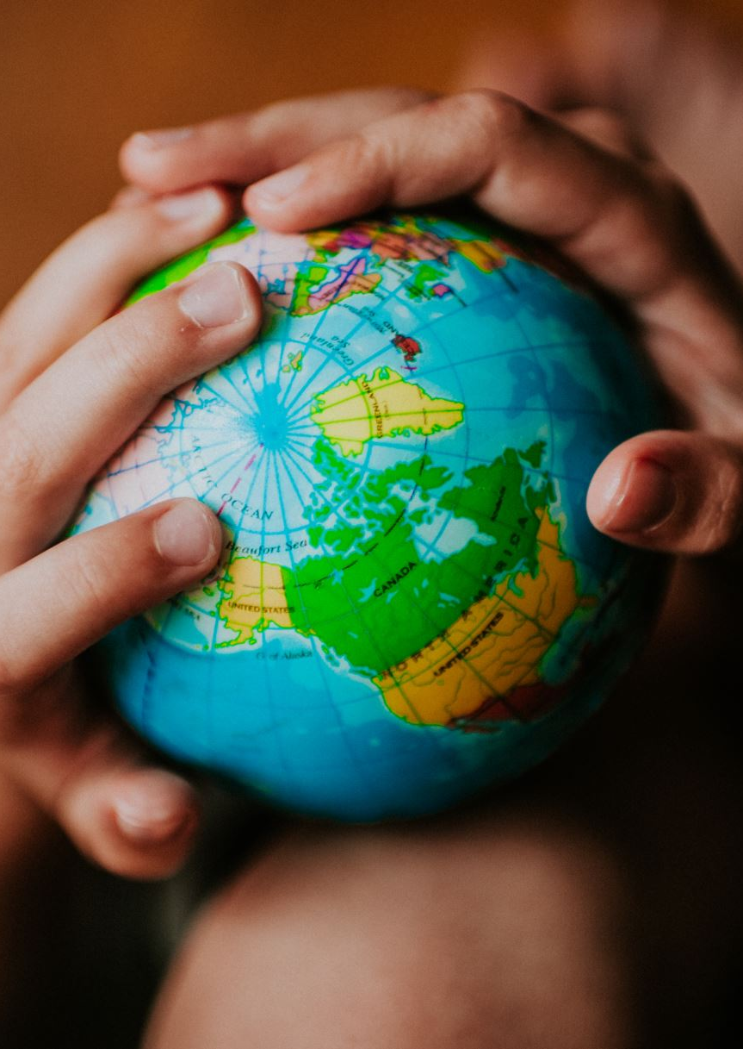
Partnering for Change Across Hemispheres
What were our research concerns and out conditions of work when we first started working together? What was the nature of the partnership in that phase?

Slide 5

Documenting Change: How and why did things shift?

Slide 6

What made our partnership last this long? And take its current form?

Slide 7
Some selected publications and projects, 1996-2026
Gender, education and HIV – Conventional hierarchies
Engaging with policy – new positionings
Participation and visual methods – doing research differently
Girlhood Studies - listening

Slide 8
Gender, education and HIV
Morrell, R., Epstein, D., Unterhalter, E., Bhana, D. and Moletsane, R,, 2009, Towards equality? Gender in South African schools during the HIV and AIDS epidemic Durban: University of Kwazulu Natal Press Unterhalter, E., North, A., Morrell, R., Bhana, D., Epstein, D., & Moletsane, L. (2008). 8 Mobilising care: accounts of gender equality, schooling, and the HIV epidemic in Durban, South Africa in Aikman, S., Unterhalter, E. and Boler, T. eds. Gender Equality, HIV, and AIDS, Oxford: Oxf Unterhalter, E., Epstein, D., Morrell, R., and Moletsane, R, 2006, ‘Be yourself: Class, race, gender and sexuality in South African school children’s accounts of social relations’In Lauder, H., Brown, P., Dillabough, J. and Halsey, A.H. eds., Education, Globalisation and Social Change Oxford: Oxford University Press, 586-595. Epstein, D., Morrell, R., Moletsane, R., & Unterhalter, E. (2004). Gender and HIV/AIDS in Africa south of the Sahara: interventions, activism, identities. Transformation: critical perspectives on Southern Africa, 54(1), 1-16. Moletsane, R., Morrell, R., Unterhalter, E., & Epstein, D. (2002). Instituting gender equality in schools: working in an HIV/AIDS environment: HIV/AIDS and education. Perspectives in Education, 20(1), 37-53. Morrell, R., Unterhalter, E., Moletsane, R., & Epstein, D. (2001). Missing the message: HIV/AIDS interventions and learners in South African schools. Canadian Woman Studies/les cahiers de la femme. Unterhalter, E., Moletsane, R & Epstein, D. (2001). HIV/AIDS: Policies, schools and gender identities. Indicator South Africa, 18(2), 51-57.

Slide 9
Engaging with policy
Unterhalter, E., 2003, Education, capabilities and social justice’. Bckground paper commissioned by UNESCO for the EFA (Education for All) Monitoring Report 2003. Paris: UNESCO
Moletsane, R. (2004, February). Gender equality and teacher education in South Africa: A review of the history. Beyond Access Seminar, Nairobi (pp. 1-4).
Moletsane, R. (2005). Looking back, looking forward: analysing gender equality in South African education 10 years after Beijing. Agenda, 19(64), 80-88.
Moletsane, R., Mitchell, C., & Lewin, T. (2010, May). A critical analysis of gender violence and inequality in and around schools in South Africa in the age of AIDS: Progress or retreat. In Paper presentation at the UNGEI E4 conference: Engendering, Empowerment, Education and Equality in Dakar, Senegal. May (pp. 17-20).
Unterhalter, E., Arnot, M., Lloyd, C., Moletsane, L., Murphy-Graham, E., North, A., ... & Saito, M. (2014). Interventions to enhance girls' education and gender equality: Education rigorous literature review. Department for International Development.

Slide 10
Participatory processes and visual methods
Moletsane, R., Mitchell, C., & Lewin, T. (2015). Gender violence, teenage pregnancy and gender equity policy in South Africa: privileging the voices of women and girls through participatory visual methods. In Parkes, J. ed. Gender violence in poverty contexts (pp. 183-196). Abingdon: Routledge.
Moletsane, R. (2023). Using photovoice to enhance young women’s participation in addressing gender-based violence in higher education. Comparative Education, 59(2), 239-258.
Unterhalter, E., Longlands, H., Moletsane, R., Peppin Vaughan, R., 2024 How To Run a participatory dashboard workshop using the AGEE (Accountability for Gender Equality in Education) Framework London: AGEE Project , https://www.gendereddata.org/wp-content/uploads/2024/07/How-to-do-an-AGEE-workshop.final_.pdf

Slide 11
Thinking about girlhood studies
Moletsane, R., Mitchell, C., Smith, A., and Chisholm, L. (2008). Methodologies for Mapping a Southern African Girlhood in the Age of Aids. Rotterdam/New York/Taipei: Sense Publishers.
Moletsane, R. (2007). South African girlhood in the age of AIDS: towards girlhood studies?. Agenda, 21(72), 155-165.
Fourshey, C. C., Jaksch, M., & Moletsane, R. (2025). African Feminist Girlhood Studies and Development. Palgrave Macmillan.
Unterhalter, E. (2025). Disarticulated networks and neoliberal agendas: How insights from GAD theory became disconnected from work on gender, girls’ education and international development. Third World Quarterly, 1-19.

Slide 12
What are some implications for other projects?
Co-development
Co learning/mutual learning
Long lasting relationships
Working against the grain that tends to silencing
Naming forms of racism and its effects
Trying to lean into processes for change

