Slide 1
Roots and Routes to Equity
Diego Baptista – Head of Research and Funding Equity
Jonathan Underwood – Lead, Major International Programmes
Peter Kilroy – Senior Research Manager, Discovery Research

Slide 2

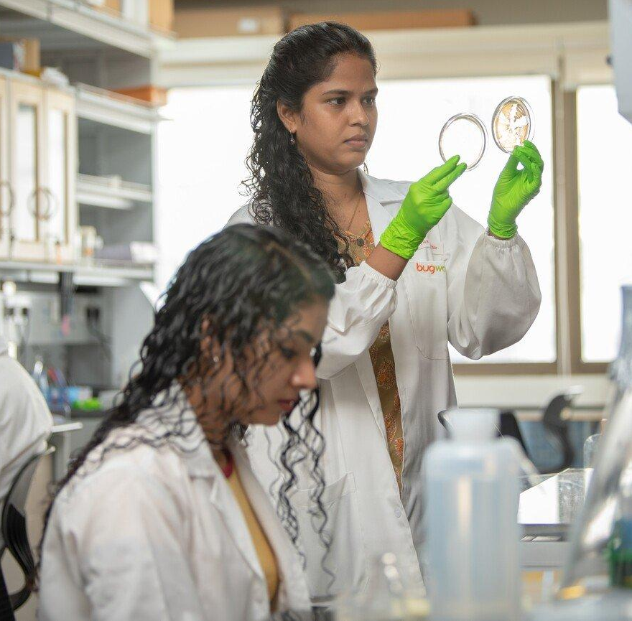
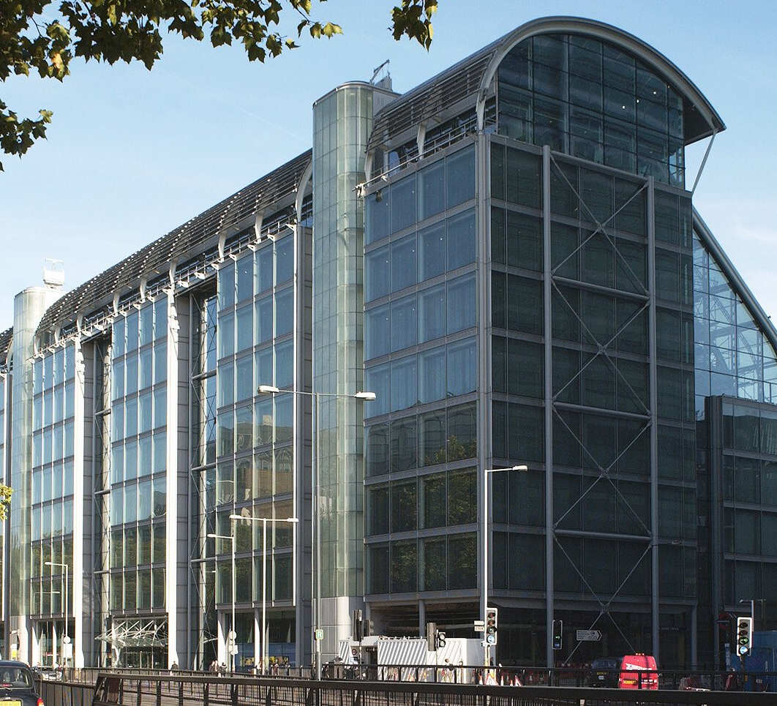
Who are we?
Wellcome is a global charitable foundation. Founded in 1936, we’re based in London but work internationally
Our Mission:
Wellcome supports science to solve the urgent health challenges facing everyone
Our Vision:
A healthier future for everyone
All our work is funded from our £37 billion investment portfolio We plan to spend £1.6 billion annually for the next decade on our four strategic priorities

Slide 3
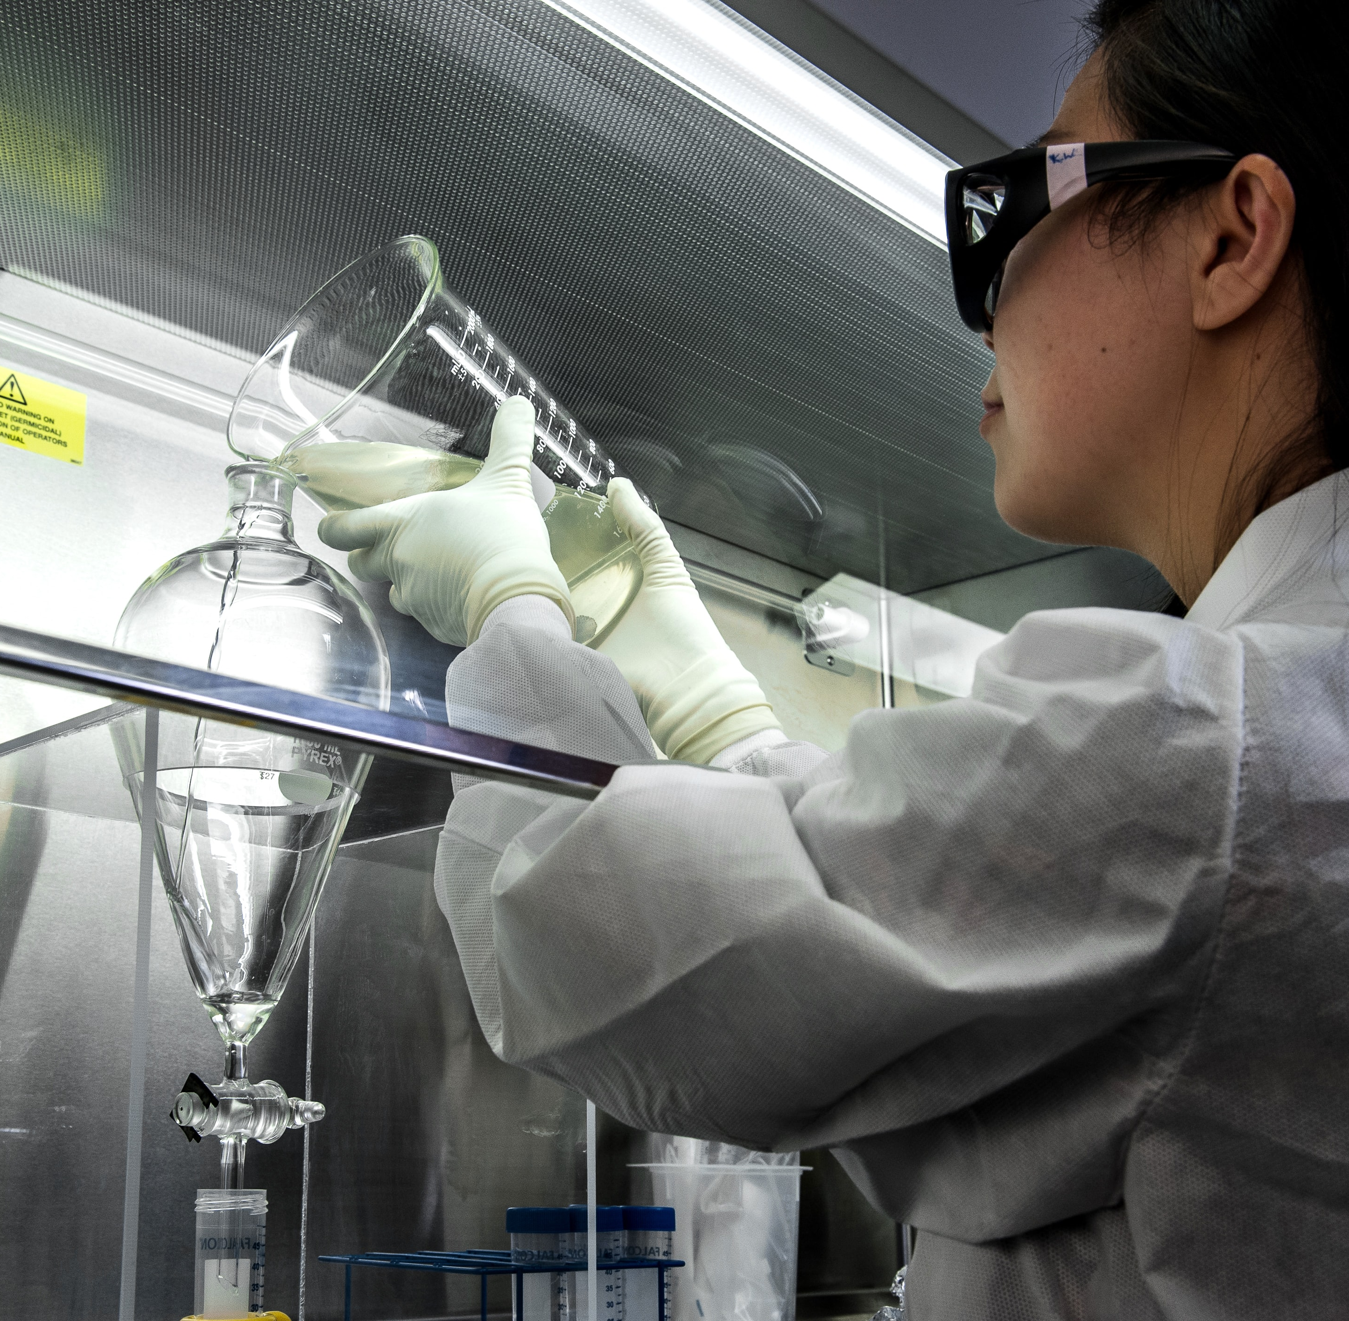

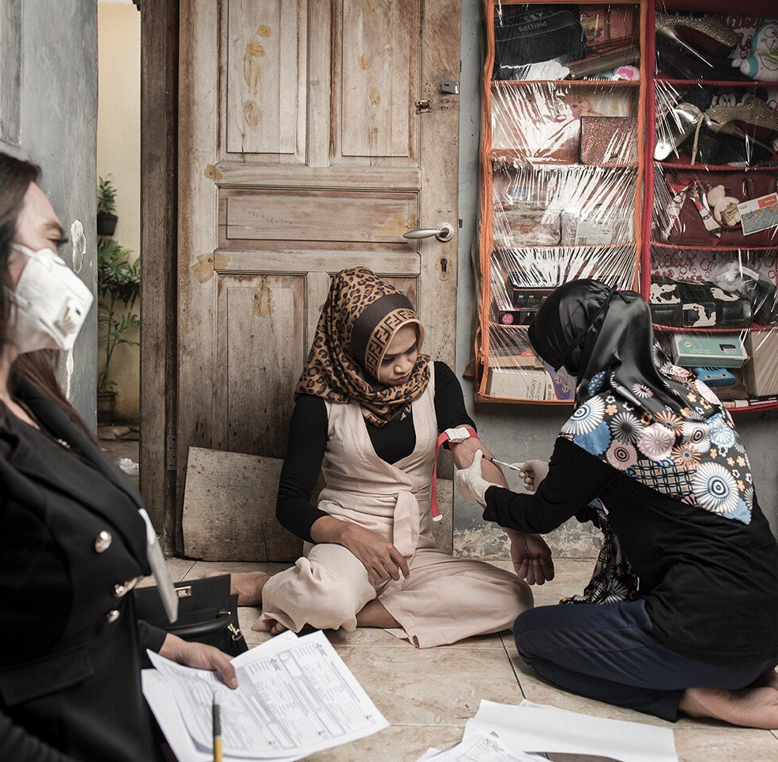

Wellcome’s Strategic Programmes
Discovery Research
Mental Health
Infectious Diseases
Climate & Health
|
Discovery Solutions

Slide 4
Wellcome’s Equity Department
Put in post a Chief Equity, Diversity, and Inclusion Officer in October 2023.
An Equity Department “Newly” forms in October 2024.
Working with wider Wellcome, we are evolving Wellcome’s approach to Equity work to be embedded across our Strategic Programmes, Operations, and Influencing and Engagement functions.

Slide 5
Wellcome’s strategy commits us to…
Prioritising equity, diversity and inclusion as a critical approach to the science that we fund;
Working in partnership with those making a difference in their communities through the research they do,
Recognising that deep local and regional expertise is critical to drive change which leads to equitable and accessible solutions to benefit human health.
Image credit: Photo by CDC on Unsplash, CC-BY

Slide 6
Where does it make sense to consider equitable partnerships for Wellcome?
Our research funding
Our idea generation
Our influencing

Slide 7
Major International Programmes

Slide 8
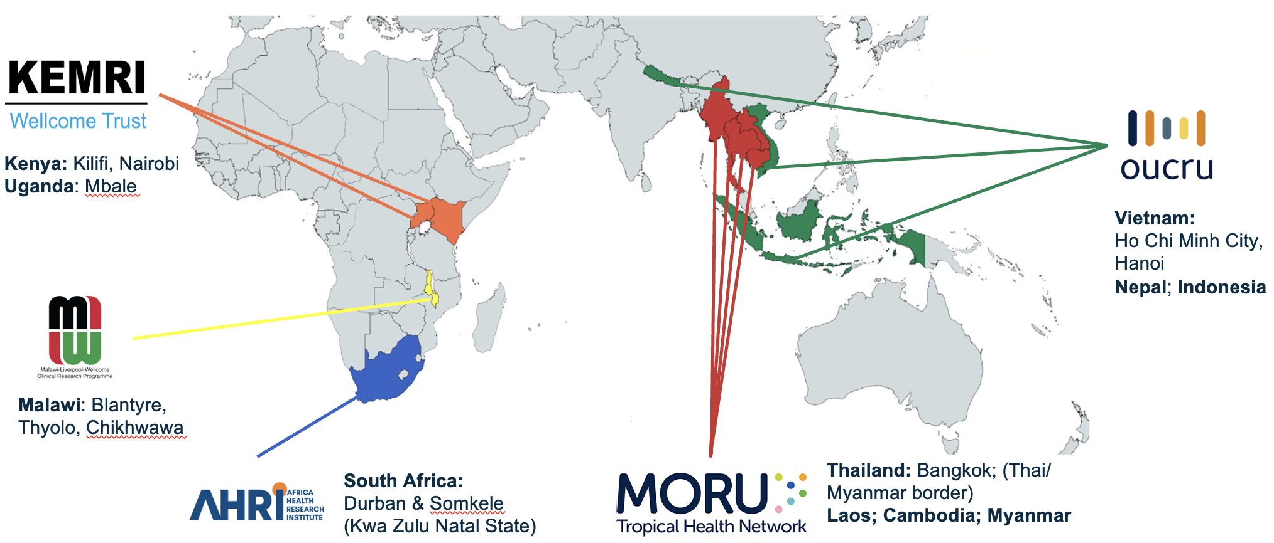

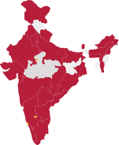

Core Funded International Programmes
Research Institutions
Funders
Funding health researchers and research institutions in Africa, India and Southeast Asia
Hub (and spoke) institutions delivering excellence in health research and sustained pathways to research leadership

Slide 9

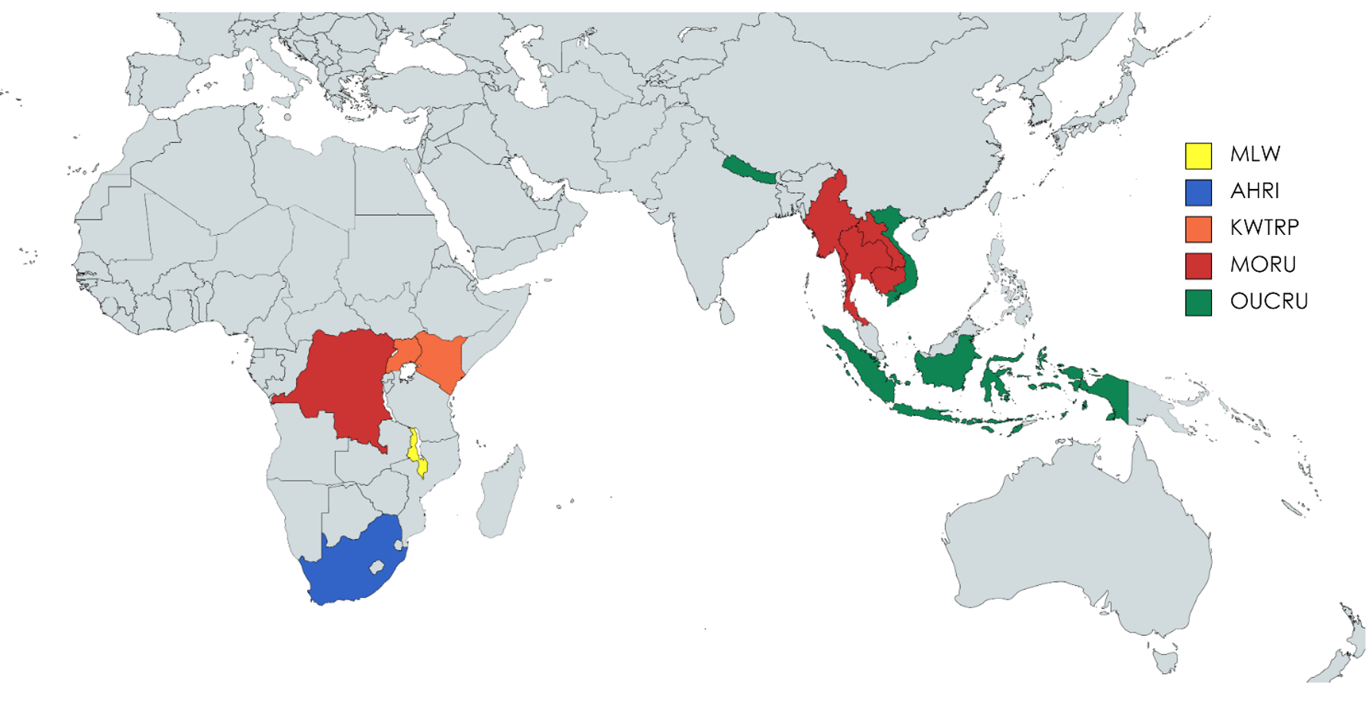
Our partners play a key role in tackling health problems where the need is greatest and making a difference in their communities through the research they do
International
partnership approach
Mutual learning and shared priorities
Two-way engagement to optimise strategic alignment and delivery on Wellcome’s and these partners’ priorities
Founded on shared values, particularly in enabling research environments and cultures which are equitable, diverse and inclusive
Recognition that deep local and regional expertise is critical to drive change which leads to equitable and accessible solutions to benefit human health.

Slide 10

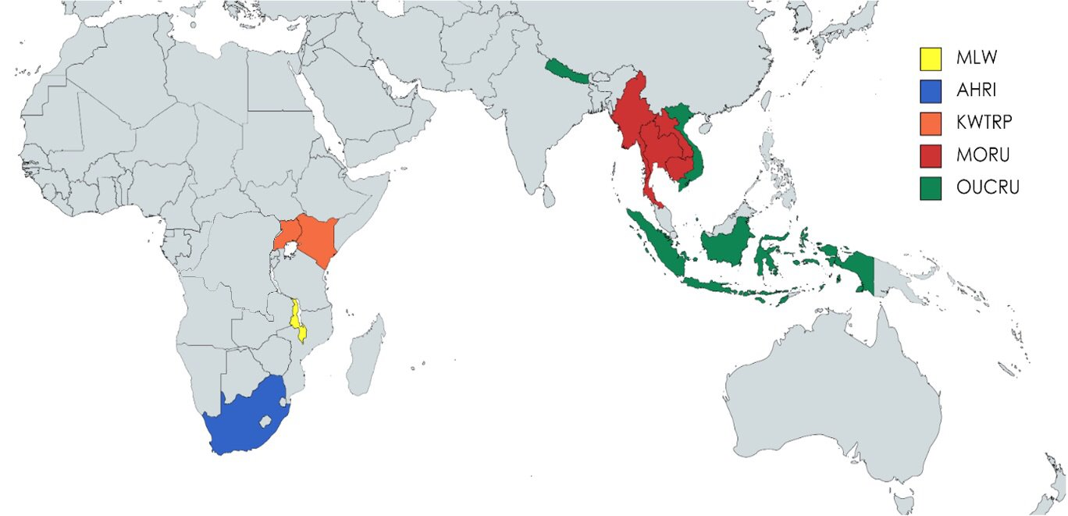




Major International Programmes
Africa and Asia Programmes
Malawi: Blantyre, Thyolo Chikhwawa.
South Africa:
Durban & Somkele
(Kwa Zulu Natal State)
Kenya:
Kilifi, Nairobi
Uganda: Mbale
Thailand:
Bangkok, Laos, Cambodia, Myanmar (Thai/ Myanmar border) and Democratic Republic of Congo
Vietnam:
Ho Chi Minh City, Hanoi, Nepal, and Indonesia

Slide 11
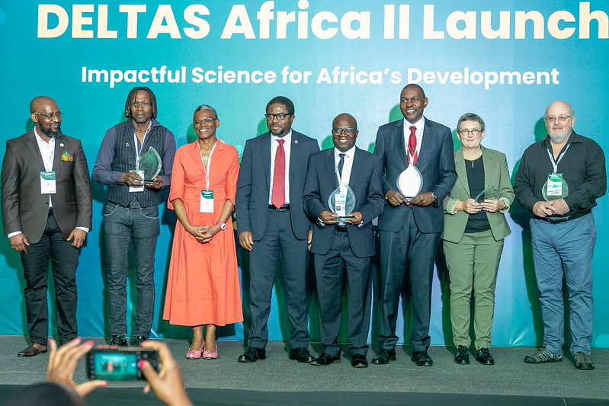
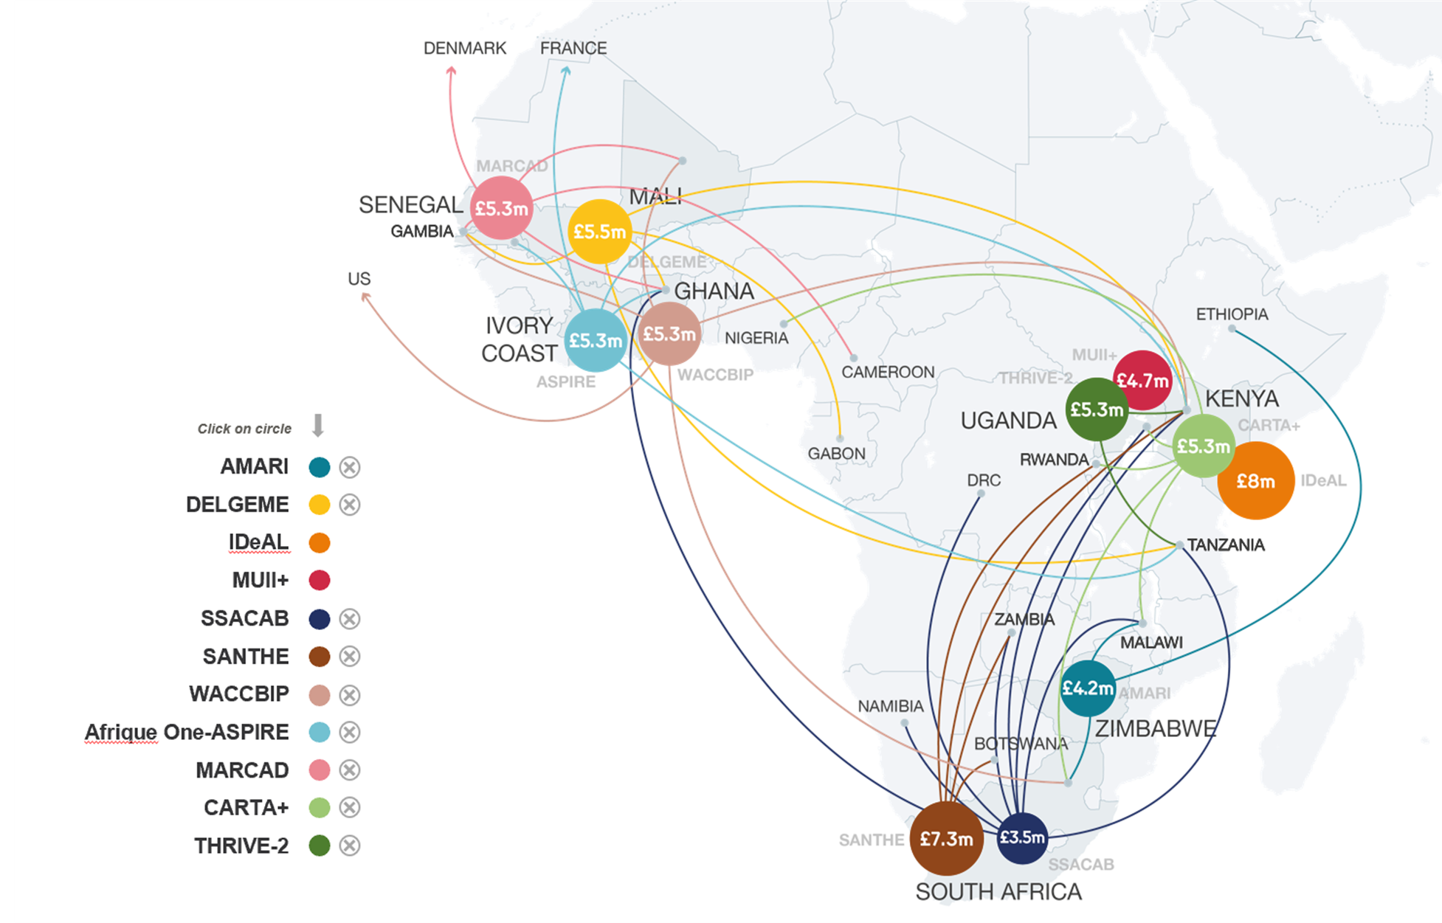
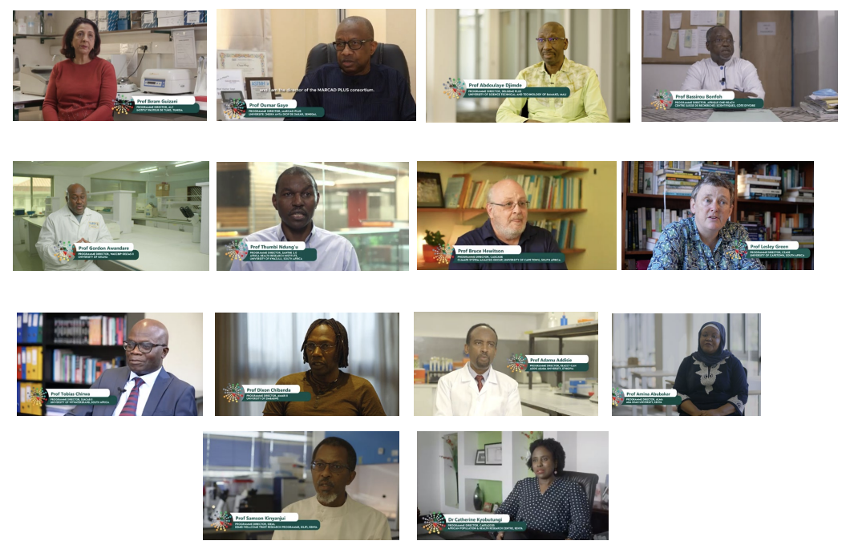
Major International Programmes
Funding Institutions
Developing Excellence in Leadership, Training And Science
(DELTAS)
  DELTAS II
14 Africa-led research consortia linking 35 countries
By region:
North Africa 1
East Africa 5
Southern Africa 4
West Africa 4
DELTAS I
DELTAS II with a Wellcome lens:
Infectious Disease 4
Mental Health 2
Climate & Health 2
DR/Cross-cutting 6
Outcomes:
2000 Fellows
1000 Networks
1500 Publications

Slide 12



Major International Programmes
India Alliance
Phase 2 2019 – 2024 partnership with Department of Biotechnology DBT, India Government
Partnership funding model to shift the centre of gravity
    leadership of funding, agenda setting and management of health research capacity in India
    >500 grants for fellowships and research management across 145 institutions
https://www.indiaalliance.org/

Slide 13
SEA DREAM
Developing Research Excellence and Mentorship in Southeast Asia
Funding to multiple research consortia focussed on a specific thematic research area
Multi-country partnerships between leading researchers
Open competition with proposals selected on their research excellence
Consortia supporting emerging research leaders and development pathways in enabling environments
Image credit: Photo by CDC on Unsplash, CC-BY

Slide 14
Discovery Research

Slide 15



Discovery Research
Research we fund across fields and disciplines generates new knowledge with the potential to transform life, health and wellbeing in ways that we may not have anticipated.
Fundamental processes that underpin biology to understand more about how life works
Needs, values and priorities of the people and communities affected by disease and health inequalities
Complexities of human health and disease including clinical and population-based approaches
Social, cultural, political and historical contexts
of human health and disease
Development of methodologies, conceptual frameworks technologies, tools or techniques that could benefit health-related research
While we do not support research that is exclusively translational, we encourage discovery research that has translational potential

Slide 16


Our ambitions for Discovery Research
Breakthrough research
Field-opening
Breadth of disciplines
People and
careers
Unlock potential
Time and freedom
Teamwork and collaboration
Research ecosystem
Break barriers
and bottlenecks
Research culture

Slide 17
Challenges for ‘LMIC’-led Discovery Research
Fewer LMIC-led applications submitted compared to UK-led applications
Higher withdrawal rates for LMIC-led applications due to remit and eligibility
Lower overall success rates for LMIC-led applications (for eligible applications in remit)
      Similar success rates at interview stage for shortlisted LMIC-led applications
Practical barriers:
Alongside systemic challenges:
Being unaware of funding opportunity
Concerns or misconceptions about remit, eligibility and expectations
Differential access to mentoring / support for research development
Related challenges: increasing equitable access / strengthening mutual capabilities;
and promoting equitable partnerships

Slide 18
Supporting ‘LMIC’-led Discovery Research
Promoting equitable access and strengthening capabilities
LMIC External Advisory Group
Established: Q1 2023
Equitable access
Strengthen capabilities
LMIC targeted external engagement and comms
Research support hubs
Support and develop local led mentorship programmes
Deliver seed funding
Training
WT eligibility supports global career structures
Application support and active feedback

Slide 19

Research Development Support Hubs
Vision
Foster a vibrant research ecosystem
Increase access to research development support
Agile mechanisms tailored to local needs
Increase internationally competitive grant funding, strengthen research networks / collaborations
Pilot
Understand whether the model is feasible, acceptable and meets expected outcomes
Provide useful resources for implementation learning for future initiatives
Designed to reach into a broader ecosystem

Slide 20
Assessing Research Environment
Career development and leadership
Team composition and partnerships
Research practice
Ethical considerations
Stakeholder engagement
Outputs management
For you and your team
How do you want to lead?
Research culture
Equitable partnerships
Balance and diversity
Inclusion and recognition

Slide 21
Thank you

Slide 22
Appendix
(for reference as needed in the meeting)

Slide 23
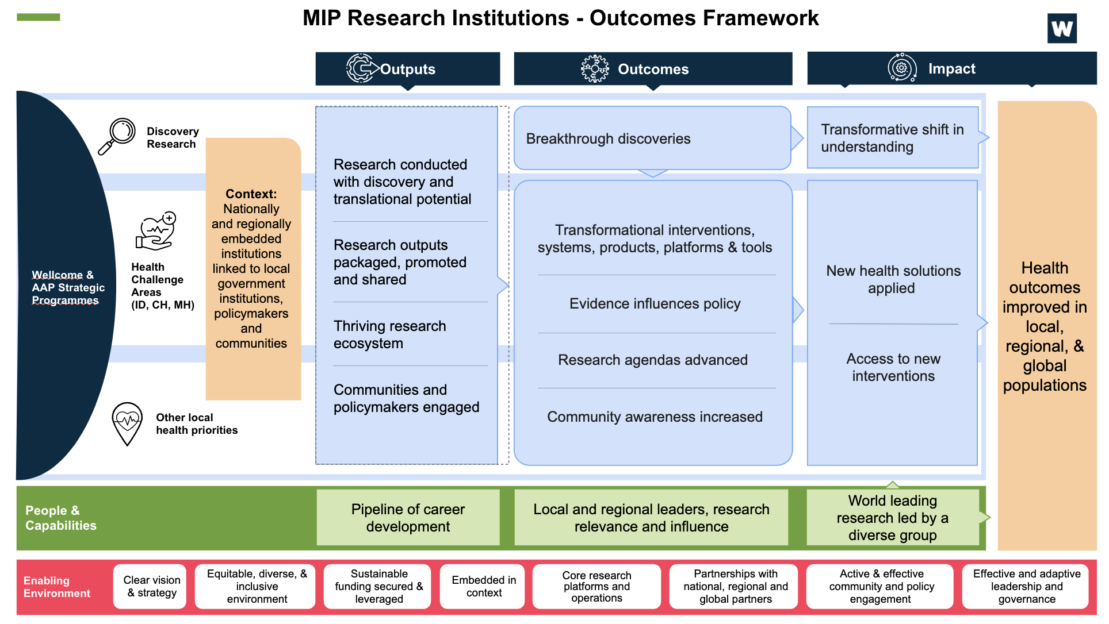
Major International Programmes
Research Institutions - Outcomes Framework
    Wellcome conducts 7-year renewals cycles with the MIP Research Institutions, which includes
    Submission of full applications by the Programmes
    Site visits by Wellcome staff and external experts to assess Science, Public Engagement and Operational Delivery
    Assessment is undertaken against an Outcomes Framework
    This framework maps the input to impact pathway but does not prescribe how or in what area of Health Research these should be achieved.
    From 2024, annual submissions from the reports (Annual Reports) are providing evidence against the framework

