Slide 1
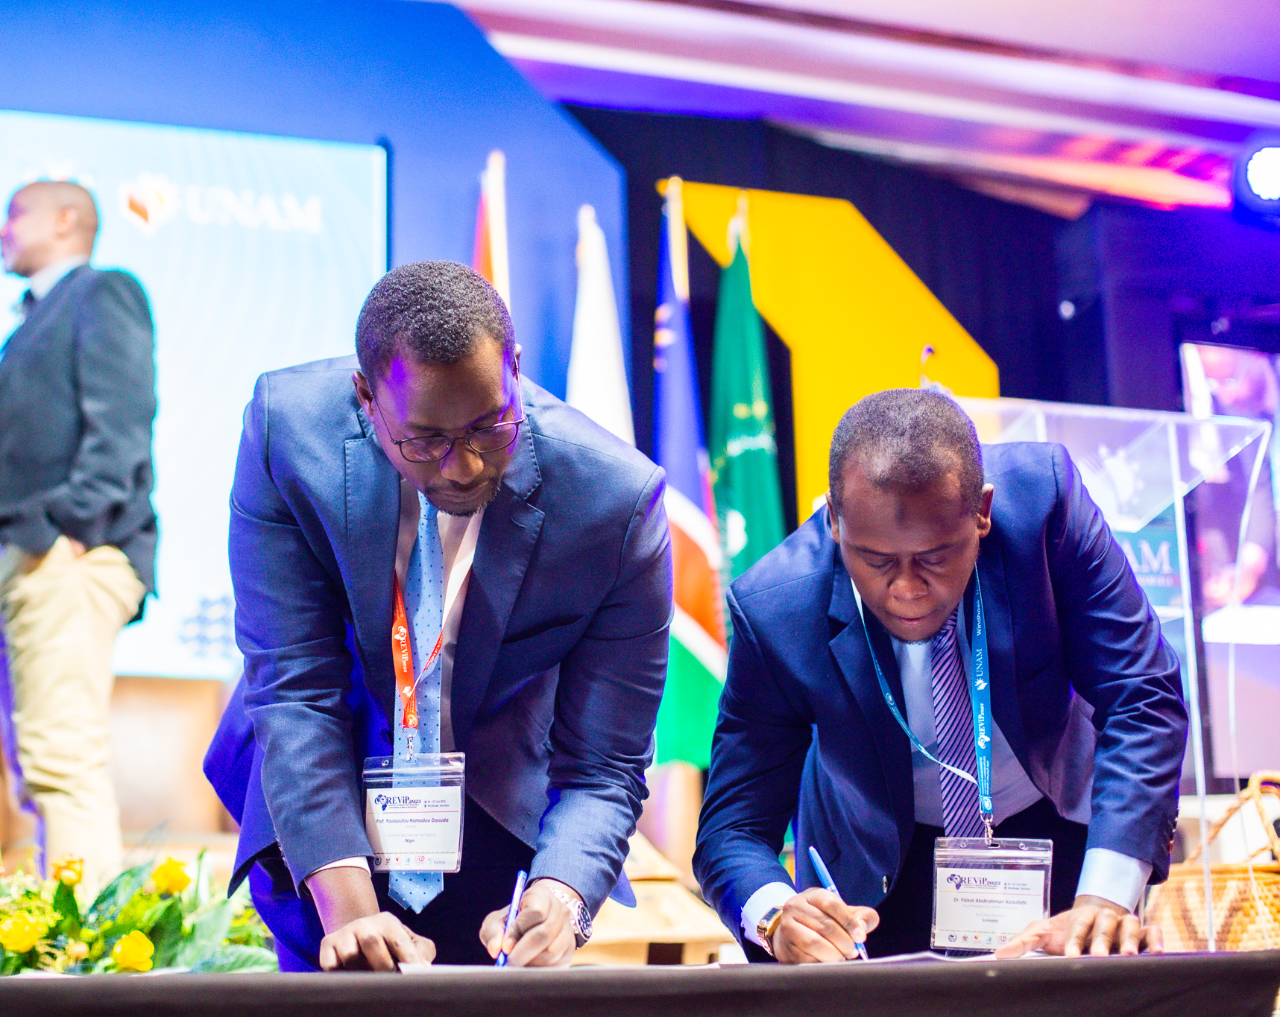
Africa Charter for Transformative Research Collaborations: from principles and aspirations to action
Building on existing equitable partnerships guidance and conversations?
‘Bringing together’ the field?

Slide 2
Outline
Context
  – Toward equitable partnerships: expanding debate
The Africa Charter
  – Argument, relevance, plans for implementation
Toward ‘good’ collaborative practice approaches and policy models’
  – Drawing on existing equitable partnerships guidance?
Reflections
  – Drawing on evolving multi-stakeholder conversations?
  – Bringing together the field?

Slide 3
Context

Slide 4
Toward equity in ‘North-South’ partnerships: expanding debate
Intensifying scholarly, policy and practice-focused debate (largely ‘North’- driven)
Ubiquitous reference, commitments to ‘equitable partnerships’
Accumulation of practice-focused guidance documents
Growing calls for move toward action

Slide 5
Emphasis on:
Mutuality in project arrangements for:
    Determination of research foci
    Division of labour
    Capacity strengthening
    Decision making on budgets, samples
    Authorship of publications, outputs
More enabling research management and administration

Slide 6
What is it for?
    Enhanced uptake of research findings, impact (global challenges)
    Longevity, ‘resilience’ of partnerships
    Integrity of investigations
    The right thing to do…

Slide 7
Shifting perspective: ‘South’-centred thinking
Southern Voice - IDS
Africa Charter (2023)
  Co-created, driven by major HE and research bodies in continent
  Explicitly Africa-centred
  Analysis, conceptual frame draw on:
    Established African and ‘Southern’ anti-, post- and decolonial scholarship
    Systems thinking

Slide 8










































Slide 9
The Africa Charter
Argument, relevance, plans for implementation

Slide 10
The wider context..
Marked expansion in international, including ‘North’ – ‘South’ research collaborations in last two decades
‘Globalisation of science’
Core – periphery structure

Slide 11
Source: Gui, Liu & Du, 2019

Slide 12
Core (13 countries):
North America, Europe (UK, FR, D,NL,CH), Asia-Pacific (AUS, China, S. Korea)
Source of knowledge spillover; leaders of cutting-edge research
Primary partners for peripheral countries (historical colonial links significant)
High density, high strength, massive volume of collaborations within group
Strong semi-periphery (37 countries):
E+ S Europe; Scandinavia; NZ, Singapore
Latin America (ARG, BRA, Chile, Mex); S. Asia (India, Pakistan); Africa (Egypt, S. Africa)
Regional leaders wrt. science output
Intermediaries between core and periphery
Periphery (120 countries):
Africa (52 countries), Caribbean, Pacific Islands, West Asia, Middle East
‘Knowledge spillover recipients’ and ‘cutting-edge science followers’
Limited scientific research capacity
Few, weak ties within group

Slide 13
Researchers and outputs
Central, East, Southern, Western Africa, 2018:
10% of global adult population, contribute:
  0.7% of all researchers globally (lowest % of all major regions)
  1.6% of indexed scientific publications globally*(half from SA)
UNESCO World Science Report, 2021
Considerable volume of African research output not captured in global citation databases: compounds subsidiarity

Slide 14
Rankings:
Institutions (QS 2024)
One African University in top 200 - University of Cape Town #173
Seven Universities in top 500 (5 in SA, 2 in Egypt)
None outside SA, Ghana, Egypt, Ethiopia, Uganda, Tunisia in top 1000
Individuals (Clarivate 2020)
Of 6,389 highly cited scholars, only twelve affiliated in Africa (9 in SA)

Slide 15
Core-periphery positionings in global science: a ‘global challenge’ in its own right.
  Shapes countries’ prospects (economic, political, soft power)
  Reflects uneven playing field in scientific knowledge production
    Multi-layered power imbalances - colonial legacy

Slide 16
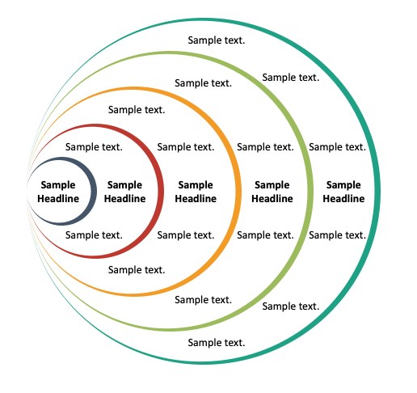
1. Epistemologies
2. Language
3. Theories, concepts - ‘extraversion’
4. The ‘development’ frame and gaze
5. Institutional resourcing, capabilities
6. Concrete collaboration arrangements

Slide 17
Evening playing field; rebalancing global science system: an imperative
  Social justice
  Advancing aspirations of continent
  Enriching global scholarship - ‘solutions’ to world’s crises (beyond ‘monochrome logic’ of Euromodern thought)
International research collaborations as key entry-, leverage point ‘transformative potential’

Slide 18
Ttransformative mode of research collaborations: redressing each layer of power imbalance:
→ 10 Charter principles
1. Epistemologies
2. Language
3. Theories, concepts - ‘extraversion’
4. The ‘development’ frame and gaze
5. Institutional resourcing, capabilities
6. Concrete collaboration arrangements

Slide 19
Change to establish transformative collaboration mode as benchmark and, gradually, as standard practice within scholarly community
Individual
Universities (networks)
Funders
Publishers
Research assessment frames (e.g. REF)
Consciousness, Capabilities
Resource streams
Informal
Formal
Practice
Norms
Policies, Regulations
Guidelines
→ 6 Charter aspirations
Systemic
Adapted from Green, D. (2016) How change happens. Oxford: Oxford University Press

Slide 20
Relevance ?
100+ signatories
  major University Networks
  learned societies
  leading HEI in Africa, Europe, North- and Latin America
Active engagement: funders, publishers, international agencies
Frame of reference for considering ‘equity’ in research collaborations

Slide 21
Toward implementation - plans
Identifying good/promising collaboration practice approaches, policy models and gaps across fields
Ongoing exchange, joint learning, strengthening capacities
Scholarly debate: refining, elaborating concepts, arguments, (expanding horizons?)

Slide 22
Identifying good collaboration practice and policy models and gaps across fields
Participatory processes to reflect on extant collaborations against Charter (e.g. UoB, Coimbra Group, AAU, UCT, UNISA)
Careful reviews of existing institutional policy architectures
Building on existing practice-focused ‘equitable partnerships’ guidance?

Slide 23
Examining existing equitable partnerships guidance
Where, how do guidance frames speak to multilayered power imbalances, domains of change and wider orientations captured in the Charter?
11 guidance documents identified; 3 loose groupings
    Discipline/ Profession focused
    Topic/Issue based
    Government (agency)-led
Approach: document analysis - qualitative content analysis
  Directed (deductive) and conventional (inductive)
  Focus on manifest- and latent content (meaning that is not overtly evident)

Slide 24
Guidance document | Year | Sponsoring Organisation | Stakeholder consultation
CCGHR Principles for Global Health Research | 2015 | Canadian Coalition for Global Health Research | √√
Research Fairness Initiative | 2007/8 | Council on Health Research for Development
Global Code of Conduct for Research in Resource-Poor Settings | 2018 | The TRUST Code | √√
Plan S | 2018 | European Science Foundation, European Commission, European Research Council, other funders
Promoting Fair and Equitable Research Partnerships to Respond to Global Challenges | 2018 | Rethinking Research Collaborative; UKRI | √√
Cape Town Statement | 2022 | World Conference on Research Integrity | √√
Four Approaches to Supporting Equitable Research Partnerships | 2022 | UKCDR and ESSENCE | √√
A Guide for Transboundary Research Partnerships | 2018 | Swiss Commission for Research Partnerships with Developing Countries; Swiss Academy of Sciences
Toolkit for Equitable Partnership | 2023 | Association of Commonwealth Universities
Valuing Voices for Equitable and Responsible Research Toolkit | 2024 | University of York + Mahidol University | √√
Ethical action in global research | 2019 | University of Edinburgh | √

Slide 25
Reflections?

Slide 26
How should we, could we draw on evolving multi-stakeholder conversations, perspectives – BA, AHRC, others?
How can we bring the field together? Should we attempt to?

Slide 27
Thank you!

