Slide 1

Reclaiming Knowledge Systems: Embedding African Methodologies in Workshop Design and Facilitation 11 February 2025
Dr Wyclife Ong'eta
Dr Leani Van Vuuren
Dr Melis Cin
Prof Ashley Gunter
Dr Manu Lekunze
Prof Parvati Raghuram
Mr Ruan Schoeman

Slide 2
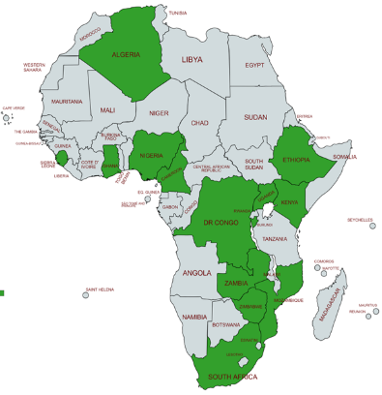
WHY WE ARE HERE
AHRC funding – Building Equitable African Partnerships
Builds on
10 year partnership of distinctive players in the HE environment
Building on existing OU-UNISA collaboration but creating new partnerships
Funding
First funding is from global South: UNISA visiting professor
ESRC-Newton: sets us up as equivalent partners
Small grants with new UK partners; shows sustainable relationships
AHRC Network plus model: DEPA 14 countries, 16 projects

Slide 3
WHAT HAS BEEN GAINED THROUGH PARTNERSHIPS
Networking within Africa – Pan-African capacity sharing.
Rights-holders and Stake-holders - communities, artists, educators, schools, teacher training, refugees)
Postdocs and Graduate students – funding attached to projects and giving them global exposure in both directions
Links to policy: AU, COMESA, ANIE
IMPACT for the Research Excellence Framework!!

Slide 4
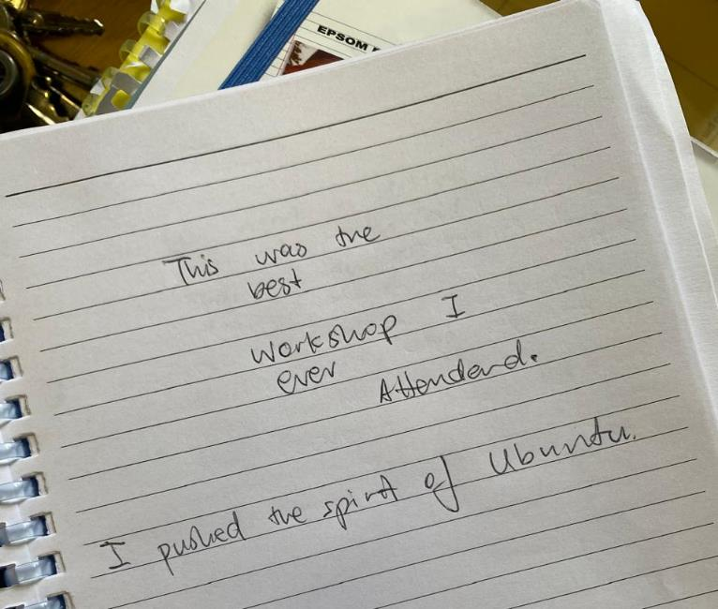
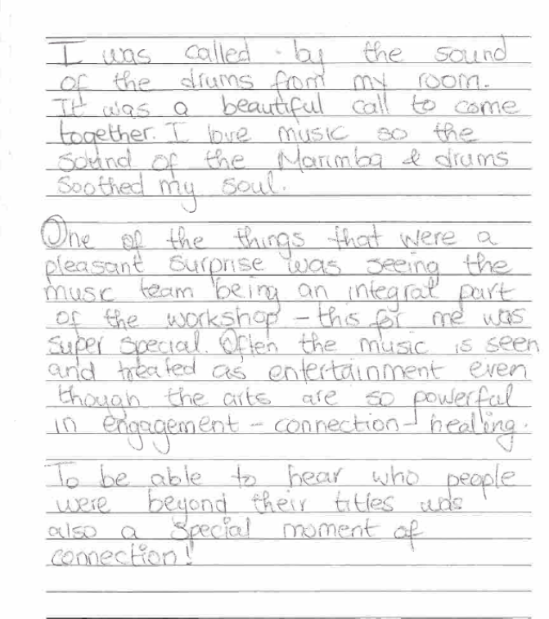
Reclaiming Knowledge Systems: Embedding African Methodologies in Workshop Design and Facilitation

Slide 5
PRINCIPLES FOR DESIGNING AN AFRICAN-CENTRED Workshop
Ownership
Reflecting everyday African practices and experiences
African philosophies
Experimental/multiple methods
Space and time
Relationship-building and bonding

Slide 6
PRINCIPLES FOR “FACILITATING” AN AFRICAN-CENTRED Workshop
Trust – Knowledge is collectively built through dialogue, storytelling, and shared lived experiences, ensuring inclusivity and relevance.
Co-creation, openness
At its best, a disappearing role
Utilised by the community
Holistic and Contextual – Indigenous philosophies integrate spiritual, environmental, and social dimensions into knowledge-sharing, making learning deeply rooted in cultural identity.

Slide 7
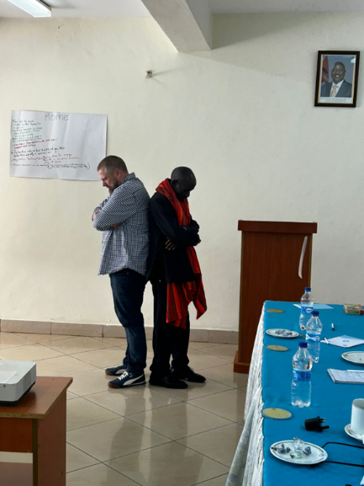
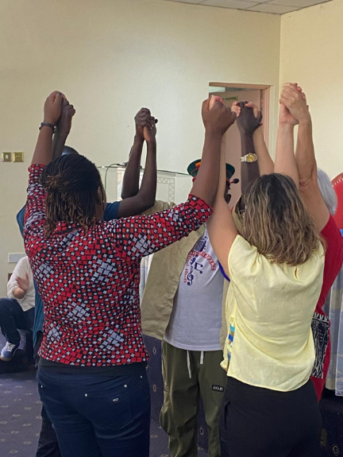
Practical Applications – Turning Philosophy into Action
Life Stories (Isintu): Linking identity to knowledge-sharing.
Fire Pit Conversations (Ubuntu): Creating safe spaces for open dialogue.
Matatu Stop Exercise & Image Theatre (Harambee): Storytelling and listening as tools for collaboration.
Journalist & Politician Roleplay & Podcats (Lekgotla): Engaging in critical discourse on knowledge production.

Slide 8
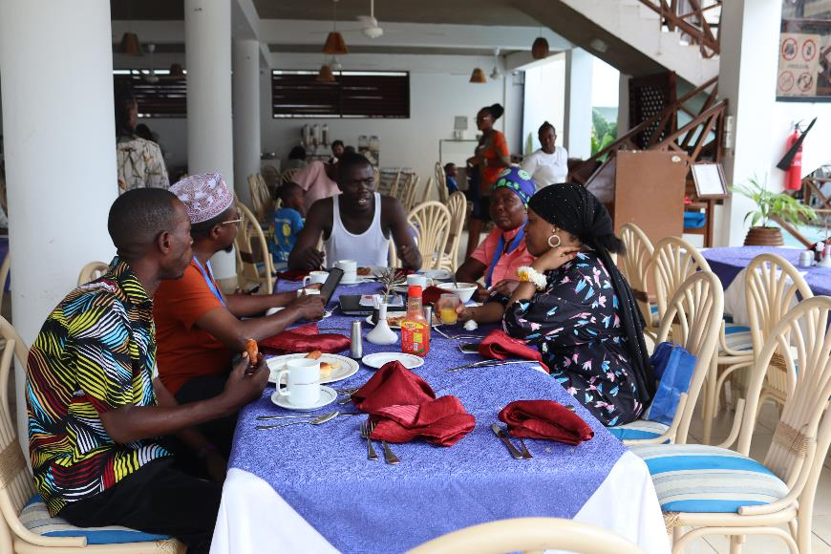
Ubuntu – Creating Inclusive and Relational Learning Spaces
Ubuntu - 'I am because we are' – Knowledge is co-created through relationships.
Emphasis on inclusivity: Everyone has a role in meaning-making.
Learning is a shared journey, not a hierarchical process.
Fosters mutual respect, empathy, and active participation.

Slide 9
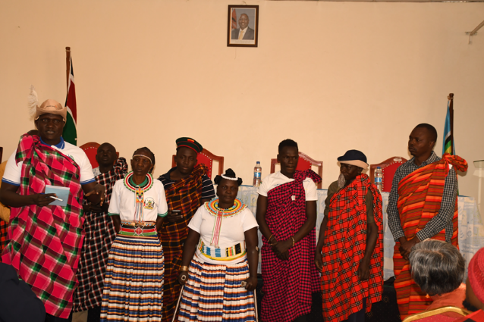
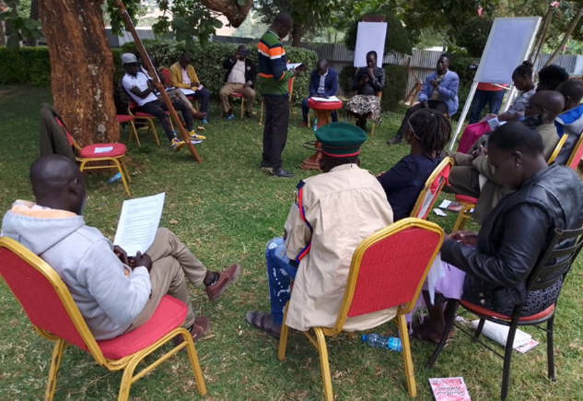
Lekgotla & Isintu – Dialogue and Cultural Identity in Facilitation
Lekgotla (Traditional African Assembly):
Everyone participates, ensuring all perspectives are heard.
Decision-making is collective, not imposed.
Isintu (Cultural Heritage & Identity):
Grounding knowledge in cultural traditions.
Storytelling as a critical teaching tool.
Learning through symbols, art, and personal narratives.

Slide 10
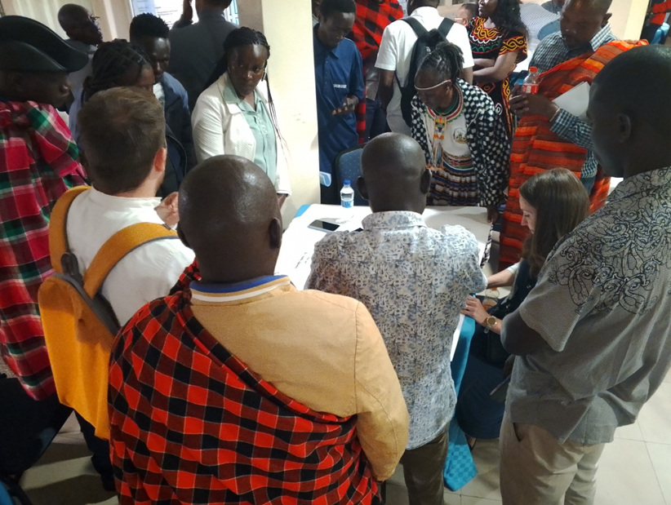
Harambee –
Co-Creation and Collective Action
Harambee - 'Pulling together' – Knowledge is built collaboratively.
Encourages co-creation rather than passive reception.
Collective responsibility for learning and application.
Ensures inclusivity and equitable engagement.

Slide 11
Asante sana
THANK YOU
Ngiyabonga

