Slide 1
BRITISH ACADEMY’S 1st CONFERENCE ON EQUITABLE PARTNERSHIPS
LONDON 11- 12 FEBRUARY 2025
INTERNATIONAL COLLABORATION IN RESEARCH CONSIDERING EQUITABILITY:
SOME CHALLENGES OF NORTH-SOUTH PROGRAMS (UK-BRAZIL & EU-BRAZIL)
MARIA ZAIRA TURCHI
Director for international cooperation - CONFAP

Slide 2
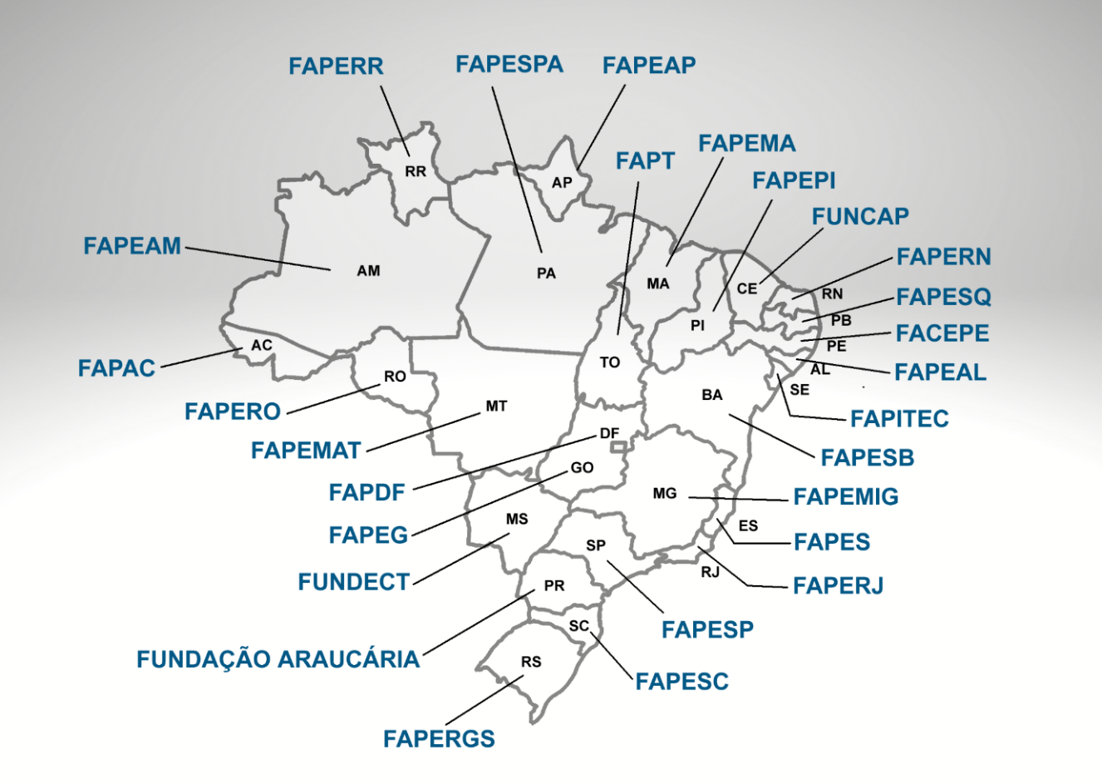
Brazilian National Council of State Funding Agencies
National Coverage & Capillarity
CONFAP is a non-profit organization that represents all Brazilian State Funding Agencies (FAPs) – set up in 2006;
27 FAPs; One State Funding Agency in each State + Federal District
Capillarity, wide spectrum actions and acknowledgement of regional differences
National partnerships with Federal Institutional Parner and funders: MCTI, CNPq, CAPES, EMBRAPii, FINEP, among others
Member of the National Council of ST&I
Numerous active International Partnerships
Gathers its strategic partners in the CONFAP Forums (4 per year)

Slide 3
Support from FAPs: how it works
Calls
CONFAP publishes calls together with the respective international partners, or signs MoUs to participate in calls launched (for multilateral joint calls)
Support
FAPs who wish to participate to the calls, sign their accession / confirm their support
Rules
Each FAP supports according to its rules / modalities / budget; applicants from the respective Brazilian States need to consult the FAPs; Guinelines may be published
Agreements
CONFAP signs agreemets or MoUs – legal umbrella

Slide 4
NORTH-SOUTH PROGRAMS UK-BRAZIL Newton Fund
The Newton Fund fostered UK-Brazil partnerships within its cooperation with middle-income countries
It supported collaborative research on shared priorities of partner countries
Calls were jointly designed by the UK and partner country funders
In Brazil, CONFAP partnered with the Newton Fund, co-funding projects through its State Funding Agencies in joint calls (2014, 2015, 2016)

Slide 5
POSITIVE ASPECTS AND BENEFITS – Newton Fund
UK and Brazil funders jointly building an inclusive agenda
Funders regarded as equal partners within the program
Joint decisions guiding priorities and common interests
Bottom-up approach
Partnerships built on trust
Cutting-edge projects with significant impact
Mutual learning and shared knowledge
Inclusion of underrepresented groups and regions

Slide 6
Challenges – UK-Brazil (Newton Fund)
Joint management and decision-making processes
Multi-agency involvement, including UK and Brazilian State Funding Agencies
Increased complexity in funding arrangements
Shared responsibility and mutual benefits for all partners
Project timelines affected by budgetary constraints
Ensuring long-term sustainability
Managing bureaucracy and legal frameworks across multiple parties

Slide 7
Cooperation with the European Union
Administrative Arrangement between the European Commission and CONFAP that allows to implement co-funding mechanisms to support Brazilian participation in projects approved under Horizon Europe
including targeted calls to support MSCA Staff Exchanges Horizon Europe calls
Implementing Arrangement with the European Commission / European Research Council – to support visits of Brazilian researchers in ERC funded Projects
European Partnerships: CONFAP / FAPs - Co-fund annual joint calls in the framework of:
Biodiversa+
Water4All
Sustainable Blue Economy Partnership
Participation as a Partner in Horizon 2020 Coordination & Support Actions: INCOBRA, ENRICH in Brazil, AANChOR

Slide 8
POSITIVE ASPECTS AND BENEFITS – EU-BRAZIL
Maximizing research impact
Expanding international cooperation
Fostering mutual learning and knowledge exchange
Advancing excellence in Science
Enhancing access to financial resources
Strengthening capacity building for individuals, institutions, and research systems

Slide 9
CHALLENGES of EU-Brazil Programs
Power imbalance with EU (Northern institutions) dominating research agendas
Top-down agenda setting driven by large consortiums
Complex funding arrangements
Fairer research partnerships needed for greater ownership
Project timelines affected by various complexities
EU (high-income countries) driving the seat in initiation, funding, and management in international development research programs

Slide 10
Amazon+10 Initiative:
Initiative fostered by CONFAP, CONSECTI & CNPq
Scope: support scientific research and technological development on the tropical forest, nature-society interactions and the sustainable and inclusive development of the Legal Amazon
International partners:
UK: British Council, UK Research and Innovation – UKRI
Germany: Bavarian Academic Centre for Latin America - BAYLAT
France: Embassy of France in Brazil
Italy: University of Turin
Switzerland: Swiss National Science Foundation – SNSF
Belmont Forum
IBD - Inter-American Development Bank
New calls and collaborative opportunities in 2025 being defined
Openness to widen partnerships and synergies

Slide 11
Towards greater equitability in international research collaborations
International collaboration in Science requires building trust and shared goals
Mutual benefits and interests
Fair matching and co-financing
Equitable recognition of management capacity
Fair data ownership, storage, access, and usage
Guidelines for setting equity expectations

Slide 12
Maria Zaira Turchi
Director for International Cooperation
zaira.turchi@gmail.com
Thank you!

