Slide 1
Co-Developing Solutions to Enhance Equitable Partnerships
Helen Hopkins
Strategic Research Coordinator, Global Health
University College London
Helen Rajabi
International Networks and Collaborations Manager
University of Leeds
Mary Ryan
International Research Development Manager
University of Glasgow

Slide 2
Research management is fundamental to equitable partnership
Research to tackle societal challenges requires complex support
Policies
Processes
People
Research managers and administrators underpin research delivery and compliance

Slide 3
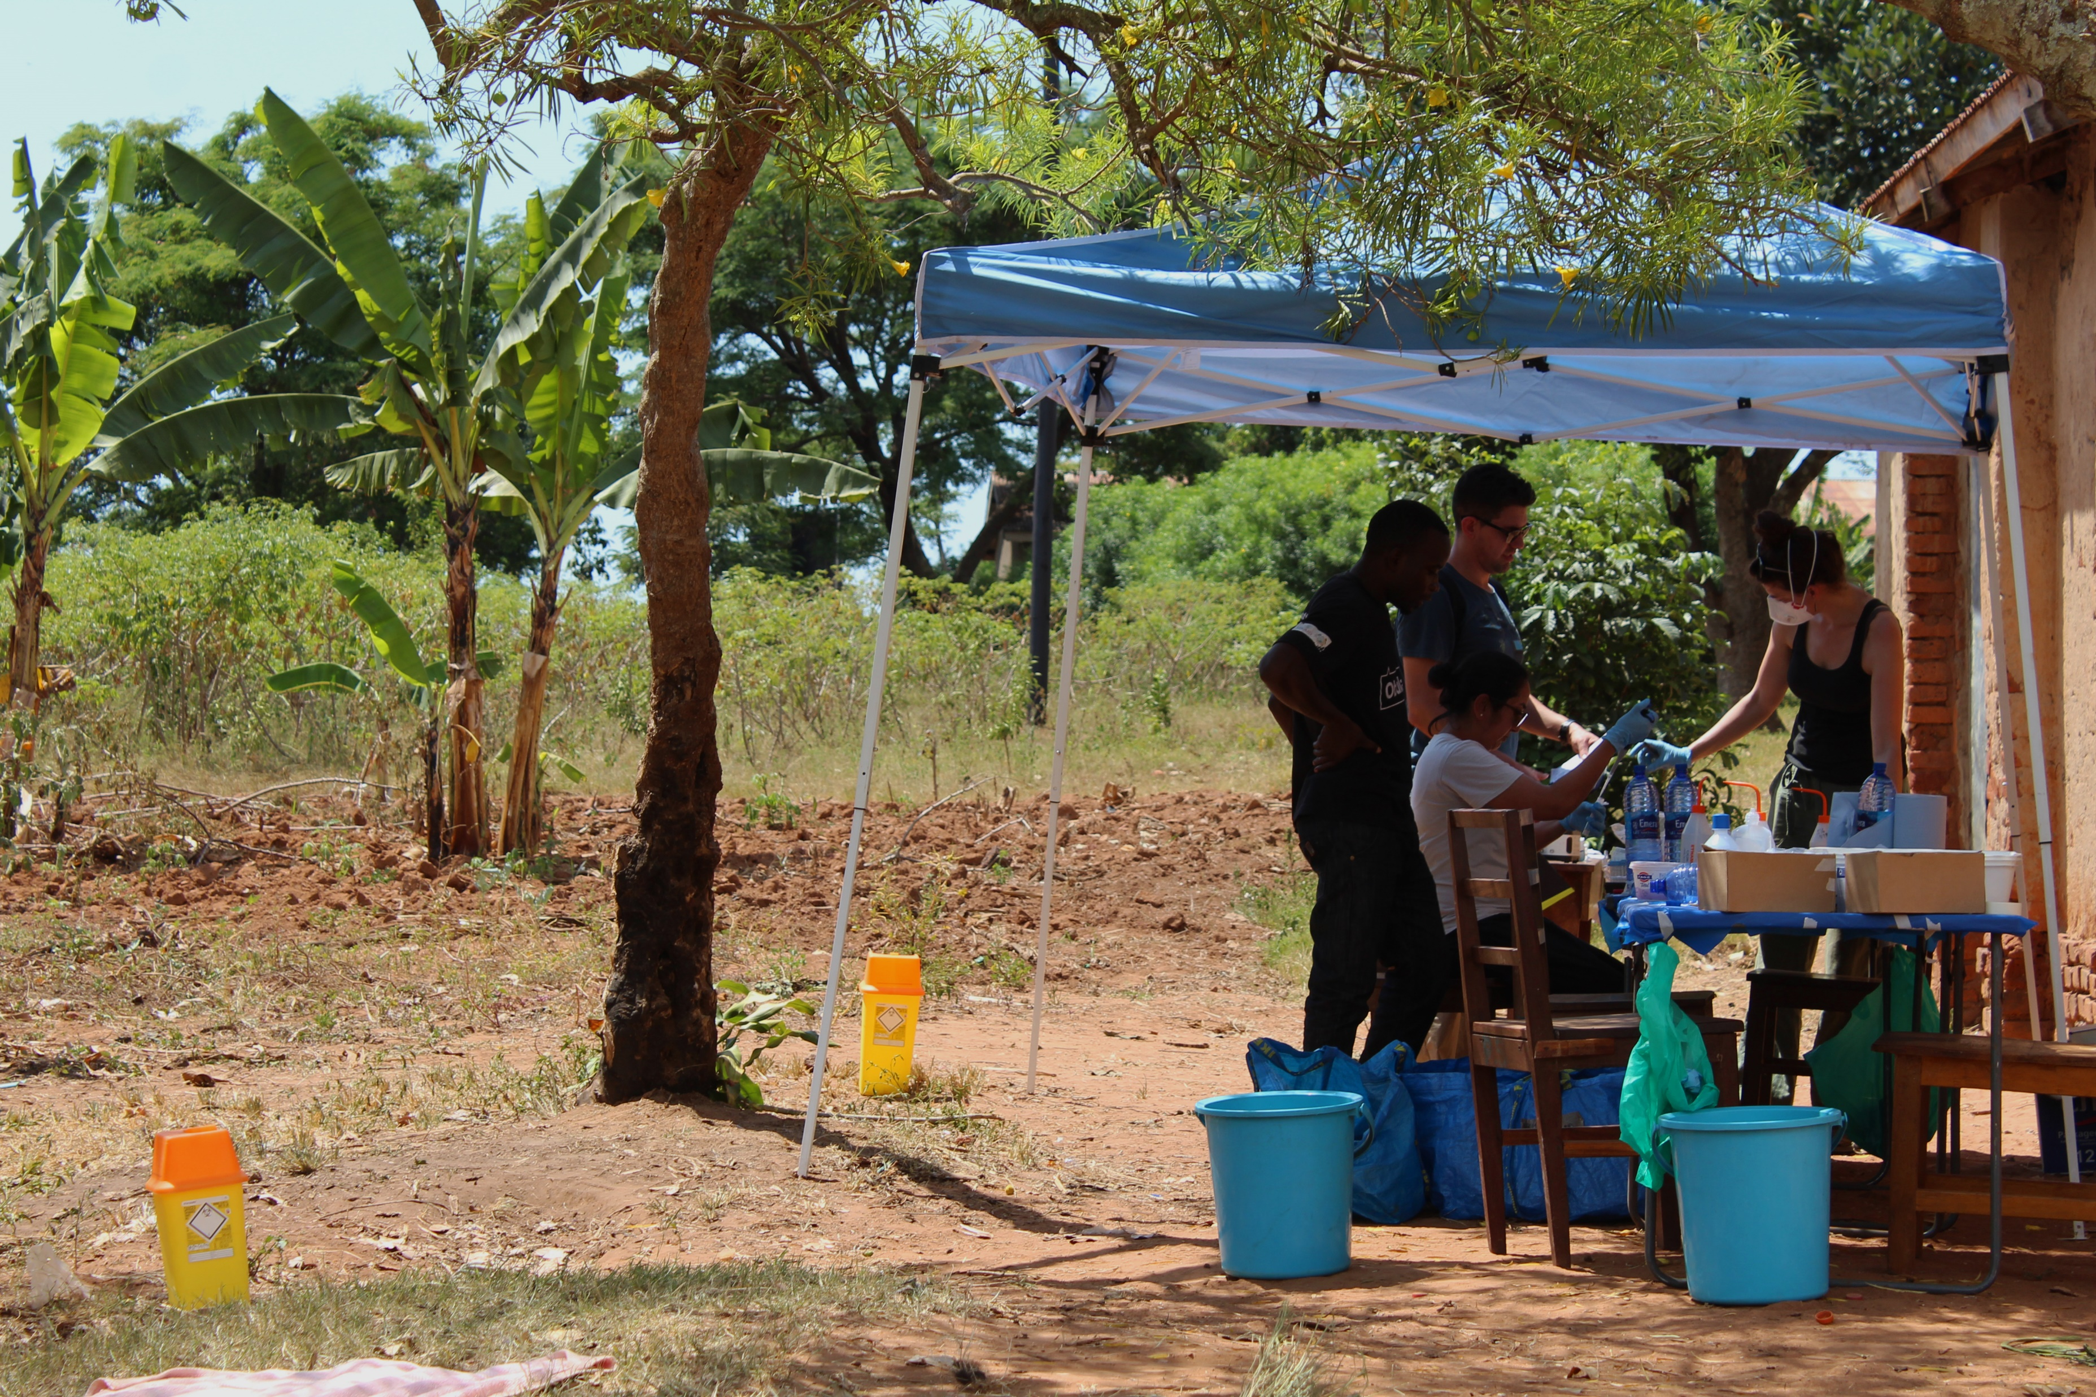
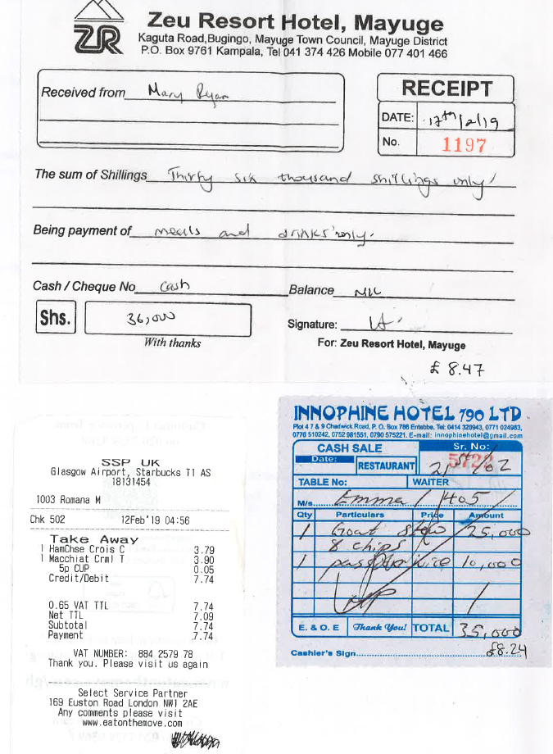
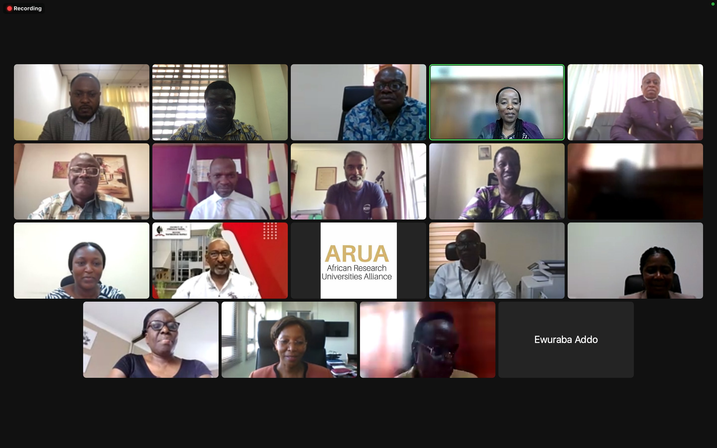
May you live in uncertain times…
Research is constantly changing
Research administration and management changes as well
New challenges require new solutions
Capacity strengthening often tied to individual research projects rather than institutional capacity
@ARUA_News

Slide 4
Case Studies

Slide 5
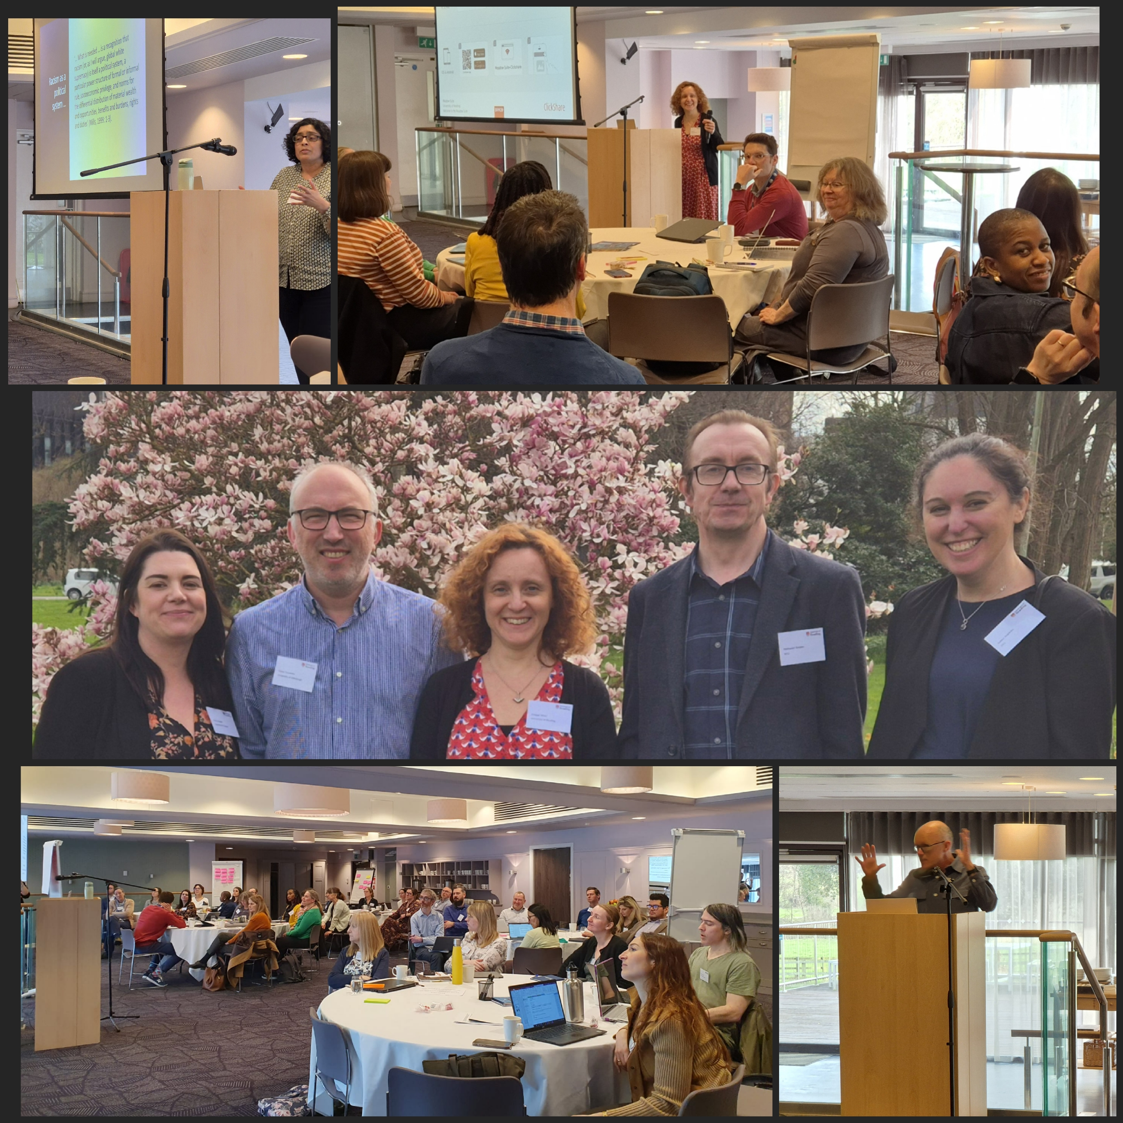
Research Managers Network for LMIC Partnership - UK HEIs
A Network of research Managers from over 50 UK Universities aiming to enhance research partnerships with LMICs Aims: - Supporting more equitable research partnerships with LMICs. - Maximising the impact of research funding. What we do: - We create a space for discussion, knowledge exchange and sharing good practice in research management. - We generate a supportive environment to better understand the funding landscape. - We connect and engage with other University Networks.

Slide 6
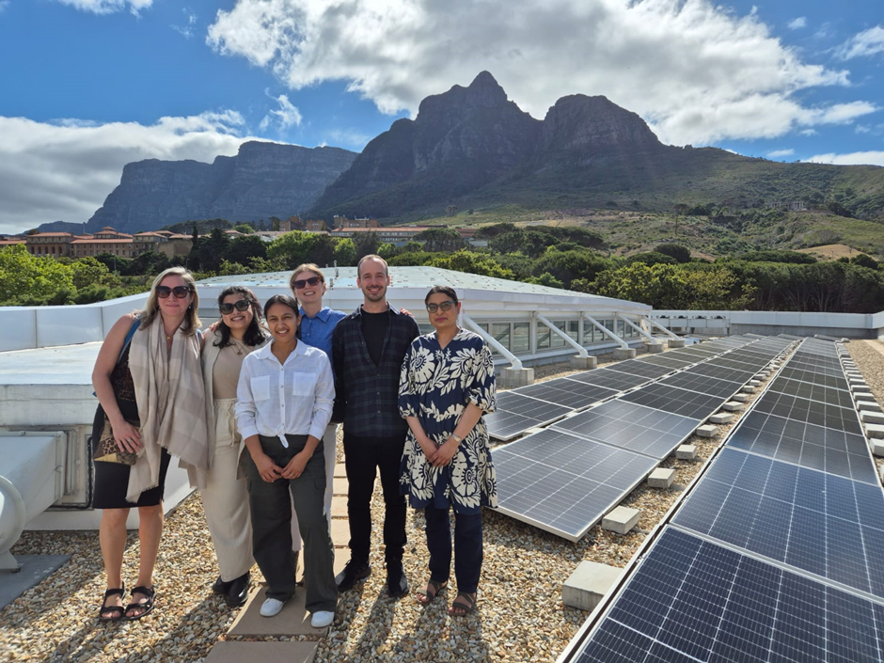
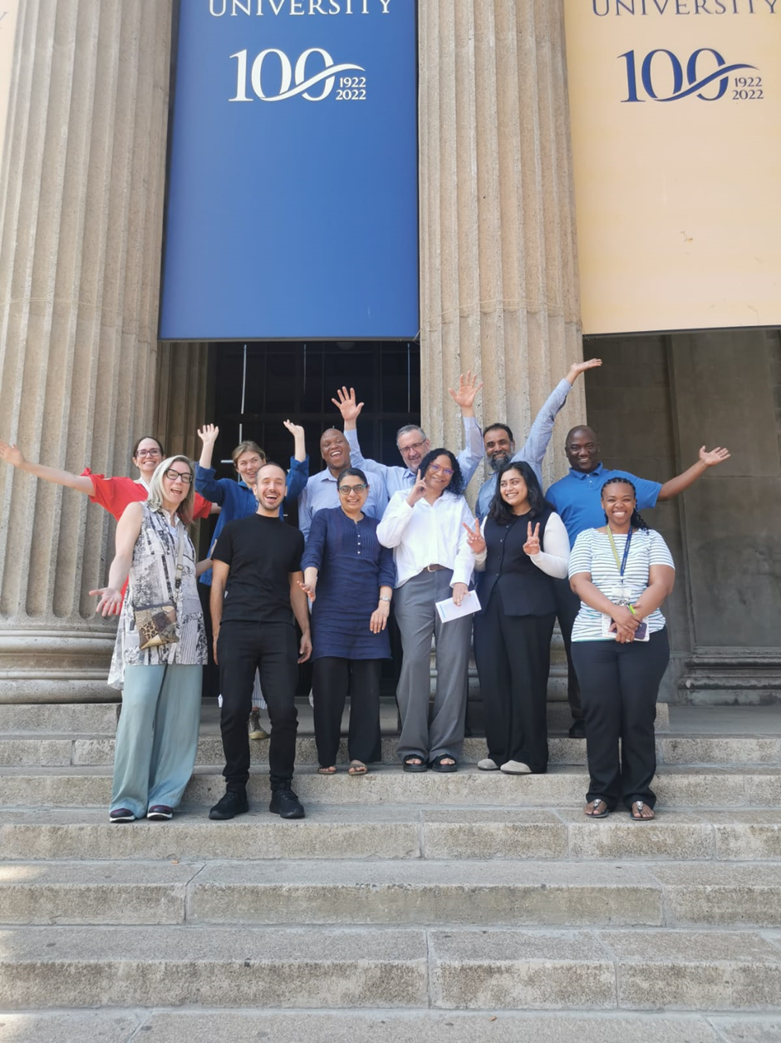
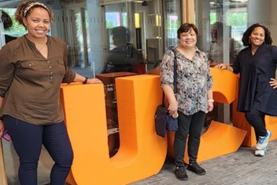
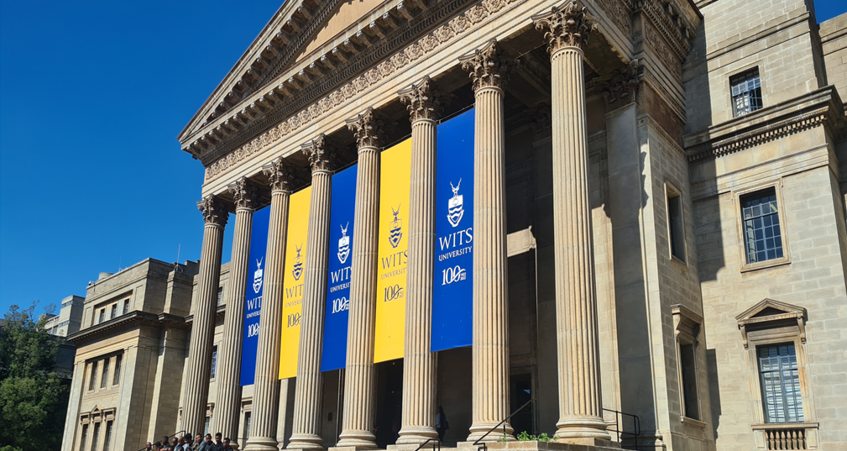
Research Capacity Strengthening: Harnessing Research Management to Foster Global Equitable Partnerships​
Objectives & Outcomes
Strengthening strategic institutional relationships leading to enhanced collaborations
To exchange learning, to strengthen research management eco systems to enhance the delivery of impactful equitable global research.
Increased staff capacity. Professional development opportunity for PS staff.
Research Capacity Strengthening (RCS) refers to the deliberate and sustained efforts to enhance the ability of individuals, institutions, and systems to conduct high-quality research effectively through strengthening research management ecosystems.
Bi-directional Fellowship. Five days of work shadowing & knowledge exchange. Emphasis on two-way learning.
Fellows from partner universities in South Africa (Wits University and University of Cape Town) visited UCL in June ‘23 and June '24, and fellows from UCL visited the partner institutions in South Africa in Oct ‘23 and Nov '24

Slide 7
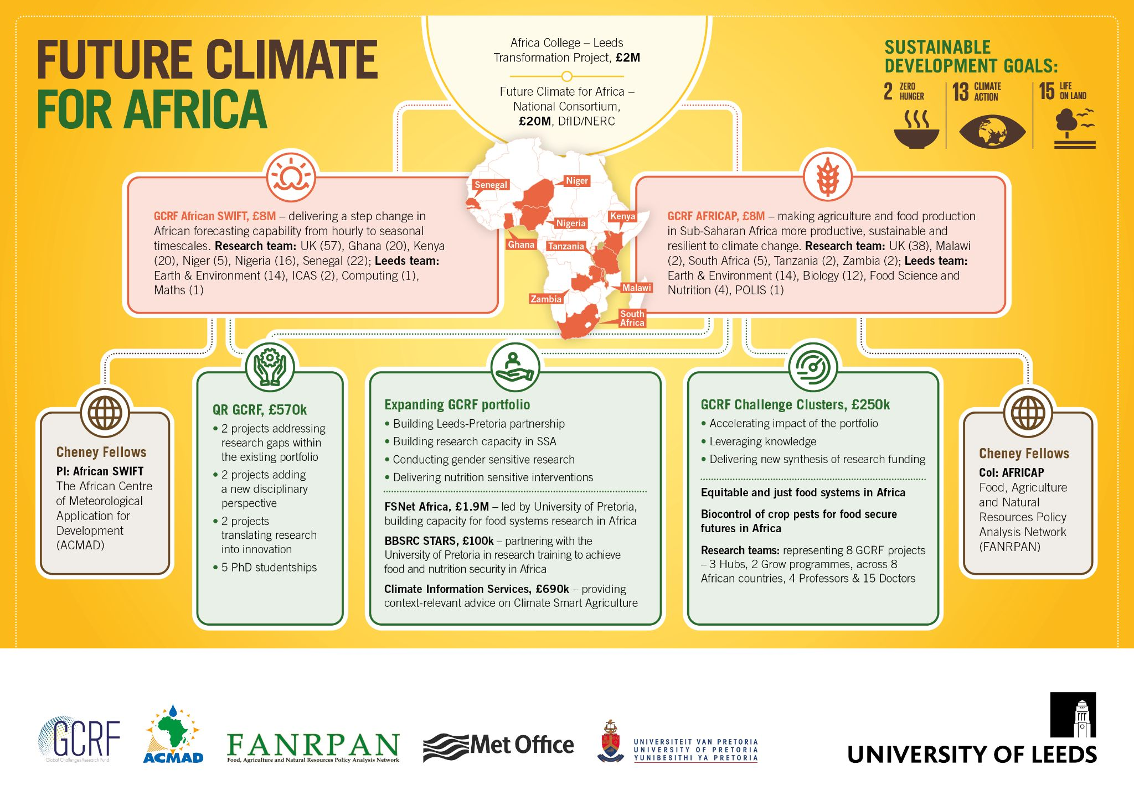
Supporting research for Global Challenges
Universities have developed substantial global research portfolios using ODA.
This is underpinned by trusted partnerships with collaborators in the Global South.
To sustain and grow we need a long-term international funding strategy which supports the whole research pipeline.

Slide 8
Supporting research for Global Challenges
Over 200 projects and over 40 countries

Slide 9
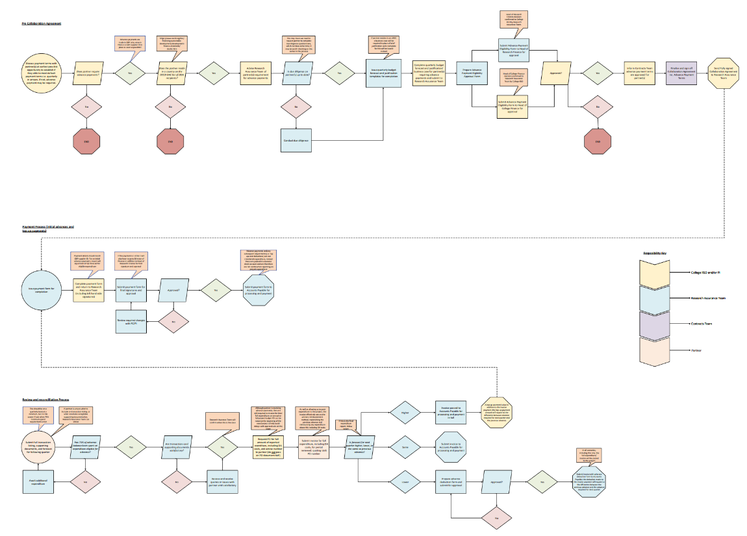
Advance Payments
Money, power and equity are tied together
Standard UK approach is payment in arrears
For many LMIC institutions, this is not an option
Advance payment is necessary, but not standard
Processes are determined by the lead institution
"We handle them on a case-by-case basis."

Slide 10
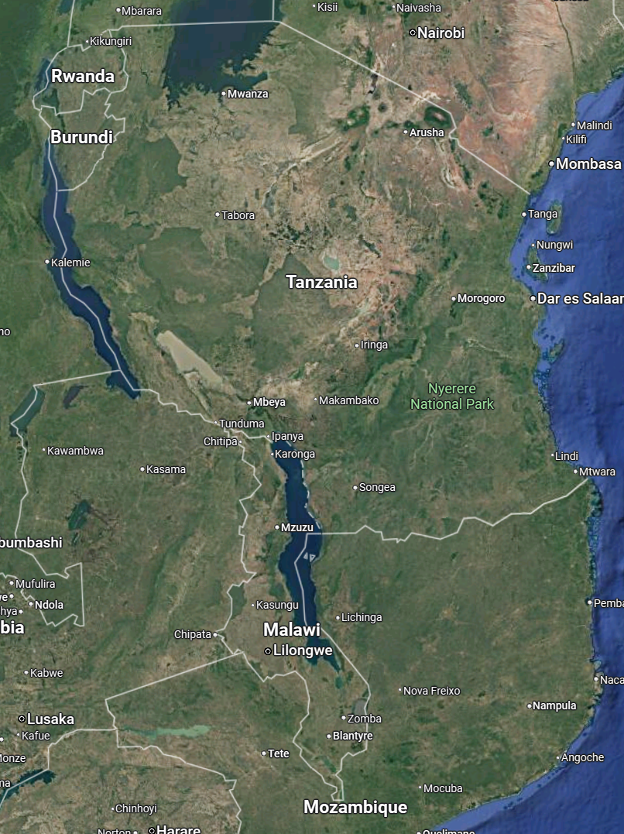
Advance Payments
Kilimanjaro Clinical Research Institute
UofG is overhauling our policy/process
Broadening the scope and taking a wider approach to risk management
Consultations
RMAs at UofG
Researchers at UofG
RMAs at 5 partner institutions
Ifakara Health Institute
Malawi Epidemiological and Intervention Research Unit
Blantyre Malaria Project
Kamuzu University of Health Sciences

Slide 11
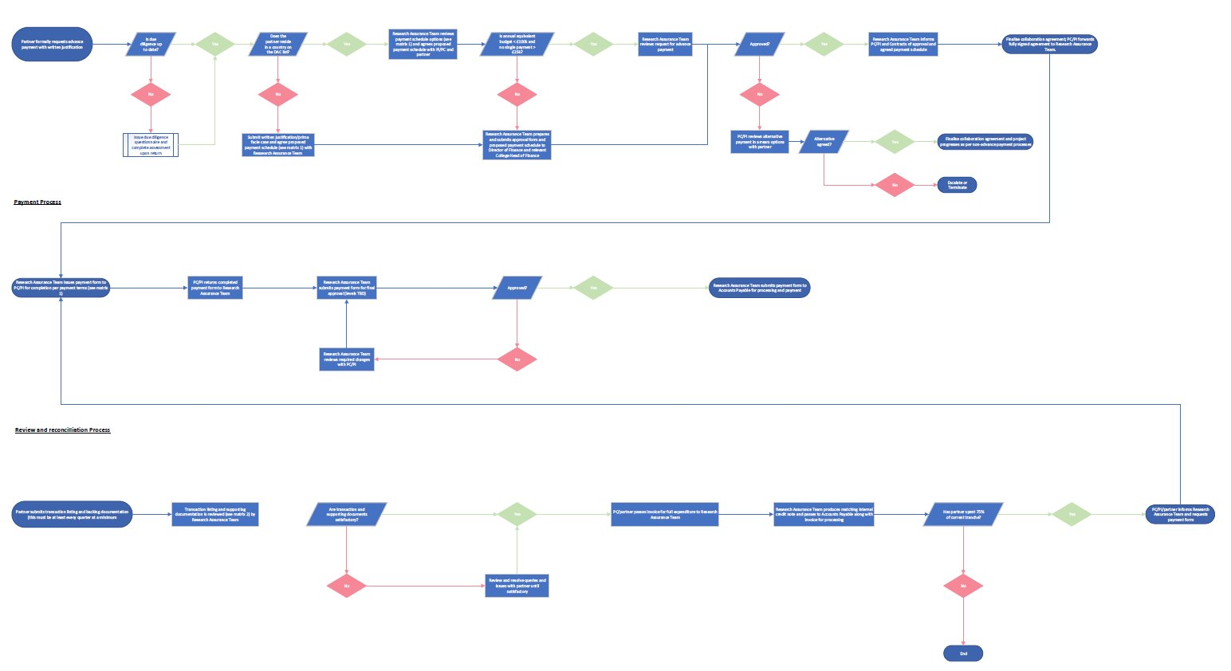
Advance Payments
SOP is in final stages with roll-out aiming for August 2025
Benefits
Co-Development
Local Context
Challenges
Time
Money

Slide 12
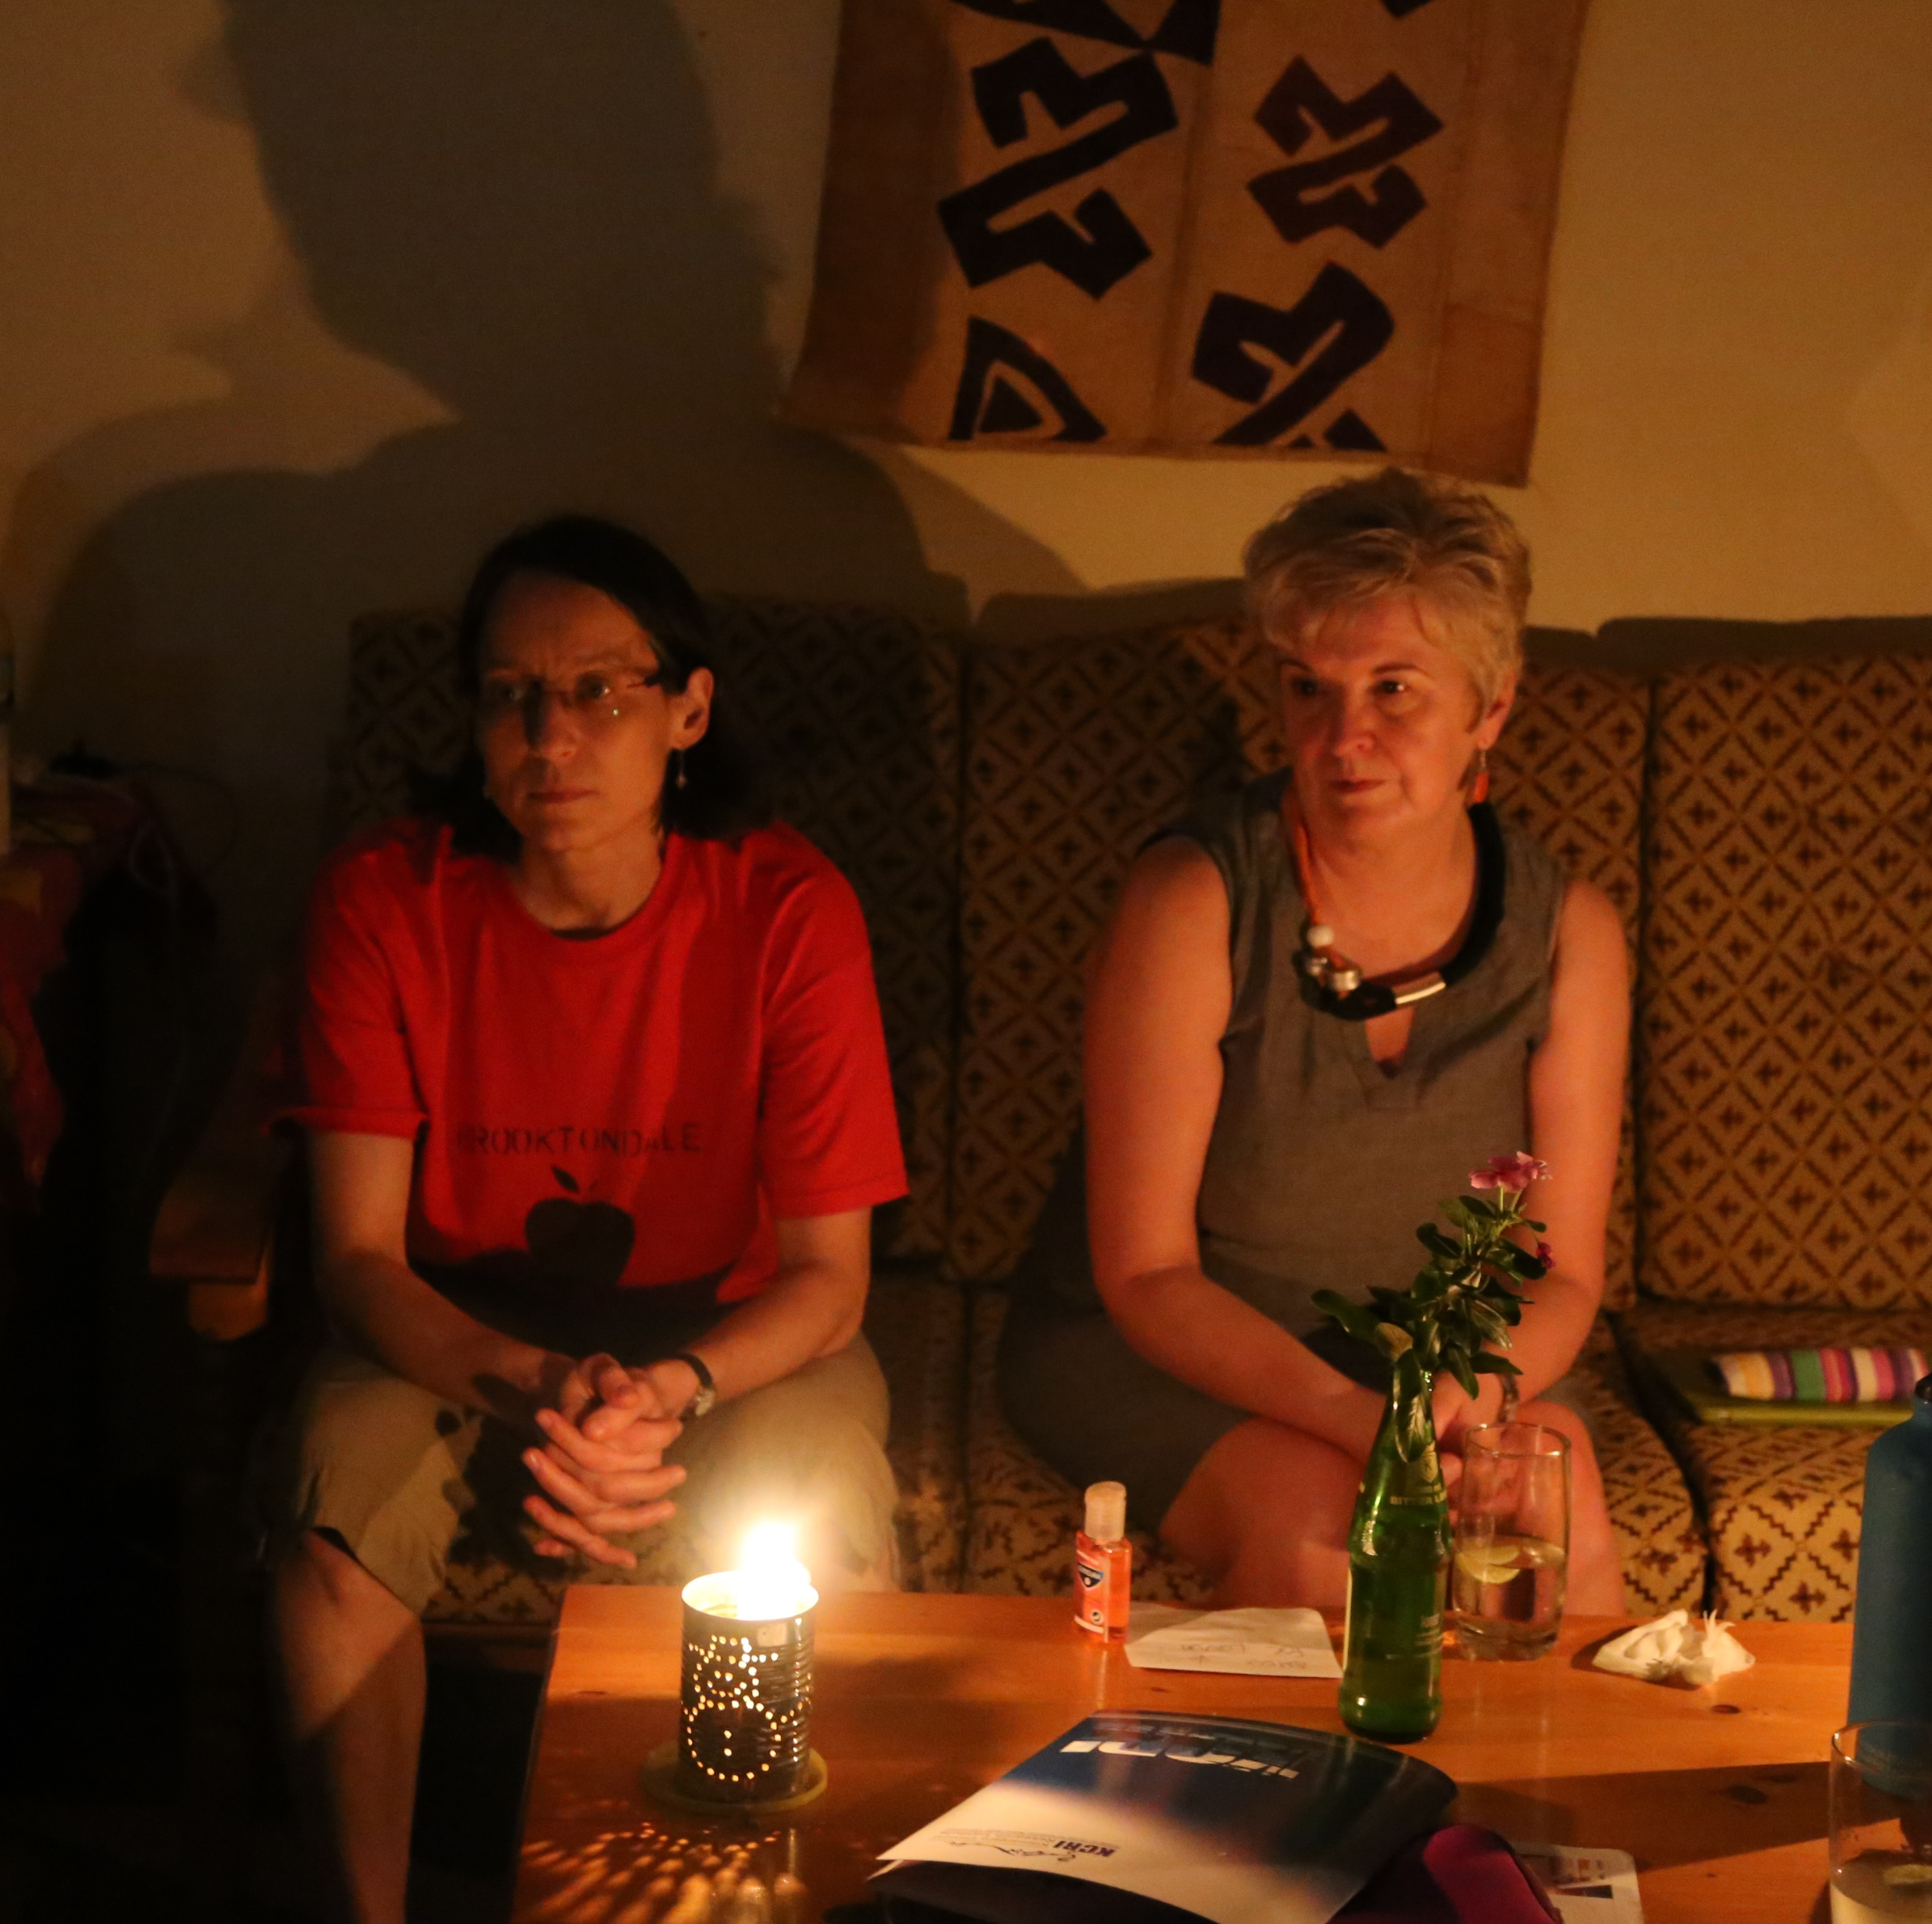
Capacity Strengthening Workshop
Challenges are more acute in LMICs
Infrastructure
Digital Divide
Institutional Funding Models
Opportunities for Continuing Professional Development
And yet…“Even if we are in Africa, we have to manage research at an international level.”

Slide 13
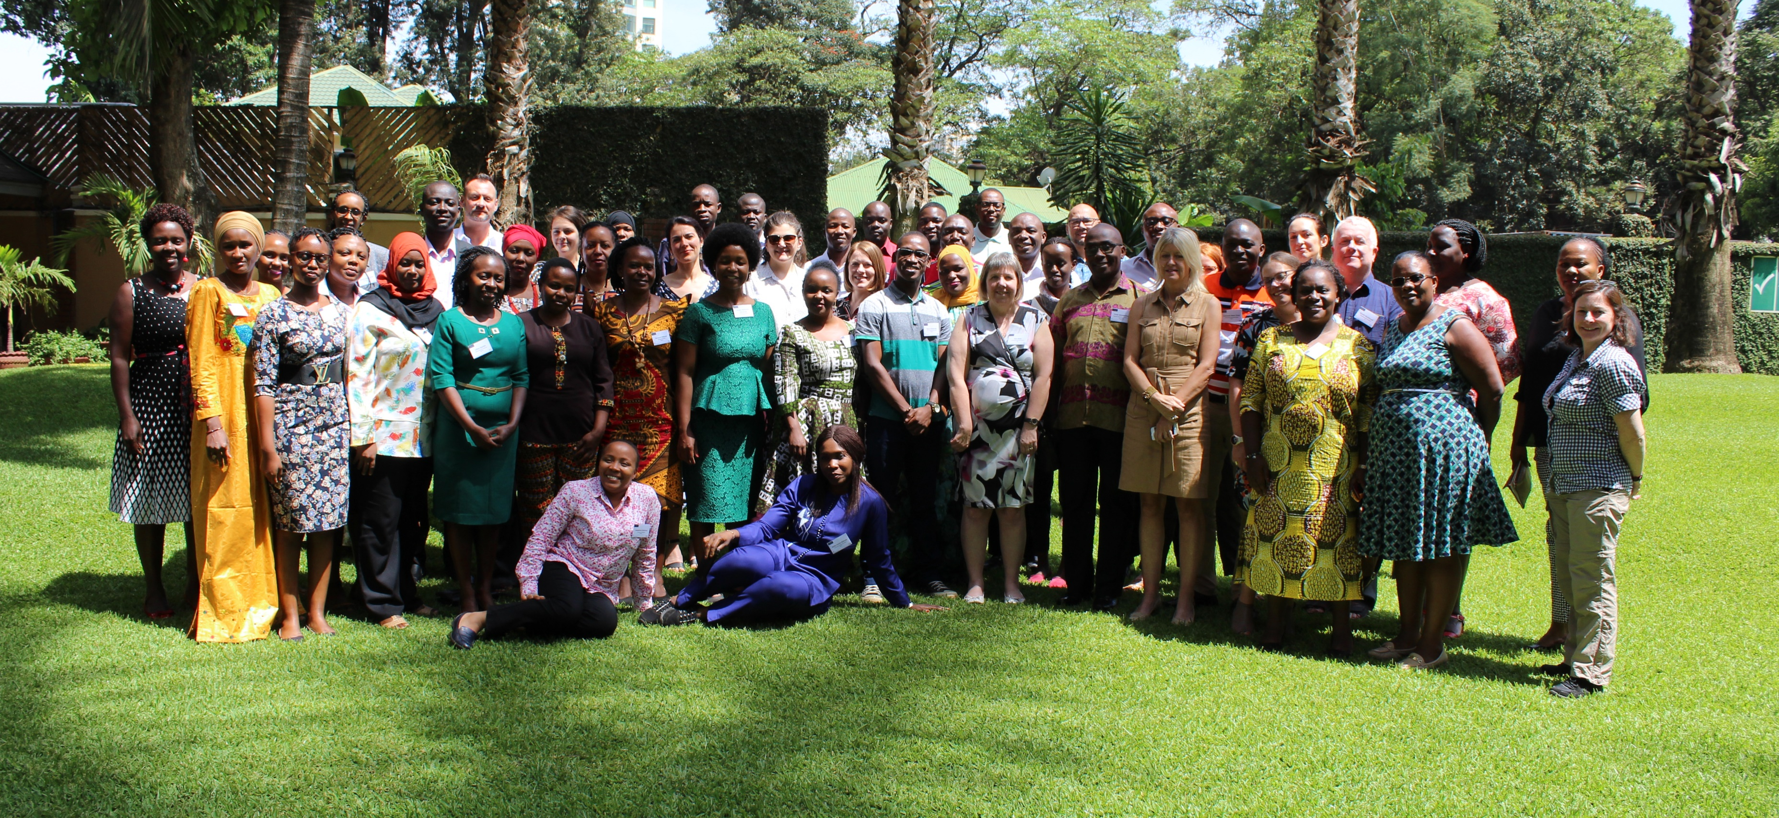
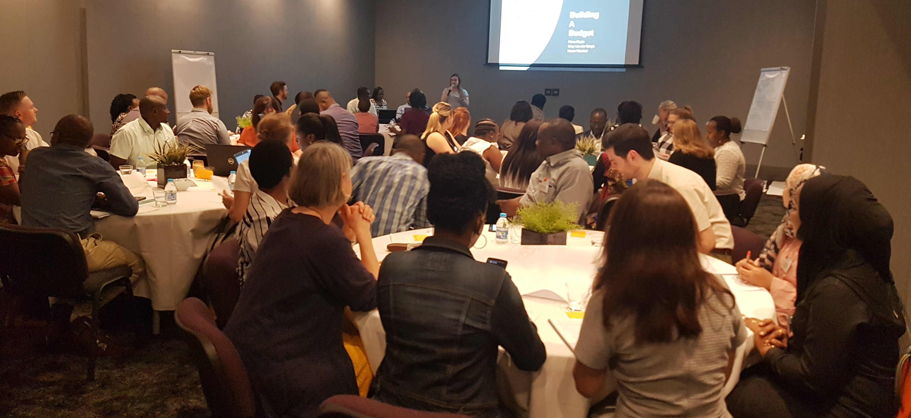
The barest attempt to address this massive challenge
Research Management Capacity Strengthening Workshops
Everyone is a student, everyone is a teacher

Slide 14
A coalition of the willing
Facilitation Team
7 universities
1 research institute
1 clinical research programme
2 funders
2 professional organizations
4 countries
Attendees
106 registered attendees
60 institutions
22 countries

Slide 15
Who decides?
All delegates are asked:
What challenges are you facing in your work that you hope a community of other people like yourself might be able to help resolve
What do you hope to get from this meeting? Personally? Professionally? What will have to happen for you to consider this meeting a success?

Slide 16
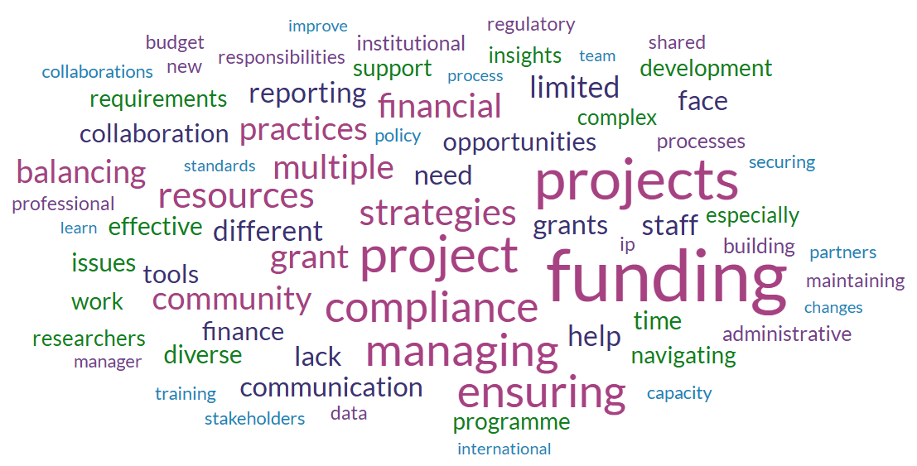
Challenges

Slide 17
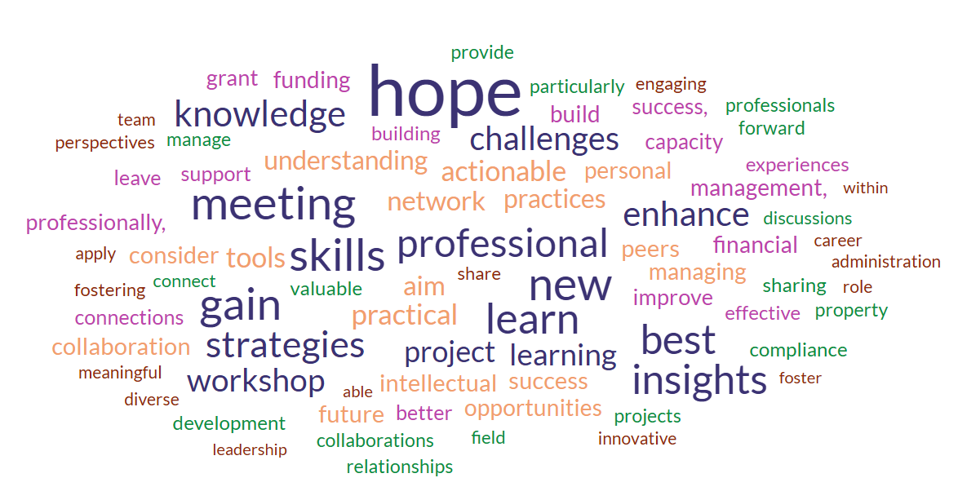
Hopes

Slide 18
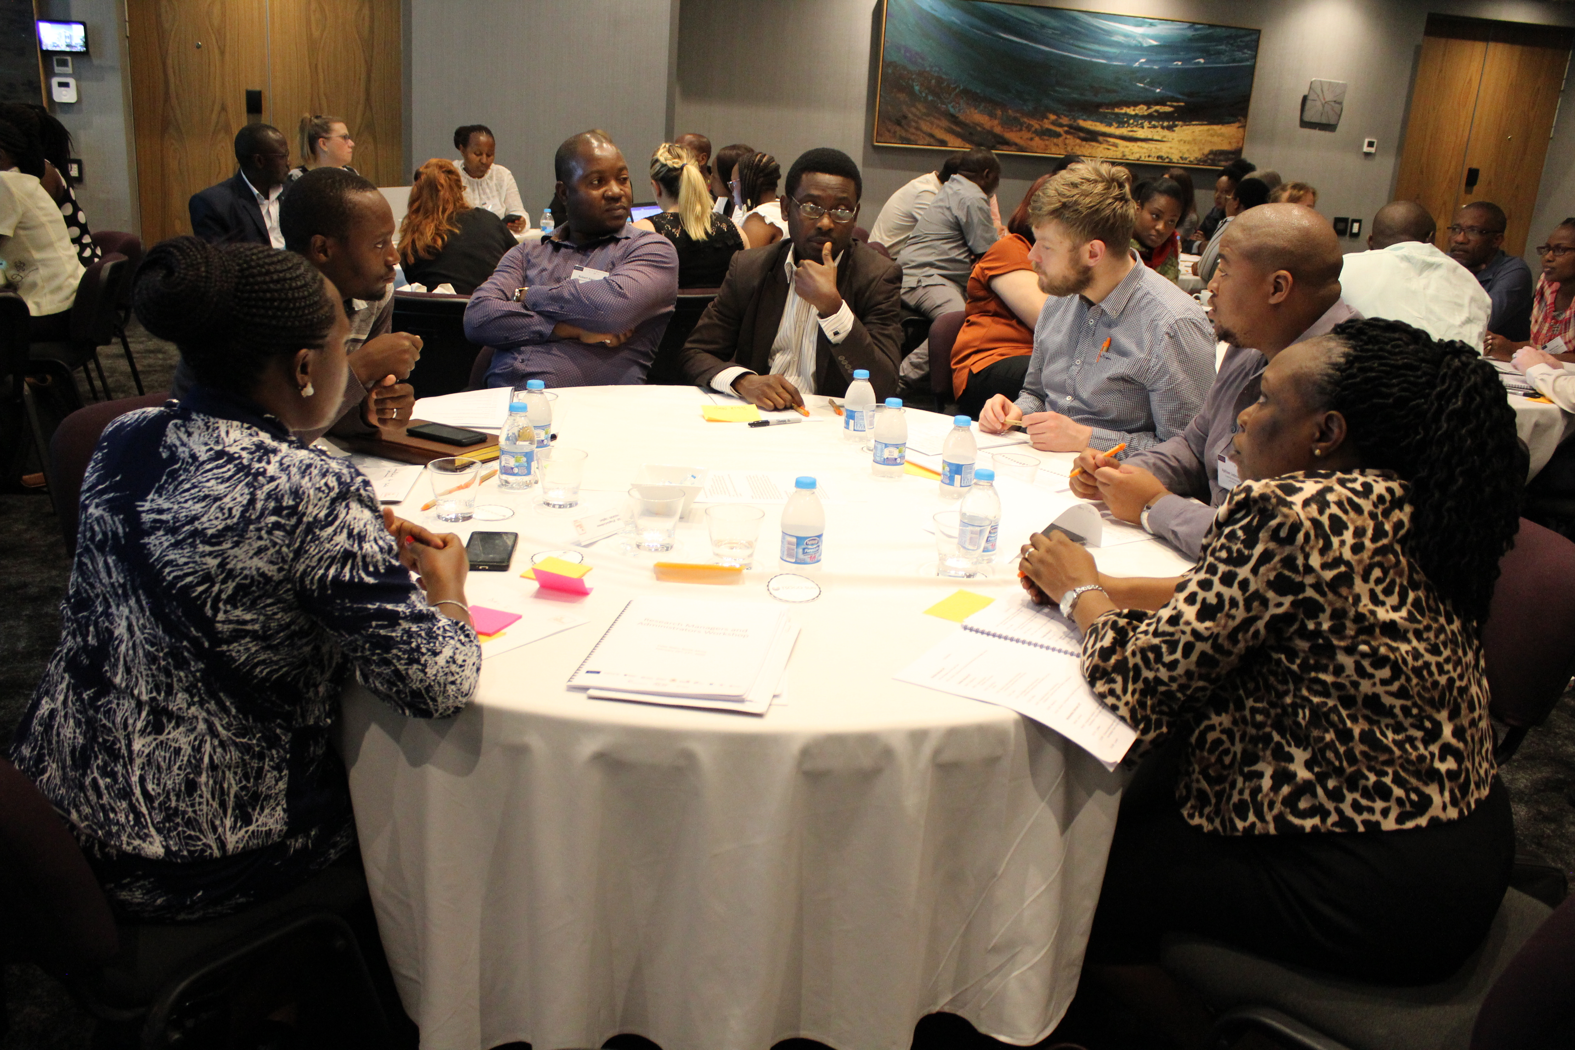
Then we try to deliver
Sessions based on most requested topics
Practical exercises and tools
Assigned seating
Emphasis on peer-to-peer learning

Slide 19
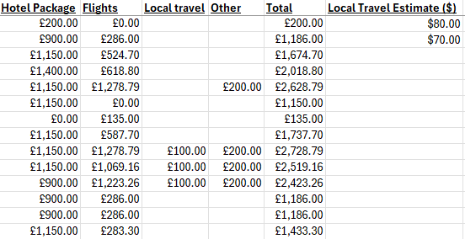
Some thorny issues to grapple with
Time
Money
Potentially reinforces problematic practices
Unsustainable model
Not led by the right people

Slide 20
The Way Forward
Untie research management capacity strengthening from research projects
Support for networks for KE in the UK
Dedicated support for LMIC-led professional development initiatives
Strategic coordination
Consolidation of sector-wide knowledge and approaches
Leveraging RMA expertise to shape an equitable future
Ongoing consultation with RMA professionals.

