Slide 1
The Role of Research Development Offices in Developing and Maintaining Long-Term Partnerships
A Case Study of Fundação Getulio Vargas

Slide 2
Fundação Getulio Vargas (FGV)
A private, non-profit foundation dedicated to education, research, and innovation, with a focus on applied social sciences and humanities.
Mission: to foster Brazil's social and economic development.
Notes:
Key Message: Researchers juggle multiple roles—support structures are essential to enable impactful research.

Slide 3
Fundação Getulio Vargas (FGV)
President
Schools and Research Centers
Brazilian Institute of Economics - IBRE
Institute of Educational Development
FGV Projetos
FGV Publisher
Schools of Business and Public Administration
Schools of Economics
Law Schools
School of Social Sciences
School of Applied Mathematics
School of International Relations
School of Government and Public Policy
School of Marketing and Communication
Indexes and Indicators
Executive Education
Consulting
Research and Innovation Office
Notes:
Key Message: Researchers juggle multiple roles—support structures are essential to enable impactful research.

Slide 4
CHALLENGES FACED BY RESEARCHERS
Publication Goals
Securing Funding
Establishing Partnerships
Managing and Maintaining Projects
Dealing with Administrative Burdens
Student Guidance
Notes:
Pressure for Productivity → High expectations for publishing and academic output
Securing Funding → Competitive and complex grant application processes
Establishing Partnerships → Finding and maintaining strategic international collaborations
Managing and Maintaining Projects → Overseeing timelines, deliverables, and team coordination
Dealing with Administrative Burdens → Navigating bureaucratic processes and institutional requirements
Balancing Academic and Professional Responsibilities → Teaching, supervising, and conducting research simultaneously *Highlight which of these struggles can be tackled by an RDO office

Slide 5
Technology Readiness Level
Societal Readiness Level
TRL1 | Beginning of Scientific Research. Results lead to new research and development. | SRL1 | Identifying problem.
TRL2 | Practical applications are developed from the initial results (still without “proof of concept”). | SRL2 | Formulation of problem, proposed solution(s) and potential impact Identifying relevant stakeholders for the project.
TRL3 | Laboratory studies. Construction of the "proof of concept" model. | SRL3 | Initial testing of proposed solution(s) together with relevant stakeholders
TRL4 | Conducting tests with the model built in the previous phase. | SRL4 | Problem validated through pilot testing in relevant environment to substantiate potential impact
TRL5 | Simulations in an environment similar to reality. | SRL5 | Proposed solution(s) validated, now by relevant stakeholders in the area
TRL6 | Prototype of the technology in operation. | SRL6 | Solution(s) demonstrated in relevant environment and in co‐operation with relevant stakeholders
TRL7 | Technology operating in a real environment. | SRL7 | Refinement of project and/or solution.
TRL8 | Technology ready for integration into an existing system (ready for use). | SRL8 | Proposed solution(s) as well as a plan for societal adaptation complete and qualified
TRL9 | Technology in use. | SRL9 | Solution(s) proven in relevant environment
Base Source: NASA
Base Source: Innovation Fund Denmark

Slide 6
WHAT A RESEARCH DEVELOPMENT OFFICE (RDO) DOES?
Supports researchers to find funding opportunities, building partnerships, and managing projects.
Common in Europe and the USA, but rare in some regions.
Notes:
Pressure for Productivity → High expectations for publishing and academic output
Securing Funding → Competitive and complex grant application processes
Establishing Partnerships → Finding and maintaining strategic international collaborations
Managing and Maintaining Projects → Overseeing timelines, deliverables, and team coordination
Dealing with Administrative Burdens → Navigating bureaucratic processes and institutional requirements
Balancing Academic and Professional Responsibilities → Teaching, supervising, and conducting research simultaneously *Highlight which of these struggles can be tackled by an RDO office

Slide 7
Research Development Office
FUNDING OPPORTUNITIES
NETWORKING
FINANCIAL PLANNING
PROPOSAL SUBMISSION
I.T.
CONTRACT NEGOTIATION
MANAGEMENT OF INTERNAL PROCESSES
DISSEMINATION
Notes:
Slide da apresentação do 5CNCTI

Slide 8
KEY FUNCTIONS OF RDOs
1
2
3
4
5
Identification and Development of Funding Opportunities: Prospecting, planning, and developing funding opportunities, with a focus on multidisciplinarity
Establishment and Maintenance of Strategic Partnerships:
Identifying, building, and strengthening partnerships with academic institutions, industries, municipal, state, and federal governments, as well as national and international funding organizations.
Structuring Research Networks: Supporting the formation of collaborative networks among researchers from local and international institutions
Proposal Submission Management: Coordinating the submission of funding proposals to third parties.
Engagement with National and International Funders: Acquiring knowledge about funders' requirements, priority topics, and strategic contacts.
Notes:
Ver com a Bete, em alguma das versões tem papéis e responsabilidades da Rede

Slide 9
KEY FUNCTIONS OF RDOs
6
7
8
9
10
Research Governance System: Supporting researchers to comply with all the internal requirements of the research governance system (Ethics Compliance Committee for Research Involving Human Subjects., Research and Innovation Commission, and Central Office for Scientific Integrity)
Dissemination of Research Results:
Communicating research results to internal and external stakeholders and supporting strategies to generate impact on society.
Financial Management of Funds to Support Research and Innovation: Management of internal financial resources to promote R&D&I
Intellectual Property Management:
Management and Negotiation of IP
Innovation Promotion: Designing guidelines and policies to promote R&D&I initiatives.
Notes:
Ver com a Bete, em alguma das versões tem papéis e responsabilidades da Rede

Slide 10
FGV: A Case Study

Slide 11
THE IMPACT OF THE RESEARCH DEVELOPMENT OFFICE AT FGV
✔ Support to the Research Governance System at FGV
Research and Innovation Committee.
Ethics Compliance Committee for Research Involving Human Subjects (FGV CEPH).
Central Office for Research Integrity (FGV ECIC).
✔ Management of Sensitive Data for Research
✔ Support to Multidisciplinary Research Centers:
FGV IISR – Institute of Insurance and Reinsurance, with 100% external funding.
✔ Revista Impactos, magazine to disseminate research findings

Slide 12
THE IMPACT OF THE RESEARCH DEVELOPMENT OFFICE AT FGV
✔ Funding for R&D projects:
External: Increased third-party research funding for FGV schools by approximately 242% in total & 358% in funds raised from Brazilian funding agencies, including FAPESP, CAPES, FAPERJ, and CNPq.
Internal: FGV FPI (FGV Research and Innovation Fund)
Established in 2014, this fund provided seed money for 302 research projects led by FGV researchers.
✔ Mariana Project: Supported the development of an interdisciplinary research team to estimate the social economic impact of the Mariana disaster.
Notes:
Schools: Law, Applied Mathematics, Business, Economy

Slide 13
The Impact of Research Development Office Support: FGV & BR-UK PACT
The Challenge
Three different FGV proposals were submitted to the BR-UK PACT initiative in 2024
The Key Difference
Only one proposal had the support of the Research Development Office (RDO)
The Outcome
The only selected proposal was the one supported by the RDO
Why It Worked
Strategic guidance in proposal preparation
Secured ~£1,000,000 in funding
Alignment with funding priorities
Stronger project structure and compliance
High competition and strict selection criteria
- Three different FGV proposals were submitted to the BR-UK PACT initiative in 2024 - High competition and strict selection criteria
Notes:
Adicionar 3 temas nas quais foram submetidas as propostas.
+ Adicionar

Slide 14
FGV and FAPESP
Goal of the Partnership:
By fostering a strong relationship with FAPESP, FGV has successfully secured both local and international funding, while also establishing strategic partnerships.
National Level:
Funding for projects that support evidence based public policy. Fostering convergence and goal-oriented applied studies that bridge government, industry, and academia.
International Level: Applied projects with real-world impact, bringing together researchers to address common challenges. Strengthening the connection between local and global perspectives.

Slide 15
FGV and FAPESP
International Level:
Understanding innovative initiatives for governing food, water and energy nexus in cities
(José Puppim, FGV EAESP)
Collaboration with Yale University (USA), United Nations University Institute for Integrated Management of Material Fluxes and of Resources (UNU-FLORES, Germany), Ming Chuan University (Taiwan), ICLEI Cities Biodiversity Center (South Africa), Stockholm University (Sweden)
(Fapesp-Belmont Forum T2S2016) Waterproofing data: engaging stakeholders in the sustainable governance of flood risks for urban resilience
(Maria Alexandra Cunha, EAESP)
(Fapesp-ESRC))
(Award: Impact Prize do UKRI 2023 )
Notes:
National Level collaborations:
Centro de Estudos em Implementação de Políticas Educacionais – CEPIPE (Ricardo Gomes FGV EAESP)
CIDADES: Centro de Inovação em Políticas Públicas Urbanas (Ciro Biderman FGV EAESP)
Centro de Estudos em Analytics e Políticas de Segurança -FGV Analytics (João Becker FGV EAESP)
CEPID: Governance of Global Environmental Changes (José Antônio Puppim FGV EAESP)

Slide 16
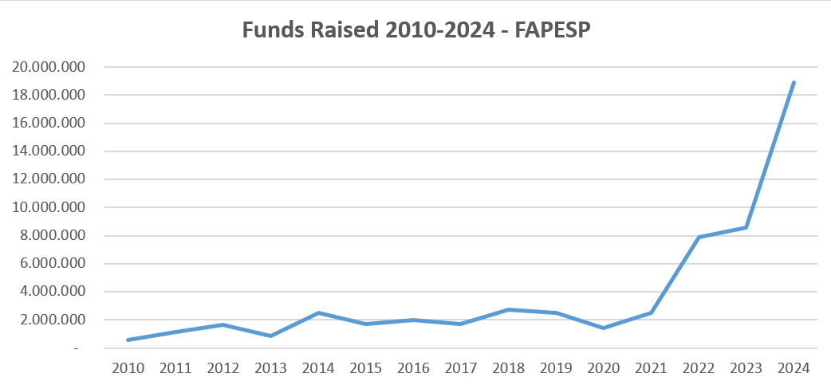
Notes:
escala a partir do 1, sem valores

Slide 17
A Successful Partnership: FGV & University of New South Wales (UNSW-Sydney)
Key Strategies for Success
Building Institutional Affinity
✔ Online & in-person meetings to ensure alignment of interests
✔ Leadership engagement to foster long-term collaboration
✔ Identification of opportunities for collaboration and potential sources of funding
Seizing the Momentum
✔ Avoiding lost opportunities by maintaining active communication ✔ Rapid follow-up actions to solidify partnership
Institutional Partnership Development
✔ Identifying Complementarities & Synergies – Leveraging strengths from both institutions ✔ Cooperation Across Multiple Fields – Expanding collaboration beyond a single project (student exchange, dual degree, research and innovation)
✔ Ensuring Strategic Alignment – Matching institutional goals for sustainable impact

Slide 18
FGV and Fiocruz Partnership (Working in Progress):
Goal of the Partnership:
Institutional collaboration with strong potential for researcher complementarities.
Challenges:
FGV and Fiocruz are large institutions with complex bureaucratic structures.
Workaround: How RDO can help?
✔ Promoting more agile and tailored initiatives to foster collaboration.
✔ Establishing more strategic and flexible points of contact within both institutions.
✔ Prioritizing focused collaborations with well-defined objectives to maximize impact.
Notes:
Key Takeaway: Institutional support makes a difference! Effective research development enhances funding success.
Establishing more strategic and flexible points of contact within both institutions. -> Como o que vem sendo feito com a Biomanguinhos

Slide 19
Why are RDOs Important?
CONCLUSION
Help researchers focus on science.
Support project management, funding applications, and partnerships.
Enhance institutional research capacity.

Slide 20
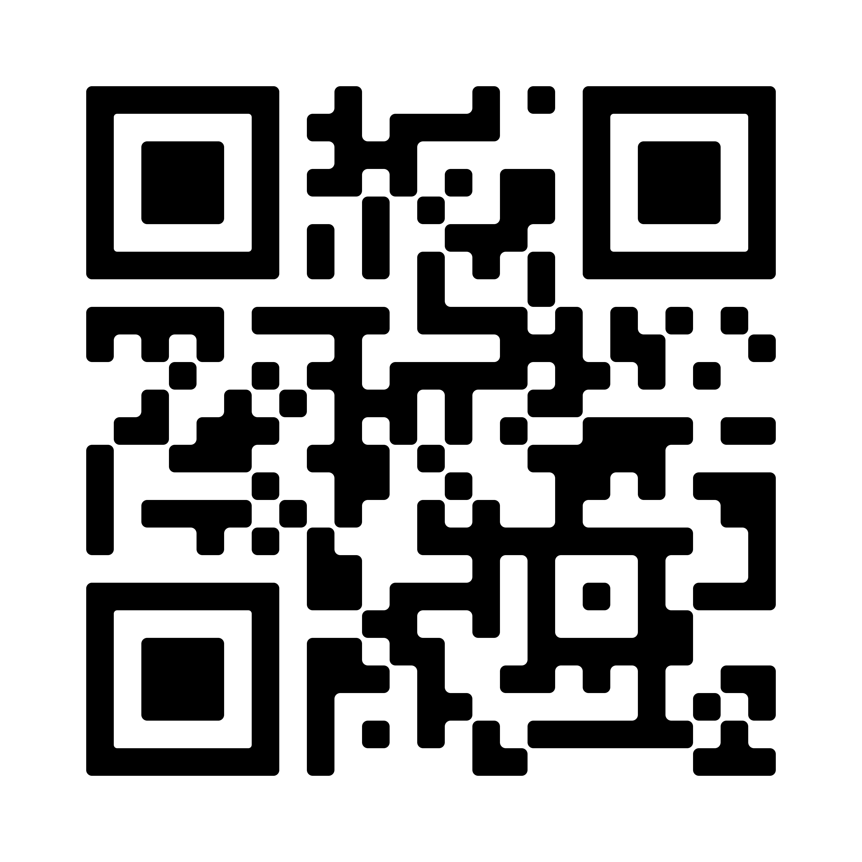
Q&A
Thank you!
Looking forward to your questions and discussion.
Connect with Linkedin
Notes:
Encerrar com figura do Tio Patinhas

