Slide 1
Strengthening Knowledge Networks:
University Data Science Centers' Partnerships for Research Excellence
Cristine Pinto | Dean of Research and Graduate Education
02/2025

Slide 2

We are a non
-profit institution
Our mission is to promote the transformation of Brazil thought:
Training of innovative leaders
High quality applied research

Slide 3

What do you need to achieve excellence in applied research?
​Excellent researchers and students.
Infrastructure that ensures a secure environment for working with sensitive data.
Partnerships with other institutions to facilitate scholar exchanges and resource sharing.

Slide 4
DATA & AI CENTER​

Slide 5

In Data
We Trust
The Data & AI Center provide:
Secure access and robust infrastructure for processing and analyzing research data.
Partnerships with both public and private sector institutions to support advancements in research and the application of data science.

Slide 6




















Data Cooperation Agreements by sector
Health
Urbanism/
Real state
Education
Government
Others
Sponsors:

Slide 7



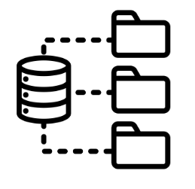


Infrastructure and Research Support
Virtual Machines
Robust environment for data processing​
Data Lake
Data Repository​
Open access and restricted data with strict security protocols
Data Management Plan Tool​

Slide 8


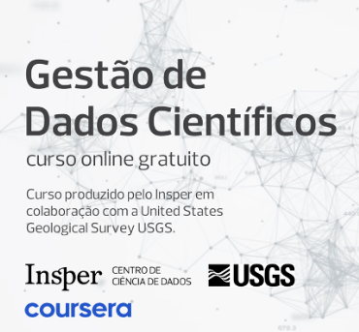

Regular Data Literacy Programs
Datathon: A data competition where multidisciplinary teams come together to analyze a real-world problem and propose an efficient and sustainable solution through Data Science.
Data Science Week: An initiative that promotes a week of events with mini-courses and panels in the field of data science, sharing knowledge with professionals from various fields.
Right Data!: In-person workshops focused on knowledge exchange and skill development in data-driven entrepreneurship.
Course “Scientific Data Management”, available on the Coursera Plataform

Slide 9
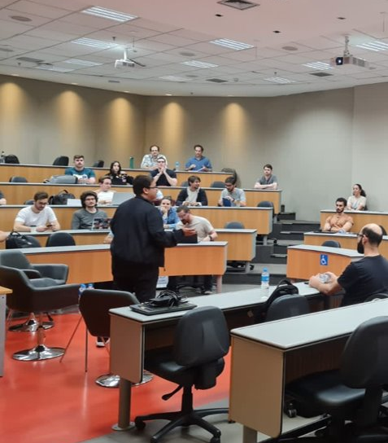

DATA GOVERNANCE TRAINING PROGRAMES
Topics
Leveraging ANS Data Governance Strategy
Enabling an analytical ecosystem
Maximizing value delivery
Applied workshop

Slide 10
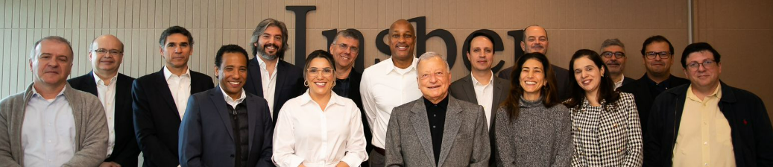
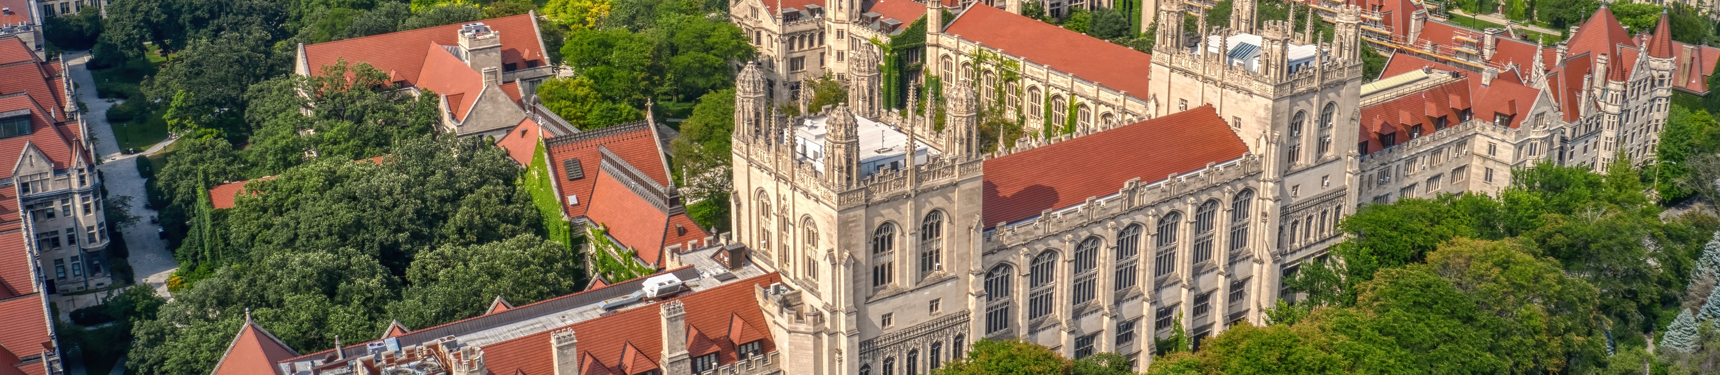
Artificial Intelligence Deployment AWS | Insper
Computational power for research processing, enabling the practical application of Artificial Intelligence in advancing insights and innovation.
Development of a free course titled Artificial Intelligence and its Impact on Business and Society, created in partnership between AWS and Insper, aimed at developing technical and managerial skills for the general Brazilian population, empowering individuals to understand and utilize AI to drive positive transformations in business and society.

Slide 11
UNIVERSITY OF ABERDEEN (SCO) | PARTNERSHIP

Slide 12
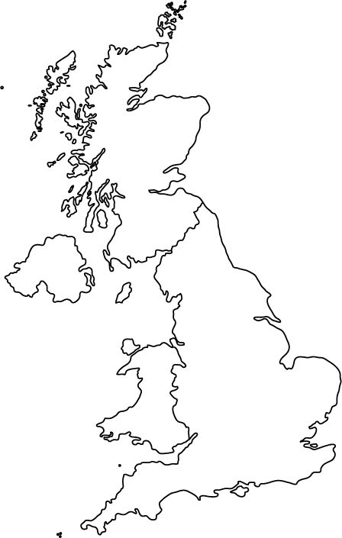





INSPER x ABERDEEN
Foster the advancement of data-driven research by securely managing sensitive data through safe room environments. This enables researchers at Insper to access sensitive data physically hosted in Aberdeen while also allowing researchers from the University of Aberdeen to access sensitive data physically hosted at Insper with access to researchers from institutions in Brazil and around the world.
ACCREDITED SAFE ROOM PROTOCOL
NATIONAL
PUBLIC HEALTH
DATA
GRAMPIAN POPULATIONAL PLATFORM DATASETS

Slide 13

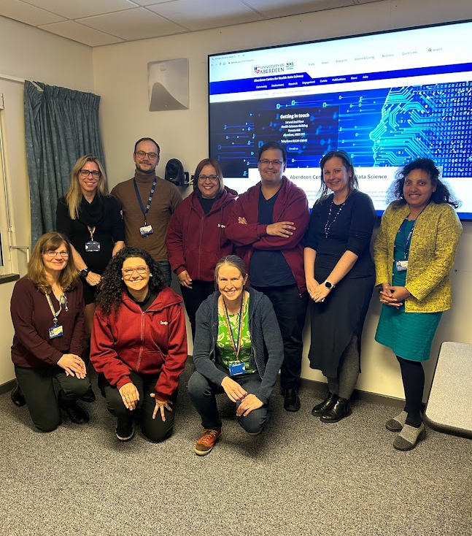
Insper’s visit to the Aberdeen University 2023
The University of Aberdeen is a partner in the Grampian Data Safe Haven (DaSH), a secure research environment for health and population data. DaSH is a virtual data analysis and storage center that allows for the secure processing and linking of sensitive data.
The visit of the Data and AI Center team to Aberdeen aimed to:
Foster dialogue for discussions and seek collaboration in research.
Learn about the security protocols used by the University of Aberdeen.
Request a visit to our institution in Brazil to evaluate our security protocols.
Seek information on certification processes for handling sensitive data.
Invite the University of Aberdeen to share their experience at the annual event organized by the Data and AI Center of Insper.

Slide 14

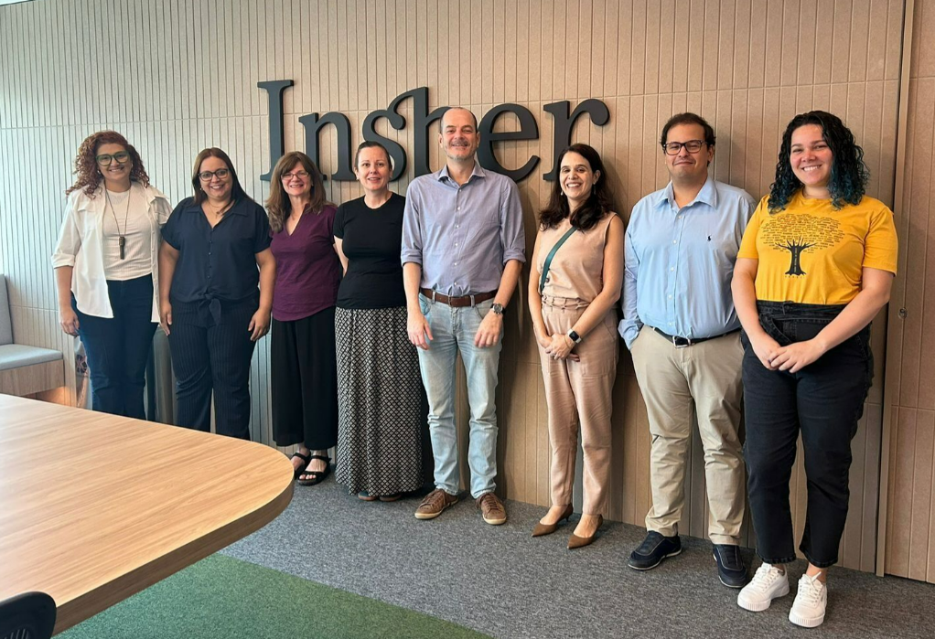
Aberdeen University’s visit Insper
2024
The visit of the University of Aberdeen team to Insper aimed to:
Connect researchers from Insper and the University of Aberdeen to foster knowledge creation and joint project development collaborations.
Integrate undergraduate and graduate courses to encourage knowledge exchange and the sharing of classes between the institutions.
Formalize a student exchange agreement to expand academic opportunities.
Encourage researchers from the University of Aberdeen to participate in Insper's Annual Event and share their experiences on access to sensitive data in Scotland.
Promote the exchange of experiences between research offices on national and international funding processes.
Analyze the architecture and technological security of the Data Center and AI, ensuring the protection and efficiency of data transfer.

Slide 15
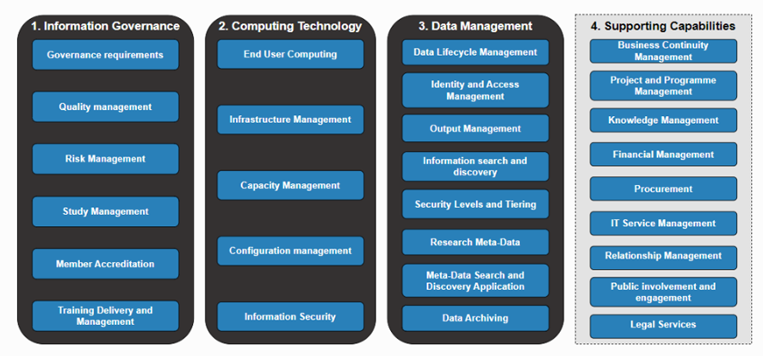
What is the SATRE project?
The SATRE project is an initiative developed by UK Health Data Research (HDR UK) that standardizes the Architecture of Trusted Research Environments (TREs), incorporating best practices from various institutions across the UK.
It covers information governance, technology, data management, and other capabilities, aiming to facilitate the use of confidential data and make the operation of Trusted Research Environments (TREs) more transparent.
SATRE Assessment Framework
https://satre-specification.readthedocs.io/en/v1.0.0/index.html

Slide 16
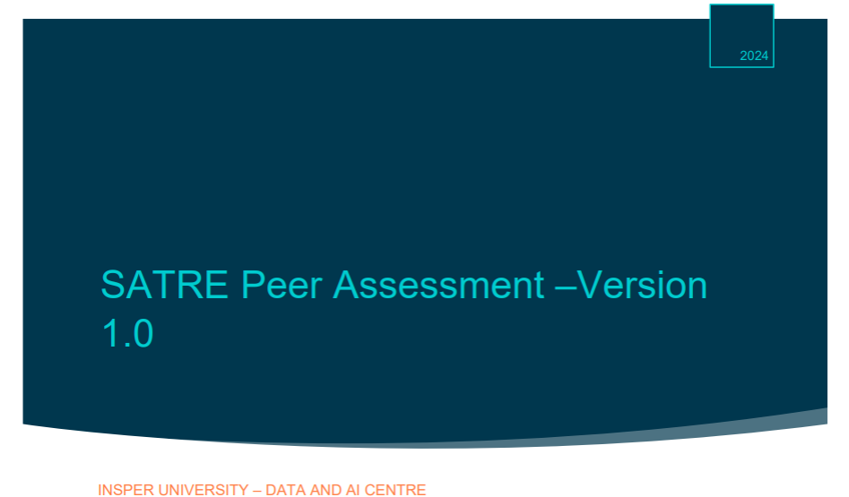
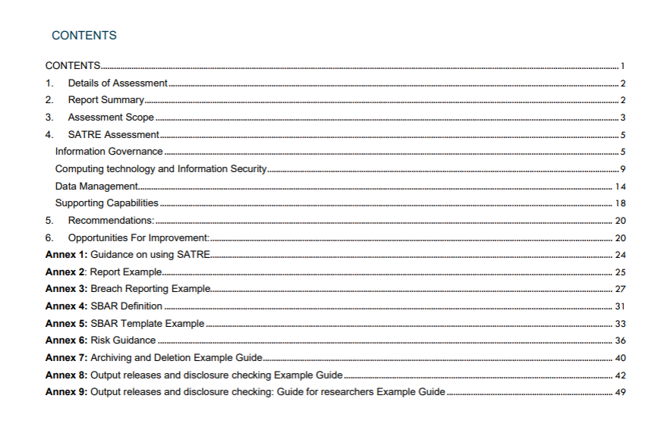


Insper Data & AI Center Assessment
In September 2024, the Insper Data and AI Center underwent a rigorous evaluation by the esteemed University of Aberdeen, utilizing the SATRE framework as a foundation. This assessment highlights the center's commitment to excellence and its dedication to advancing the field of data governance.
Out of the 160 questions that are assessed, 79 are mandatory, 60 are recommended, and 21 are optional.
160
79
60
21
Questions
Mandatory
Recommended
Optional
As a result, the Data and AI Center achieved
79,38%
20,62%
achieved
not achieved

Slide 17
AS A RESULT...

Slide 18
The Insper Data and AI Center establishes itself as a leading Data Hub, forming strategic partnerships with national and international organizations to provide essential datasets, drive research at the forefront of knowledge, and create new opportunities for innovation.
Bridging diverse cultural contexts, fostering knowledge creation through research that unites different perspectives and expertise.
British Academy Funding ODA Research Management Capacity Strengthening “INSPERation: Advancing Research Management Capacity for International Data Science Excellence. To deepen the exchange of knowledge and experiences between Brazil and Scotland, focusing on research management and best data governance practices.
Creating secure environments that democratize data access ensures that knowledge is available to all, no matter the barriers. Now, we have researchers working in Heath combining data from Brazil and from United Kingdom.
Maximizing knowledge building through research, fueled by advanced data access, empowers breakthroughs and innovation.

Slide 19
APPENDIX

Slide 20





Accreditations
Associations

Slide 21

Overview
3,516
32k
Alumni
+100
Undergraduate students
43
International
Partnerships
2,550
Student
Organizations
Graduate students
10%
8,194
99%
of undergraduate students are scholarships
holders
of the undergraduate students complete their programs employed or launching businesses
Executive Education students

Slide 22
Our Story
We were born and evolved as an integrated school
Launch of the undergraduate programs in Business Administration and Economics
Inauguration of Building 2
Beginning of classes for M.Sc. in Public Policies
Launch of the undergraduate program in Computer Science
New
campus​
Insper brand
1987
2004
2007
2015
2020
2024
1999​
2006
2009
2019
2022
First MBA program
We became a non-profit institution.
Launch of classes for the M.Sc. in Economics
Beginning of classes for the M.Sc. in Business Administration
Launch of Doctoral Program in Economics
New undergraduate programs in Mechanical Engineering, Mechatronics, and Computer Engineering
Launch of the undergraduate program in Law
Celebrating 25 years of Undergraduate Programs at Insper

Slide 23
INTERNATIONALIZATION​

Slide 24
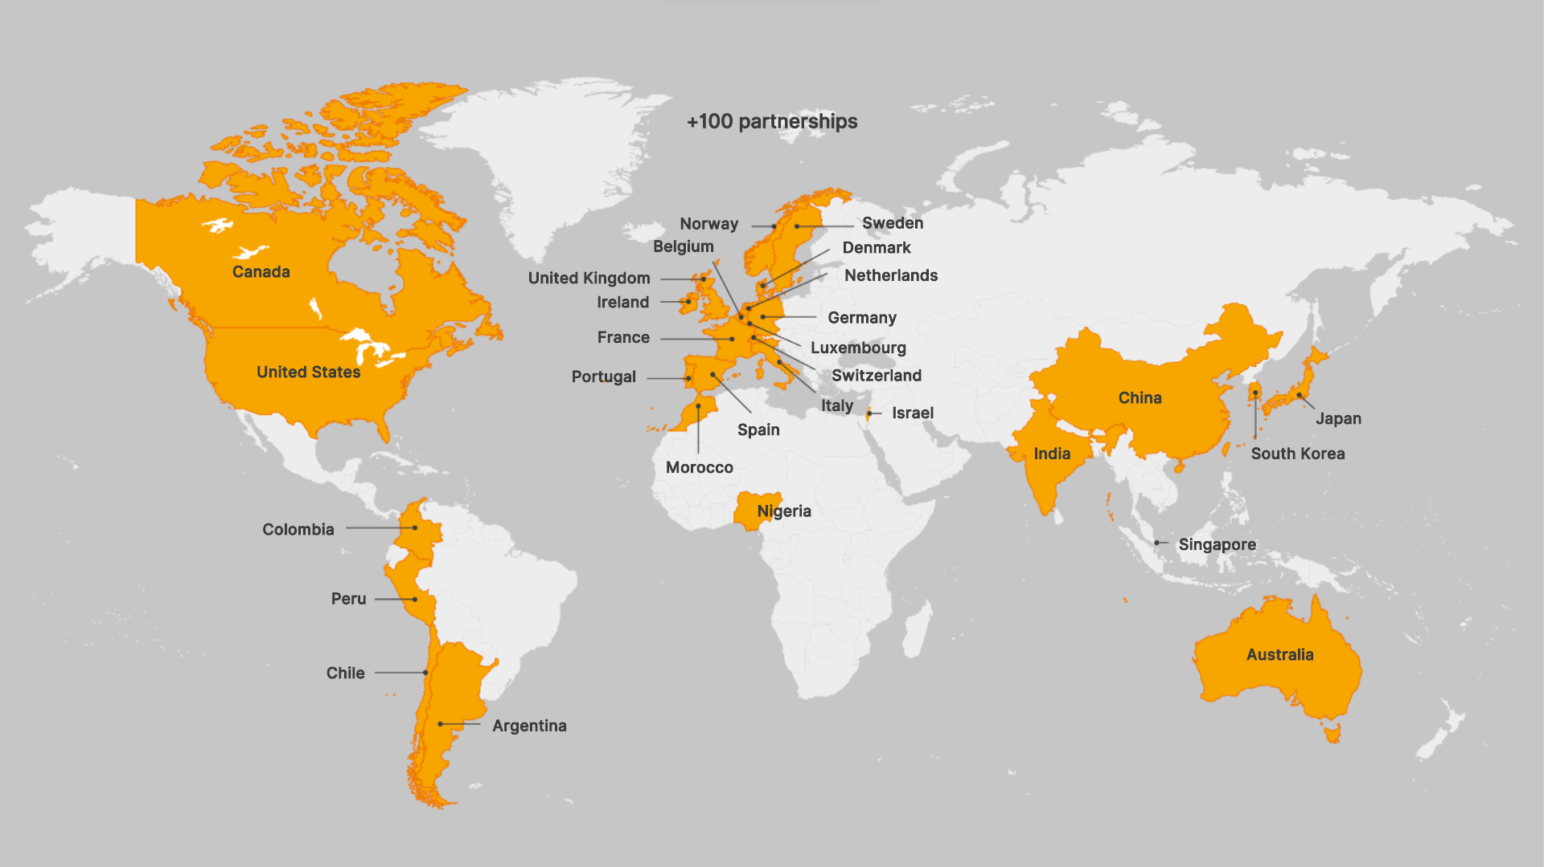
International

Slide 25
Internationalization​
Some programs in progress​
Collaborative research – University of Chicago
Predoctoral Research in Economics Program – University of Chicago
Summer Institute in Social Research Methods – University of Chicago
Production of cutting-edge research involving academics from Insper and the Becker-Friedman Institute, and development of a pipeline of early-career researchers trained in advanced economic research methods.
Aimed at undergraduate students or recent graduates from Insper interested in pursuing an academic career. This program, offered by the Becker-Friedman Institute, lasts for two years.
Holiday program that connects undergraduate students to the research activities of the Social Sciences Division of the University of Chicago.

Slide 26
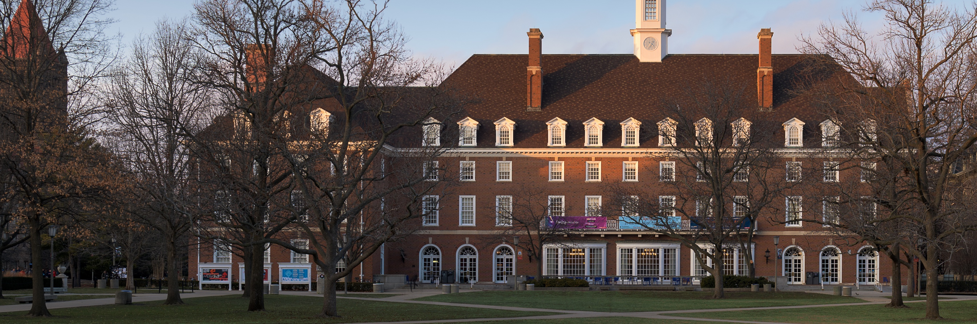
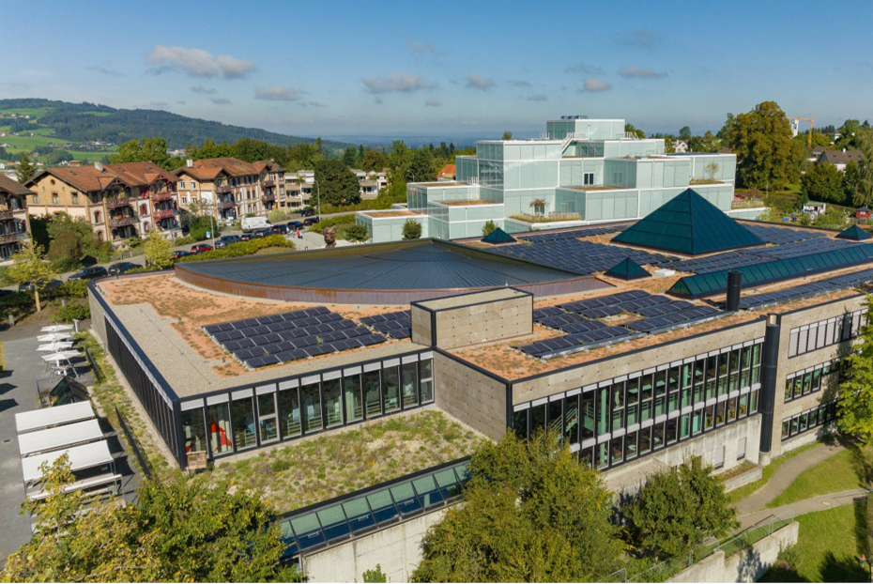
Internationalization​
Some programs in progress
Digital Policy Leadership Program – University of St. Gallen
Collaborative research – University of Illinois
Summer Research Program – University of Illinois
Production of cutting-edge research involving faculty from Insper and the University of Illinois Urbana-Champaign.
​Aimed at undergraduate students in Engineering and Computer Science, connecting them with the academic production at the University of Illinois Urbana-Champaign.
Lasting one year and open to students from all undergraduate programs, this program is focused on research activities and networking in the theme of digital policy.

