Slide 1



Equitable partnerships for transdisciplinary learning:
Making impact while swimming upstream amid the floods
Catherine Sutherland and Mary Lawhon
WASH R&D Centre, University of KwaZulu-Natal
Institute of Geography, University of Edinburgh
1st Conference on Equitable Partnerships: British Academy
11 and 12 February 2025

Slide 2
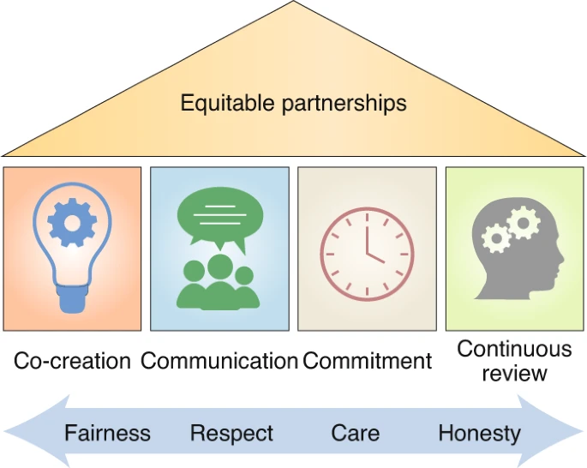
Equitable partnerships: broad and abstract principles
https://www.nature.com/articles/s43016-020-00201-9

Slide 3
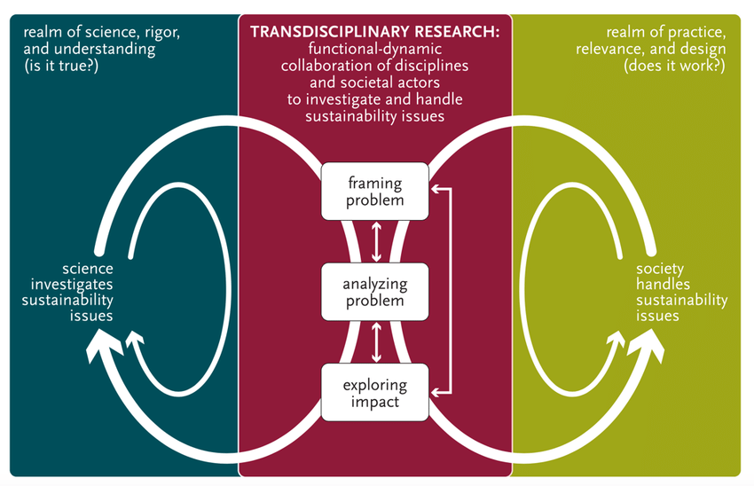
Transdisciplinary research
TRANSDISCIPLINARY RESEARCH
Science and societal actors collaborate to address societal issues
Realm of science
Framing the problem and the questions
Co-producing knowledge and data
Society
(sustainability issues)
Analysing the data and finding solutions
Understanding impact
Pohl et al., 2017

Slide 4
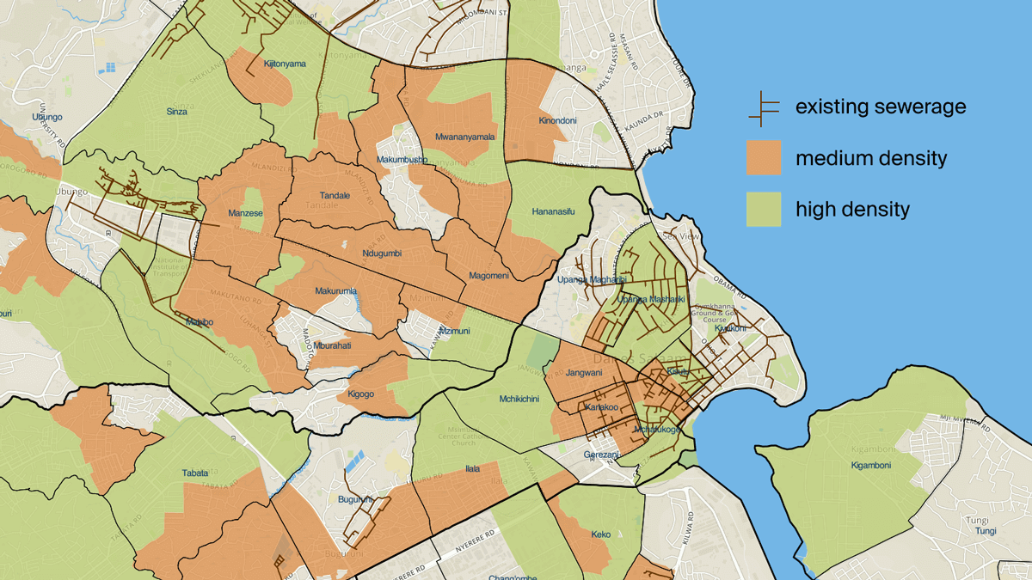
Universal centralized systems ………
Decentralized water and sanitation systems
Water and sanitation are inextricably linked, sanitation is the major challenge
Where sewers go … but where access, reliability and quality is a challenge
Social and environmental costs
The urgent need: developing sanitation systems where the sewer doesn’t go
Dar Es Salaam

Slide 5
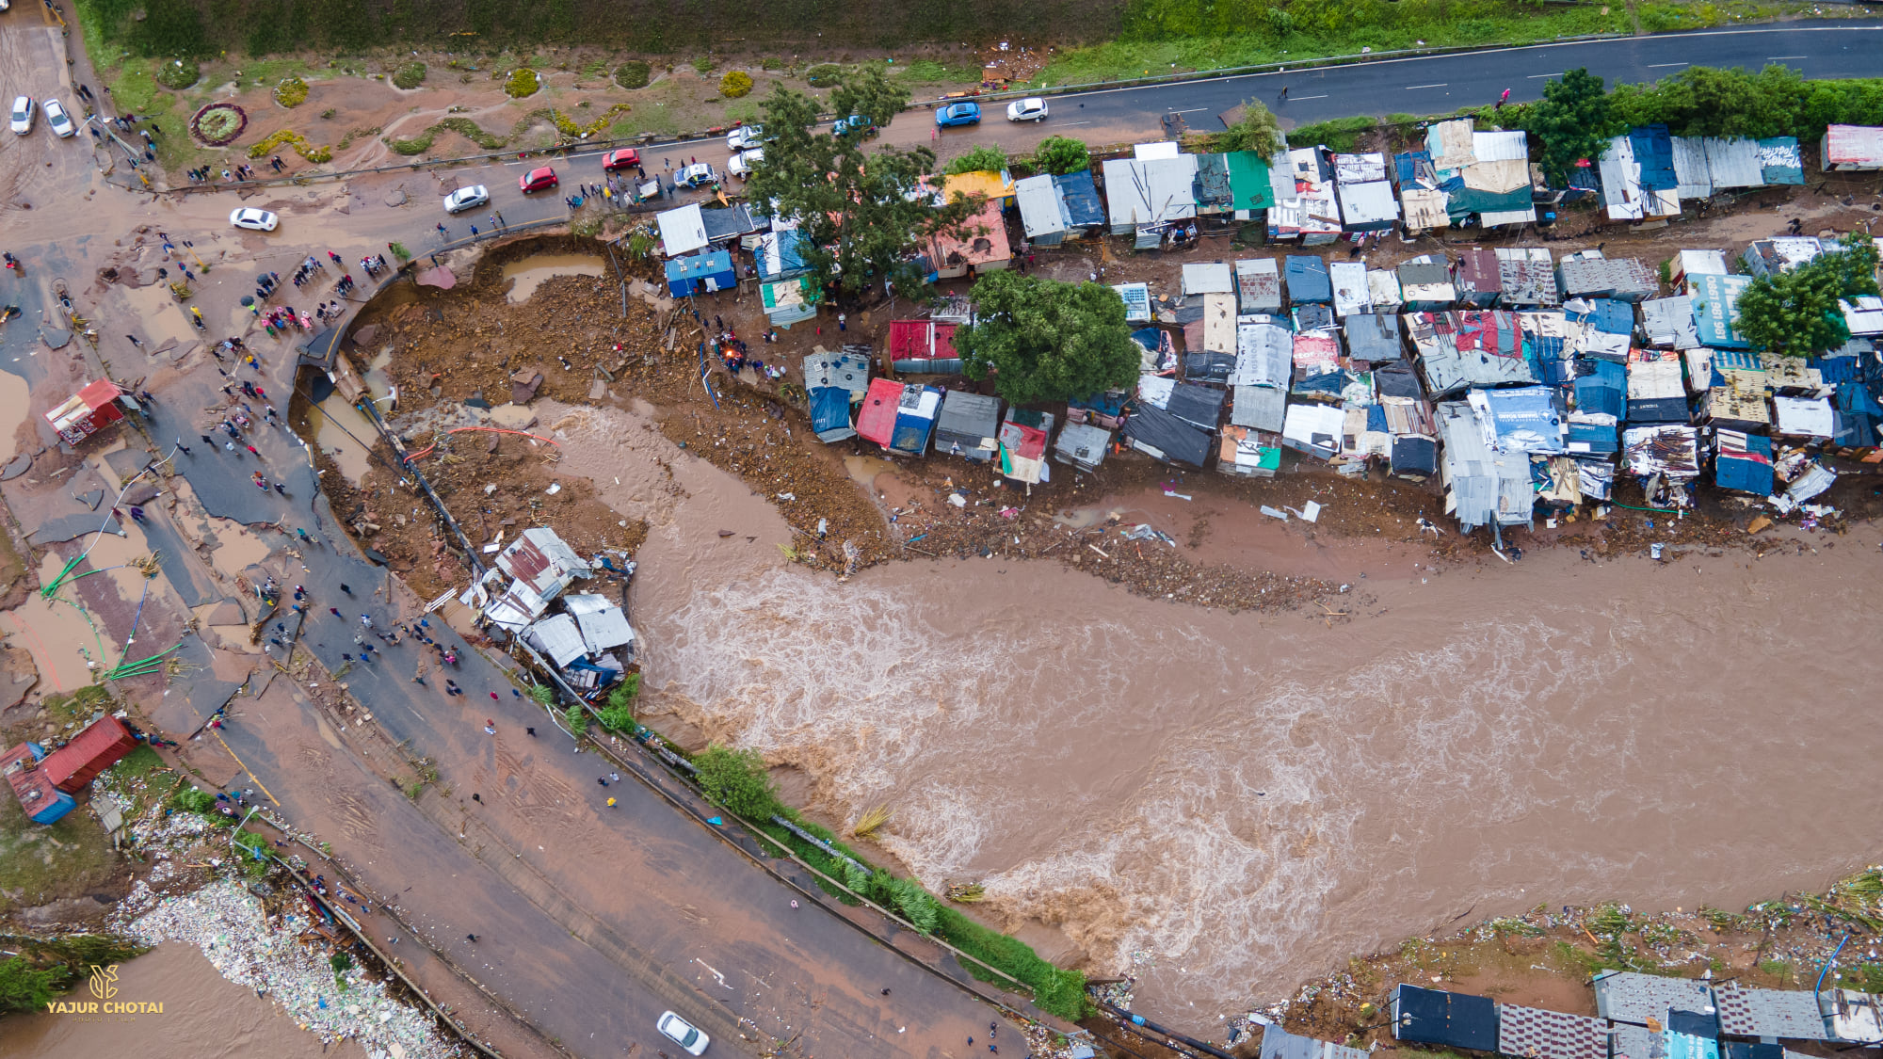
We use examples from our Learning from Durban (LfD) project
Proposed learning
About
From
For
Non-sewered sanitation
Who decides on the framing of the problem?
Who decides the impact/what impact is good?

Slide 6
Equitable is not ‘the same’
Recognising differences
Finding and respecting complementary differences
Not presume ‘southern data’ and ‘northern intellectual contribution’
Non-hierarchical: all the pieces are valuable

Slide 7
Mindful that the training, pressures, professional interests, responsibilities of different members of the team…
Need for time for reading, thinking and WRITING (esp for global south researchers doing transdisciplinary research)
Potentially building in project writing retreats
Unlearning what is assumed and often constructed far away (esp for global north researchers)
Valuing labour (time and emotional) associated with bringing foreign researchers to ‘the field’

Slide 8
In our LfD work…
Thinking carefully about effective use of resources
Limiting the fieldwork done by ‘outsiders’
Making use of existing data
Not every project needs foreign researchers engaging at the local level
Mix of academic papers, accessible infographics, posters, position papers, policy briefs…
Time to write from already-existing data and ‘bring forward’ and ‘broaden’ insights

Slide 9
Equitable partnerships across disciplines
Respect for and valuing what different disciplines offer
Project team might not have time to fully develop shared knowledge during proposal writing phase
Openness to learning across disciplines
Importance of social science for bridging ‘is’ and ‘ought’ matters significantly for understanding ‘impact’
What a good impact is not always clear
Different visions for what purpose (across all actors in the partnership)

Slide 10
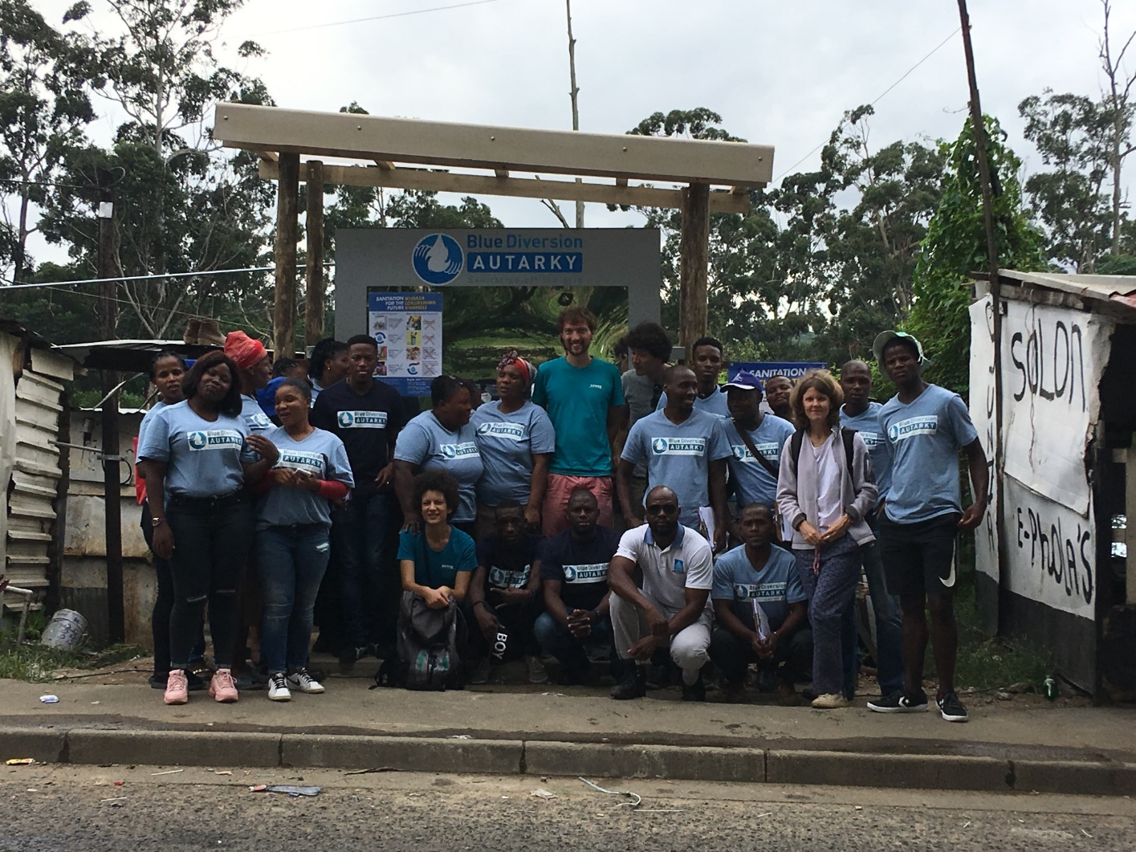
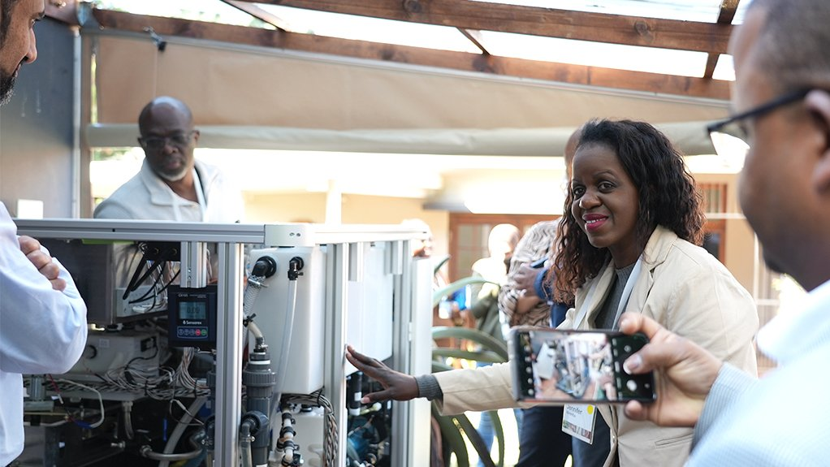
For LfP Project…
NSS
Presumption that engineers do ‘the design’
Social scientists convince and teach people to use it
We centre the importance of social embedding-- acceptance is constructed
Importance of the role of the state
Considering ‘what good impact is’ as a subjective and contested process (we don’t all agree on what the desired impact is for a project and for society)

Slide 11
Framing of the research project
Rooting the question in what is needed, balancing
Deference to local insights
With insights from literature and other sites
Acknowledging the knowledge that already exists (and is created in many ways)
Finding ways to build on what is already going on and integrate questions
Making good use of already-existing data
Balancing the multiple purposes and audiences of a project, outcomes and impacts

Slide 12
In our LfD project
Spending time as a team before writing
Serendipity! But also small funds to help build relationships
Proposed to develop ideas both ‘for general knowledge’ and ‘applied to the case’
A framework for non-sewered sanitation that can be widely used and to use it in Durban
The framing of the problem drove the need for transdisciplinary thinking and integration across different kinds of knowledge
Notes:
Thank you to British Academy for being able to see that we have practical tools and what is needed in our research and the academic contribution and for funding our research as we did this jointly …

Slide 13
What ‘good impact’ is might not be agreed upon, nor known upfront
Data can tell us ‘what is’ not ‘what ought to be’
But transdisciplinary research and research that has ‘impact’ has to do more than just describe ‘what is’
Need for time as a project team to think about what kind of impact
And understand with stakeholders the very different desired outcomes not just for a research project but for society as a whole
Openness to learning ‘what good impact is’ along the way

Slide 14
In our LfD project…
Our work is about ‘improving resilience of NSS’ not ‘advocating for NSS’
But acknowledge the politics of what we do, and that this is widely implicitly supportive of NSS
We both have wrestled extensively with ‘is NSS good?’
In light of ecological uncertainties (climate)
Whose interests does it serve? (Gates Foundation, municipality, engineers…)
Opposition from other political parties and academics

Slide 15
In our proposal, we did not know ‘the answer’ in terms of what exactly we wanted to get from the project
Need to think with stakeholders about what is desirable and why
What resilience NSS entails cannot be determined only be ‘experts’ in the academy (we see all actors as experts and refer to academy as specialists)
Need for an open understanding of what ‘resilience’ is and its sociotechnical, biophysical and political dimensions
Understand the histories and geographies of ‘resilience’

Slide 16
Social science as theory, social science as empirical
Theoretical interests
What is interesting about this, what does this paper, research contribute
Empirical interests
What does this research tell us, how does documenting it help us, how does it make a difference or impact?
The contribution of the paper beyond presenting this particular case is not yet clear. The research question is broad and rather than focusing on a particular, more narrow topic of interest, so are the empirical sections. This seems to be an interesting case but you have not justified why this case is theoretically important or interesting. I would suggest you adopt a narrower, more analytical focus and research question. Your main advantage probably is that you have conducted research on this process for many years and you probably have rich data.

Slide 17
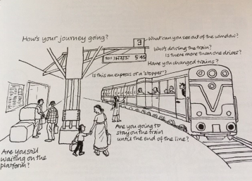
Leadership for equitable partnerships in research
Build leadership capacity and empower
Academy
Practitioners
Early career researchers
Community-based researchers
Civil society
Support and invest in
Champions
Innovators
Those working within their disciplines but who play the role of bridges or intermediaries (knowledge and skills to support equitable research partnerships)
Those who can build relationships

